Slide 1

Prediction and Intervention System for Improving Sleep Quality
TMU – Project Presentation for
MIT Sana Class HST.936
Shwetambara Kekade (India),
Mantosh Kumar Satapathy (India),
Maximilian Kurscheidt (Germany),
Md. Mohaimenul Islam (Rubel)(Bangladesh)
Supervisor: Dr. Shabbir Syed-Abdul

Slide 2
Table of content
Introduction – Shwetambara
Background – Mantosh
Design – Max
Discussion – Rubel
2

Slide 3
Introduction
Project description
Factors affecting sleep
Why predicting sleep quality?
3

Slide 4
Background
Aim: Pre-sleep intervention
Datasets
Biosignals
Subjective information
Concept
4

Slide 5
System Design
Biopatch:
Heartrate Variability
Physical Activity
Backend:
Signal Processing
Storage
Machine Learning Algorithms
SVM
ANN
Training / Test Dataset
Outcome:
Sleep Quality Prediction Level
Intervention Suggestions
Improving Sleep Quality
Smartphone App:
Person Background Information (1x)
Sleep Diary (m)
Rate Intervention (m)
Activity Diary (e)
Stress Level (e)
Presenting Daily Intervention in App

Slide 6
Discussion
Target Groups
Outcome
Self-fulfilling Prophecy

Slide 7
Thank you very much for your attention!
Questions?!
7

Slide 8
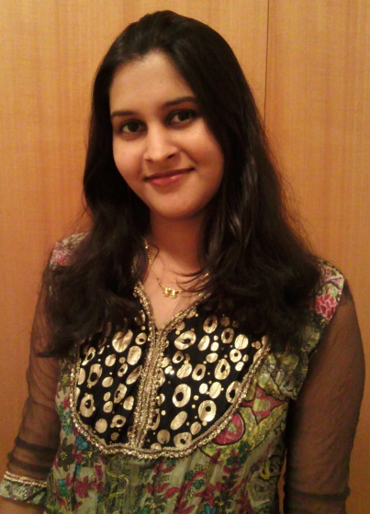
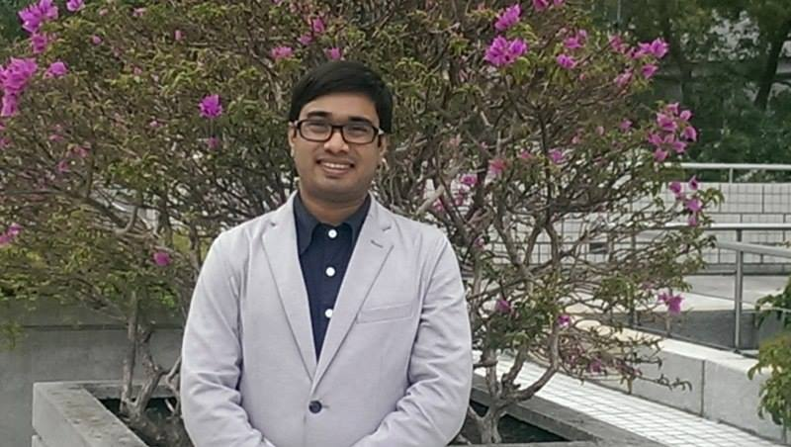

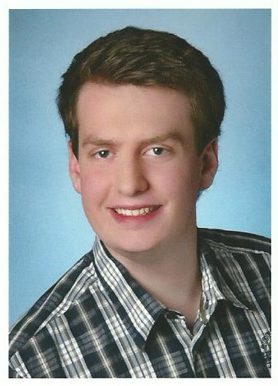
Team Members
Shwetambara Kekade
Mantosh Kumar Satapathy
Md. Mohaimenul Islam (Rubel)
Maximilian Kurscheidt

