Slide 1

Prediction and Intervention System for Improving Sleep Quality
TMU – Project Presentation for
MIT Sana Class HST.936
Shwetambara Kekade (India),
Mantosh Kumar Satapathy (India),
Maximilian Kurscheidt (Germany),
Md. Mohaimenul Islam (Rubel)(Bangladesh)
Supervisor: Dr. Shabbir Syed-Abdul

Slide 2
Table of content
Introduction – Shwetambara
Background – Mantosh
Design – Max
Discussion – Rubel
06.05.2016

Slide 3
Introduction
Project description
Factors affecting sleep
  Stress, Physical Activity
  Advanced Mobile Technology
Why predicting sleep quality?
  Pre-sleep Intervention to improve sleep quality
06.05.2016

Slide 4
Background
Aim: Effect of pre-sleep intervention
Datasets
  Biosignals
    Physical activity during working hours
    Heart Rate Variation (HRV)
  Subjective information
    Age, Gender, Job Description etc.
Major objective(s)
06.05.2016

Slide 5
System Design
Biopatch:
Heartrate Variability
Physical Activity
Backend:
Signal Processing
Storage
Machine Learning Algorithms
  SVM/ ANN
  Training Dataset
  Test Dataset
Outcome:
Sleep Quality Prediction Level
Intervention Suggestions
Improving Sleep Quality
Smartphone App:
Person Background Information (1x)
Sleep Diary (m)
Rate Intervention (m)
Activity Diary (e)
Stress Level (e)
Presenting Daily Intervention in App
06.05.2016

Slide 6
Discussion
Target Groups:
  First group (Heavy): People who are taking regularly sleeping pill.
  Second group (Intermediate): People who are facing sleep problem up to 3 times per week and sometimes have to take sleep medication.
  Third group (Light): People who sometimes face sleeping problem, but they do not take any sleep medication.
06.05.2016

Slide 7
Discussion
Outcome:
  The system will categories people into 5 group of interventions through the “Sleep Quality Prediction Level”. Level 1 is bad predicted SQ and 5 is symbolizing a good predicted SQ .
Self-fulfilling Prophecy:
  The system returns the intervention to the user but not its predicted SQ level, so the user does not face more psychological stress, if his predicting SQ level is bad.
06.05.2016

Slide 8
Thank you very much for your attention!
Questions?!
06.05.2016

Slide 9
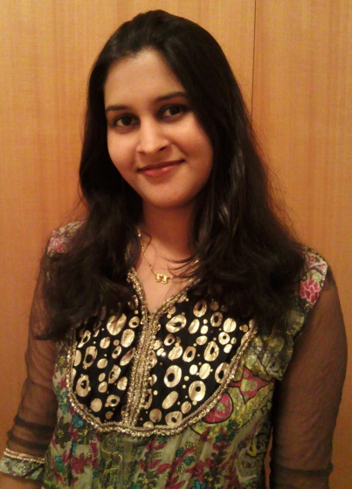
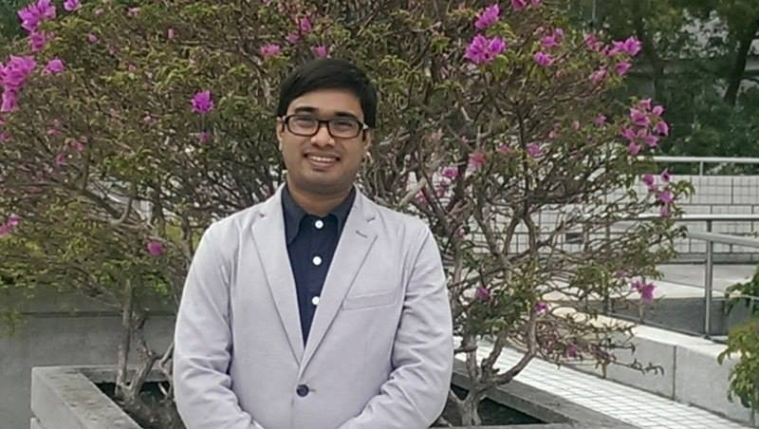
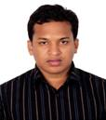
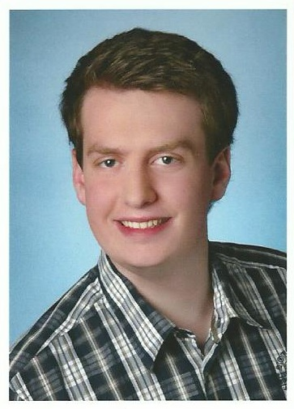
Team Members
Shwetambara Kekade
Mantosh Kumar Satapathy
Md. Mohaimenul Islam (Rubel)
Maximilian Kurscheidt

