Slide 1
Intro to Swing
Using Java Swing and MVC Design Pattern

Slide 2
Today's Overview
Git Exercise
Swing basics
Swing Exercise
More Git exercise
Notes:
Source: http://en.wikipedia.org/wiki/Model%E2%80%93view%E2%80%93controller#mediaviewer/File:MVC-Process.svg
<number>

Slide 3
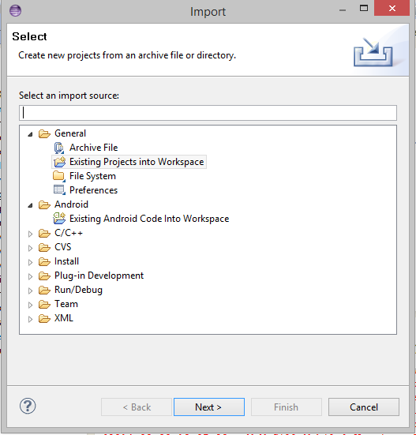
Importing a project
File -> Import -> Existing project into Workspace -> Browse for project
Go ahead and import today’s example code

Slide 4

Model View Controller Design Pattern
Why bother with MVC?
High Coupling
Low Cohesion
Modular
Model: Representation of Data
View: Graphical Interface
Controller: Binds Model to View
Notes:
Source: http://en.wikipedia.org/wiki/Model%E2%80%93view%E2%80%93controller#mediaviewer/File:MVC-Process.svg
<number>

Slide 5


Model View Controller Design Pattern
Notes:
<number>

Slide 6
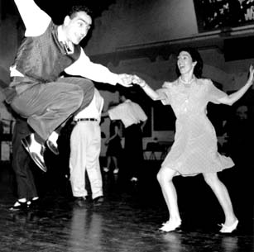
Java Swing
The very basics

Slide 7
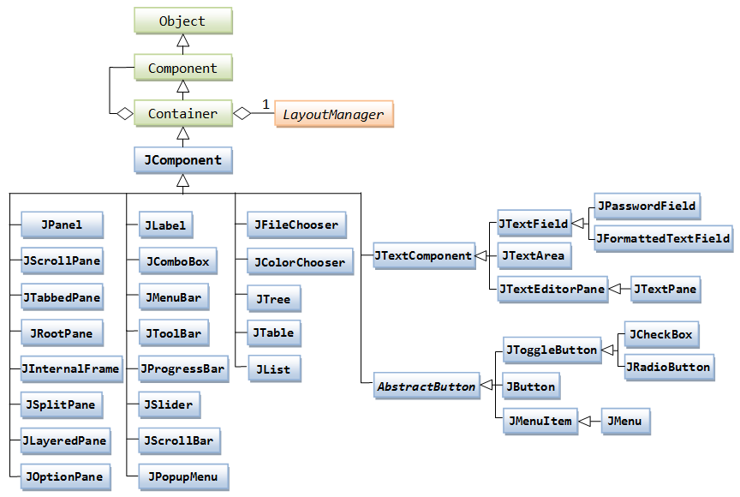
Java Swing
Java Swing is the library used to make Graphical user interfaces in Java
Notes:
Source: http://www.ntu.edu.sg/home/ehchua/programming/java/images/Swing_JComponentClassDiagram.png
<number>

Slide 8
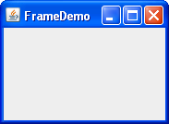
Swing Basics - JFrame
A JFame object is your window

Slide 9
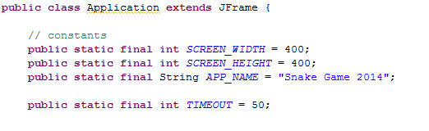
Swing Basics - JFrame

Slide 10
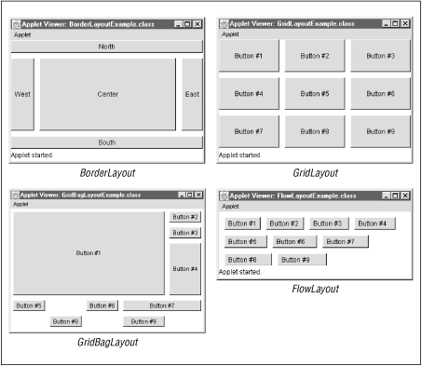
Swing Basics - Layouts
A layout is how components are placed

Slide 11
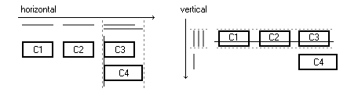
Swing Basics - Layouts

Slide 12
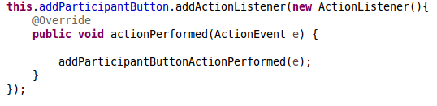
Swing Basics – Action Listener
Action Listener calls a method when a particular action takes place

Slide 13
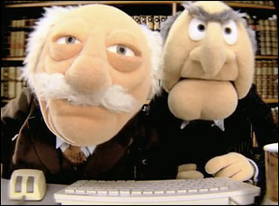
Pair Programming exercise

Slide 14
References
Java Game Tutorial: http://zetcode.com/tutorials/javagamestutorial/
Java Group layout:https://docs.oracle.com/javase/tutorial/uiswing/layout/group.html

