Slide 1
Eclipse, Git and Github
A very short introduction
More info in the notes
Notes:
Most picture slides will have additional information here in the notes.
<number>

Slide 2

Your TA this semester
Shabbir Hussain
Graduated EE @ McGill Last Semester
1st yr Masters in Comp Eng
TAed this course twice Before
Contact:
Shabbir.Hussain@mail.mcgill.ca
https://github.com/shabbir-hussain/
Notes:
Introduce myself
How tutorials will work
How to reach me
About You

Slide 3
What are we doing today?
0. Programming Exercise
Installing Eclipse
Installing Git
Configuring Git
Short break
Basics of Git
Bring your Laptops to tutorials!

Slide 4
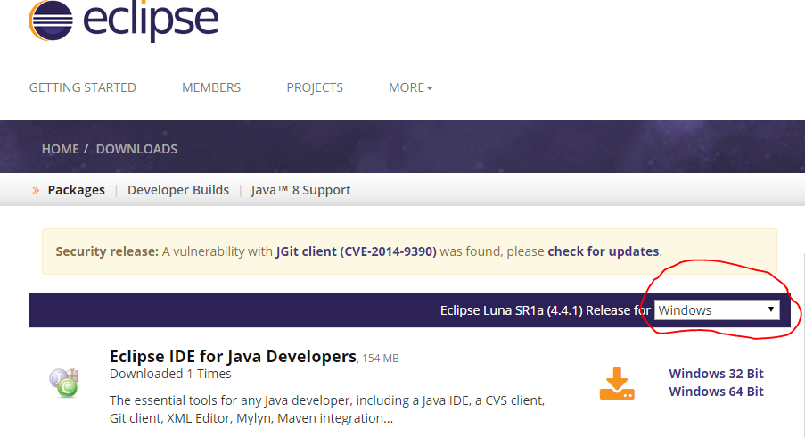
Eclipse IDE
https://eclipse.org/downloads/

Slide 5
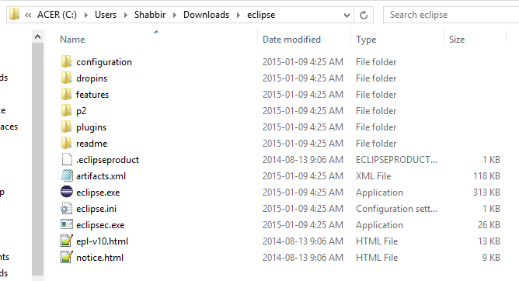
Eclipse IDE
Extract zip
Start using

Slide 6

Eclipse IDE
IDE: Integrated Development Environment
Write code, compile, test all in one program
https://eclipse.org/downloads/

Slide 7



Let get Git
http://git-scm.com/download/win
http://git-scm.com/download/mac
sudo apt-get install git
Notes:
<number>

Slide 8

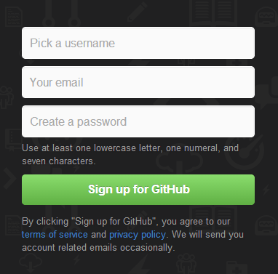
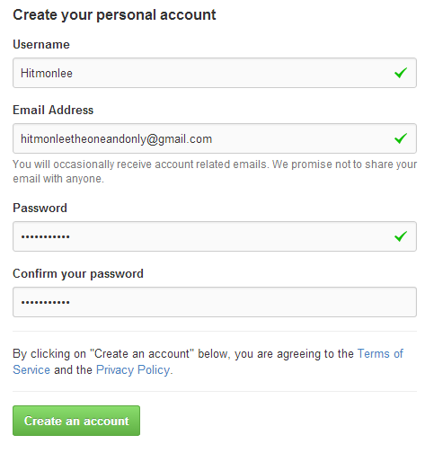
Registering for Github
1
2
3
Notes:
Go to https://github.com
Click to sign up
Create a free account
Profit
<number>

Slide 9

What is Version Control?
Version Control software is a tool used to keep track of different versions of files
Revert to an old version
Branch to create multiple versions
Merge two different versions together
Synchronize files on different machines
Notes:
<number>

Slide 10
Pop Quiz
Would it be a good idea to use version control on your photo album?
When would you want to revert to a previous version of a file?
Why would you want to branch your files?

Slide 11
Why You're going to use it
You need it for this class
It’s a great way to sync your code with your team
Because using dropbox to sync your code is so last semester
Notes:
<number>

Slide 12
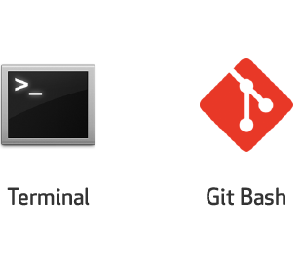
Did I install it correctly
Notes:
For linux and mac, Go to terminal and type git then hit enter. If you see a long paragraph starting with the word usage, then you’ve done it correctly.
For Windows if you search for the program git bash then you are good to go.
<number>

Slide 13


Making git work with GitHub
1
2
3
https://help.github.com/articles/generating-ssh-keys
Notes:
Configure your username
Configure your email
Configure ssh keys
Make sure that the username and email you put are the same as you have on github. SSH keys are like your password. Github compares the SSH keys coming from git to make sure its really you.
<number>

Slide 14
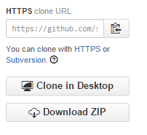
Getting the Tutorial notes
1
2
3
Notes:
Go to https://github.com/shabbir-hussain/ecse321tutW15
Find the link to clone on the right hand side
Type the command ‘https://github.com/shabbir-hussain/ecse321tutW15.git’
enjoy
<number>

Slide 15
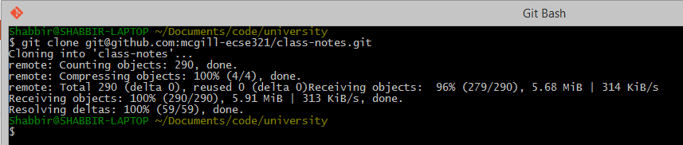
Getting the Tutorial notes
Notes:
Congratulations. If you see the above message you’ve correctly cloned the repository
<number>

Slide 16


Understanding Git and some basic functions
Going from this
To this
Notes:
<number>

Slide 17
Quick glossary
Git is your version control software
Git Hub is a website that hosts your repositories
Repositories are a collection of files and file histories
Commits are like save states

Slide 18



Repositories
This is what a Repository Looks like
.git
All the data about a repository lives in this folder
Helloworld.java
Helloworld.o
Notes:
A repository is essentially a folder
But this folder also contains extra information about your previous versions known as commits
<number>

Slide 19


Creating our own Repository
1
2
3
Notes:
Create a folder
Go into that folder
Type the command ‘Git init’
Lean back
<number>

Slide 20
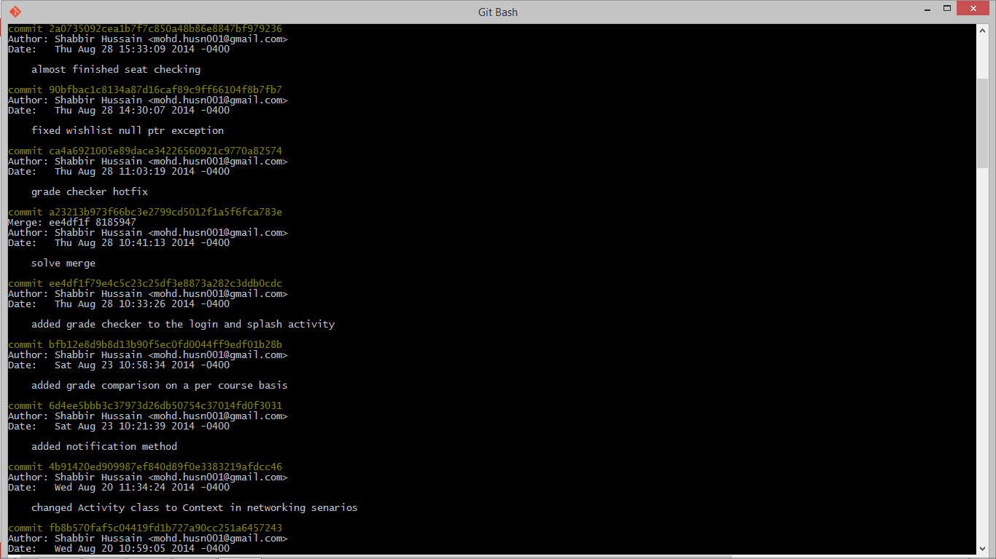
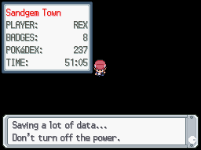
What is a Commit?
Save states
Commits
Notes:
A commit is a save state of all your files
Commits are useful to go back to a an exact point in time
Commits are just like save states in video games
A commit object contains:
Unique Sha1 identifier
Snapshot of all the files in the working directory
Creation date
Author
<number>

Slide 21


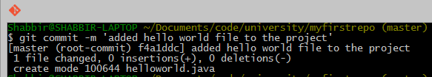
Adding and committing a file
1
2
3
Notes:
Create a file called helloworld.java
Add it to the repository
Commit your new file to the repository
<number>

Slide 22
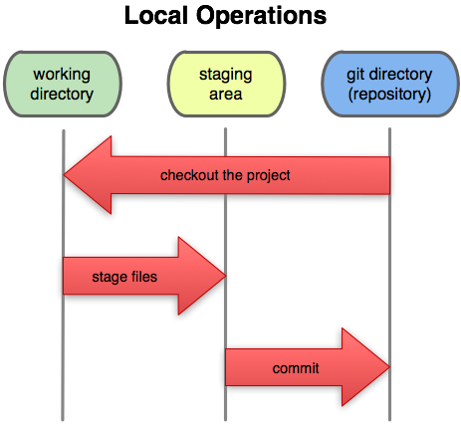
Inside a Repo
Working Directory: Files being worked on right now
Staging area: Files ready to be committed
Repository: A collection of commits
Why should we stage files instead of directly committing them?
Notes:
The above diagram represents 3 states a file can be in.
The working directory is the current state of all files.
The staging area is an abstract concept. It is the state files are put into right before being committed. We stage a file with the command “git add <filename>”. This is useful for situations when you want a commit to represent several files. Why else would you stage a file?
Once files are staged. We can commit staged files to the repository.
<number>

Slide 23

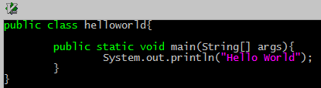
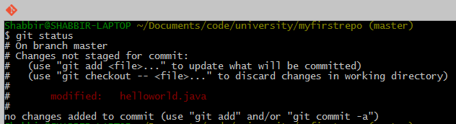
File Status Updates
1
2
3
Notes:
Open the file in an editor (you can use your favorite editor like note pad)
Modify the file to print hello world and save
Check the status of the repository
Checking the status tells us the state our repository is in. In this case it says that we made changes to a file but did not add it to the staging area
<number>

Slide 24


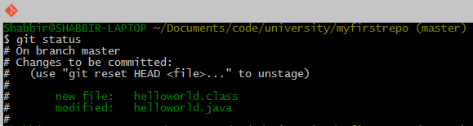
Staging and Unstaging files
1
2
3
Notes:
Compile the file
Then add all the files to the staging area (“git add .” is a shorthand for adding all files to the staging area)
Check the status of the repo
Here in the Status We can see that there are two files in the staging area. This is because we created a class file when we compiled our program.
<number>

Slide 25
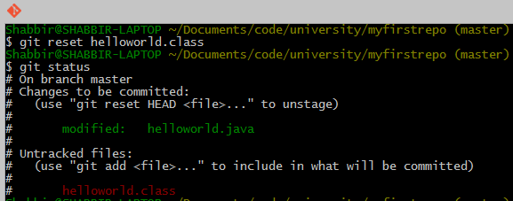
Staging and Unstaging files
Notes:
Let’s pretend we don’t want the class file to be in our next commit. We can remove a file from the staging area with “git reset <filename>”
<number>

Slide 26


Committing files (cont.)
Only Staged files are committed.
Notes:
In this case, only our helloworld.java will be in our most recent commit.
<number>

Slide 27
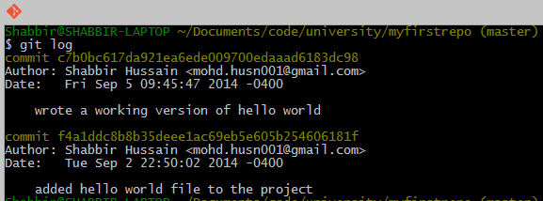
Reviewing commits
Notes:
Check the logs to see who committed, what they committed, and when with “git log”
<number>

Slide 28
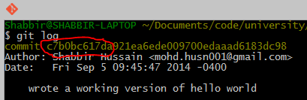


Tagging commits
1
2
3
Notes:
Identify a few digits of the commit you want to tag
Tag the commit using “git tag <tagname> <firstFewDigitsOfCommit>”
Check tag using git log
Tagging is useful if you want to identify a point in your code using human words. For example, if you have multiple versions of your code, you can tag which commit corresponds to version 1. Tagging will be useful for your class assignments
Also, we used a different flavor of git log. We added some options so that it would show us the log in a different format.
<number>

Slide 29
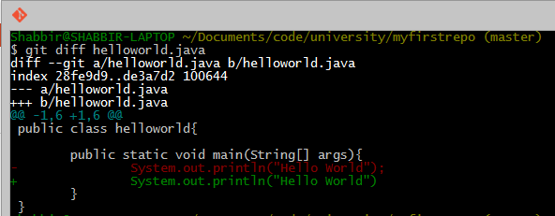
Finding Mistakes with Diff
Notes:
Git diff shows us changes in a file since the last commit. In this case I’ve deleted a semicolon
<number>

Slide 30



Fixing Mistakes with checkout
No semicolon
Replaced semicolon
Notes:
“git checkout <filename>” reverts the file to the previous commit. You can even do this with the entire directory. We’ll dive deeper into this command during the next tutorial.
<number>

Slide 31
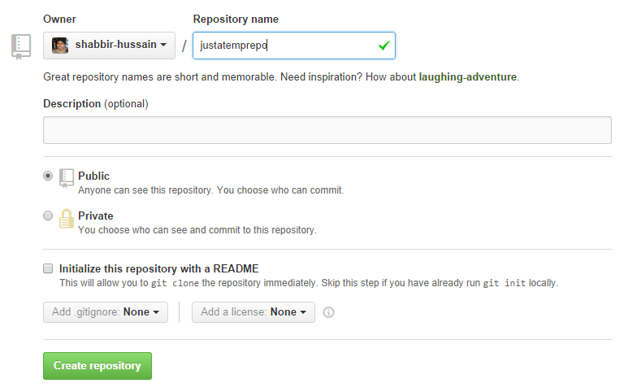
Uploading your local Repository to the cloud
1
2
Notes:
We now need to sync our work to the cloud.
Start by
going to the link
and creating a new repository on github
<number>

Slide 32

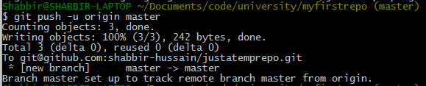
Uploading your local Repository to the cloud
3
4
5
Notes:
3. Copy the link to the clipboard
4. Use the link to set the origin
5. Push your commits to the remote repository
<number>

Slide 33
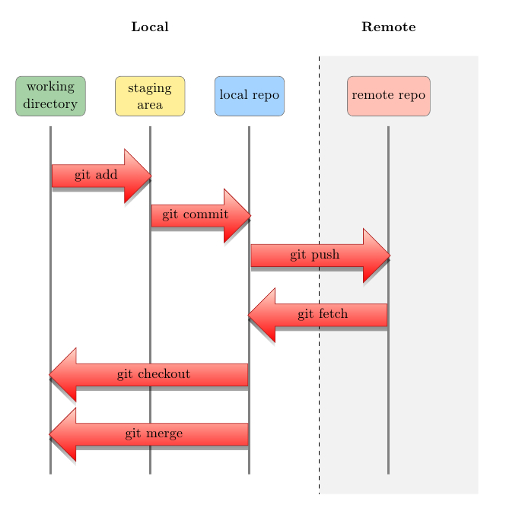
Uploading your local Repository to the cloud
Notes:
Now that you have linked your local repository to one in the cloud, you can push commit to synchronize the remote repo, or pull commits to synchronize the local repo.
<number>

Slide 34
Extra Credit
Try github Interactive Tutorial: https://try.github.io/levels/1/challenges/1
Visual Explanation: http://www.wei-wang.com/ExplainGitWithD3/

Slide 35
More resources
Vogella Reference: http://www.vogella.com/tutorials/Git/article.html
SSH keys tutorial: https://help.github.com/articles/generating-ssh-keys
Git Cheetsheet: https://raw.githubusercontent.com/nerdgirl/git-cheatsheet-visual/master/gitcheatsheet.png
Dominic’s Tutorial slides: http://slides.com/dominiccharleyroy/tutorial-1-git#/
Notes:
<number>

