Slide 1
Introduction
ToR network:
traffic go through the onion routers to destination
joining ToR network:
users get connected to multiple ToR routers
routing in ToR network:
find “best” route for traffic
how to define “best”
tradeoff between cost and security
evaluation of different models
use the probability of traffic is attacked to evaluate

Slide 2
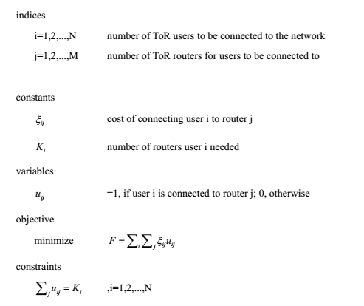
Model of joining ToR network
Formulation

Slide 3
Model of joining ToR network
Similar to the model of connecting N ares to M locations
Adding one parameter K for users to get connected to multiple ToR routers

Slide 4
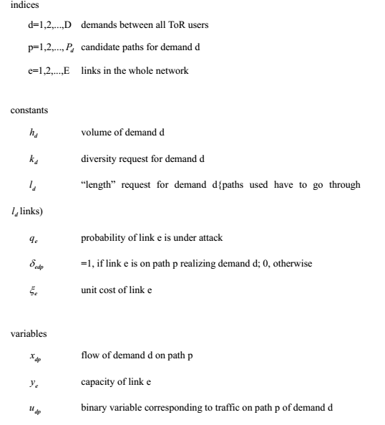
Model of routing: security model 1
Formulation

Slide 5
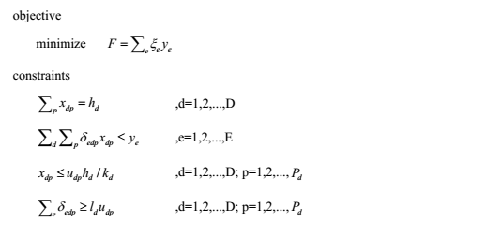
Model of routing: security model 1
Formulation (contd.)
The basic idea is to add additional constraints on path diversity and path length.
path diversity(k): don't put all eggs in one basket
path length(l): in ToR network data is encrypted by all keys of routers along the path, so, longer the path safer the data

Slide 6
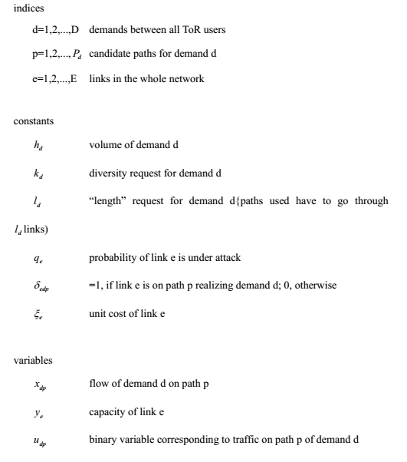
Model of routing: security model 2
Formulation

Slide 7
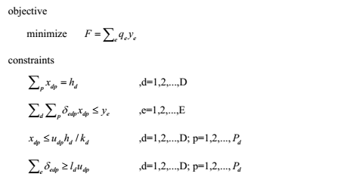
Model of routing: security model 2
Formulation (contd.)
This new model use the same mechanism as security model 1.
Considering if link 1 is used by most of the demands, and it has a high probability of being attacked, model 1 will result in a bad performance of protecting data.(model 1 obj. is minimize total cost)
In model 2, we set the sum of probability of links’ being attacked weighted by the load of the link as objective function.

Slide 8
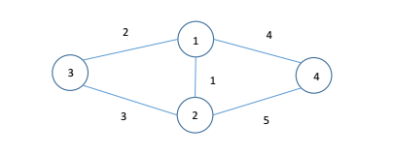

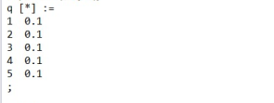

Simple Topology
The shortest path is:
link 2 and 4, or
link 3 and 5
Demand d: node3 to node 4,h=4;
There are 4 candidate paths:
3-1-4,(link 2 and 4)
3-2-4,(link 3 and 5)
3-1-2-4,(link 2, 1 and 5)
3-2-1-4,(ink 3, 1 and 4)
With unit link cost:
link1: 1
link2: 2
link3: 2
link4: 2
link5: 2

Slide 9
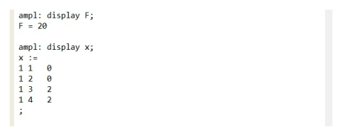
Simple Topology Running Result
Traffic will use path 3 and 4:
3-1-2-4,(link 2, 1 and 5)
3-2-1-4,(ink 3, 1 and 4)
instead of using the shortest path,
which leads to lower probability of being attacked(better security).
NOTE: Both paths use link 1, which have potentially high risk.

Slide 10
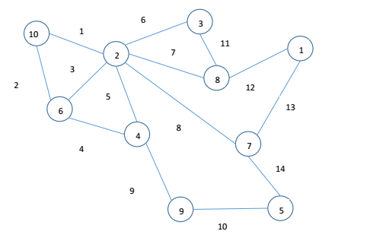
Complex Topology

Slide 11
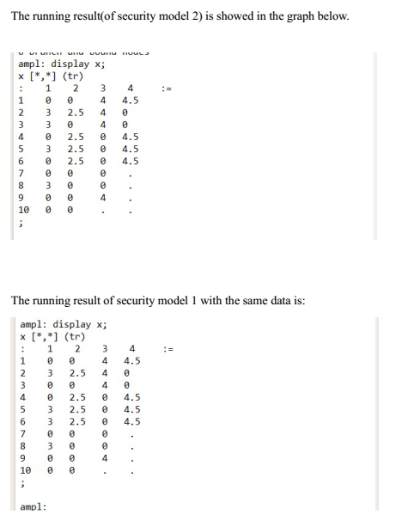

Complex Topology Running Result

Slide 12
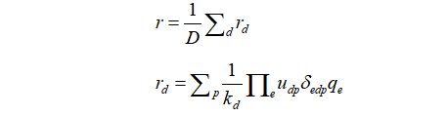
Comparison(S-P routing,security model 1,security model 2)
We will use the expectation of probability that traffic is attacked to evaluate these three model, let’s call it r
r | S-P routing | security model 1 | security model 2
k=2 | 0.0315 | 0.0014 | 0.001366
k=3 | 0.0315 | 0.0001148 | 0.0001044
k=4 | 0.0315 | 0.000106383 | 0.000105625

Slide 13
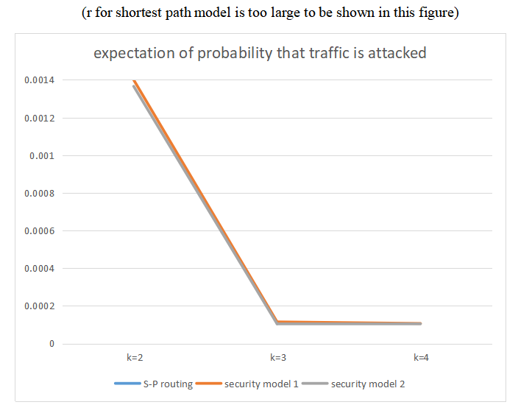
Comparison(S-P routing,security model 1,security model 2)

Slide 14
Conclusion
Using security model 1 and 2 is much safer than simply using shortest path routing in the ToR network;
By increasing the path diversity factor k, we can improve the security performance;
Using security model 2 is a little bit better than model 1in the probability of traffic being successfully attacked.

