Slide 1
Perl on Lambda
Exploration of AWS Lambda custom runtimes
@zjt

Slide 2
Why Perl on Lambda?
Perla
Legacy code hard to replicate in other languages (time)
Monolith → Microservices
Because I still love Perl
Lambda
https://en.wikipedia.org/wiki/AWS_Lambda
I don’t want to bother with running servers or Docker containers
I have access to AWS and familiar with their PaaS services
TIMTOWTDI is a universal law of nature,
ergo it must be possible to run Perl on Lambda
(Logic!)

Slide 3
Lambda example: Battlesnake (as a service)
https://play.battlesnake.io/
The players (snakes) are each HTTP servers.
No reason to keep a server running.
Python (naturally)
https://play.battlesnake.io/g/700d84ae-4cd2-43cc-9fda-824ce8fc5a69/
https://us-east-2.console.aws.amazon.com/lambda/home?region=us-east-2#/functions/cloud9-battlesnake-battlesnake-5U9V0NRXHE6R?tab=graph
https://us-east-2.console.aws.amazon.com/cloudwatch/home?region=us-east-2#logStream:group=/aws/lambda/cloud9-battlesnake-battlesnake-5U9V0NRXHE6R;streamFilter=typeLogStreamPrefix
https://us-east-2.console.aws.amazon.com/cloud9/ide/fe59d87faa444e0eb692038c9274d807

Slide 4
Research
I could build my own FaaS (not interested)
https://github.com/openfaas/faas
https://openwhisk.apache.org/
Found this blog: https://medium.com/@avijitsarkar123/aws-lambda-custom-runtime-really-works-how-i-developed-a-lambda-in-perl-9a481a7ab465
Lambda custom runtimes: https://docs.aws.amazon.com/lambda/latest/dg/runtimes-walkthrough.html

Slide 5
AWS IAM setup
Open the roles page in the IAM console.
Choose Create role.
Create a role with the following properties.
  Trusted entity – Lambda.
  Permissions – AWSLambdaBasicExecutionRole.
  Role name – lambda-role.
The AWSLambdaBasicExecutionRole policy has the permissions that the function needs to write logs to CloudWatch Logs.

Slide 6
bootstrap
#!/bin/sh
set -euo pipefail
# Initialization - load function handler
source $LAMBDA_TASK_ROOT/"$(echo $_HANDLER | cut -d. -f1).sh"
# Processing
while true
do
HEADERS="$(mktemp)"
# Get an event
EVENT_DATA=$(curl -sS -LD "$HEADERS" -X GET "http://${AWS_LAMBDA_RUNTIME_API}/2018-06-01/runtime/invocation/next")
REQUEST_ID=$(grep -Fi Lambda-Runtime-Aws-Request-Id "$HEADERS" | tr -d '[:space:]' | cut -d: -f2)
# Execute the handler function from the script
RESPONSE=$($(echo "$_HANDLER" | cut -d. -f2) "$EVENT_DATA")
# Send the response
curl -X POST "http://${AWS_LAMBDA_RUNTIME_API}/2018-06-01/runtime/invocation/$REQUEST_ID/response" -d "$RESPONSE"
done

Slide 7
function.sh
function handler () {
EVENT_DATA=$1
echo "$EVENT_DATA" 1>&2;
RESPONSE=$(perl -e 'print "hello, perl!. ".join(",",@ARGV)' "$EVENT_DATA")
echo $RESPONSE
}

Slide 8
Create and run “hello, perl!”
Create
chmod 755 function.sh bootstrap
zip function.zip function.sh bootstrap
aws lambda create-function \
--function-name bash-runtime \
--zip-file fileb://function.zip \
--handler function.handler \
--runtime provided \
--role arn:aws:iam::123456789012:role/lambda-role
Run
aws lambda invoke \
--function-name bash-runtime \
--payload '{"text":"Hello"}' response.txt
cat response.txt

Slide 9
Update the function only - using layers
zip runtime.zip bootstrap
aws lambda publish-layer-version \
--layer-name bash-runtime \
--zip-file fileb://runtime.zip
aws lambda update-function-configuration \
--function-name bash-runtime \
--layers arn:aws:lambda:us-east-2:123456789012:layer:bash-runtime:1
zip function-only.zip function.sh
aws lambda update-function-code \
--function-name bash-runtime \
--zip-file fileb://function-only.zip

Slide 10
Cleaning up
Delete the layers
aws lambda delete-layer-version --layer-name bash-runtime --version-number 1
aws lambda delete-layer-version --layer-name bash-runtime --version-number 2
Delete the function
aws lambda delete-function --function-name bash-runtime

Slide 11
Parsing the event - Needs JSON.pm
Need to install JSON perl library to parse request/response.
First, we need to download the dependencies
https://metacpan.org/pod/Carton
Install Carton to local lib.
perl -MCPAN -Mlocal::lib -e 'CPAN::install(Carton)'
Define the dependencies in cpanfile
requires 'JSON';
Use carton to grab the dependencies.
Using local lib here because carton was installed in local lib.
perl -Mlocal::lib ../perl5/bin/carton install
On my build environment...
CPAN isn’t even installed.
Perl on AWS Linux is bare bones.
sudo yum install perl-CPAN
Why I use Cloud9?
Seems logical to build on AWS Linux so that Lambda runtime server is most similar
Cloud9 is convenient/awesome, since I use ChromeOS

Slide 12
Update function to use bundled module
Let’s update the function to use JSON from the local lib. Also included perl version in output.
RESPONSE=$(perl -Ilocal/lib/perl5 -MJSON -MData::Dumper
-e 'print "hello, perl!. $]\n".Dumper(decode_json($ARGV[0]))' "$EVENT_DATA")
Now all of JSON dependencies are in the local dir, and the function is updated to load a module from it..
First, let’s test our code so that we can catch errors before redeploying. test.sh
#!/bin/bash
source function.sh
handler $1
$ ./test.sh '{"text":"Hello"}'
{"text":"Hello"}
hello, perl!. 5.016003 $VAR1 = { 'text' => 'Hello' };
In my testing I determined that I needed to also use Data::Dumper so that I could confirm that the JSON decoded into a perl hash

Slide 13
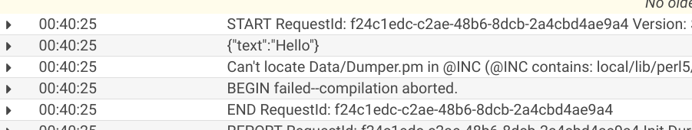
Bundle and invoke again
Update the zip to bundle both, and invoke again.
This time deploy and invoke as a script: deploy_and_invoke.sh
zip -r function-only.zip function.sh local
aws lambda update-function-code --function-name bash-runtime --zip-file fileb://function-only.zip
aws lambda invoke --function-name bash-runtime --payload '{"text":"Hello"}' response.txt
cat response.txt
Fail. But why?
{
"FunctionError": "Unhandled",
"ExecutedVersion": "$LATEST",
"StatusCode": 200
}
{"errorType":"Runtime.ExitError",
"errorMessage":"RequestId: f24c1edc-c2ae-48b6-8dcb-2a4cbd4ae9a4
Error: Runtime exited with error: exit status 2"}
Oops! I included Data::Dumper without bundling it with Carton. Cloudwatch screenshot.

Slide 14
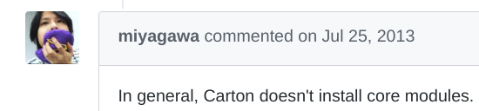
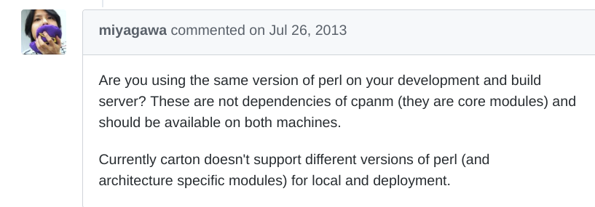

Problem! Core Perl modules aren’t installed
1. Update cpanfile with Data::Dumper
2. Carton install
3. Doesn’t download core modules
Is the perl on Cloud9 EC2 different
than what’s on the lambda instance?
Inside the lambda
hello, perl!. 5.016003{"text":"Hello"}
Same version.

Slide 15
So why not just avoid core modules?
Switch to Data::Printer
$ cat cpanfile
requires 'Data::Printer';
requires 'JSON';
$ perl -Mlocal::lib ../perl5/bin/carton install
$ cat function.sh
…
RESPONSE=$(perl -Ilocal/lib/perl5 -MJSON -MData::Printer -e 'p(decode_json($ARGV[0]))' "$EVENT_DATA")
...
But, I don’t think I can always avoid core module dependencies!

Slide 16
How do I get core modules down to local lib?
cpanm installs it OK but Carton still doesn’t pick up core modules
$ perl -MCPAN -Mlocal::lib -e 'CPAN::install(Data::Dumper)'
$ find .. | grep Data/Dumper.pm | grep -v .cpan
../perl5/lib/perl5/x86_64-linux-thread-multi/Data/Dumper.pm
$ perl -Mlocal::lib ../perl5/bin/carton install
Installing modules using /home/ec2-user/environment/cpanfile
Complete! Modules were installed into /home/ec2-user/environment/local
$ find .. | grep Data/Dumper.pm | grep -v .cpan
../perl5/lib/perl5/x86_64-linux-thread-multi/Data/Dumper.pm
$ find .. | grep Data/Printer.pm | grep -v .cpan
../environment/local/lib/perl5/Data/Printer.pm

Slide 17
What about App::FatPacker?
$ cat hello.pl
#!/usr/bin/env perl
use Data::Dumper;
use Data::Printer;
$ perl -MCPAN -Mlocal::lib -e 'CPAN::install(App::FatPacker)'
$ perl -Mlocal::lib -Ilocal/lib/perl5 ../perl5/bin/fatpack trace hello.pl
Can't locate Data/Printer.pm in @INC (@INC contains: /home/ec2-user/perl5/lib/perl5/5.16.3/x86_64-linux-thread-multi /home/ec2-user/perl5/lib/perl5/5.16.3 /home/ec2-user/perl5/lib/perl5/x86_64-linux-thread-multi /home/ec2-user/perl5/lib/perl5 /usr/local/lib64/perl5 /usr/local/share/perl5 /usr/lib64/perl5/vendor_perl /usr/share/perl5/vendor_perl /usr/lib64/perl5 /usr/share/perl5 .) at hello.pl line 3.
BEGIN failed--compilation aborted at hello.pl line 3.
$ export PERL5OPT="-Ilocal/lib/perl5"
ec2-user:~/environment $ perl -Mlocal::lib ../perl5/bin/fatpack packlists-for `cat fatpacker.trace `
...
local/lib/perl5/x86_64-linux-thread-multi/auto/Data/Printer/.packlist
…
(No Data::Dumper packlist)

Slide 18
The fatpacker docs solved the cpanm issue
https://metacpan.org/pod/App::FatPacker::Simple::Tutorial
# Oh, HTTP::Tiny is not core module for old perls, so we have to fatpack it too!
$ cpanm --reinstall -Llocal -nq HTTP::Tiny
$ perl -Mlocal::lib ../perl5/bin/cpanm --reinstall -Llocal -nq Data::Dumper
Successfully installed Data-Dumper-2.173 (upgraded from 2.135_06)
1 distribution installed
Not sure if the PERL5OPT env var is still necessary, but it doesn’t hurt
Fatpacker still might be a good way to package Perl on Lambda though...

Slide 19
Now we’re cookin’
$ perl -Mlocal::lib ../perl5/bin/fatpack pack hello.pl >hello.packed.pl
hello.pl syntax OK
File /home/ec2-user/environment/fatlib/x86_64-linux-thread-multi/auto/Data/Dumper/Dumper.so isn't a .pm file - can't pack this -- if you hoped we were going to, things may not be what you expected later
File /home/ec2-user/environment/fatlib/x86_64-linux-thread-multi/auto/Data/Dumper/Dumper.bs isn't a .pm file - can't pack this -- if you hoped we were going to, things may not be what you expected later
$ grep -c Data::Dumper hello.packed.pl
75

Slide 20
Putting it all together - carton, cpanm, fatpacker
$ cat hello.pl
#!/usr/bin/env perl
use Data::Dumper;
use JSON;
print Dumper(decode_json($ARGV[0])
$ cat function.sh
...
RESPONSE=$(perl -Ilocal/lib/perl5 hello.packed.pl "$EVENT_DATA")
…
$ cat deploy_and_invoke.sh
#!/bin/sh
export PERL5OPT="-Ilocal/lib/perl5"
perl -Mlocal::lib ../perl5/bin/carton install
perl -Mlocal::lib ../perl5/bin/cpanm --reinstall -Llocal -nq Data::Dumper # TODO move to cpanfile?
perl -Mlocal::lib ../perl5/bin/fatpack pack hello.pl >hello.packed.pl
zip -r function-only.zip function.sh hello.packed.pl local
aws lambda update-function-code --function-name bash-runtime --zip-file fileb://function-only.zip
aws lambda invoke --function-name bash-runtime --payload '{"text":"Hello"}' response.txt
cat response.txt

Slide 21
Pushing it to the limit
Moose (add to cpanfile and hello.pl)
{"errorMessage":"2019-05-14T03:34:44.940Z 11921be2-dd0f-45e7-a0b0-c35006be6398 Task timed out after 3.00 seconds"}
Dancer doesn’t time out (for comparison)
XS modules don’t work because the libraries aren’t installed
You could bundle the C libraries locally in the runtime, in theory. But my years of struggling with Perl on Solaris taught me that there are a ton of Perl modules that make assumptions about where libraries are installed

Slide 22
What else?
Ship Perl in the Lambda runtime?
Yes, this would work, and it would make the dependency issue easier as well as giving you better versions of Perl to use.
The aforementioned blog actually did this using Activeperl.
Would perlbrew work better?
How does this affect the startup performance and cost (CPU/memory overhead)?
Future research TBD
Docker?
I tend to dockerize all my apps nowadays, so this would be super awesome
In theory…
On the build server:
docker pull perl
docker save perl > docker-perl.tar
In the Lambda runtime
docker load docker-perl.tar
docker run ...
But… It turns out that docker isn’t installed on the Lambda server (boo)

Slide 23
What’s next
A PSGI shim so that all of the pure-Perl Plack modules on CPAN work - would be awesome
Experiment with bundling perlbrew in the Lambda runtime - determine if there is a penalty
Rewrite battlesnake in Perl - because why not

Slide 24
Perlbrew
$ perl -MCPAN -Mlocal::lib -e 'CPAN::install(App::perlbrew)'
(or)
$ cpanm -Llocal -nq App::perlbrew
$ perl -Mlocal::lib ../perl5/bin/perlbrew init
$ perl -Mlocal::lib ../perl5/bin/perlbrew install-patchperl
$ perl -Mlocal::lib ../perl5/bin/perlbrew install perl-5.28.2

