Slide 1



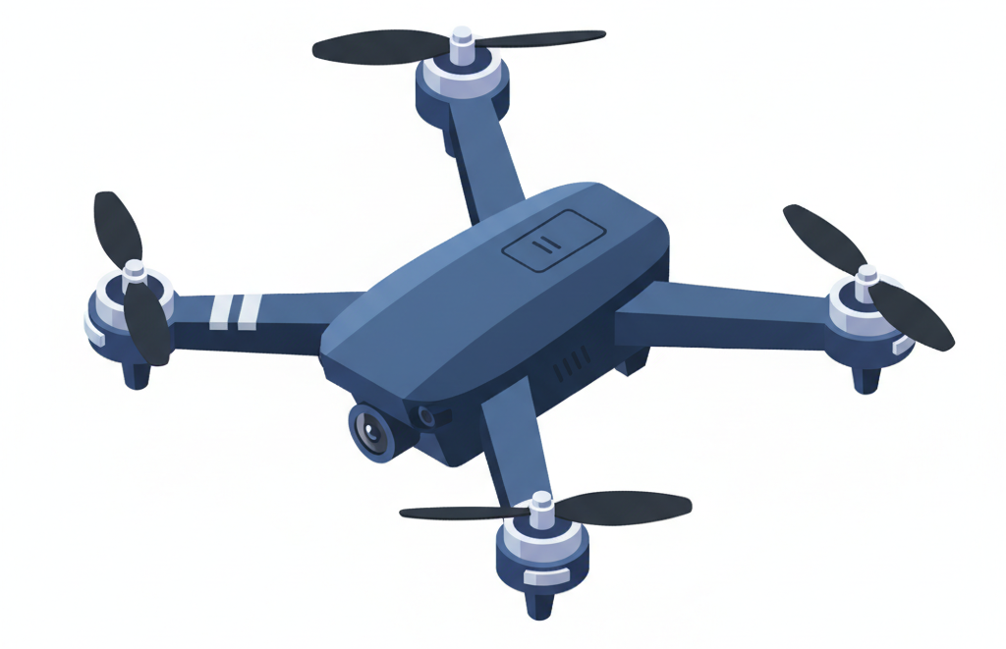
TEAM INTRODUCTION
TechnoCognition ‘25
Startup, Innovation & Incubation
Presented by:
TEAM AYATI
Jain (Deemed-to-be University)
TechnoCognition'25

Slide 2
PROBLEM STATEMENT
THE FALSE POSITIVE PARADOX
Why Existing C-UAS Solutions Fail to Distinguish the threats
LIMITATION: Single-sensor C-UAS (Counter-Unmanned Aircraft Systems) fail to distinguish between actual threats and background noise.
EXISTING SYSTEMS OVERVIEW: Standard wireless Counter-UAS (C-UAS) solutions are operationally unsuitable:
  Failure in high-EMI environments (e.g., substations, power lines, machinery).
  Unreliability in "RF-crowded" urban/airport zones.
  Vulnerability to jamming and spoofing.
The Result: The very critical infrastructure that needs authenticity cannot be reliably produce authentic results.
@Electroblitz Club-Department of Electronics and Communication- Dayananda Sagar University
TechnoCognition'25

Slide 3
SOLUTION OVERVIEW
THE MULTI-MODAL FUSION ENGINE:
Combined Volumetric, Acoustic, Radar & Vibration data.
CORE INNOVATION: Fusing diverse sensor data provides exponentially higher certainty than a single sensor.
MULTI-MODAL NODES: Modular Edge Nodes (using Arduino & ESP32) perform multi-modal sensor fusion (RF, Acoustic, Radar, Vision).
KEY ADVANTAGE: Enabling secure, high-bandwidth streaming of raw sensor data for superior, high-fidelity fusion at a Central Command Center.
FUTURE-PROOFING: This architecture provides the a viable defense against the emerging threat of "UNJAMMABLE" zero-RF-signature fiber-tethered drones
TechnoCognition'25

Slide 4
IMPLEMENTATION/PROTOTYPE
TRIGGER EVENT: Enables low power radar to wake up the system [saving energy].
THE FUSION LOGIC: Once awake, ESP32 runs its equation for volumetric, acoustic and Radar validation
ACTUATION: If TRUE: ESP32 sends command to “ FIRE_NET ”. And Arduino triggers the Single Channel Relay for immediate capture
TechnoCognition'25

Slide 5
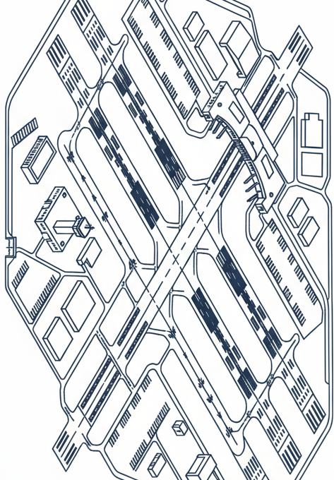
TECHNOLOGY STACK
1. HARDWARE:
ACTUATOR: Arduino UNO
FUSION: ESP32.
Sensors: MEMS Mic (INMP441), mmWave Radar (RCWL-0516).
Redundancy: RCWL mmWAVE RADAR.
2. SOFTWARE (EDGE):
C/C++ (Arduino IdE).
TechnoCognition'25

Slide 6
IMPACT & SCALABILITY
Market Impact & Scalability
OPERATIONAL IMPACT (THE DIFFERENTIATOR):
  Solves the industry-wide issue of reliability.
  99.9% data integrity vs. wireless packet loss.
  Ensures the system only engages for valid threats, saving power and resources.
  Legally-Compliant: Provides high-assurance data without illegal RF jamming.
  Allows for seamless transition from Wireless (ESP-NOW) to Fiber (TCP/IP) in the future without rewriting the core fusion logic.
TechnoCognition'25

Slide 7
IMPACT & SCALABILITY
Market Impact & Scalability
BUSINESS IMPACT (THE MARKET OPPORTUNITY):
  MARKET SIZE: $20.31 Billion by 2030, reflecting a 25.1% CAGR.
  MONETIZATION: Proven recurring-revenue models: Detection as a Service (DaaS), Hardware Kits (CapEx), and SaaS Dashboard (OpEx).
  SCALABILITY: Highly scalable; adding new nodes on a fiber ring does not degrade network performance.
TechnoCognition'25

Slide 8
RESULTS/FUTURE SCOPE
Roadmap & Validation
RESULTS / VALIDATION:
    Validated dual-MCU architecture effectiveness.
    Successful integration of Acoustic and LIDAR data to eliminate false positives.
TechnoCognition'25

Slide 9
RESULTS/FUTURE SCOPE
Roadmap & Validation
FUTURE STEPS & STRATEGIC RECOMMENDATIONS:
    INTEGRATE "SAFE CAPTURE" ACTUATORS: Partner with net/entanglement drone systems (a legally viable hard-kill option).
    ARCHITECTURE PATENT: File a provisional patent on the (Multi-modal node + fiber-optic backhaul + centralized fusion) architecture.
    PILOT TESTS: Field-test pilots at target high-EMI sites (e.g., power substations, refineries).
TechnoCognition'25

