Slide 1
Country Flag Attribute Analysis for Classification
CSE453 Pattern RECOGNITION FINAL PROJECT
Berke Süslü - 161044076

Slide 2
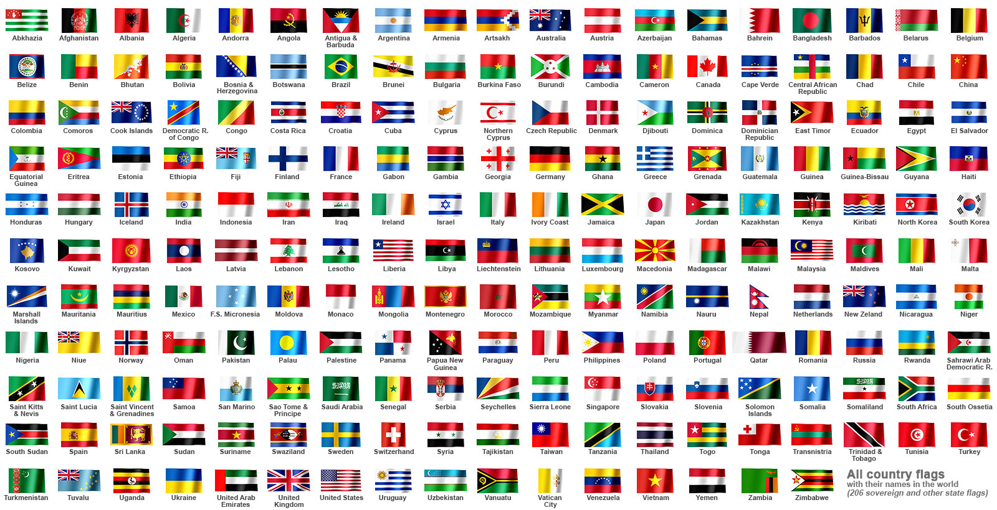
Purpose of classification
Finding the religious belief of that country by examining the characteristics of the given flag.

Slide 3
Dataset
This dataset contains details of various nations and their flags. In this dataset, the fields are separated by commas. The dataset is created in 5/15/1990 and has 30 attributes and 194 instances.

Slide 4
Dataset Attribute Informations
1. name: Name of the country concerned
2. landmass: 1=N.America, 2=S.America, 3=Europe, 4=Africa, 5=Asia, 6=Oceania
3. zone: Geographic quadrant, based on Greenwich and the Equator
1=NE, 2=SE, 3=SW, 4=NW
4. area: in thousands of square km
5. population: in round millions
6. language: 1=English, 2=Spanish, 3=French, 4=German, 5=Slavic, 6=Other
Indo-European, 7=Chinese, 8=Arabic,
9=Japanese/Turkish/Finnish/Magyar, 10=Others
7. religion: 0=Catholic, 1=Other Christian, 2=Muslim, 3=Buddhist, 4=Hindu,
5=Ethnic, 6=Marxist, 7=Others
8. bars: Number of vertical bars in the flag
9. stripes: Number of horizontal stripes in the flag

Slide 5
Dataset Attribute Informations
10. colours: Number of different colours in the flag
11. red: 0 if red absent, 1 if red present in the flag
12. green: same for green
13. blue: same for blue
14. gold: same for gold (also yellow)
15. White: same for white
16. black: same for black
17. orange: same for orange (also brown)
18. mainhue: predominant colour in the flag
19. circles: Number of circles in the flag
20. crosses: Number of (upright) crosses
21. saltires: Number of diagonal crosses
22. quarters: Number of quartered sections

Slide 6
Dataset Attribute Informations
23. sunstars: Number of sun or star symbols
24. crescent: 1 if a crescent moon symbol present, else 0
25. triangle: 1 if any triangles present, 0 otherwise
26. icon: 1 if an inanimate image present (e.g., a boat), otherwise 0
27. animate: 1 if an animate image (e.g., an eagle, a tree, a human hand) present, 0 otherwise
28. text: 1 if any letters or writing on the flag (e.g., a motto or
slogan), 0 otherwise
29. topleft: colour in the top-left corner
30. botright: Colour in the bottom-left corner

Slide 7

Example of a flag attribute
name | landmass | zone | area | population | language | religion | bars | stripes | colours | red | green | blue | gold | white
Turkey | 5 | 1 | 781 | 45 | 9 | 2 | 0 | 0 | 2 | 1 | 0 | 0 | 0 | 1
black | orange | mainhue | circles | crosses | saltires | quarters | sunstars | crescent | triangle | icon | animate | text | topleft | botright
0 | 0 | red | 0 | 0 | 0 | 0 | 1 | 1 | 0 | 0 | 0 | 0 | red | red

Slide 8
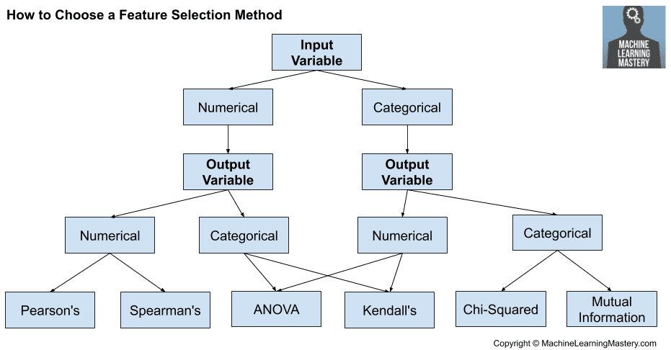
Feature Selection Methods
ANOVA Test
Chi-squared Test
Recursive Feature Elimination

Slide 9
ANOVA Test
ANOVA test was used to obtain categorical outputs from numerical inputs. The test produced p-values and a significance level of 0.05 was set. The features below the significance level were selected.

Slide 10
Chi-squared Test
Chi-squared test was used to obtain categorical outputs from categorical inputs. The test produced p-values and a significance level of 0.05 was set. The features below the significance level were selected.

Slide 11
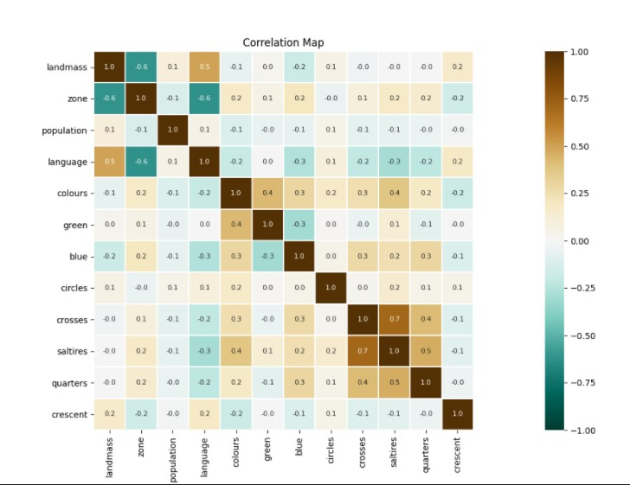
Correlation Map of Results

Slide 12
Recursive Feature Elimination
The Recursive Filter Elimination method was used to combine the results from the two feature selection methods. Decision Tree Classifier was used as the estimator. The best 10 features are selected.

Slide 13
Decision Tree Classifier
Entropy is used as a classification criteria. The obtained features were loaded into the Decision Tree model and the training data were placed in this model(%80 training data, %20 test data). After the model was created, predictions were made with the test values and compared with the actual values.

Slide 14
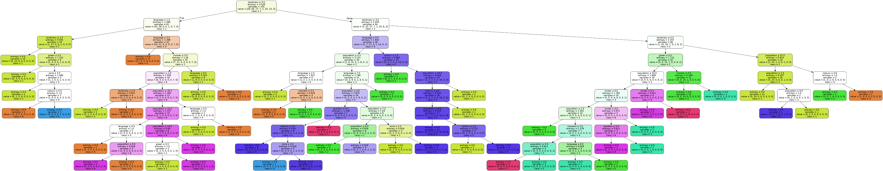
Example of a Decision Tree Model

Slide 15
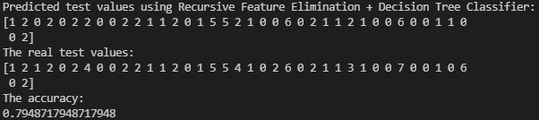
Conclusions
The test and training data were shuffled so that the results were different each time. As a result, the accuracy rate varies between 50% and 80%.

