Slide 1





Big Data Madison & Mad AI
MEETUP
www.fensteranalytics.com
Sam Adams
Co-Founder
company/fenster-analytics
October 25, 2023

Slide 2






Fenster Team
Charlie Olson
Sam Adams
Jana Gorol
Sebastian Herbertsson
Joha Salinas
CEO / CTO
Experienced Gameplay Analyst & Gameplay Engineer
Head of Business Operations
Experienced Biz Development & Operations
UX/UI Design
Principal Software Engineer
Experienced Full-Stack Developer
DS Content Strategist
Experienced Technologist and Marketer

Slide 3

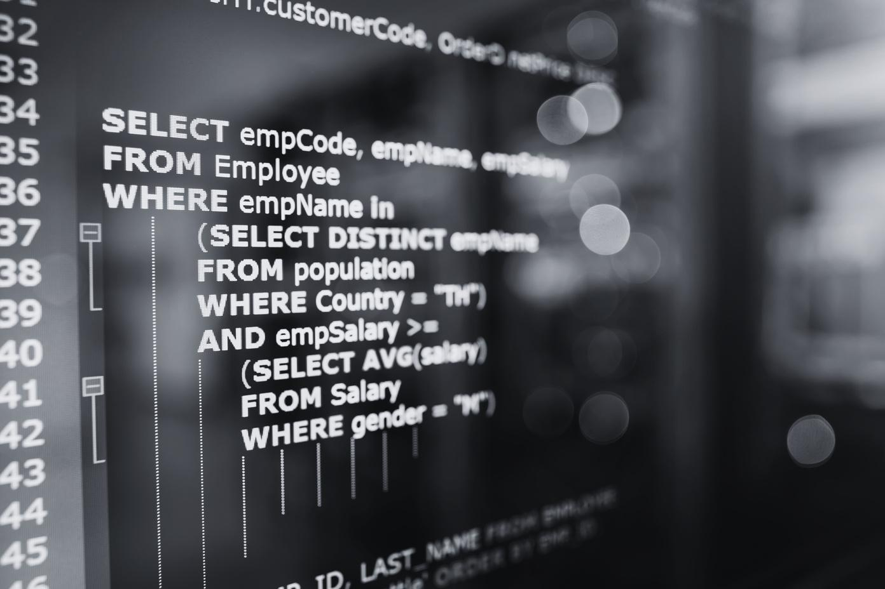

Does This Describe Your Work?
Rapid ad hoc analysis with SQL under time pressure
Consistently writing and organizing similar queries
Colleagues await results that will influence decision-making
Colleagues expect output as charts and dashboards

Slide 4

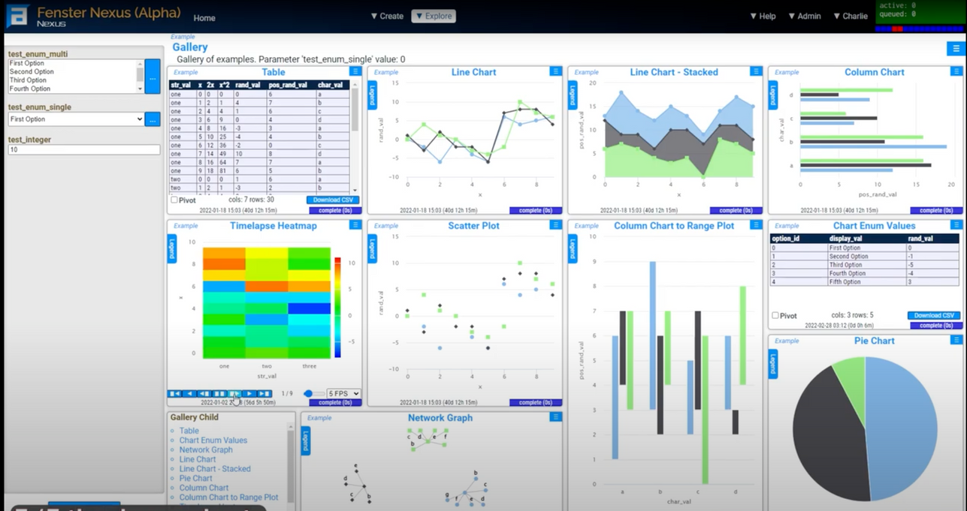
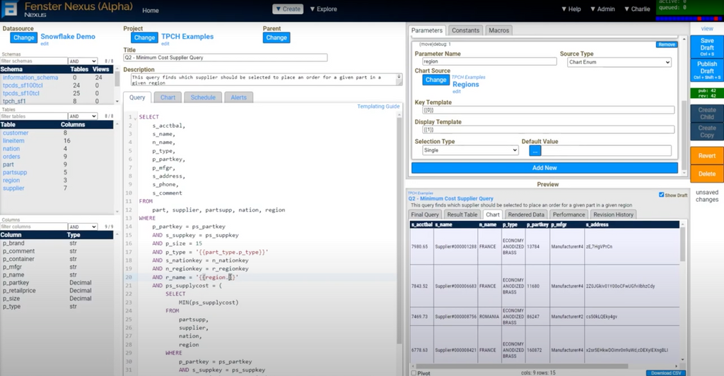
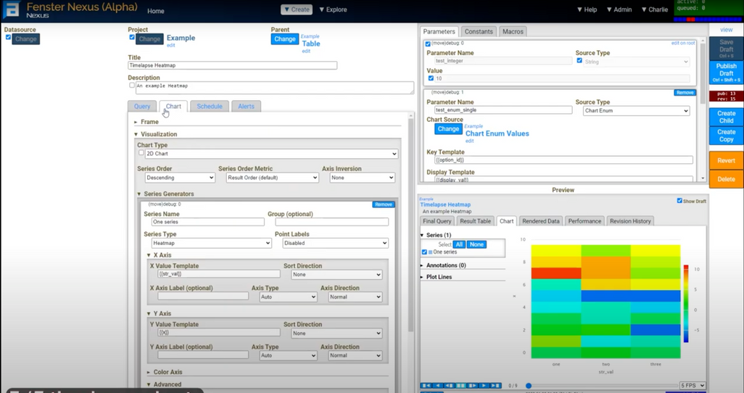
Status - One Year Alpha Experience

Slide 5






High Velocity Data Visualization
Hi Data Lover!
Help!
New Template
Select period:
from Jan 1, 2022
to Dec 31, 2022
Search...
Filter
Total Income
Inquiry Success Rate
Number of New Clients
Number of Completed Projects
$250,000.00
36.2%
36
29
Inquiry Breakdown
Inquiries per Month
Inquiry Source Breakdown
Booked
36.2%
30
75
20
50
Flopped
63.8%
10
25
0
Jan
Feb
Mar
Apr
May
Jun
Jul
Aug
Sep
Oct
Nov
Dec
0
Web
Email
Instagram
TikTok
Pinterest
Income per Quarter
Income per Month
Income Source per Month
Q1
13.1%
40,000
50,000
Q4
30.3%
30,000
40,000
20,000
30,000
Q2
28.6%
10,000
20,000
0
10,000
Q3
28%
Jan
Feb
Mar
Apr
May
Jun
Jul
Aug
Sep
Oct
Nov
Dec
0
Jan
Feb
Mar
Apr
May
Jun
Jul
Aug
Sep
Oct
Nov
Dec
1
2
4
6
3
Hierarchical Content System Enables Ad Hoc Questions
5
Developed for Liveops at Game Studios
Customizable Responsive User Interface
Customizable Dashboards
Advanced SQL Editor
Growing List of Data
Connections

Slide 6



Strata Beta Test Invite
Early and exclusive access to Strata
Shape the product, work directly with the development team
Free License
Strata Swag!
fensteranalytics.com/stratabeta

Slide 7


Let's Chat!
Enjoy Drinks and Food Courtesy of:
Linkedin
company/fenster-analytics
Follow us
fensteranalytics.com
fensteranalytics.com/stratabeta

