Slide 1


Team
HELLO WORLD!
presents
Bit Stock
RIDE THE TRENDS, SEIZE THE OPPORTUNITIES.

Slide 2
Trending Cryptocurrency Front-End Application:
Develop a user-friendly desktop or mobile application that visually displays real-time trends in the cryptocurrency market .
The application should provide comprehensive information on trending cryptocurrencies, market capitalization, price movements, and other relevant data, enhancing user experience and facilitating informed decision-making.
PROBLEM
STATEMENT

Slide 3
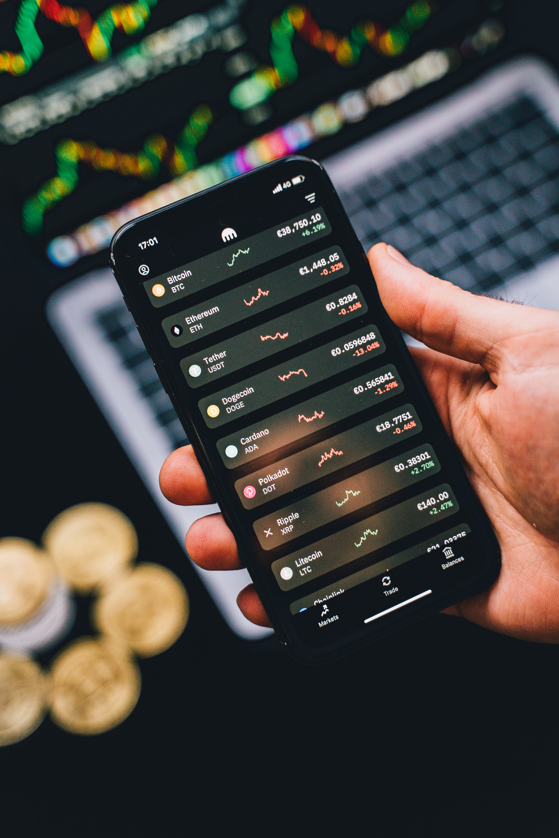
SOLUTION
"Stay ahead of the crypto curve with our all-in-one platform “BitStock” ! Real-time trends, detailed info on hot cryptocurrencies, market capitalization updates, dynamic price movements with interactive graphs, latest crypto news, and seamless buying/selling capabilities – all at your fingertips. Whether on your computer or phone, our app keeps you in sync with the ever-evolving world of cryptocurrencies, empowering you to make informed decisions in the digital market."

Slide 4

Features that make us Stand out
01 | Real-Time trends in Crypto-currency
02 | Information on trending Crypto-currencies
03 | Market Captialization
04 | Price Movements through Dynamic Graphs
05 | Crypto News at fingertips
06 | Buying and Selling Crypto

Slide 5

FUTURE SCOPE
Integrating BlockChain Technology
Integrating Chatbot for beginner friendly interface
Bussiness Plans
For secure transactions
Premium Features
Offers and discount coupons

Slide 6








Tech - Stack
Android
Web Dev.
UI/UX
HTML
CSS
Figma
Flutter
Javascript
Canva

Slide 7

TEAM MEMBERS
PARTH AGARWAL (ANDROID)
SRISHTI SINGH (WEB DEV)
VAISHNAVI SINGH (UI/UX)

Slide 8

THANK
YOU!

