Slide 1
CampusCal
Turning the campus inbox into a calendar that fills itself
Agile CCC Ideathon | Solutions Cell submission
Working prototype running on live IIMA Gmail | August 2026
Prepared for the Agile CCC Ideathon. Screenshots are from the live prototype and show a real student inbox.
Notes:
Open with the governing thought: campus information is not missing, it is scattered across email. CampusCal makes the inbox fill the calendar. It already runs on live IIMA mail.

Slide 2
CampusCal converts campus email into a calendar that fills itself, and it already runs on live IIMA mail
The problem is discovery, not information. Quizzes, deadlines, club events and placement notices all arrive by email. In one live student inbox, 14 mails landed in the four hours before capture, and the 100 most recent inbox mails span barely a week. Anything not read on the day is effectively lost.
Every calendar tool assumes somebody types the event in. Nobody does. The gap is not tooling, it is manual entry. Students already own Google Calendar, they simply never populate it from 100 mails.
CampusCal reads the inbox and writes the calendar, in two layers. A shared campus layer captures what everyone may attend; a personal layer captures what is addressed to the individual student, such as quizzes, assignments and placement notices.
Segmentation is deterministic, tiered and auditable. 21 imported Gmail filter rules, 112 sender patterns, 9 generic sender rules and 237 weighted keywords route each mail onto one of 18 source labels and one of 9 calendar categories, with a keyword fallback that prefers Other over a wrong guess.
The prototype is complete end to end and measured. 133 events are live on the calendar today. Unclassified events fell from 89% to 23% after the segmentation rework, and 126 automated checks pass on every build.
Source: CampusCal prototype instrumentation, live Gmail account, 5 August 2026
1
Notes:
The bold sentences alone are the argument. Land the 133 events and the 89% to 23% improvement.

Slide 3
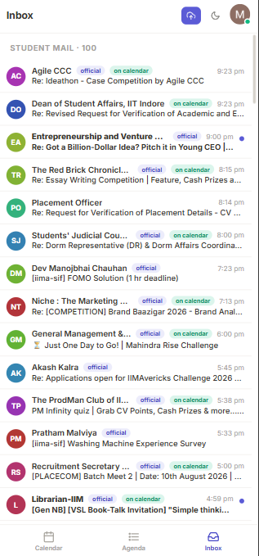
The information is not missing, it is scattered: 14 mails reached one student inbox in four hours
Students find out second hand, because reading everything on the day is the only way not to
Live student inbox, not a mock-up
What arrives in a single evening
Inbox as captured, most recent first¹
Four of these 14 mails carried a dated commitment
Mail volume is steady and unfiltered. A quiz notice and a food delivery receipt arrive in the same stream, with the same weight.
9:23 pm
Ideathon case competition
Club event, registration link
8:15 pm
Essay writing competition
Club event, results announced next day
The details are all there: date, time, venue, registration link. They simply never reach a calendar, because that step is manual.
8:00 pm
Dorm representative elections
Notice, voting window
3 per hour
5:00 pm
PLACECOM batch meet, 10 August
Placement, dated and compulsory
Average inbound rate over the captured window
The remaining 10 mails were notices, surveys and newsletters that must not reach a calendar²
14
100
7
mails in 4h 24m
mails on the first inbox page
unread at capture
1. Timestamps read from the live inbox capture: 14 mails between 4:59 pm and 9:23 pm on 5 August 2026
2. Only mails carrying a date, time or venue can become calendar entries; the rest are notices or newsletters
Source: CampusCal inbox view, live IIMA Gmail account, 5 August 2026
2
Notes:
Point at the timestamps down the right edge. Four and a half hours, 14 mails, four of them carrying a hard commitment.

Slide 4
Every existing tool assumes a student types the event in, which is exactly the step that never happens
Illustrative, not exhaustive
What the current process assumes
What actually happens
1
The student reads every mail on the day it arrives
14 mails an evening; most are skimmed, many are never opened
2
The student copies date, time and venue into a calendar
Manual entry is the single step nobody performs, for any mail
3
Clubs and offices publish to a shared campus calendar
No shared calendar exists; each club broadcasts by email only
4
Registration links are saved when the mail is read
Links are buried in threads and re-found by searching the inbox
5
Missing an event is an individual lapse
Whole sections learn about deadlines second hand, from peers
The implication: automate the entry step and the rest of the problem disappears, because the data already exists in the mail
Source: CampusCal problem definition, Agile CCC application response, July 2026
3
Notes:
This is the complication slide. The gap is not tooling, it is the manual step in the middle.

Slide 5
CampusCal removes that step: it ingests, classifies, extracts and publishes, with no manual entry at any point
A. Ingest
B. Classify
C. Extract
D. Publish
Gmail API, read only
4 tiers, most certain first
Date, time, venue, links
Campus layer or personal layer
100 mails per page, 12 parallel fetches
18 source labels, 9 categories
Quoted reply text stripped first
One click push to Google Calendar
Polls every 45 seconds while open
Denylist blocks newsletters and receipts
Confidence score on every draft
Idempotent and fully reversible
Student stays in control throughout: every auto-added event links back to its source mail, every draft is editable before saving, and every push to Google Calendar can be undone in one click
Ingestion and classification run on sign-in, on each Load more, and on a 45 second poll while the app is open
No manual entry means no adoption barrier: a student signs in once and the calendar is already populated, which is the difference between a tool that is tried and a tool that is used
Source: CampusCal architecture, backend/parser.py and backend/main.py
4
Notes:
Four stages. Emphasise that the same pipeline runs on login, on Load more, and every 45 seconds while open.

Slide 6
Two layers separate what the whole campus may attend from what is addressed to the individual student
Campus calendar, shared layer
My calendar, personal layer
Broadcasts anyone on campus may attend
Mail addressed to this student specifically
Seminars & Talks
Research seminars, speaker series
Exam Notices
Quizzes, mid-terms, end-terms
Career Clubs
Case prep, masterclasses, competitions
Assignments & Quizzes
Submissions, Turnitin, due dates
Other Clubs
Fests, sports, cultural, dramatics
REM & Doubt Sessions
Make-up classes, revision sessions
General Notice Board
Tagged [Gen NB] announcements
Section Admin
Registration windows, section notices
Student Governance
Council notices, elections
Placement Committee
PPTs, CV verification, interview slots
Hostel & Facilities
Maintenance and dorm notices
Course Forums
Course announcements and material
Routing rule: The source label decides the layer, so a mail from the exams office is personal and a mail from a club is campus wide
Override: Personal intent phrases such as shortlisted, your interview or roll number move a broadcast onto the personal layer
Denylist: 4 of the 18 labels never create events at all: The Ken, Form Receipts, Library and Personal & Govt
Source: CampusCal label routing table, backend/categories.py
5
Notes:
The two-layer design comes straight from the original Agile CCC application answer. Routing is by source label, then overridden by personal-intent phrases.

Slide 7
Six capabilities are live in the prototype, each measurable on real inbox data
Capability
What it does
Evidence in the running build
A. Gmail ingestion
Reads the inbox over the Gmail API, read only, with paging and a live poll
100 mails per page, 12 parallel fetches, 45 second poll
133
B. Segmentation
Routes every mail onto one source label and one calendar category
18 labels, 9 categories, 4 tiers
events live on the calendar today
C. Event extraction
Pulls title, date, time, venue and links from the mail body
237 weighted keywords, 5 date formats
126
D. Registration links
Detects and attaches the registration or meeting URL to the event
4 link classes, tracking links dropped
automated checks, all passing
E. Google Calendar sync
Reads existing calendars and pushes CampusCal events back, reversibly
118 events read, idempotent push
~6,000
F. Responsive interface
One codebase across desktop, tablet and mobile, with dark mode
3 breakpoints, light and dark themes
lines of application code
Source: CampusCal codebase, 5,978 lines across backend and frontend; test_classification.py, 5 August 2026
6
Notes:
Run down the six. The stat rail on the right is the proof column.

Slide 8
Segmentation runs on two axes: who sent the mail, and what kind of event it is
Splitting the axes is what makes the calendar readable and the classification auditable
Segmentation logic, part 1 of 2
Axis 1: source label, who sent it¹
Axis 2: category, what kind of thing it is²
18 labels, mirrored from the student's Gmail filters
9 categories, these are what colour the calendar
Exam Notices
Assignments & Quizzes
Placement Committee
Exams & quizzes
Quizzes, mid-terms, end-terms
The label answers where an event came from and stays attached to it, so any student can verify a parse against the original mail.
Career Clubs
Other Clubs
Seminars & Talks
Assignments
Submissions and due dates
Section Admin
REM & Doubt Sessions
Course Forums
Classes
Lectures, REM, make-up classes
The category answers what it is and drives colour, filtering and layer routing. Nine colours read cleanly on a month grid; eighteen do not.
General Notice Board
Student Governance
SIF
Placement
PPTs, CV rounds, interviews
Hostel & Facilities
Wellness
Library
Workshops
Case prep, training, masterclass
18 x 9
The Ken
Form Receipts
Personal & Govt
Talks & seminars
Speaker series, panels
Label and category combinations, from one classification pass
Greyed labels are denylisted: newsletters, receipts and account mail never create an event
Club events
Fests, competitions, auditions
Notices & admin
Facilities, elections, circulars
Other
Deliberately unclassified
1. Source labels are imported from the student's own Gmail filter set (gmail_filters_import.xml), so the website and the inbox agree
2. Nine categories were chosen deliberately: 18 colours on a month grid is unreadable, so provenance is carried by the label instead
Source: backend/categories.py; gmail_filters_import.xml, 21 rules covering 18 labels
7
Notes:
This is the slide the panel will probe. Explain why two axes: colour must stay readable, provenance must stay auditable.

Slide 9
Classification resolves in four tiers, cheapest and most certain first, and prefers Other over a confident wrong guess
Segmentation logic, part 2 of 2
Tier
Signal used
How it decides
Scale in the build
Tier 1
Gmail label already applied
Reads the IIMA label the student's own Gmail filters attached to the thread
Authoritative, zero logic, free
Tier 2
Imported filter rules¹
Re-evaluates the same 21 rules inside the app, for accounts that never imported the filters
112 sender and recipient patterns
Tier 3
Generic sender rules
Covers the non-IIMA world: LinkedIn, Unstop, Coursera, Meetup, banks, delivery and newsletters
9 rules, 5 of them event creating
Tier 4
Weighted keyword scoring
Subject hits count three times body hits; the highest scoring category wins
237 keywords across 8 categories
Worked example, one real inbox mail
1
Tier 2 matches: Sender is in the Career Clubs rule, so the label is Career Clubs
Subject: Re: [COMPETITION] Brand Baazigar 2026, Brand Analysis
Sender:
niche@iima.ac.in
2
Base category: Career Clubs maps to Workshops by default
3
Content override: COMPETITION scores higher within the activity set, so the category becomes Club events
4
Layer: Career Clubs is a broadcast label, so the event lands on the campus calendar
1. Tier 2 evaluates the same query grammar Gmail uses: from, to, cc, subject, negation, OR and parentheses
2. Tier ordering is explicit: subject tags such as [Gen NB] and [PLACECOM] outrank sender rules, and the broad noreply catch-all is evaluated last
Source: backend/rules_engine.py and backend/parser.py; rule set generated from gmail_filters_import.xml
8
Notes:
Walk the four tiers. The key defensive point: the fallback refuses to guess, which is why Other still exists at 23%.

Slide 10
Extraction pulls five fields from the mail body, and a surety gate blocks anything the parser cannot prove
What is extracted from each mail
The surety gate, applied before any automatic add
Title
Subject line, cleaned of Re, Fwd and Reminder prefixes
1
Allowed source
Denylisted labels are dropped outright
4 labels blocked
Date
Five formats: 18 July, 18/07/2026, 18.07.2026, tomorrow, this Friday
2
A parseable date
No date, no event
quoted text stripped¹
Time
6:30 PM, 6.30 pm, 1730 hrs, 17:00, noon, and ranges
3
A corroborating signal
A time, a venue, or event language
237 keywords
Venue
Campus gazetteer: RJM Auditorium, KLMDC, CR-1 to CR-4, LKP
4
Date certainty
Vague dates need a time or venue²
explicit dates preferred
Links
Registration, meeting, resource; tracking links dropped
5
Not in the past
Past dated mail is never added
date compared to today
Every draft also carries a confidence score, shown to the student as a percentage before the event is saved
6
Not a duplicate
Same title and date is skipped
plus Gmail message id
Nothing is lost when the gate rejects a mail: it stays in the inbox with a one click Add to calendar button, which opens the same parsed draft for the student to correct and confirm
1. Quoted reply text is removed before parsing, so a date inside an older message in the thread cannot create a phantom event
2. Vague dates such as tomorrow or this Friday are accepted only when the mail also pins a time or a venue
Source: backend/parser.py, backend/links.py; gate logic in backend/main.py, gmail_sync
9
Notes:
Precision story. The gate is why the calendar is trustworthy; the fallback to manual add is why nothing is lost.

Slide 11
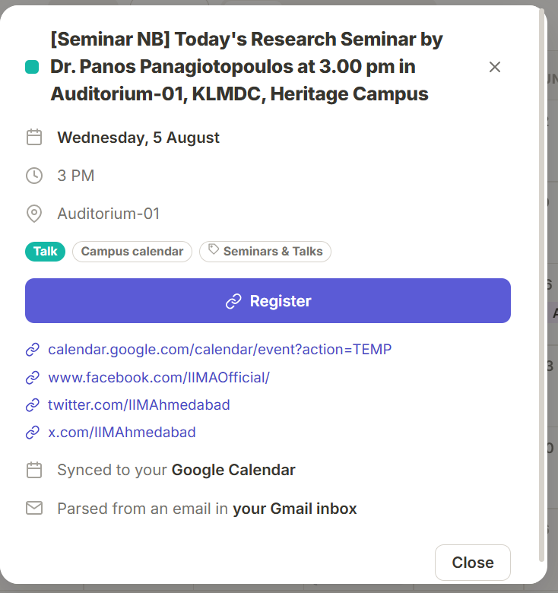
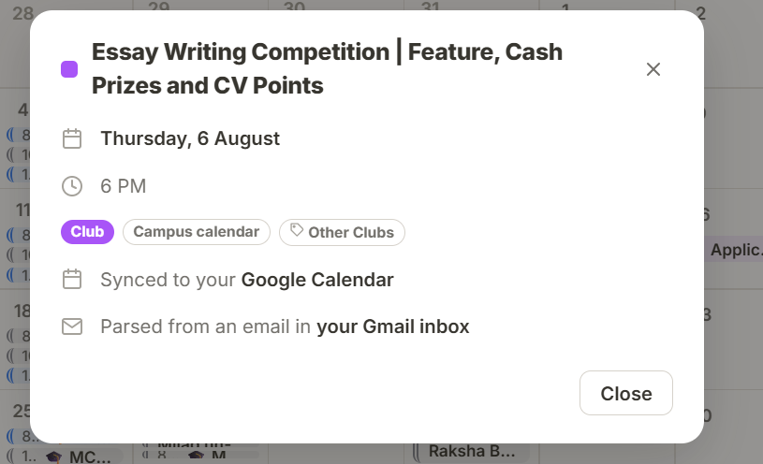
Registration links travel with the event, and one button writes the whole calendar into Google, reversibly
Screenshots from the live prototype
Why these two matter
Registration in one tap
The parser classifies every URL as registration, meeting, resource or tracking, and promotes the registration link to a button on the event
Provenance is visible
Each event states the source label, the layer and the mail it came from, so any student can audit a parse
Push is idempotent
Events are stamped with an internal id, so a second push updates in place and never duplicates
Push is reversible
Events go to a dedicated CampusCal calendar and can all be removed in one click
Seminar parsed from mail, with the registration link promoted to a button
Club event, synced to Google Calendar and traceable to its mail
Source: CampusCal event detail views, live IIMA Gmail account, 5 August 2026
10
Notes:
Two features, one slide, both shown in the product. The register button removes the search-the-inbox step entirely.

Slide 12
The segmentation rework cut unclassified events from 89% to 23% of the calendar, without loosening the surety gate
Same account, same day, before and after
Events on the calendar by category
What changed
Number of events¹
89%
23%
of events sat in Other before
after the four tier rework
Root cause: 118 imported Google Calendar events were never classified, so they defaulted into Other and masked every other category
Fix: Calendar titles now run through the same classifier as mail, and the keyword vocabulary was widened to 237 terms
Result: 103 of 133 events now carry a named category, and 8 of 9 categories are populated
Deliberately conservative²: The remaining 30 are events such as Gym or Team standup, which carry no campus signal at all
1. Measured on the same live inbox and the same 118 imported Google Calendar events, before and after the four tier rework on 5 August 2026
2. Other is retained deliberately: an event with no reliable signal is left unclassified rather than assigned to a category it may not belong to
Source: CampusCal category counters, live IIMA Gmail account, before and after builds of 5 August 2026
11
Notes:
This is the proof slide. Classes and Notices absorb most of the reclassification, because the Google Calendar import was previously untouched.

Slide 13
The prototype is complete end to end: every component is built, running and covered by automated checks
Status as at 5 August 2026
Component
Status
What is implemented
Evidence¹
Gmail ingestion
Live
Read only OAuth, 100 mails per page, 45 second poll
Demonstrated on a real account
Segmentation engine
Live
4 tiers, 21 rules, 18 labels, 9 categories, 237 keywords
126 automated checks pass
Event extraction
Live
5 date formats, 6 time formats, campus venue gazetteer
Regression cases in the test suite
Registration links
Live
4 link classes, tracking and unsubscribe links dropped
Visible on live events
Google Calendar read
Live
118 events imported and classified from existing calendars
Class schedule appears in app
Google Calendar push
Live
Dedicated calendar, idempotent, one click undo
Verified by repeat push
Interface
Live
Desktop, tablet and mobile, light and dark themes
Screenshots on the next page
Persistence
Live
SQLite with automatic schema migration on start
Survives restart without data loss
Not yet production: the app runs against one account at a time and polls Gmail rather than subscribing to push notifications, and the extraction layer is deterministic rather than model based. Both are deliberate choices for a prototype, and both are single component swaps.
1. 126 assertions covering rule coverage, label routing, the denylist, tier precedence, the surety gate, quoted text handling, link extraction and time formats
Source: CampusCal repository; python test_classification.py, 126 passed, 0 failed
12
Notes:
Close the status section. Every row is demonstrable live if the panel asks.

Slide 14
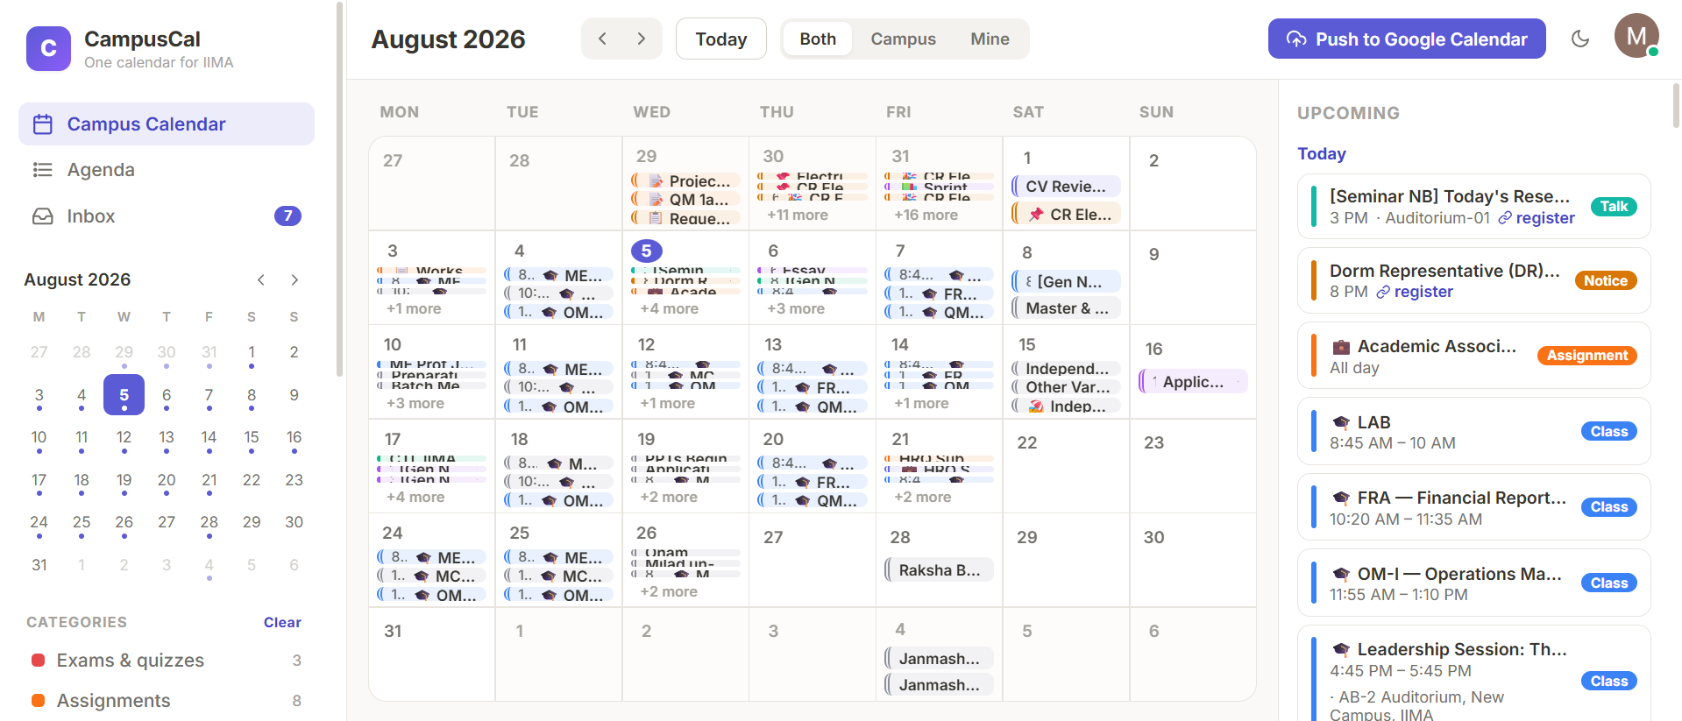
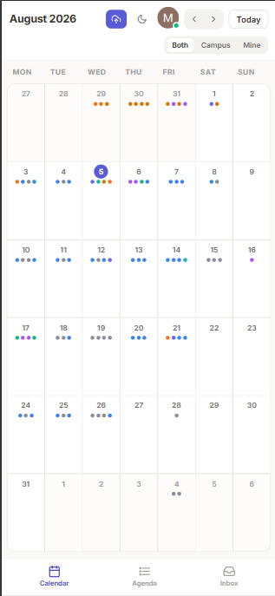
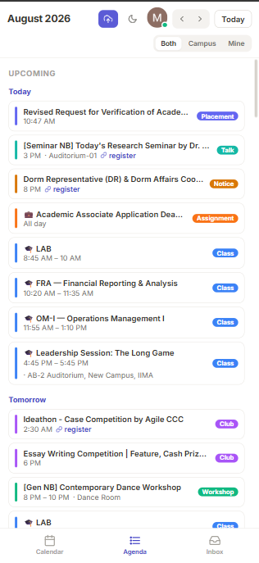
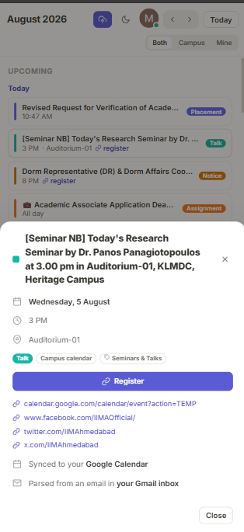
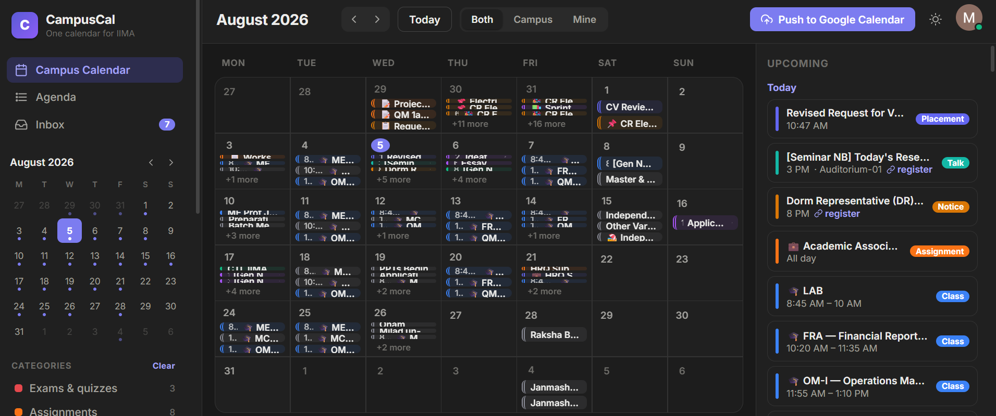
One build serves desktop, mobile and dark mode, so the calendar is usable wherever mail is read
Screenshots from the live prototype
Desktop, 1,920 px
Mobile, 320 px
Month grid with an always visible agenda rail
Dark mode, same build
Month grid collapses
to category dots
Agenda view,
grouped by day
Register directly
from the phone
Students read mail on the phone, so the phone view is the primary one: the sidebar becomes a bottom tab bar and the month grid becomes a dot grid with a tap-through day sheet
Theme switched from the top bar, no separate stylesheet
Source: CampusCal interface, live IIMA Gmail account, 5 August 2026
13
Notes:
Close the status section visually. Emphasise that students read mail on the phone, so the phone view is the primary one.

Slide 15
From 100 scattered mails to one calendar that fills itself
133
events live on the calendar
89% to 23%
unclassified events, before and after
The information was always there. CampusCal removes the only step that was ever manual, and gives every student the same view of the campus that the best informed student has.
126
automated checks passing
0
events typed in by hand
Source: CampusCal prototype, live IIMA Gmail account, 5 August 2026
14
Notes:
Close on the governing thought and hand over to the future plans section.

