Slide 1
CampusCal
Turning the campus inbox into a calendar that fills itself
Agile CCC Ideathon | Solutions Cell submission
Working prototype running on live IIMA Gmail | August 2026
Screenshots throughout are from the live prototype and show a real student inbox.
Notes:
Governing thought: campus information is not missing, it is scattered across email. CampusCal makes the inbox fill the calendar, and it already runs on live IIMA mail.

Slide 2
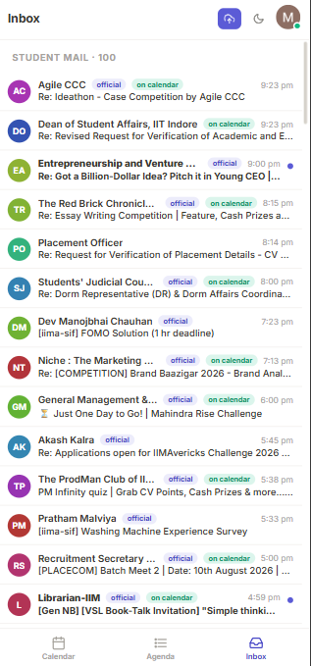
Campus information is not missing, it is scattered: 14 mails reached one inbox in four hours
Students find out second hand, because reading everything on the day is the only way not to
Live student inbox, not a mock-up
What arrives in one evening
Four carried a dated commitment
Inbox as captured, most recent first¹
Parsed by CampusCal into calendar events
9:23 pm
Ideathon case competition
Club event
registration link
A quiz notice and a food delivery receipt arrive in the same stream, with the same weight and no ranking.
8:15 pm
Essay writing competition
Club event
result date
8:00 pm
Dorm representative elections
Notice
voting window
Every detail needed is already in the mail: date, time, venue, registration link. None of it reaches a calendar.
5:00 pm
PLACECOM batch meet, 10 August
Placement
dated, compulsory
The other 10 were notices, surveys and newsletters, which must never reach a calendar
3 per hour
Why they are still missed
Average inbound rate across the captured window
1
The student is assumed to read every mail on the day
Most are skimmed, many are never opened
14
mails in 4h 24m
2
The student is assumed to copy the details into a calendar
Manual entry is the one step nobody performs
100
on the first inbox page
3
Clubs are assumed to publish to a shared calendar
No shared calendar exists, only email broadcasts
1. Timestamps read from the live inbox capture: 14 mails between 4:59 pm and 9:23 pm on 5 August 2026; the 100 most recent inbox mails span barely a week
Source: CampusCal inbox view, live IIMA Gmail account, 5 August 2026
1
Notes:
Two beats: the volume is real (screenshot, timestamps), and the details are all present in the mail. The only missing step is entry, which is manual and therefore never happens.

Slide 3
CampusCal removes the manual step: it ingests, classifies, extracts and publishes, across six live capabilities
A. Ingest
B. Classify
C. Extract
D. Publish
Gmail API, read only
4 tiers, 18 labels, 9 categories
Date, time, venue, links
Campus layer or personal layer
100 mails per page, 45 second poll
Denylist blocks newsletters
Quoted reply text stripped first
One click push to Google Calendar
Two layers, one pipeline: broadcasts anyone may attend land on the campus calendar; exams, assignments, classes and placement mail land on the student's own calendar
Capability
What it does in the running build
Measured scale
A. Gmail ingestion
Reads the inbox over the Gmail API, paged, with a live poll
100 mails per page
133
B. Segmentation
Routes each mail to one source label and one category
18 labels, 9 categories
events live on the calendar
C. Event extraction
Pulls title, date, time, venue and links from the body
237 weighted keywords
126
D. Registration links
Promotes the registration URL to a button on the event
4 link classes
automated checks passing
E. Google Calendar sync
Reads existing calendars, pushes events back reversibly
118 events read
0
F. Responsive interface
One codebase across desktop and mobile, with dark mode
3 breakpoints, 2 themes
events typed in by hand
Source: CampusCal architecture and codebase, 5,978 lines across backend and frontend, 5 August 2026
2
Notes:
Top half is the pipeline, bottom half is what that pipeline delivers. Stress that all six capabilities are running, not planned.

Slide 4
The differentiator is segmentation: four tiers resolve every mail onto 18 source labels and 9 calendar categories
Rules generated from the student's own Gmail filter export
Four tiers, most certain first
Two axes decide where it lands
Each mail stops at the first tier that matches
Provenance and colour are kept separate
Tier 1
Label already applied by the student's Gmail filters
Authoritative, zero logic
Axis 1: source label, 18 values²
Exam Notices, Assignments & Quizzes, Placement Committee, Career Clubs, Other Clubs, Seminars & Talks, Section Admin, REM & Doubt Sessions, Course Forums, General Notice Board, Student Governance, SIF, Hostel & Facilities, Wellness, Library, The Ken, Form Receipts, Personal & Govt
Tier 2
The same 21 filter rules, re-evaluated inside the app¹
112 sender patterns
Decides the calendar layer and carries provenance on every event. Four labels are denylisted and never create events: The Ken, Form Receipts, Library, Personal & Govt
Tier 3
Generic senders: LinkedIn, Unstop, Coursera, banks
9 rules
Axis 2: category, 9 values
Exams & quizzes
Assignments
Classes
Tier 4
Weighted keywords; highest score wins, else Other
237 keywords
Placement
Workshops
Talks & seminars
Club events
Notices & admin
Other
Classification alone does not create an event
A parseable, future date
quoted reply text stripped first, so an older message cannot create a phantom event
Drives colour on the calendar and the category filter. Nine colours read cleanly on a month grid; eighteen do not
1
2
A corroborating signal
a time, a venue, or event language; a vague date needs one of them
Worked example, one real inbox mail
3
Not already on the calendar
deduplicated on Gmail message id, and on same title with same date
“Re: [COMPETITION] Brand Baazigar 2026” from niche@iima.ac.in. Tier 2 matches the Career Clubs rule; that label maps to Workshops by default; the word COMPETITION scores higher within the activity set, so the category becomes Club events; Career Clubs is a broadcast label, so it lands on the campus calendar
Rejected mail is not lost: it keeps a one click Add to calendar button that opens the same parsed draft for the student to confirm
1. Tier 2 evaluates the same query grammar Gmail uses: from, to, cc, subject, negation, OR and parentheses; subject tags such as [Gen NB] and [PLACECOM] outrank sender rules
Source: backend/rules_engine.py, backend/categories.py; rule set generated from gmail_filters_import.xml, 21 rules covering 18 labels
3
Notes:
This is the USP slide. Two points: certainty is tiered, and the two axes are separate so the calendar stays readable while provenance stays auditable.

Slide 5
The tiered rework cut unclassified events from 89% to 23% of the calendar, without loosening the surety gate
Same account, same day, before and after
Events on the calendar by category
What changed
Number of events¹
89%
23%
of events sat in Other before
after the tiered rework
Root cause: 118 imported Google Calendar events were never classified, so they defaulted into Other and masked every other category
Fix: Calendar titles now run through the same four tier classifier as mail, and the keyword vocabulary was widened to 237 terms
Result: 103 of 133 events now carry a named category, and 8 of the 9 categories are populated
Held back deliberately²: The remaining 30 are entries such as Gym or Team standup, which carry no campus signal at all
1. Measured on the same live inbox and the same 118 imported Google Calendar events, before and after the tiered rework on 5 August 2026
2. The surety gate still applies: an explicit future date plus a time, a venue or event language, with quoted reply text stripped and past or duplicate events skipped
Source: CampusCal category counters, live IIMA Gmail account, before and after builds of 5 August 2026
4
Notes:
The proof slide. Name the root cause honestly: the imported Google Calendar events were never classified and masked every other category.

Slide 6
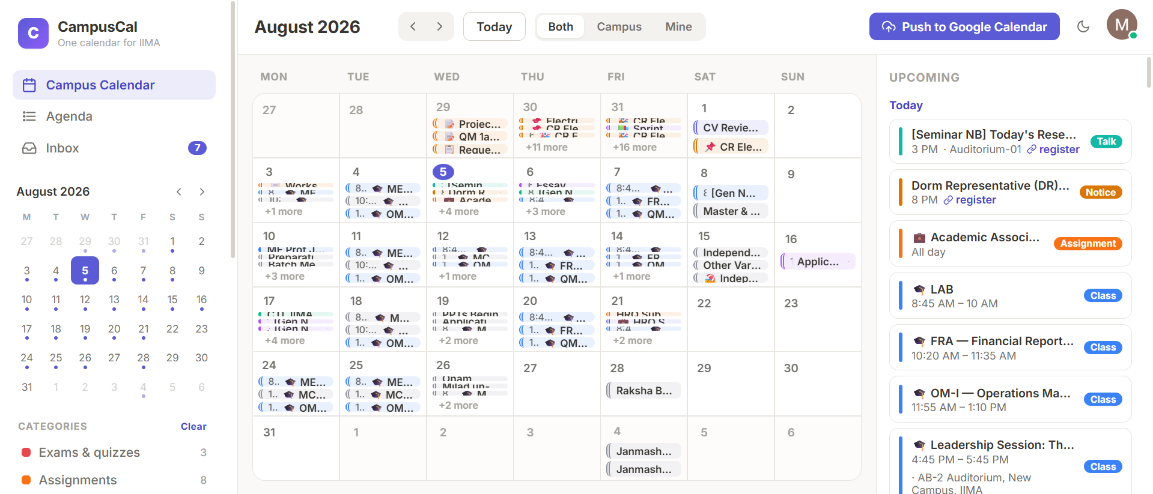
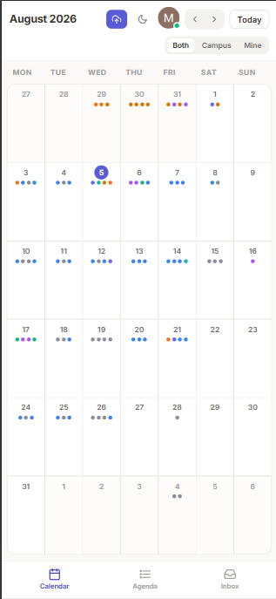
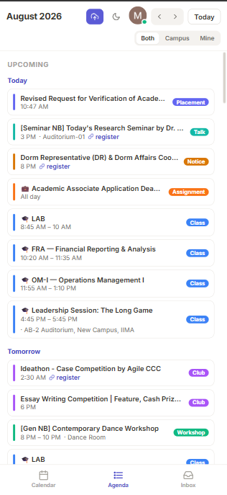
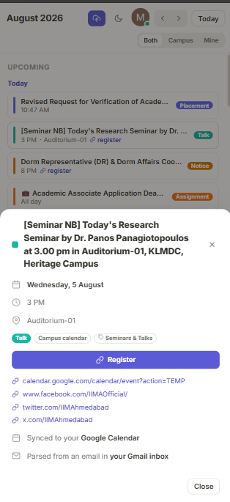
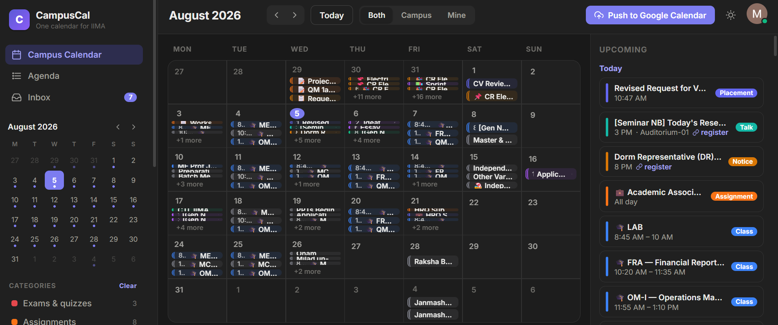
The prototype is live end to end: every capability runs today, on one build, across every device
Screenshots from the live prototype
Gmail ingestion
Segmentation
Extraction
Registration links
Google Calendar
Interface
read only, paged
4 tiers, 18 labels
5 date, 6 time formats
surfaced on the event
read and reversible push
desktop, mobile, dark
Desktop: month grid, agenda rail, campus and personal layers in one view
Month grid becomes
a dot grid
Agenda, grouped
by day
Register from
the phone
126 automated checks pass on every build, covering rule coverage, label routing, the denylist, tier precedence, the surety gate, quoted reply handling, link extraction and time formats
Dark mode: identical layout, theme switched from the top bar
Source: CampusCal interface and repository; python test_classification.py, 126 passed, 0 failed, 5 August 2026
5
Notes:
Close on proof. Offer to demonstrate live: sign in, watch the pipeline classify, open an event, push to Google Calendar.

Slide 7
From 100 scattered mails to one calendar that fills itself
133
events live on the calendar
89% to 23%
unclassified, before and after
The information was always there. CampusCal removes the only step that was ever manual, and gives every student the same view of the campus that the best informed student has.
126
automated checks passing
0
events typed in by hand
Source: CampusCal prototype, live IIMA Gmail account, 5 August 2026
6
Notes:
Close on the governing thought, then hand over to the future plans section.

