Slide 1


BEX Major Project: Final Defense
Image Processing based E-Attendance System
Name of the students Roll No.
Jenis Thapa 2073/BEX/06
Madan Rijal Magar 2073/BEX/08
Shree Krishna Dani Chhetri 2073/BEX/16
Department name : Department of electronics and communication
Project Supervisor: ER.Saban KumarKC
Date:2077-11-24

Slide 2
TABLE OF CONTENT
INTRODUCTION
OBJECTIVES
SCOPES AND APPLICATIONS
LITERATURE REVIEW
HARDWARE REQUIREMENTS
SOFTWARE REQUIREMENTS
PROJECT METHODOLOGIES
RESULTS AND DISCUSSION
CONCLUSION
LIMITATIONS
FUTURE ENHANCEMENT
REFERENCES
APPENDICES

Slide 3
1.INTRODUCTION
1.1 BACKGROUND
The existing attendance system is manual. It wastes a considerable amount of time both for teachers and students. The waiting time of the students is increased if attendance is taken manually. The larger the number of individual or the larger the organization more number of equipment required

Slide 4
1.2 PROBLEM STATEMENT
There are following major issues in existing scenario such as:
Time consuming manual attendance system
Chances of human error and manipulation exist

Slide 5
2.OBJECTIVES
2.1 MAIN OBJECTIVE
The main objective of this project is to design an Image Processing based E-Attendance System.
2.2 SPECIFIC OBJECTVES
To capture images of students using web-cam
To detect faces of students using linear binary pattern histogram algorithm
To prepare the student details such as name, roll no. and date in MS-excel file

Slide 6
3.Scopes and applications
This project can be extensively used in the places where the frequent requirement of attendance is necessary.
This project can be used to recognize the personnel belonging to a group or an organization

Slide 7
4.LITERATURE REVIEW
In organizations, industries and many companies are taking the entire attendance using RFID methods[1]. registers, Moodle based student ID identification[2].and fingerprint modules[3].
RFID technology[4] simplifies programmed wireless using digital passive and active with identifications appropriate readers. In short duration, worth’s of diffusion and implementation for an RFID card based fare cluster system can be rather expensive
Biometric time and presence system[5] is one of the most accurate requirements in biometric technology

Slide 8
The fingerprint system does not reveal any data about the original fingerprint of the user. This assumption has now been shown to be false; many algorithms[6]
This face recognition[7] based attendance management system with raspberry pi 2 using Eigen faces algorithm is high secured, highly efficient and accurate. The module espies the images of student’s face captured by the camera, which have been catalogued manually with their names and ID codes in the system database.
The background of the image also one of main effect[8] , using this Image based system. If the intensity of the background light is high system accuracy decreases.

Slide 9
5. Hardware requirements
Raspberry pi3
Ethernet cable
Pi cam
Memory card

Slide 10
6.Software Requirements
Raspbian
Open Cv
Visual studio
python

Slide 11
7.PROJECT METHODOLOGY
7.1 Workflow of the system
Problem Statements
Literature Review
Scheduling & Budgeting
Design
Selection of components & software
Coding and stimulation
Testing
Documentation

Slide 12
7.2 Block diagram of the system
Power Supply
Raspberry Pi 3
Camera Module
Excel-storage
Desktop-PC

Slide 13
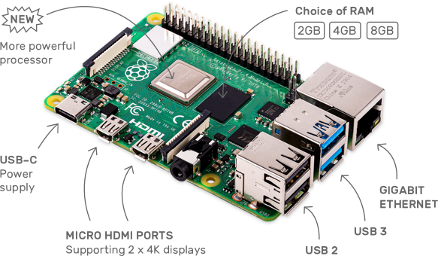
[Source: goole/imageBasic/raspberry-pi-3-labelled.webp]

Slide 14
7.3 Flow chart of the system
7.3.1 Flow chart of system storing individual detail
Start
Take a photo
Crop The Face
Image processing
Assign Student detail
Store in database
Stop

Slide 15
7.3.2 Flow chart of system recognizing student detail
Start
Take a photo
Crop The Face
Image processing
Match with student detail
YES
Take attendance
NO
stop

Slide 16
7.3.3 Face Recognition system have these steps
Collect the
photos
Prepare data sets
Use Algorithm
Get Output
Face Detection: It has the objective of finding the faces (location and size) in an image and probably extract them to be used by the face recognition algorithm.
Face Recognition: With the facial images already extracted, cropped, resized and usually converted to grayscale, the face recognition algorithm is responsible for finding characteristics which best describe the image.
Region of Interest (ROI): ROI is a region of image which is interesting and allowed to process only on it. The concept about ROI is a kind of local search and a very useful tool to reduce computation and increase object hit rate

Slide 17
7.4 ALGORITHM USED IN THE PROJECT
7.4.1 Local Binary Patterns Histograms
LBPH is a simple yet very efficient texture operator which labels the pixels of an image by thresholding the neighbourhood of each pixel and considers the result as a binary number. Local Binary Pattern Histogram summarize the local structure in an image by comparing each pixel with its neighbourhood. It takes a pixel as centre and threshold its neighbours against. If the intensity of the centre pixel is greater-equal its neighbour, then denote it with 1 and 0 if not.

Slide 18
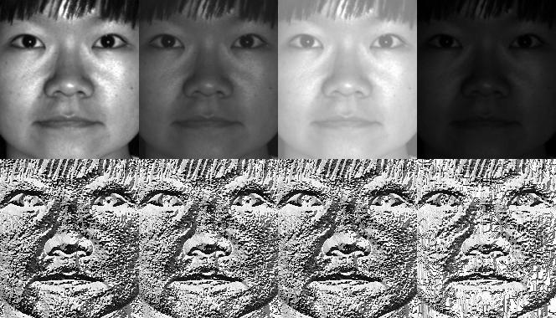
[source: www.google/image/lbph.com]

Slide 19
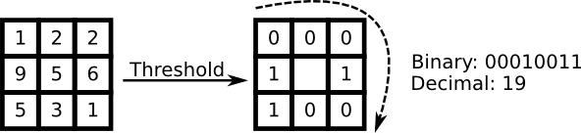
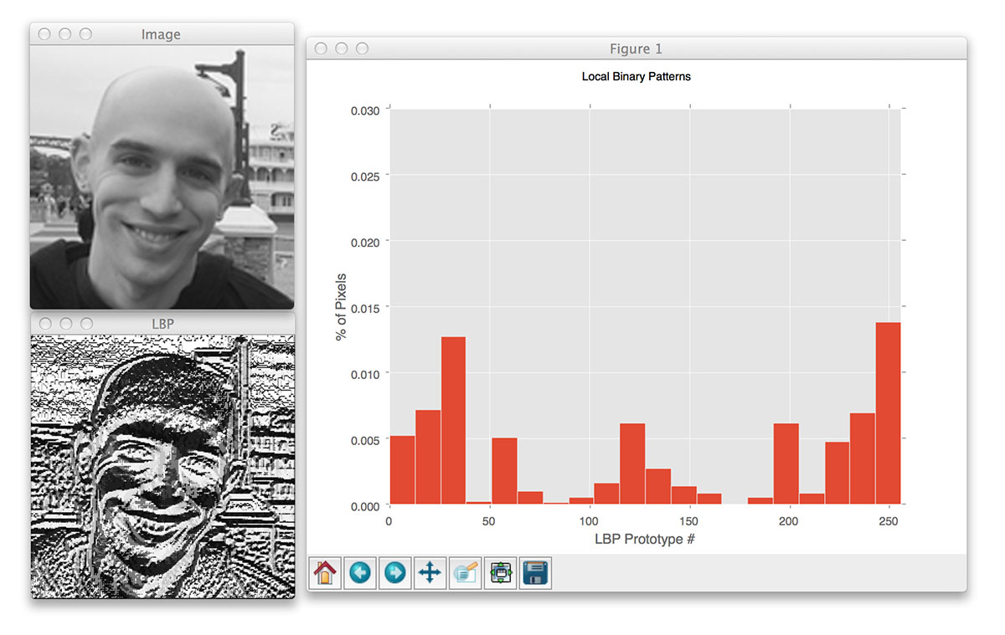
[source: www.google/images/output_lbph/man.com]

Slide 20
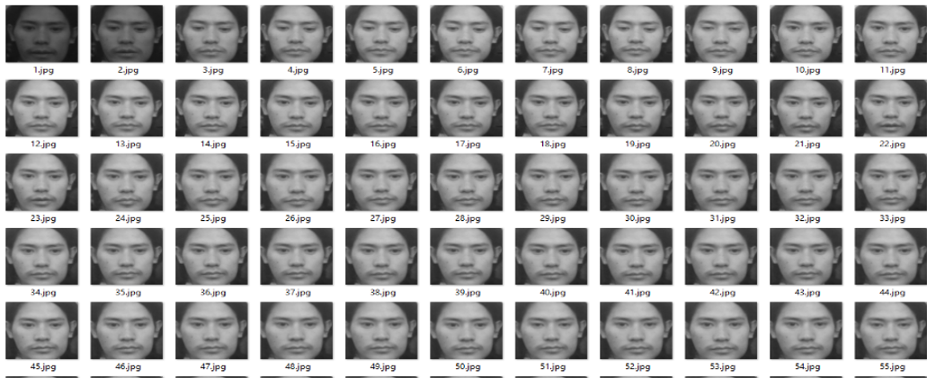
8.Results and Discussion
A. Capturing the images of students using web-cam
Here, when the student is faced toward the camera module-web-cam. The module captures 100 photos in total and trains the dataset to fill up the student detail for the further purpose of taking the attendance.

Slide 21
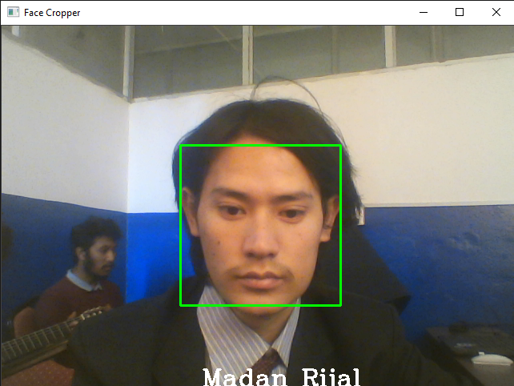
B. Detection of the faces of students using local binary pattern histogram algorithm
Local Pattern Binary Histogram algorithm is used to detect the face of student from the present datasets and display their name on the screen as to indicate the identification of student and creates a .CSV file

Slide 22
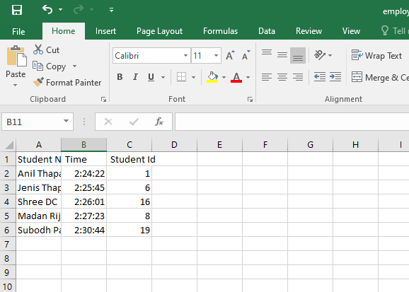
C. Result for displaying attendance
The CSV file from the algorithm is then load in the MS-Excel sheet to view the details of students like name, roll number and the date.

Slide 23
10.CONCLUSION
During the completion of this project we studied and got knowledge about the processor like raspberry pi, pi camera module & different software like visual studio python, Raspbian OS.
The project was completed and we were able to capture the images of students using web-cam, detect the faces of students using linear binary pattern histogram algorithm and finally prepare the student details such as name, roll no. and date in MS-excel file.

Slide 24
11.Limitations
This system is limited to few students dataset.
The data is registered only on MS-Excel sheet.

Slide 25
12.Future enhancement
The details of multiple student a time can be taken.
Real time security can be added.
The web-server can be used.

Slide 26
13.REFERENCES
[1]T. Fac, A. Keroh and S. Malaysia, "RFID based attendance system," 2009.
[2]T. Usagawa, N. Yuhei and C. Yoshifumi , "attendance management systen for moodle using student identification card and android device," 2014.
[3]L. Quan-Xi and L. Gang M, "An Efficient Automatic Attendance System using fingerprint Reconstruction," International journal of computer science and information technology.

Slide 27
[4]K. R.Yamamoto and P. G. Flikemma, "RFID-Based Students Attendance Management," International journal of scientific and research center, 2011.
[5]U. E. peter and N. Owerri , "Opera biometric based attendance system with remote real time monitoring," 2013.
[6]"Design and implementation of iris based attendance management system electrical engineering and information communication technologies," 2015.
[7] "Automated attendance management system based on face recognization algorithm computational intelligence and computing research," in international conference , 2013.

Slide 28
[8] Y.-M. Lu, N. Kaohsiung and . L. Bin-Yih, "A face recognizing algorithm decreasing the illuminating effect intelligent information hiding and multimedia signal processing," 2008.

Slide 29
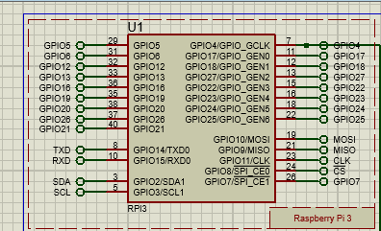
APPENDICES
Fig: stimulation of raspberry pi3

Slide 30
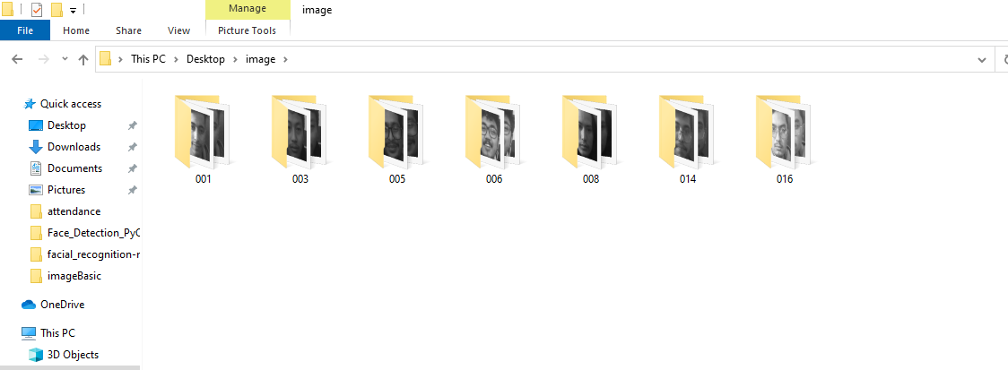
Figure : Different dataset of the student

Slide 31
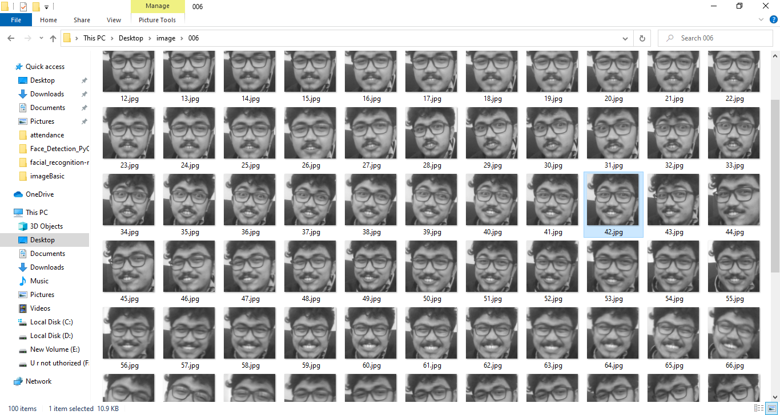
Figure :capturing the images of student using web-cam

Slide 32
THANK YOU

