Slide 1
Pathfinder
by – divyanshu, garvit, madan, manvik

Slide 2



Slide 3



Slide 4


Slide 5


Slide 6
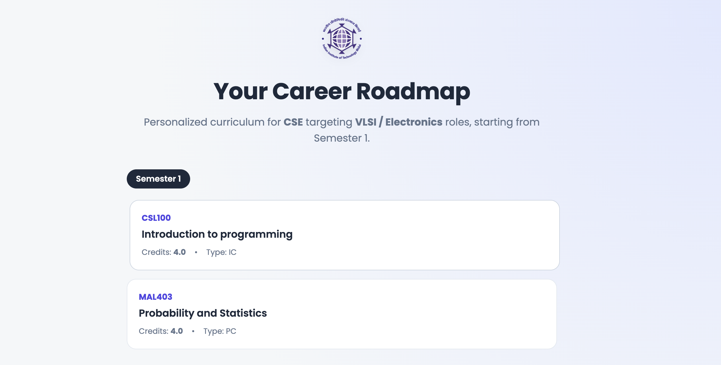

Slide 7
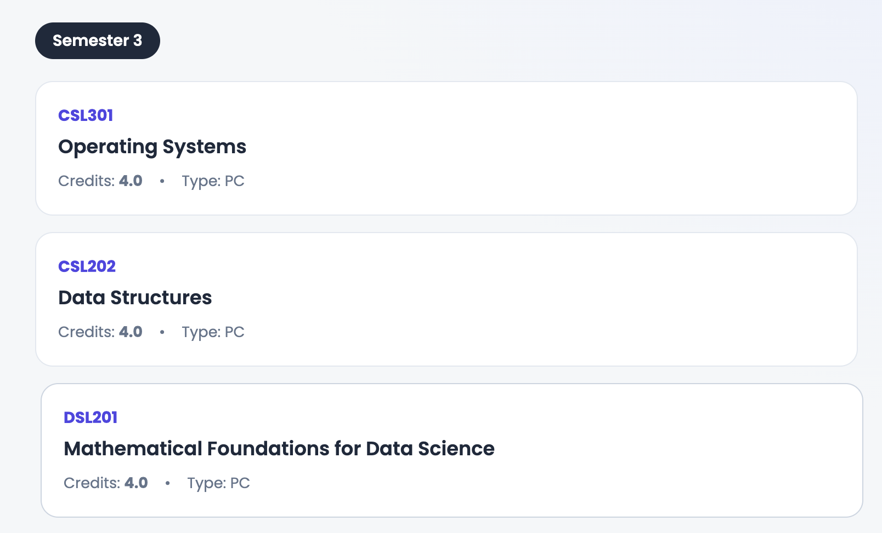

Slide 8


Slide 9
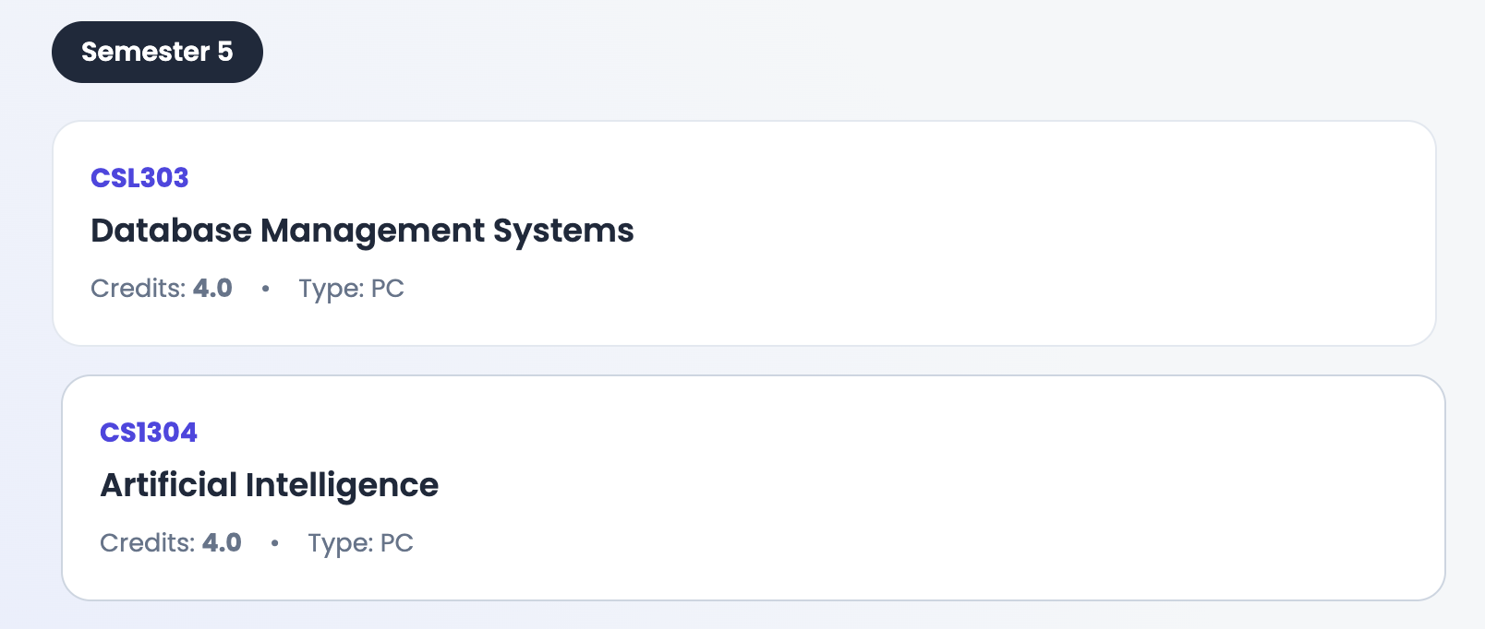

Slide 10


