Slide 1
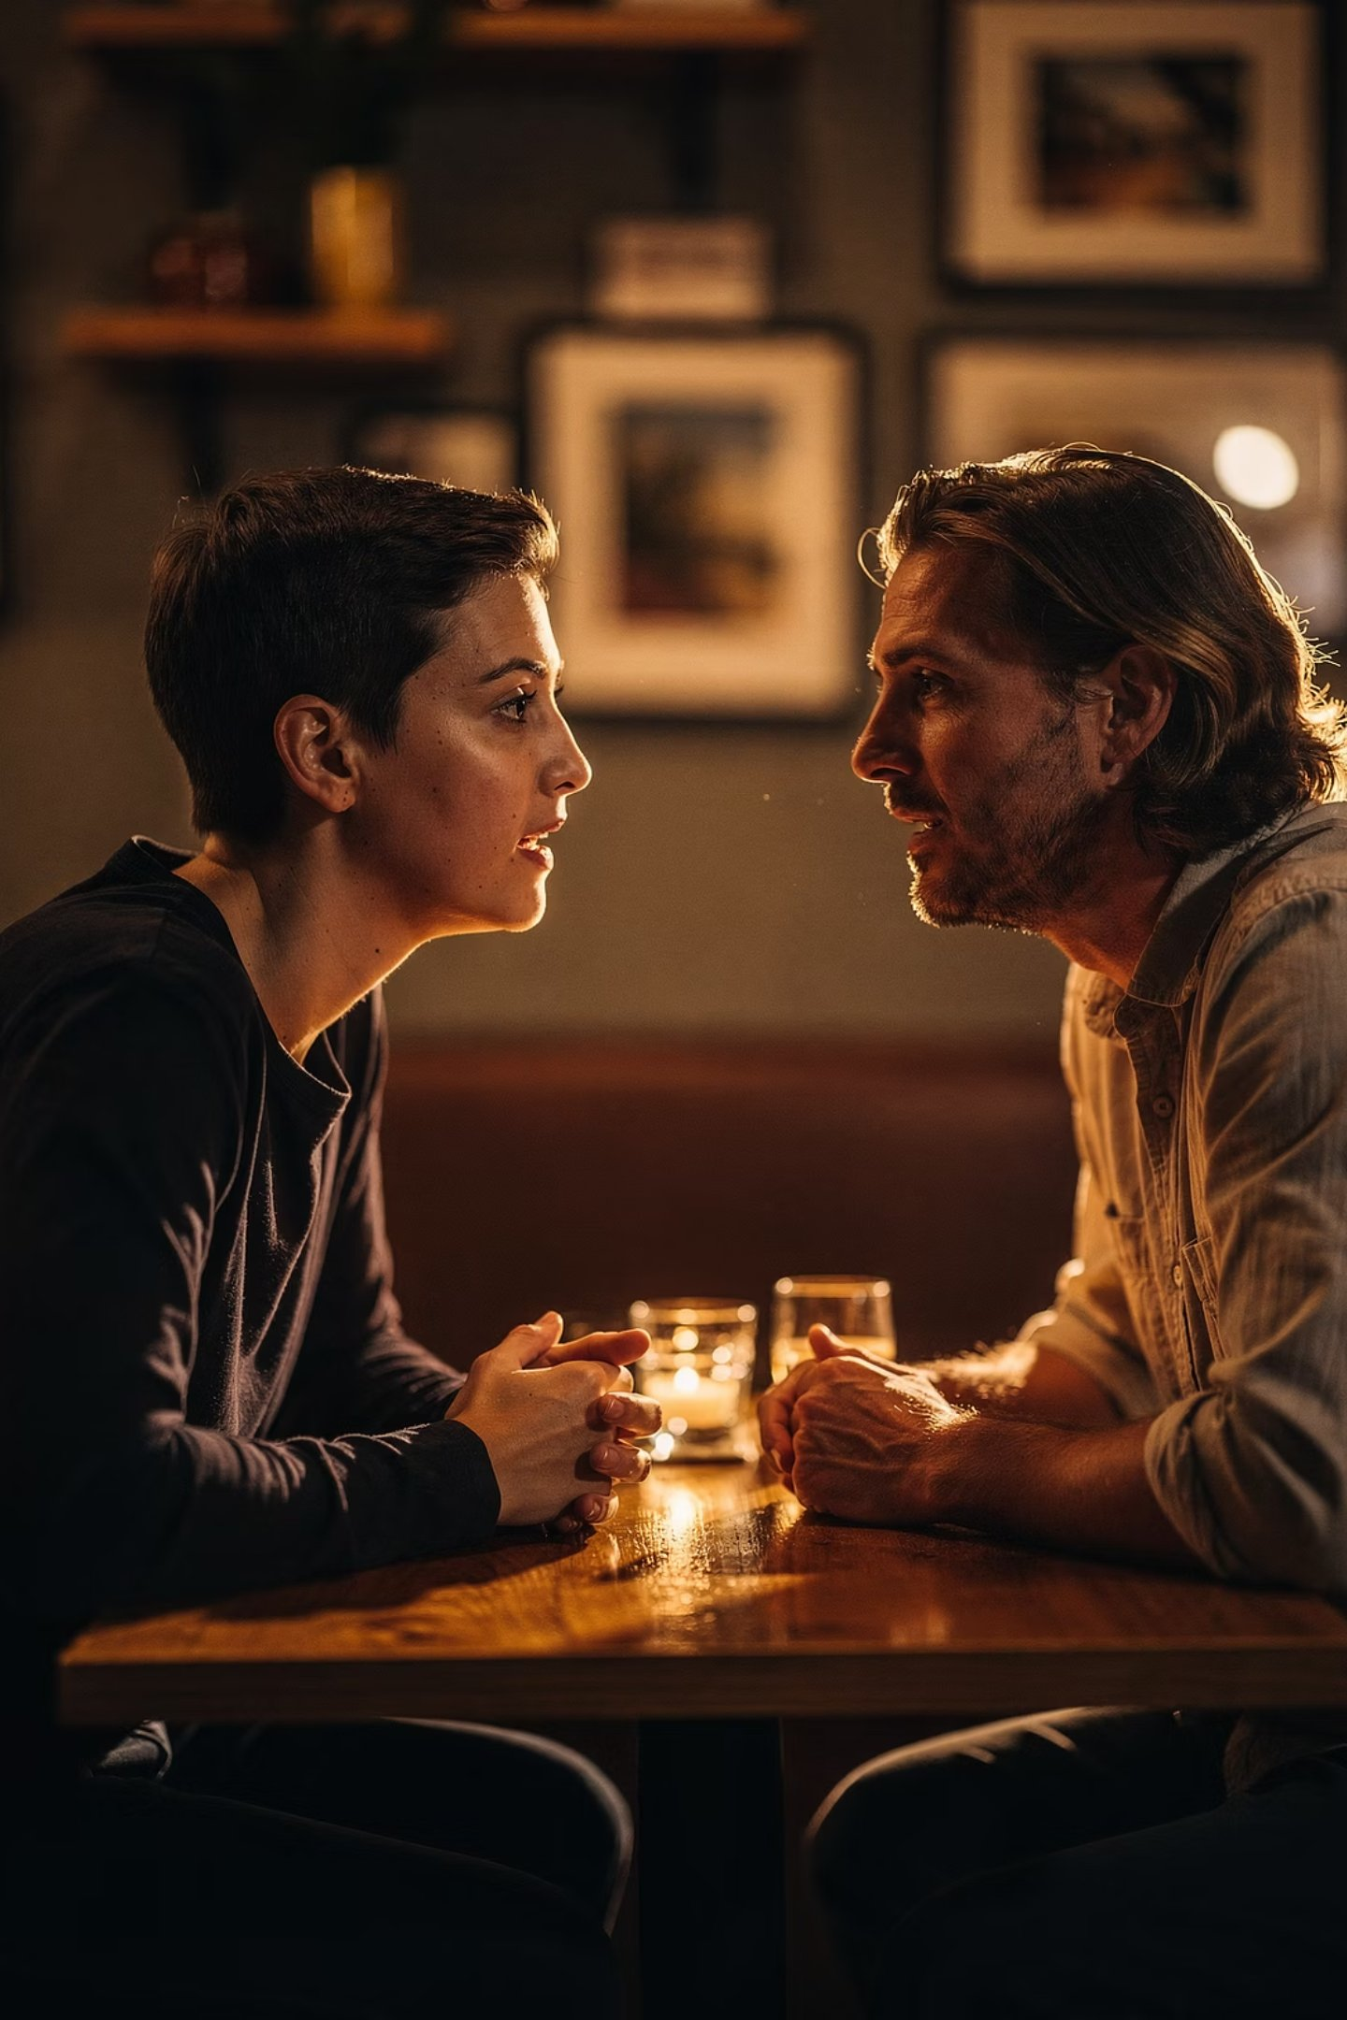
Breaking Mental Models
A podcast that calls out the elephant in the room — honest, unfiltered conversations about the things that shape us, challenge us, and quietly run our lives.
YOUR PODCAST CHANNEL

Slide 2
What This Is
We Say the Thing Nobody Else Will
Every room has one. The thing everyone notices but nobody names. The assumption everyone holds but nobody questions. The conversation that keeps getting postponed because it feels too uncomfortable, too risky, or too raw.
This isn't a polished talking-head show. There's no rigid script, no rehearsed answers, no safe corporate takes. Just two people sitting down and going somewhere real — wherever the conversation needs to go.
Breaking Mental Models is where we finally have it.
Topics range from the deeply personal to the broadly social. From career and identity to education, relationships, mental health, and the invisible structures that quietly run our lives.

Slide 3

The Philosophy
The Environment Shapes the Person — Is it also the Other Way Around?
Most of us believe we control our outcomes through willpower and discipline. But what if the container matters more than the contents? What if changing your circumstances is the most powerful thing you can do — and everything else is just noise?
That's the lens we bring to every conversation on this channel.

Slide 4
Featured Episode
Memoirs to Millions — A Conversation with Asher Wright
The Setup
The Guest
Recorded
Two men who left home at 18. One joined the U.S. Army for 22 years. The other crossed four countries collecting degrees and building education systems. Both landed in the same place: the environment shapes the person, not the other way around.
Asher Wright — Army veteran, educator, and host of the Memoirs to Millions podcast — invited me onto his show for a conversation about gap years, identity, structure, and what it means to truly live with awareness. This episode is now part of the Breaking Mental Models channel.
Thursday, 2 April 2026 | 4:30 PM ET — Originally broadcast on Memoirs to Millions. Shared here because the conversation was too important not to amplify.

Slide 5

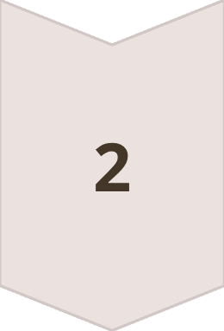
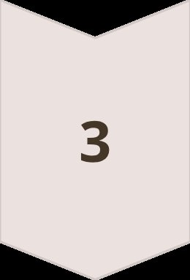
Memoirs to Millions × Breaking Mental Models
Three Anchors. One Real Conversation.
Anchor 1 — Ice & Water
Neither ice nor water has agency. The environment creates the change. So what does a gap year need to look like to actually shift the environment — rather than just pause it?
Anchor 2 — When Structure Disappears
After 22 years in the military, Asher took a sabbatical — and the emotions he'd been outrunning for decades caught up. We explore what happens in that first moment when the scaffolding falls away.
Anchor 3 — Time On, Not Time Off
Awareness is the elixir of life. Most people treat a gap year as time off. We ask: how does it become time on? And what does that distinction cost you if you get it wrong?

Slide 6
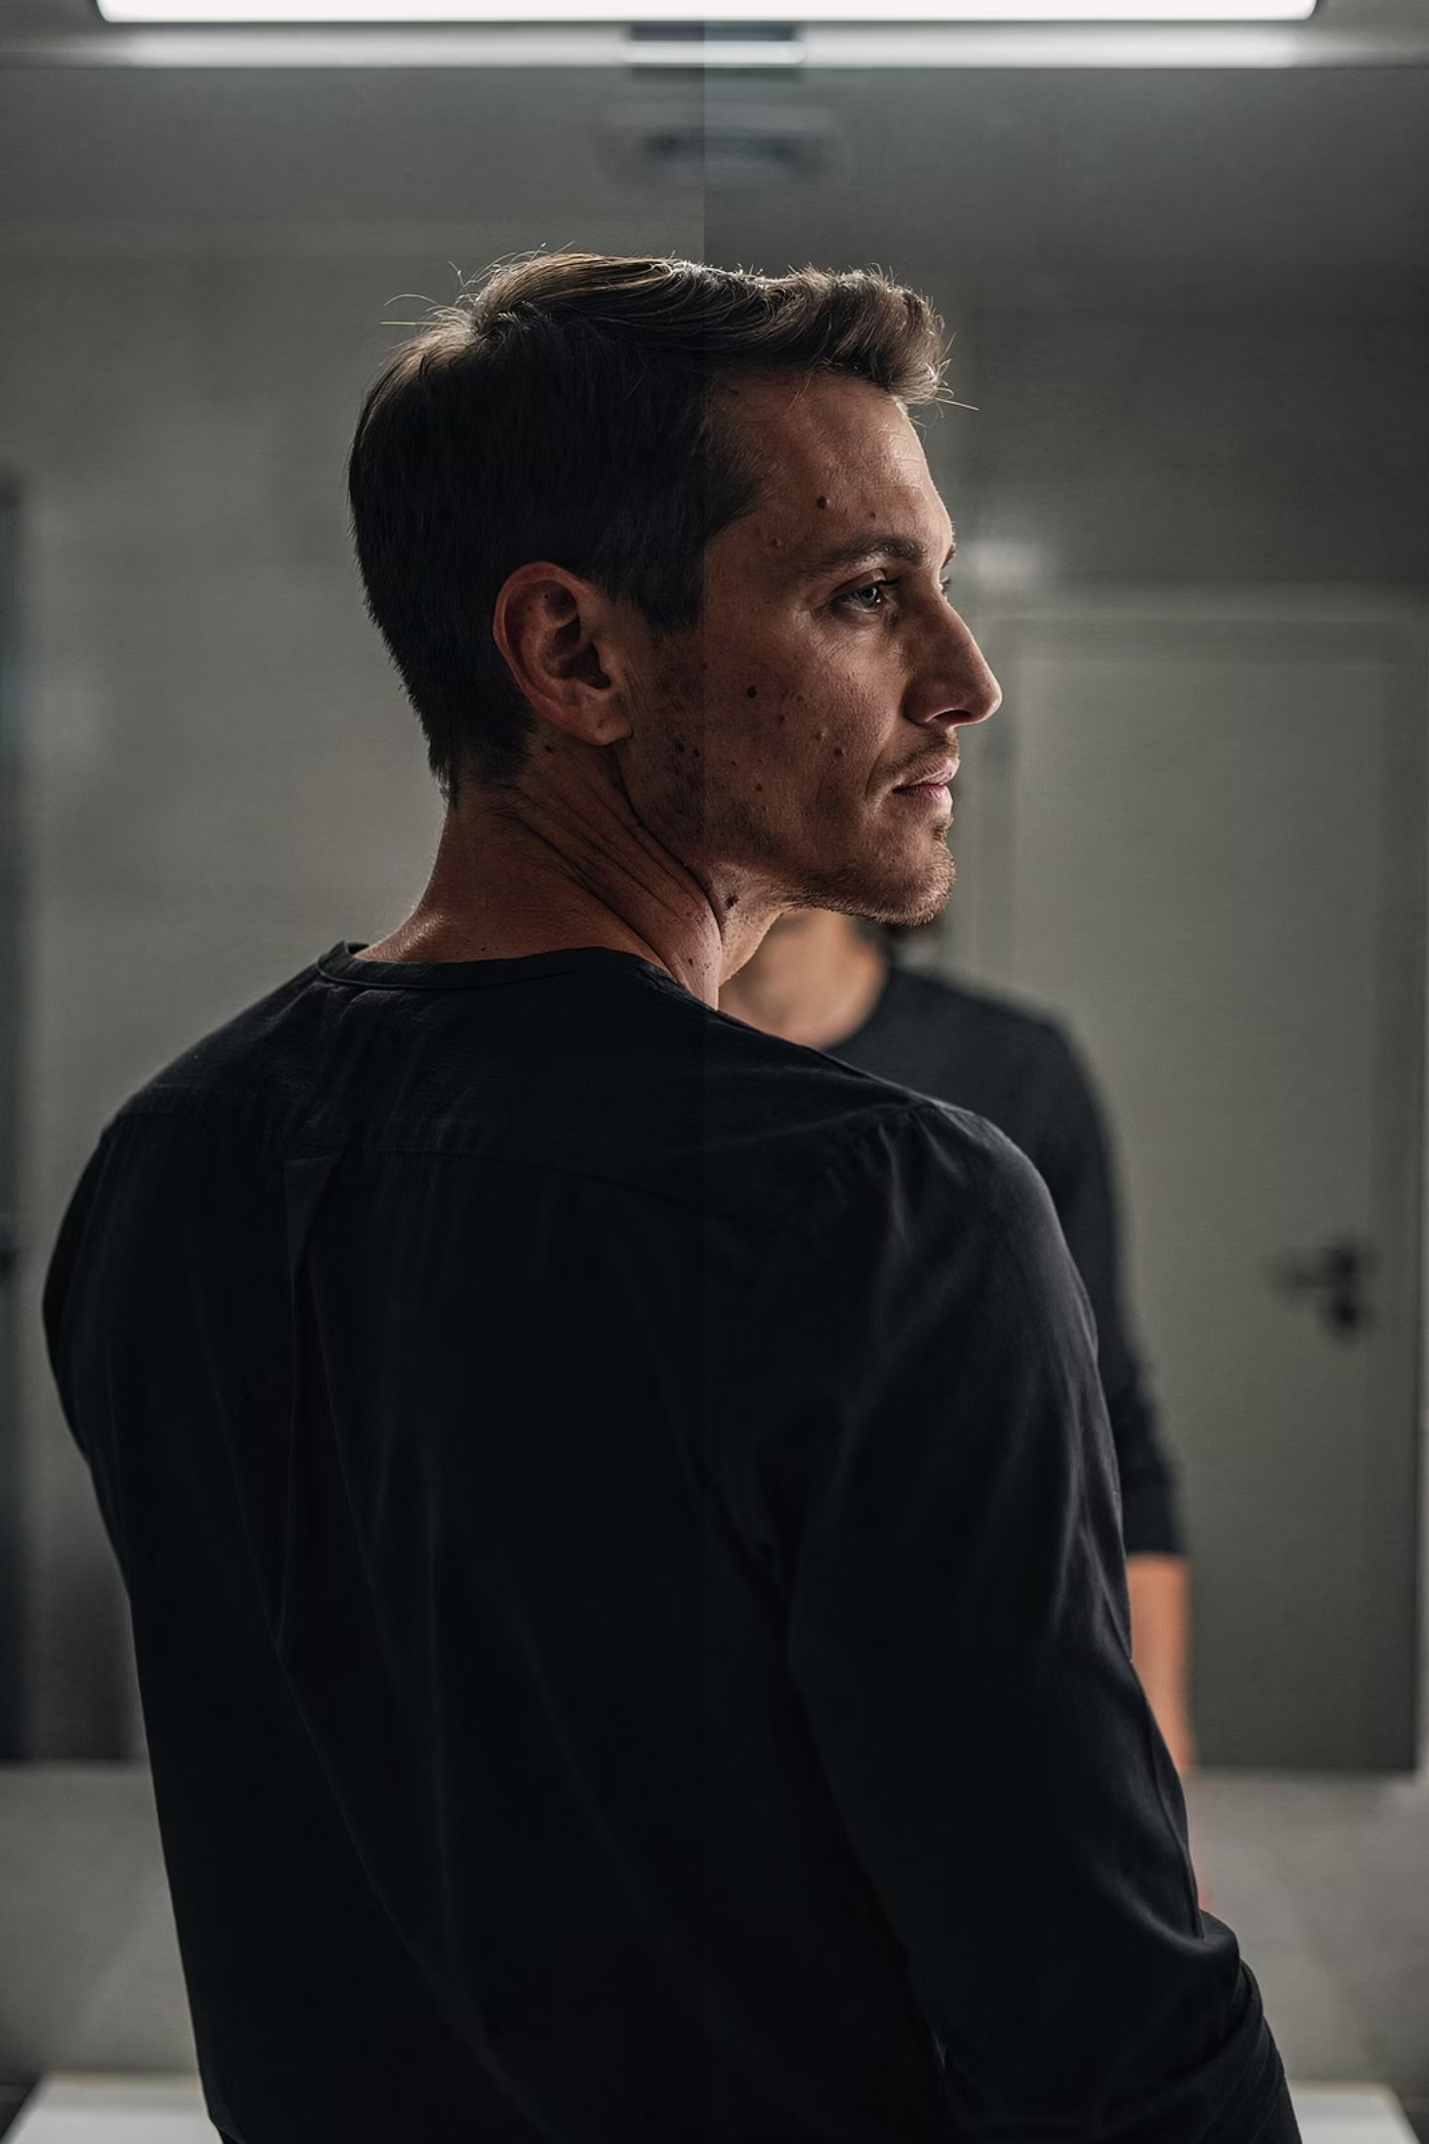
From the Memoirs to Millions Conversation
The Questions That Went Somewhere Unexpected
Front Stage vs Backstage
Who Are You Being a Hero To?
What do people see on the outside — and what is actually happening behind the scenes?
Not in the abstract. Right now. Specifically. Who needs your best version — and are they getting it?
Two Versions of You
The version of you that stayed after the hard parts — versus the version you built for other people. Which one shows up most?

Slide 7
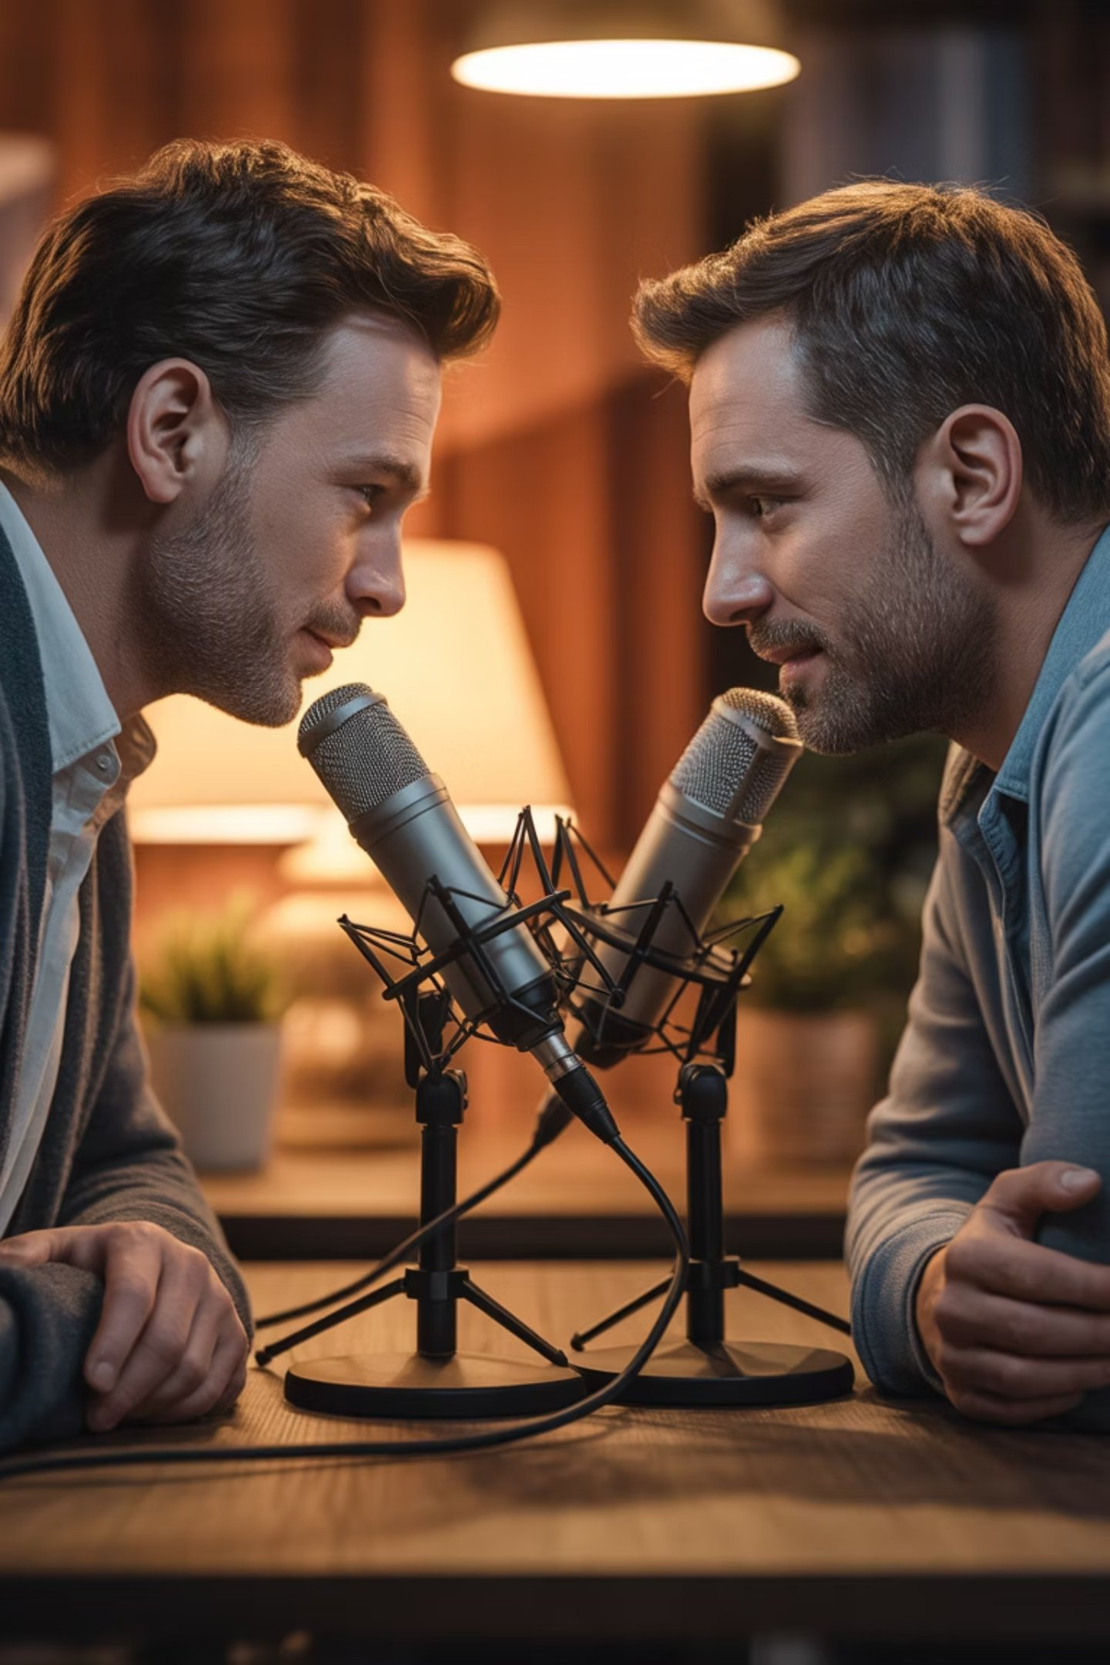
🎙 Episode 01 — Now Live
Memoirs to Millions × Breaking Mental Models
▶ Listen to the Full Episode
[Link coming — paste your episode URL here]
Recorded: Thursday, 2 April 2026 | 4:30 PM ET
Item 1 — The Guest
Item 2 — The Setup
Asher Wright — Army veteran, educator, and host of the Memoirs to Millions podcast. 22 years of military service. A man who knows what it means when the structure that defined you suddenly disappears.
Two men who left home at 18. One joined the U.S. Army. The other crossed four countries collecting degrees and building education systems. Both arrived at the same conclusion: the environment shapes the person — not the other way around.
Item 3 — What We Explored
Item 4 — The Questions That Went Somewhere
Ice & Water — neither has agency; the environment creates the change. What a gap year really needs to look like to shift the environment, not just pause it. What happens when the scaffolding of 22 years falls away overnight. Awareness as the elixir of life — and what it costs you to miss it.
Front Stage vs Backstage — what people see vs what's actually happening. Who are you being a hero to — right now, specifically? The version of you that stayed after the hard parts vs the version built for other people.
Originally broadcast on Memoirs to Millions. Shared here because the conversation was too important not to amplify.

Slide 8
🎧 All Episodes
The Breaking Mental Models Episode Library
Every conversation lives here. One completed, more on the way. Each episode is a different question, a different guest, a different model waiting to be broken. Bookmark this page — it grows.
✅ EP 01 — Memoirs to Millions
🔜 EP 02 — The Gap Year Episode
🔜 EP 03 — Open Conversation
Guest: Asher Wright | Recorded: 2 April 2026
Guest: TBC | Coming Soon
Guest: TBC | In Planning
Ice, water, and the environments that shape us. 22 years of military structure meets a lifetime of crossing worlds.
What 10,000 students taught me about the moment structure disappears — and what you build, or don't, in its place.
A guest from a completely different world. Real topic. No agenda. Just the conversation that needed to happen.
▶ [Paste episode link here]
🔗 [Link will appear when live]
🔗 [Link will appear when live]
🔜 EP 04 — [Your Title Here]
🔜 EP 05 — [Your Title Here]
🎙 Your Episode
Guest: TBC | In Planning
Guest: TBC | In Planning
Got something worth saying? A question you can't stop circling? A belief you're not sure you believe anymore?
The question we haven't named yet. The guest we haven't met yet. The model we haven't broken yet.
Another seat at the table. Another assumption up for examination.
🔗 [Link will appear when live]
→ Get in touch and let's build it together.
🔗 [Link will appear when live]
🔗 [Contact/booking link here]

Slide 9




What's Coming
The Conversations We're Planning to Have
Breaking Mental Models isn't a niche show. It's a broad, honest exploration of the patterns, pressures, and pivots that define modern life. Here's a taste of the territory we'll be covering.
Mental Health & Identity
Education & Transition
The stories we tell ourselves about who we are — and what it takes to rewrite them without losing the plot entirely.
From school to university, career to sabbatical — what happens when the structure you relied on suddenly vanishes?
Relationships & Belonging
Purpose & Work
The conversations couples, families, and friends avoid. The things left unsaid that quietly do the most damage.
What does it actually mean to add value to the world — and how do you know when you've found your lane?

Slide 10

Who We Talk To
Interesting People With Something Real to Say
No requirement for a blue tick or a bestselling book. The only qualification is that you've lived something, learned something, or questioned something — and you're willing to say it out loud without the safety net of a rehearsed answer.
Guests come from all walks of life: educators, veterans, entrepreneurs, parents, artists, change-makers, and people who've simply been through it and come out the other side with something worth sharing.

Slide 11
Not a Niche — A Philosophy
Exclusive to Everyone. Open to All.
What "Breaking Mental Models" Means
Why This Matters Now
A mental model is the invisible framework you use to interpret the world. Most of us inherited ours — from family, school, culture, trauma. We rarely chose them consciously.
We live in an era of relentless certainty — everyone broadcasting their answers. This podcast asks different questions instead. It slows down. It sits with the discomfort. It names the thing in the room that everyone else is quietly stepping around.
Breaking one isn't destruction. It's renovation. It's the work of deciding which maps still serve you — and which ones have been leading you somewhere you never actually wanted to go.
Because that's where the real conversation lives. And that's where change actually starts.

Slide 12
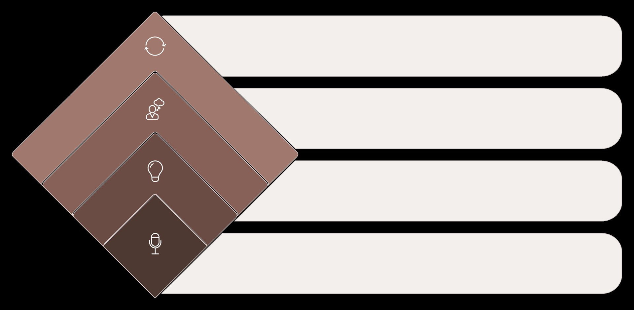




The Format
How Every Episode Is Built
Walk Away Changed
Note shifts after the talk
Sit in Discomfort
Explore what’s beneath the surface
Break the Model
Challenge the usual assumptions
Set the Stage
Provide context and background
Each episode follows a loose but intentional arc — not a script, but a rhythm. We arrive somewhere real because we're willing to not know exactly where we're going.

Slide 13
For Prospective Guests
Want to Come on the Show?
If something is bothering you — a question you can't stop circling, a conversation you wish someone would finally have, a belief you're not sure you believe anymore — this might be your seat at the table.
01
02
03
Reach Out
Pre-Chat
Show Up & Talk
Drop a message sharing what's on your mind. No formal pitch required — just tell us what you'd want to talk about and why it matters to you right now.
We'll have a brief, informal conversation to get a feel for the territory. No prep needed — in fact, the less polished, the better.
We record. No rigid agenda. Three loose anchors and a real conversation. You don't need to have all the answers — you just need to be willing to be honest.

Slide 14
The One Rule
Be honest or don't bother.
That's it. That's the whole brief. No brand management. No messaging. No staying on script. Just two humans sitting with a hard question and refusing to take the easy exit.

Slide 15
Topics That Need a Conversation
The Elephant List
These are the kinds of conversations Breaking Mental Models was built for. The ones that keep getting postponed, politely sidestepped, or dressed up in language that softens the edges too much.
1
2
Parenting & Pressure
Success & Emptiness
Are we raising children or managing our own anxiety? What we never say about how hard it actually is.
You did everything right. Got the job, the house, the title. So why does something still feel hollow?
3
4
Belonging vs Assimilation
Grief That Has No Name
How much of yourself do you quietly edit to fit in — and what does that cost you over time?
The losses that don't come with a funeral. A version of yourself. A future you had planned. A relationship that ended without closure.

Slide 16

On Awareness
"Awareness is the elixir of life. Most people treat a gap year as time off. The question is — how does it become time on?"
This question — from the Memoirs to Millions conversation — captures everything this podcast is trying to do. Slow down enough to notice. Notice enough to choose. Choose enough to actually change.

Slide 17

Why Breaking Mental Models Matters
This Isn't Just a Podcast. It's a Mirror.
Most of us are living inside frameworks we never chose. The beliefs handed to us by family, culture, institutions, and circumstance. We don't question them — not because they're right, but because questioning them is uncomfortable. Breaking Mental Models exists to make that discomfort productive.
This is not a talk show. It's not an interview. It's a conversation designed to do one thing: help you hear yourself think. When you listen to someone else wrestle with a belief they've held for decades — and watch them crack it open in real time — something shifts in you too.
What Makes This Different
We don't come with answers. We come with questions.
We don't perform certainty. We sit with doubt.
We don't stay on script. We follow the truth wherever it leads.
Every episode is an invitation to question one thing you've stopped questioning.

Slide 18




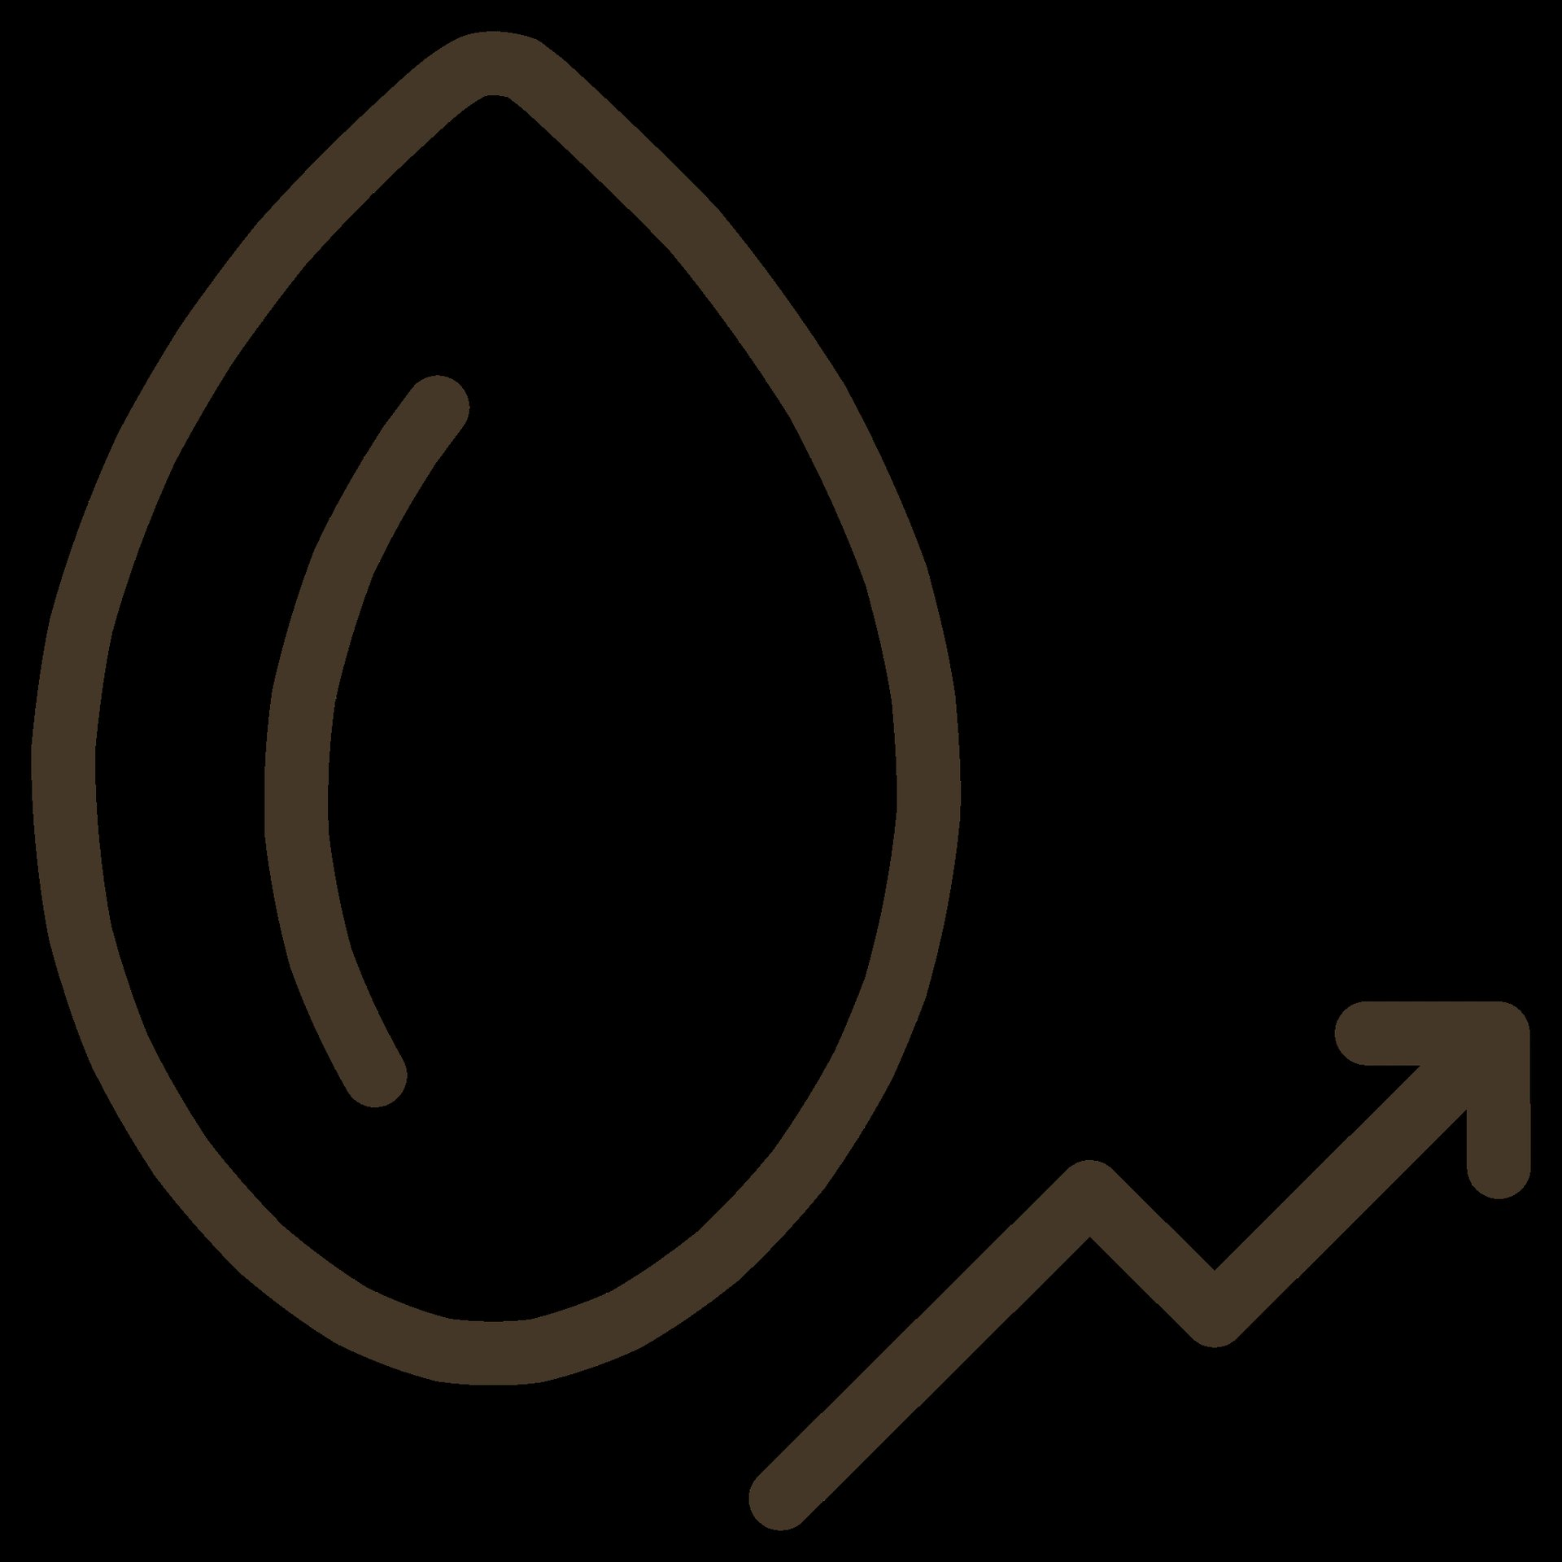
What This Podcast Does For You
You Don't Know What You Think Until You Say It Out Loud.
Most of us have never been given permission to question the assumptions we live by. Not the big philosophical ones — the quiet, everyday ones. The ones that decide how you treat yourself, what you believe you deserve, what you think is possible. Breaking Mental Models is a space to do exactly that.
You Hear Yourself Think
Most of us don't know what we actually believe until we're forced to articulate it. This podcast creates that moment — not for the guest alone, but for you, listening. When someone else names the thing you've been circling, something unlocks.
You Question What You've Settled For
We all have barriers we've stopped fighting. Not because they're right — but because we got tired. This show asks: what if you hadn't? What if you picked that question back up and actually looked at it?
You Break the Model
A mental model isn't broken by argument. It's broken by a better question. Every episode is built around the question nobody asked — and what happens when someone finally does.
You Come Back Different
Not fixed. Not resolved. But different. With one thing shifted. One assumption loosened. One conversation you're now ready to have — with someone else, or with yourself.

Slide 19




Episode Themes
What We'll Keep Coming Back To
Structure & Freedom
Crossing Worlds
What happens when the container that defined you — an institution, a career, a relationship — suddenly disappears?
Moving countries, changing careers, switching identities. The cost of becoming someone new while carrying who you were.
Inherited Beliefs
Performance vs Presence
The models you didn't choose but live by anyway. Where they came from. Whether they still serve you. What replacing them actually feels like.
The gap between who you perform for the world and who actually shows up when nobody's watching.

Slide 20

The Community
Not a Broadcast — A Conversation
Breaking Mental Models is built on the belief that the listener isn't passive. If an episode sparks something in you — a question, a pushback, a story of your own — that's the point. Reach out. Challenge it. Build on it. Tell us what we missed or got wrong.
This channel belongs to everyone willing to engage honestly. That's the only membership requirement.

Slide 21
Coming Up
Episodes in the Pipeline
April 2026
Memoirs to Millions — The conversation with Asher Wright. Ice, water, and the environments that shape us. Now live on Breaking Mental Models.
Coming Soon
The Gap Year Episode — What 10,000 students taught me about the moment structure disappears and what you build — or don't — in its place.
In Planning
Open Conversations — Episodes with guests from all walks of life. Real topics. No agenda. Just the conversation that needed to happen.
Your Episode
This could be yours. If you've got something worth saying — or something that's been bothering you — get in touch and let's build it together.

Slide 22
Join the Conversation
The Seat Is Open. Come and Sit in It.
For Listeners
For Potential Guests
Subscribe, follow, and share the episodes that hit close to home. Leave a review if something shifted for you. And if an episode makes you think of someone who needs to hear it — send it to them. That's how this grows.
You don't need credentials. You need a real question and the willingness to sit with it on record. If something is bothering you — personally, professionally, philosophically — that's a starting point. Reach out and let's figure out if there's an episode in it.
This podcast is not inclusive — it's exclusive to all. Meaning everyone's welcome, but comfort zones are not.

Slide 23

Breaking Mental Models
Say the Thing. Have the Conversation. Break the Model.
🎙 Listen
📩 Pitch Your Conversation
🔁 Share
Start with the Memoirs to Millions episode. Let it sit. Then come back for more.
Something bothering you? A question you can't stop asking? Reach out. Let's talk about it on record.
If an episode resonates, send it to one person who needs it. That's the whole growth strategy.
Breaking Mental Models is open to guests, listeners, and anyone with a real question and the willingness to ask it out loud. No gatekeeping. No green rooms. Just honest conversation.

