Slide 1
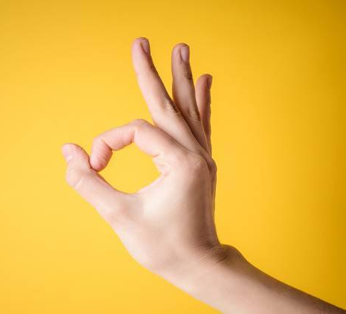
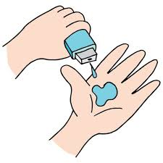
Madan
Final Project
AI sign language project

Slide 2
AI sign language Recognition Tensorflow Object detection OpenCV Keras

Slide 3

AGENDA
The world is hardly live without communication, no matter whether it is in the form of texture, voice, or visual expression.
The communication between deaf and dumb people is carried by text and visual expressions.
Hands and facial parts are immensely influential to express the thoughts of humans in confidential communication

Slide 4

PROBLEM STATEMENT
Understanding the exact context of symbolic expressions of deaf and dump people is a challenging job in real life unless it is properly specified

Slide 5
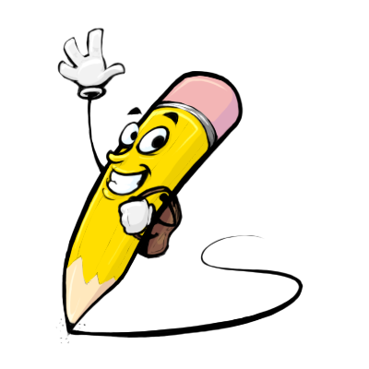
PROJECT OVERVIEW
The overview of this project is to identify the symbolic expression through images so that the communication gap between a normal and hearing-impaired person can be easily bridged

Slide 6

WHO ARE THE END USERS?
Sign Language is a form of communication used primarily by people hard of hearing or deaf.
Sign Language Recognition is a breakthrough in helping deaf-mute people

Slide 7
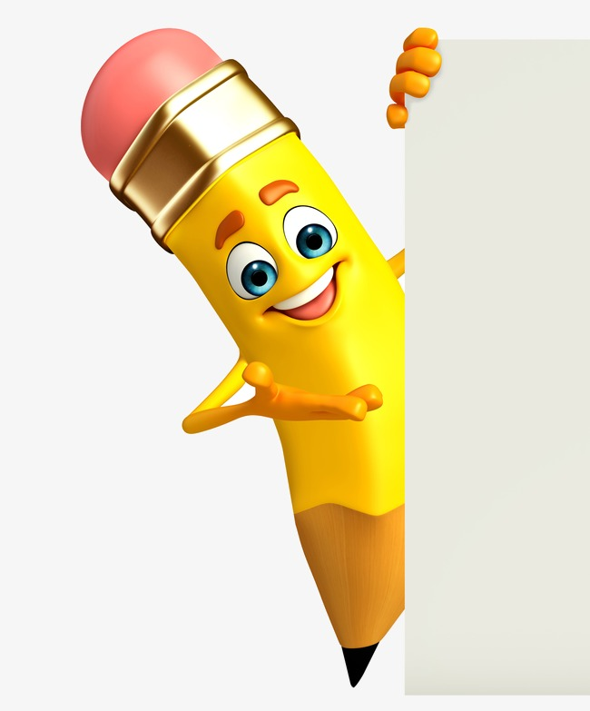
YOUR SOLUTION AND ITS VALUE PROPOSITION
I am using the OpenCV technique
Capture the images dataset with my program
Then send it to the teachable machines
After, downloading its TensorFlow file
Then, test it

Slide 8

THE WOW IN YOUR SOLUTION
In this project, we proposed an idea for feasible communication between the hearing impaired and normal people with the help of deep learning and machine learning approach

Slide 9
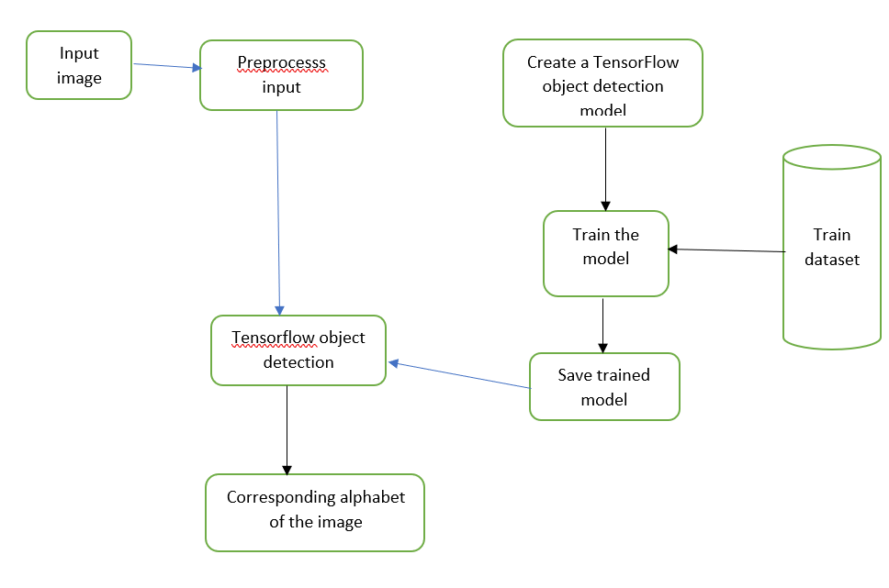
MODELLING
Teams cam add wireframes

Slide 10
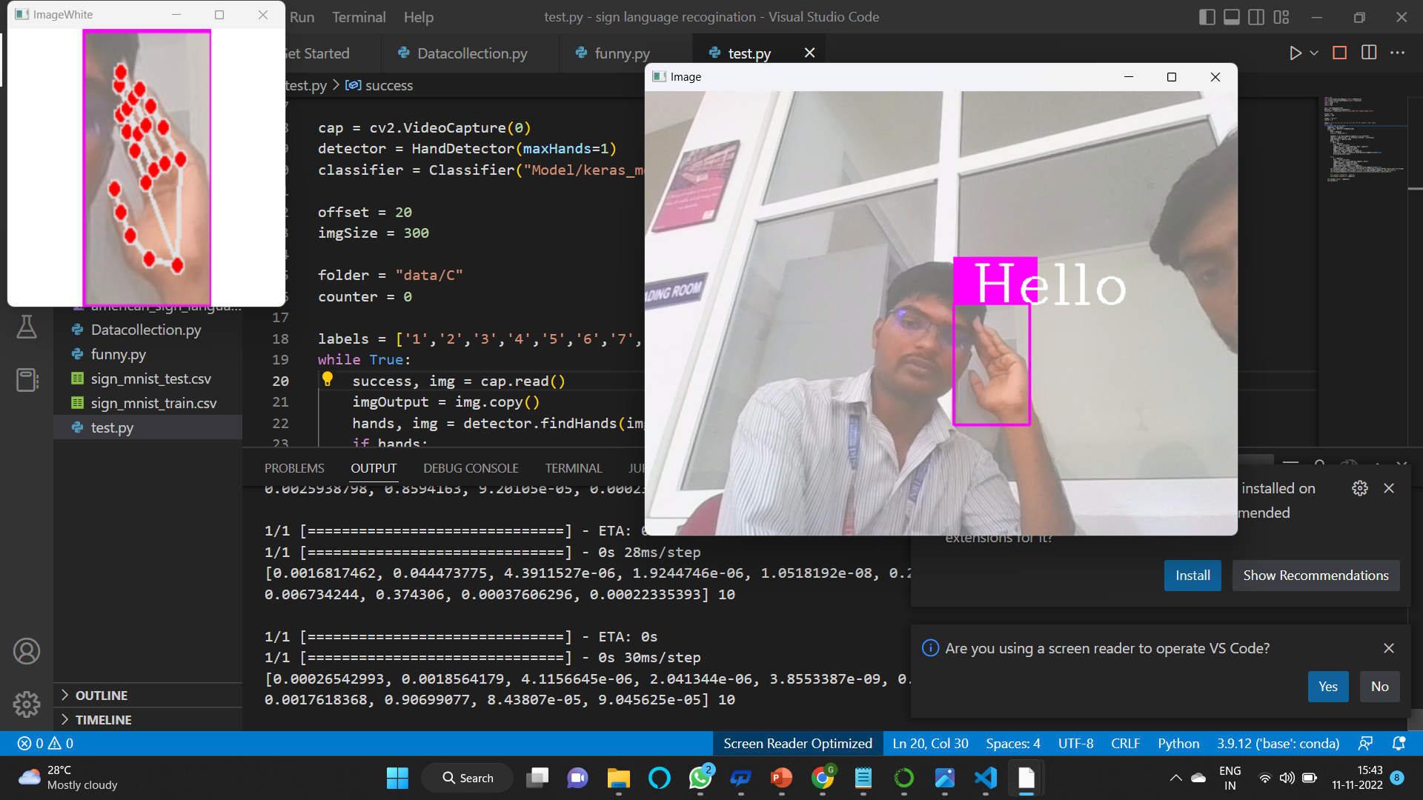
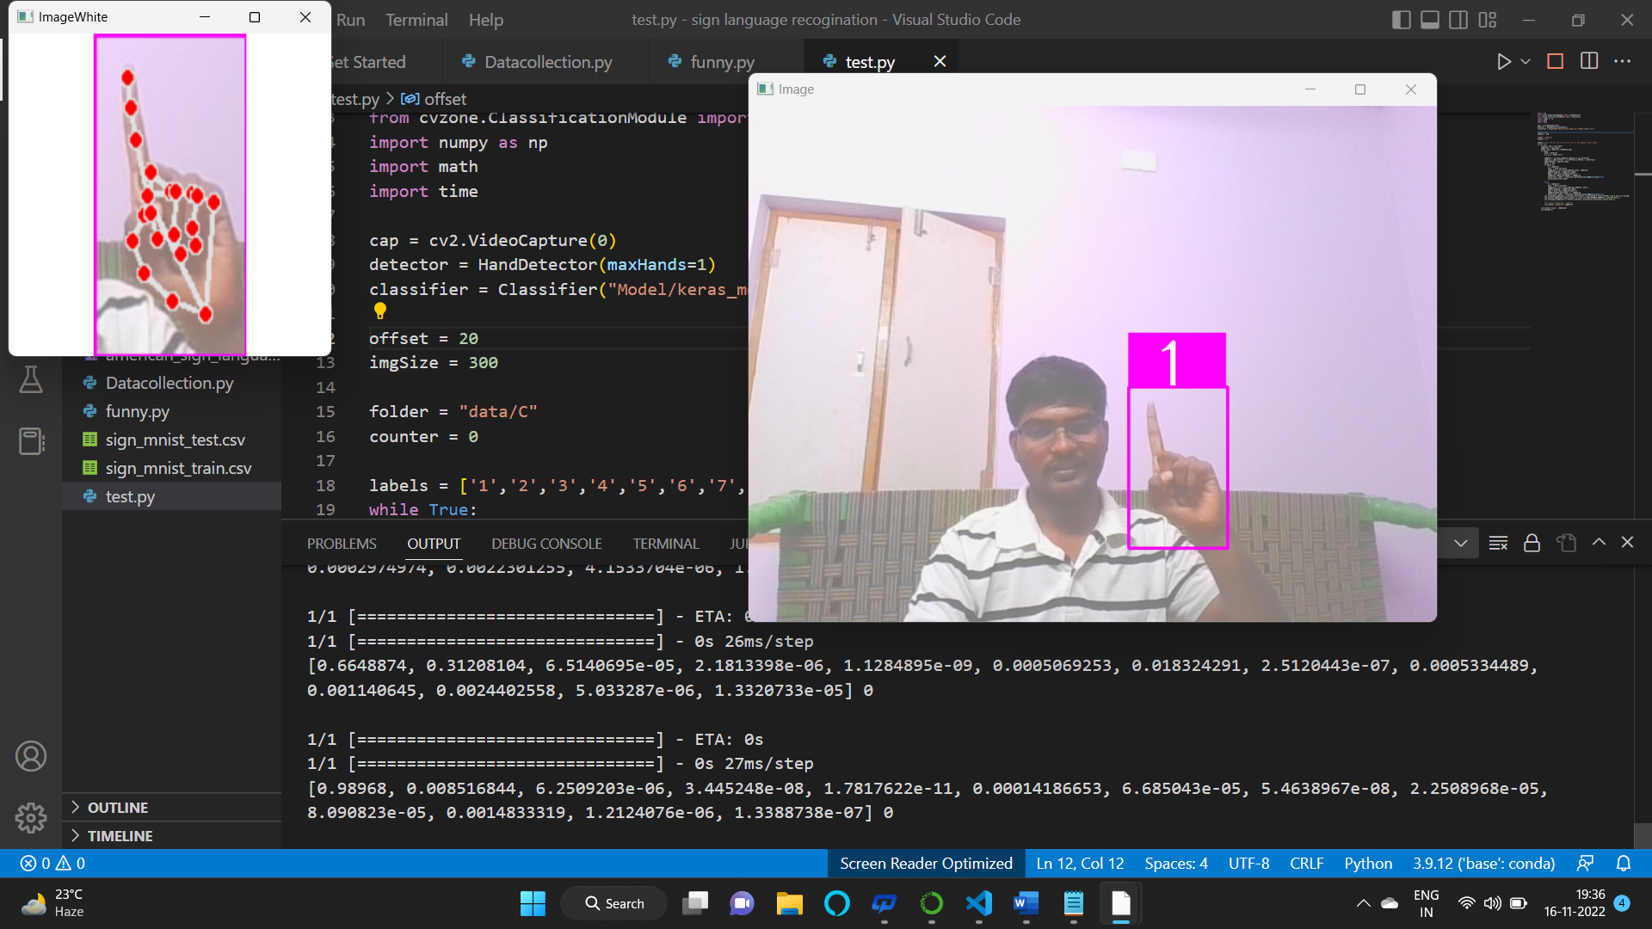
RESULTS
Demo Link

Slide 11
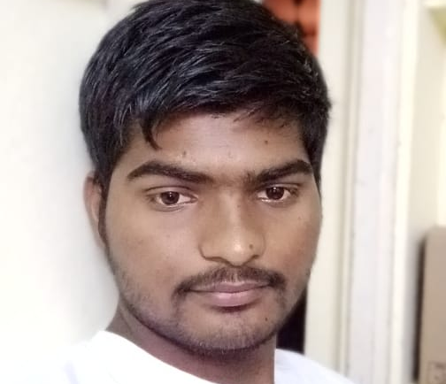
MEET OUR TEAM
GADDIPARTHI MADAN BABU
.
.

