Slide 1



Wholesale Billing Software
Mentor
Ms. M M Ramyasri
By
Madan Raj M A– 22ADR059
Maria Subiksha S – 22ADR063
Abhishek S– 22ADR001

Slide 2
Company Details
Company Name: MK Automations
Company Address: 155/3, S.S.D. Road, Tiruchengode (TK) Pin-637 211. Namakkal (DT), Tamil Nadu.
Mobile No: 9345845122, 9994209406
E-Mail: automationsmk@gmail.com

Slide 3
PROBLEM STATEMENT
To develop a secure, efficient, and user-friendly billing software that streamlines invoicing, payment processing, and financial record management. The software should enhance operational efficiency, ensure accurate billing, and generates accurate GSTs.

Slide 4
OBJECTIVE
Managing invoicing, payments, and financial records efficiently is crucial for organizations. Manual or outdated systems can cause errors, delays, and compliance issues. This project aims to develop a secure, user-friendly billing software that enhances accuracy, streamlines processes, and ensures compliance, and includes an order tracking feature, which gives the client an estimated delivery date of goods.

Slide 5
LITERATURE SURVEY
Authors | Title of the Paper | Journal Name | Year of Publication
Muzhir Al-Ani, Rabah Noory, Yaseen Al-Ani | Billing System Design Based on Internet Environment | International Journal of Advanced Computer Science and Applications (IJACSA) | 2012
Baswaraju Swathi, Abhishek Kumar, Ishu Kumar, Vathsavi Venkat | Implementation of Improved Billing System | International Journal of Scientific Research in Computer Science, Engineering and Information Technology (IJSRCSEIT) | 2020
Fernando Solis Acosta, Diego Julián Pinto | Design and Implementation of An Architecture for Electronic Billing Through Web Services and Mobile Devices | Advances in Intelligent Systems and Computing, Springer | 2020

Slide 6
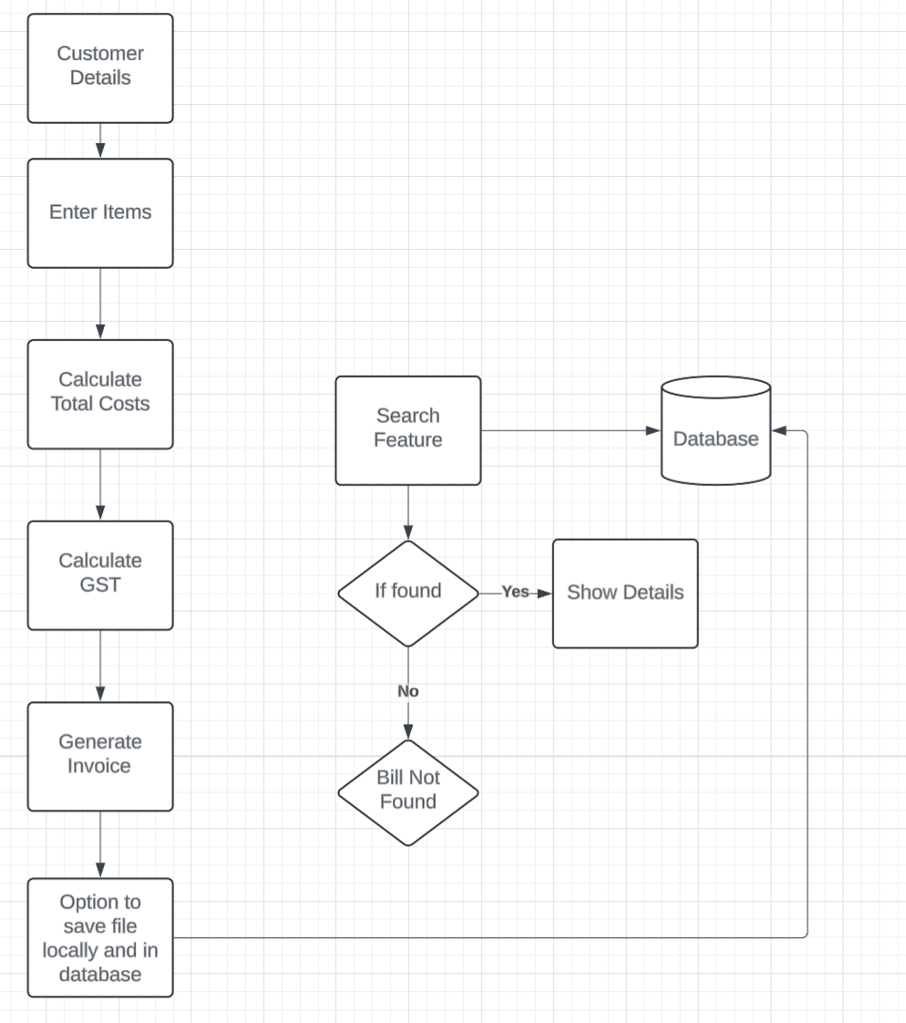
Proposed Work Flow

Slide 7
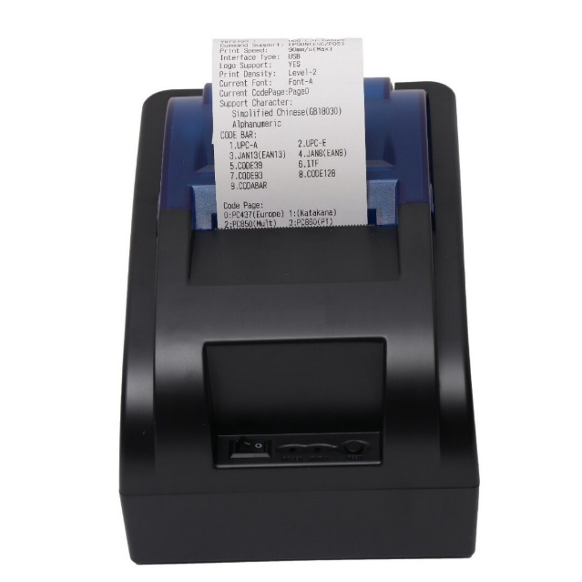
Software and Hardware Requirements
Software:
Python
Tkinter (for GUI)
Firebase (Database Connectivity)
Hardware:
Raspberry Pi
Thermal Printer
3.82 OLED

Slide 8
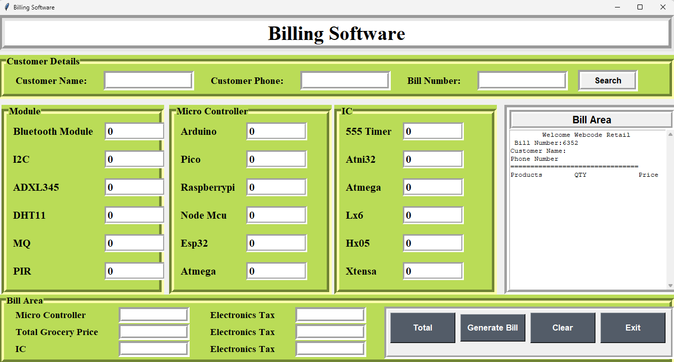
Screenshots

Slide 9
THANK YOU

