Slide 1



Organized by

Slide 2
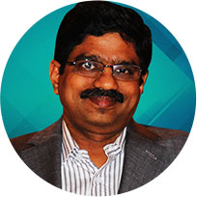
Key Note
Digital
Developer
Trends
P. Srinivasan
Senior VP & Global Head,
Hexaware

Slide 3
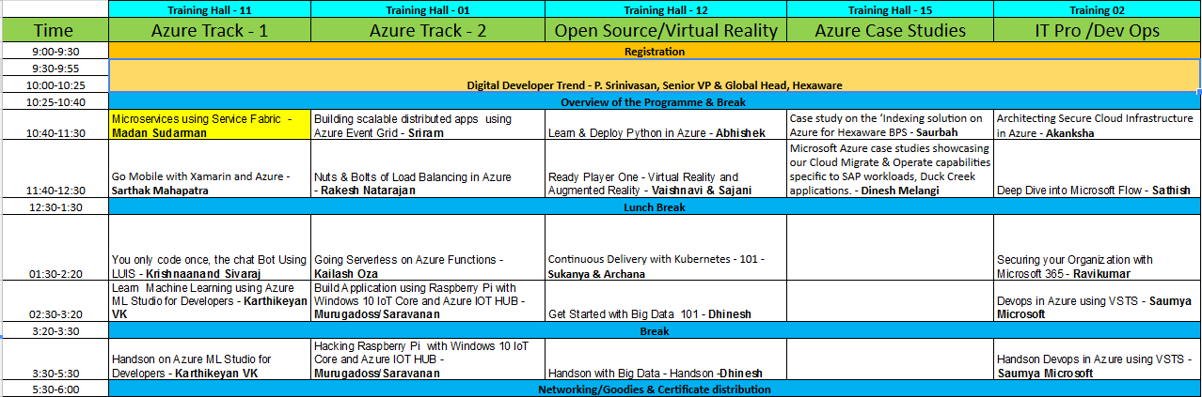
GAB 2018 Agenda

Slide 4
Thanks & Enjoy the rest of the Day!

