Slide 1

Page: 1
Master of Technology in Knowledge Engineering
Unit 1
Intelligent Systems & Techniques for Business Analytics
Exercise & Discussion
Search & Optimization
GU Zhan (Sam)
© 2016 NUS. The contents contained in this document may not be reproduced in any form or by any means, without the written permission of ISS, NUS other than for the purpose for which it has been supplied.

Slide 2
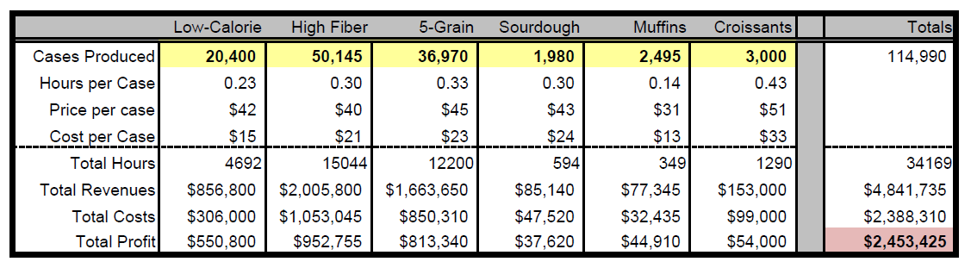
Page: 2
Exercise: Bakery
Your bakery produces six bread products. You are the bakery manager and track revenues, costs, and profits from production.
» You need determine the number of cases for each type of bread that can maximize total profit while satisfying production limit guidelines.
Adjustable cells
Fixed values
Derived values
Objective

Slide 3
Page: 3
Exercise: Bakery (cont.)
There are several constraints that must be met in this model:
» there must be at least a 3:2 ratio of High-Fiber to Low- Calorie bread.
» there must also be a 3:2 ratio of 5-Grain to Muffin.
» the total hours must be no more than 50,000.

Slide 4
Page: 4
Start Excel & Load Solver Add-in
Open ISS VM LibreOffice Calc (Excel)
» Non Linear Programming Solver (nlpsolver) is preinstalled.
Open Microsoft Excel
» File → Options → Add-ins
In the Manage box, select Excel Add-ins, click Go
» In the Add-Ins available box,
Select the Solver Add-in check box → OK
If Solver Add-in is not listed in the Add-Ins Available box, click Browse to locate the add-in
If you get prompted that the Solver add-in is not currently installed on your computer, click Yes to install it

Slide 5
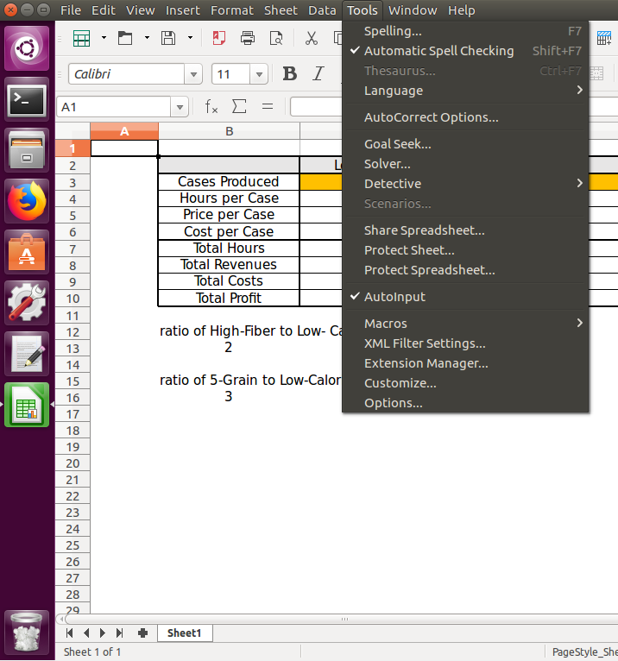
Page: 5
Start LibreOffice Solver
After you load the Solver add-in
» the Solver command is available in the Tools menu
» Click on the “Solver…”
→ “Solver Parameters”

Slide 6
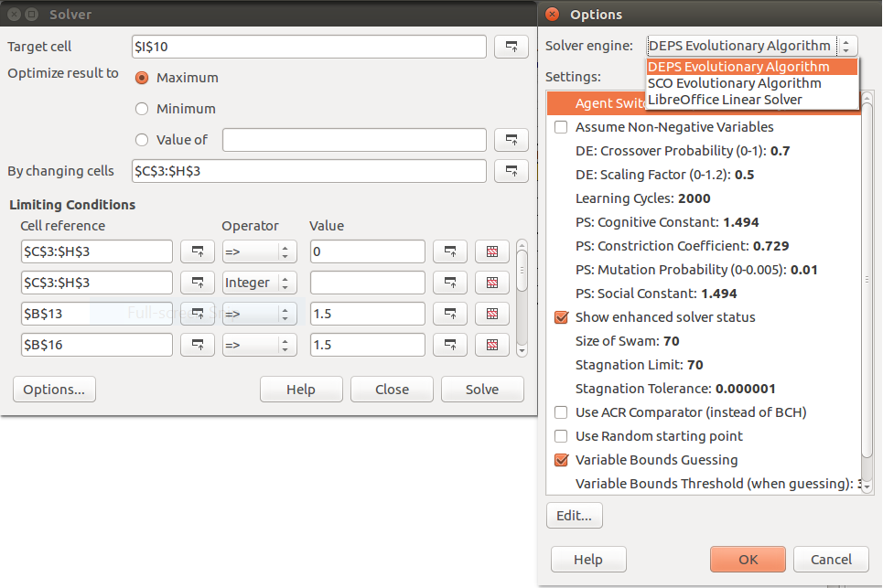
Page: 6
LibreOffice Solver Parameters
Define the parameters (values shown are for example only)
» Objective cell
Max / Min, or specific value
» Adjustable cells
» Constraints
» Solving method
Evolutionary
» Click to check “Options”
» Click to run the Solver

Slide 7
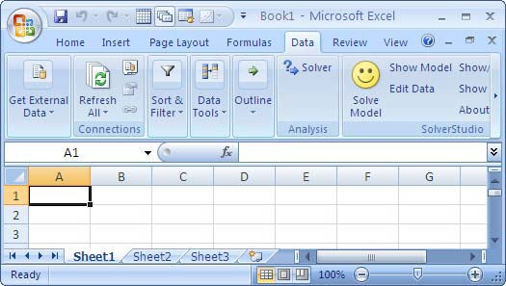
Page: 5
Start MS Office Solver
After you load the Solver add-in
» the Solver command is available in the Analysis
group on the
Data tab
» Click on the “Solver”
→ “Solver Parameters”

Slide 8
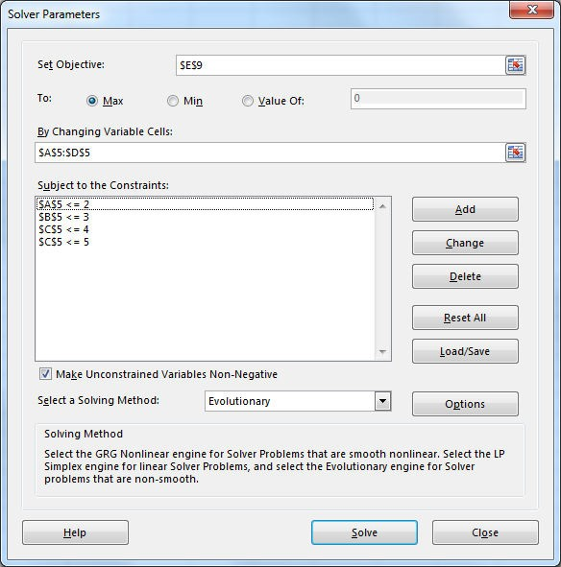
Page: 6
Start MS Office Solver
Define the parameters (values shown are for example only)
» Objective cell
Max / Min, or specific value
» Adjustable cells
» Constraints
» Solving method
Evolutionary
» Click to check “Options”
» Click to run the Solver

