Slide 1

Page: 1
Master of Technology in Knowledge Engineering
Unit 1
Intelligent Systems & Techniques for Business Analytics
Exercise & Discussion
Search & Optimization
GU Zhan (Sam)
© 2018 NUS. The contents contained in this document may not be reproduced in any form or by any means, without the written permission of ISS, NUS other than for the purpose for which it has been supplied.

Slide 2
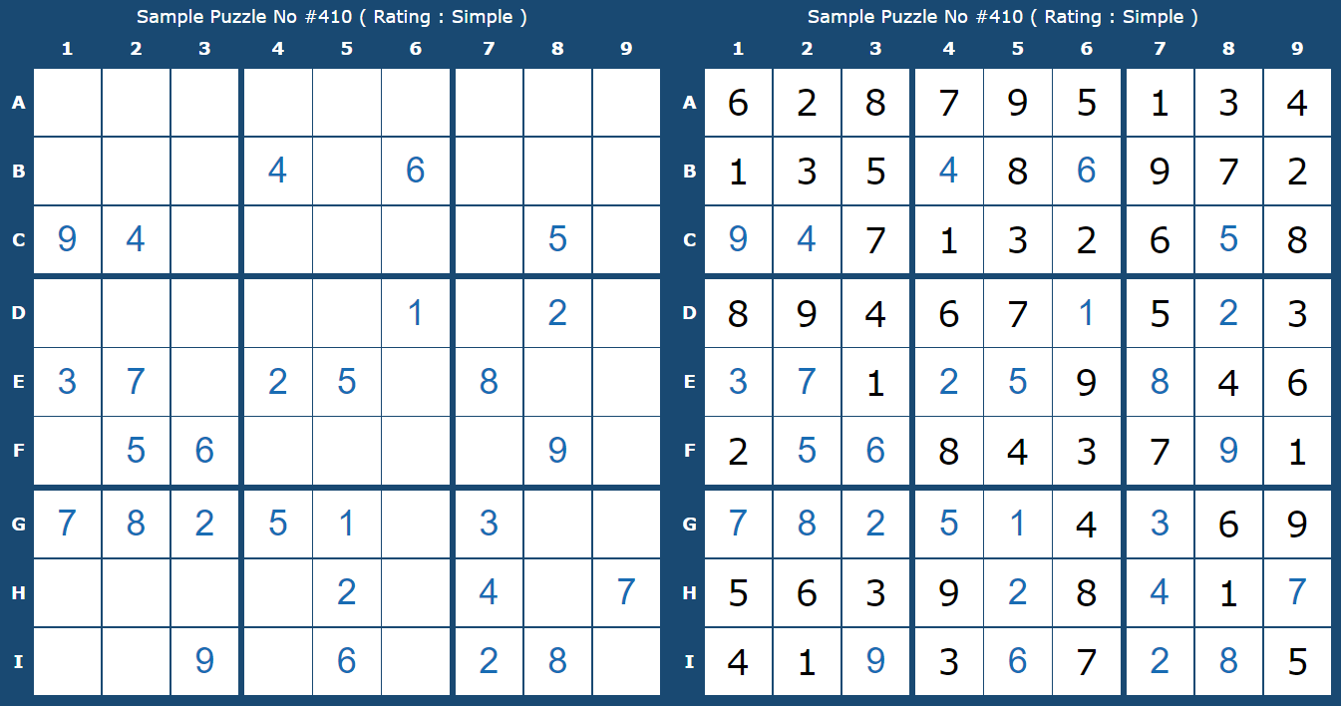
Page: 2
Exercise: Sudoku game
https://www.sudoku-solutions.com/

Slide 3
Page: 3
Exercise: Sudoku game (cont.)
Conduct internet research to understand various search based techniques for solving Sudoku.
Search GitHub, or other open source coding repositories, to find a Sudoku search programming implementation you like.
Using computer, you execute the program. Read source code to understand search type, problem and states representation, logic flow, and any heuristics used.
Explain to at least two classmates from different country of yours.
You may be randomly selected, to explain to entire class on stage.

