Slide 1

USE CASE DESCRIPTION
TEAM MEMBERS:
BHARATH-069
MADAN-079
MANINDRA-081

Slide 2

USECASE DIAGRAM:
https://app.lucidchart.com/invitations/accept/82242be5-00c2-4ccc-ad55-4a1af23f6f43

Slide 3
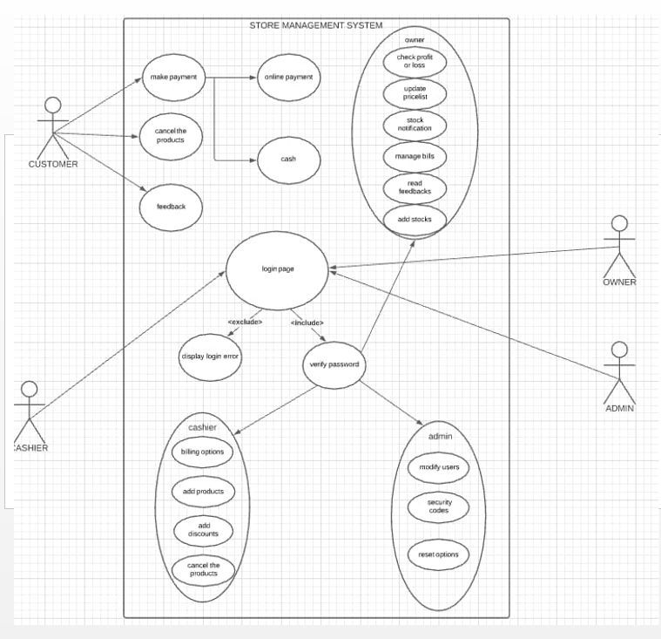

Slide 4
DESCRIPTION:
USE CASE ID : UC_01
Name : Make Payment
Actor : Customer
Description : Allows customer to make payment.
Preconditions : Customer should buy something to make payment.
Post conditions : Bill will be printed and is given to customer.
Main flow :
USER | SYSTEM
1. Clicks on the payment button.
 | 2. System displays on line payment and cash.
3. Chooses the option and pays the bill.
 | 4. Prints the bill.

Slide 5
USE CASE ID : UC_02
Name : Cancel the payment.
Actor : Customer.
Description : Allows the user to delete the items that are purchased.
Preconditions : Cashier should add the payments.
Post conditions : System deletes the products and shows the remaining products.
Main flow :
USER | SYSTEM
1. Clicks on cancel the products button.
 | 2. System displays ‘X’ mark at the right side of the product.
3. Removes the products.
 | 4. Displays the remaining products.

Slide 6
USE CASE ID : UC_03
Name : Feed back
Actor : Customer
Description : User can give the feedback regarding the services.
Preconditions : User should buy some products.
Post conditions : No post conditions.
Main flow :
USER | SYSTEM
1. Clicks on the feedback button.
 | 2. Displays all the emoji's and description to write.
3. User writes the feedback and clicks enter.
 | 4. Saves the feedback in to the owner account.

Slide 7
USE CASE ID : UC_04
Name : Cashier Options
Actor : Cashier
Description : User can use the following options in it.
Preconditions : User should login and get verified.
Post conditions : Once the login is successful system stars billing, else displays error.
Main flow :
USER | SYSTEM
1. User login as cashier.
 | 2. Displays all the options.
3. User selects the options and completes the task.
 | 4. Task will be saved in Owner account.

Slide 8
USE CASE ID : UC_05
Name : Owner options.
Actor : Owner.
Description : User can check everything regarding the store.
Preconditions : User should login and get verified.
Post conditions : No post conditions required.
Main flow :
USER | SYSTEM
1. User should login as the owner and get verified.
 | 2. System displays options.
3. User can check profit, update pricelist and etc.
 | 4. System makes necessary changes and saves.

Slide 9
USE CASE : UC_06
Name : Admin Options.
Actor : Admin.
Description : Admin can modify users, reset and can set the security codes.
Preconditions : User should login and verified.
Post conditions : No post conditions required.
Main flow :
USER | SYSTEM
1. User logins as admin.
 | 2. Displays options as modify users, security codes, reset options.
3. Admin makes necessary changes.
 | 4. System saves the dates.

Slide 10
TECHNOLOGY USED :
All computer software needs certain hardware components or other software resources to be present, in order for computers to be used efficiently. These prerequisites are known as System Requirements. Within this, we have two types – Software Requirements and Hardware Requirements.
SOFTWARE REQUIREMENTS :
Software Requirements deal with defining the software resource requirements and prerequisites that need to be installed on a computer to provide optimal functioning of an application. These preconditions are generally not included in the software installation package and need to be installed separately.
In order to use STOCK MANAGEMENT , one should have the following:
• Operating System: Windows 7 and above
• C Compiler: Can be compiled using any c compiler
• Editor: Any text editor .
HARDWARE REQUIREMENTS
Hardware requirements refer to the common set requirements defined by any operating system or software application and are usually the physical computer resources. In this, we look into the architecture, processing power, memory, secondary memory, display adapter and peripherals.
In order to use this project, one should have the following:
• Processor: INTEL i3 processor and above
• Memory: 2 GB RAM and above

Slide 11
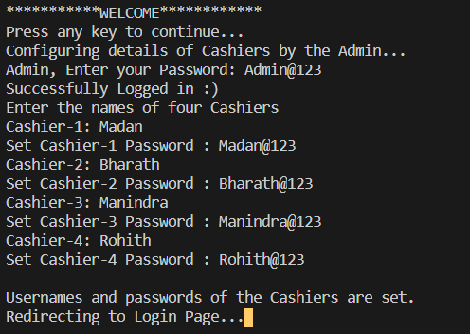
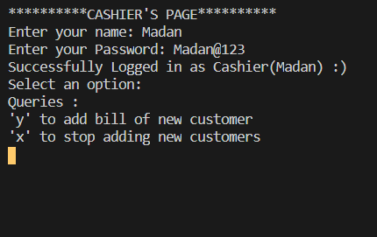
RESULTS :
1.
2.

Slide 12
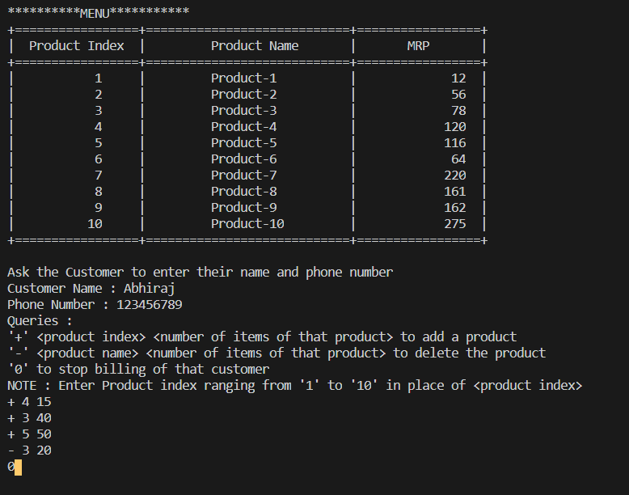
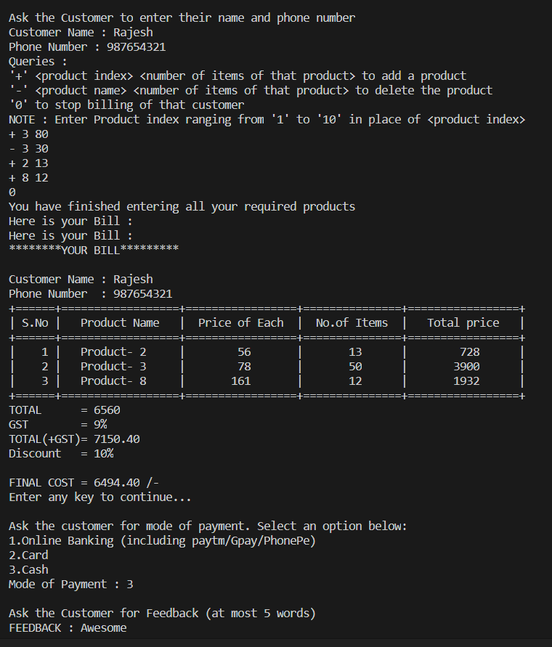
3.
4.

Slide 13
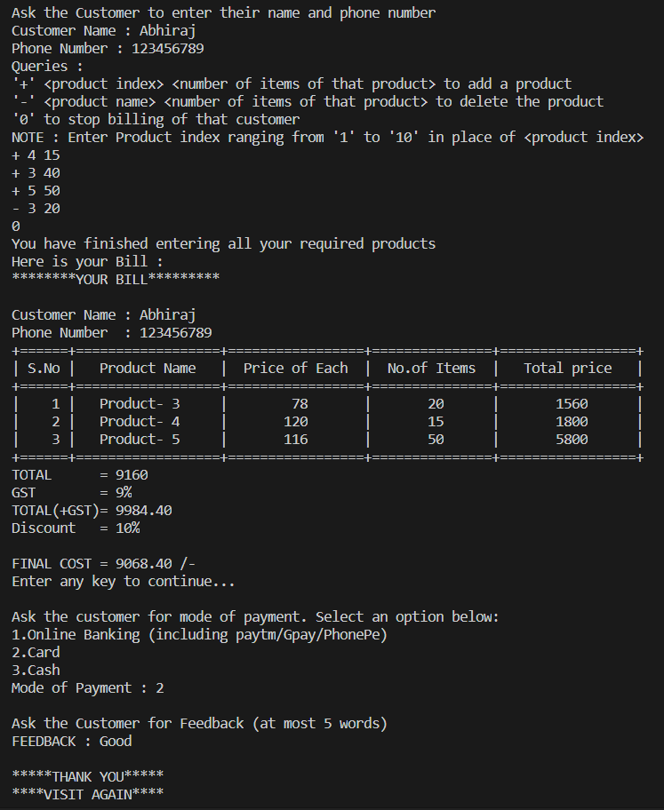
5.

Slide 14
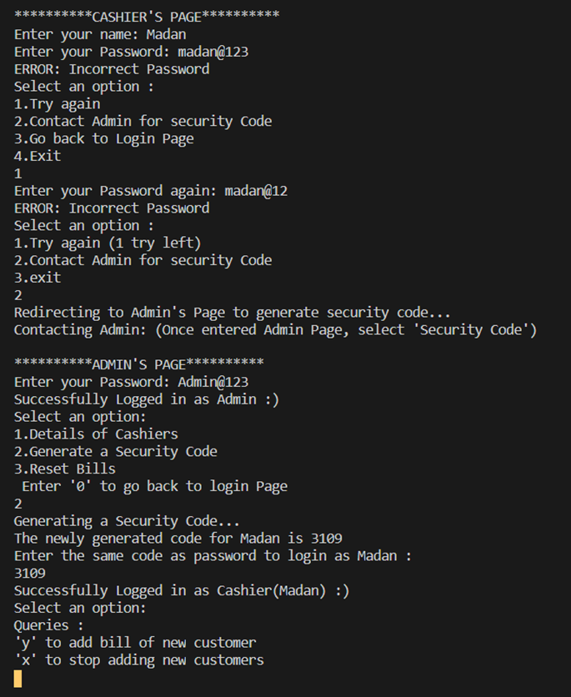
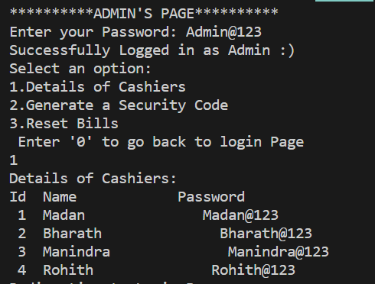
If the password entered by the cashier is wrong
6.
7.

Slide 15
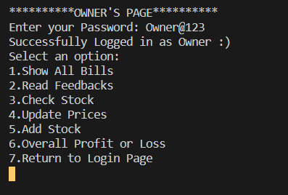
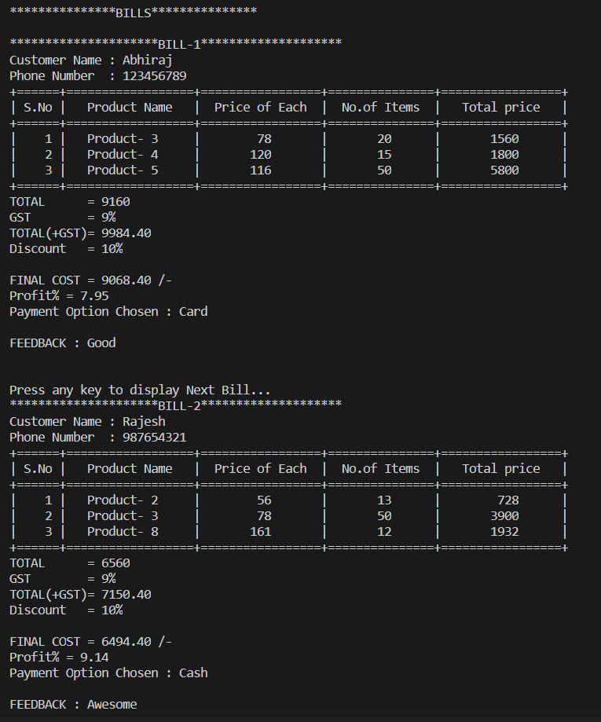
OWNER’S PAGE :
1.

Slide 16
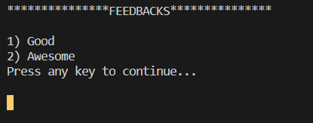
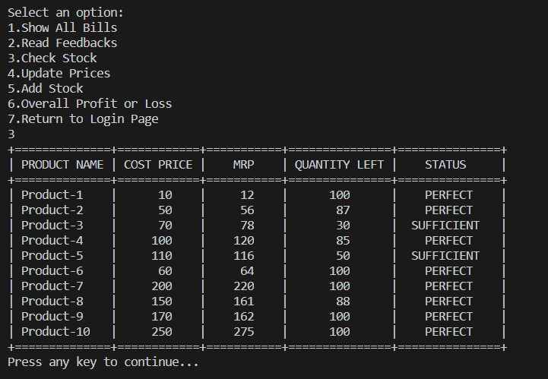
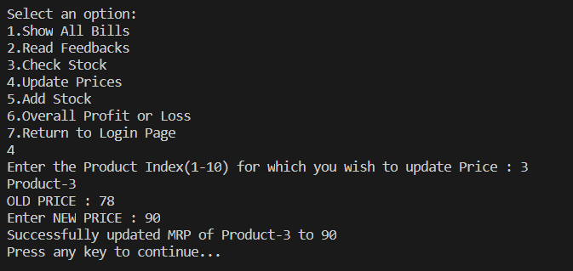
2.
3.
4.

Slide 17
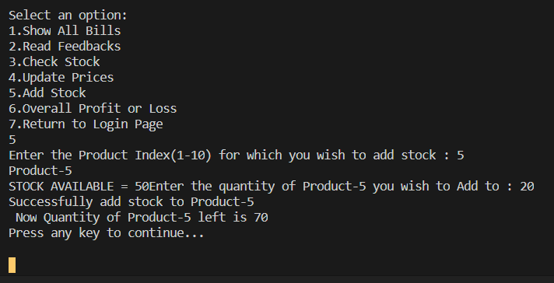
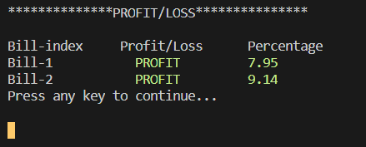
5.
6.

Slide 18
CONCLUSION AND FUTURE WORK
To conclude, this application is useful for many small store owners who are in a way illiterates. It can be operated very easily.
We develop the application in java Or HTML to make sure that it is user friendly and make real time payments which is saved in the server using HTML.

