Slide 1
Quality Control and Data Normalization
Jenny Drnevich, Ph.D.
Functional Genomics Bioinformatics Specialist

Slide 2
Steps in RNA-Seq Analysis
Experimental design
Number of factors, levels and replicates
Sequence samples
Align reads
STAR to get .bam files
Generate counts
featureCounts + .bam + .gtf to get .txt files
QC diagnostics
Sequencing quality - FastQC
% aligned to genome and gene models
Detection of outliers or batch effects
Data pre-processing
Filter out no/low information
Normalization
Statistical Analysis
Make design & contrast matrices
Get lists of differentially expressed genes
Data Mining
Venn Diagrams: compare 2+ gene lists
Heatmaps & WGCNA: visualize expression patterns
Annotation: gathering known information about the genes
Over-representation testing: finding types of genes that appear more often than expected

Slide 3
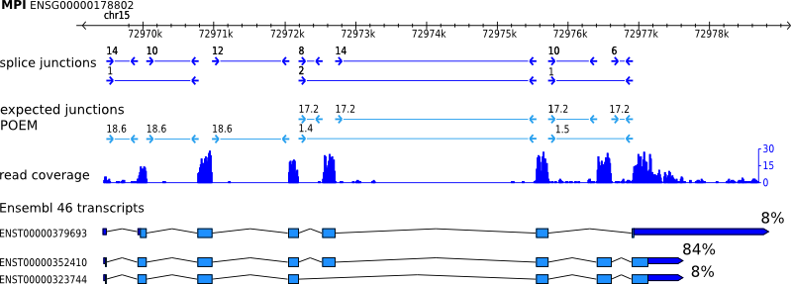
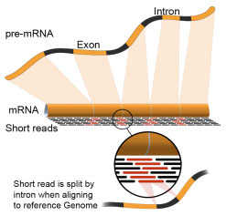
RNA-Seq Read Counts
http://www.cs.cmu.edu/~maschulz/projects.html
Sum read counts per “feature”
Gene
Transcript
Exon
Others?
http://www.bgiamericas.com/sequencing-services/rna-sequencing/

Slide 4
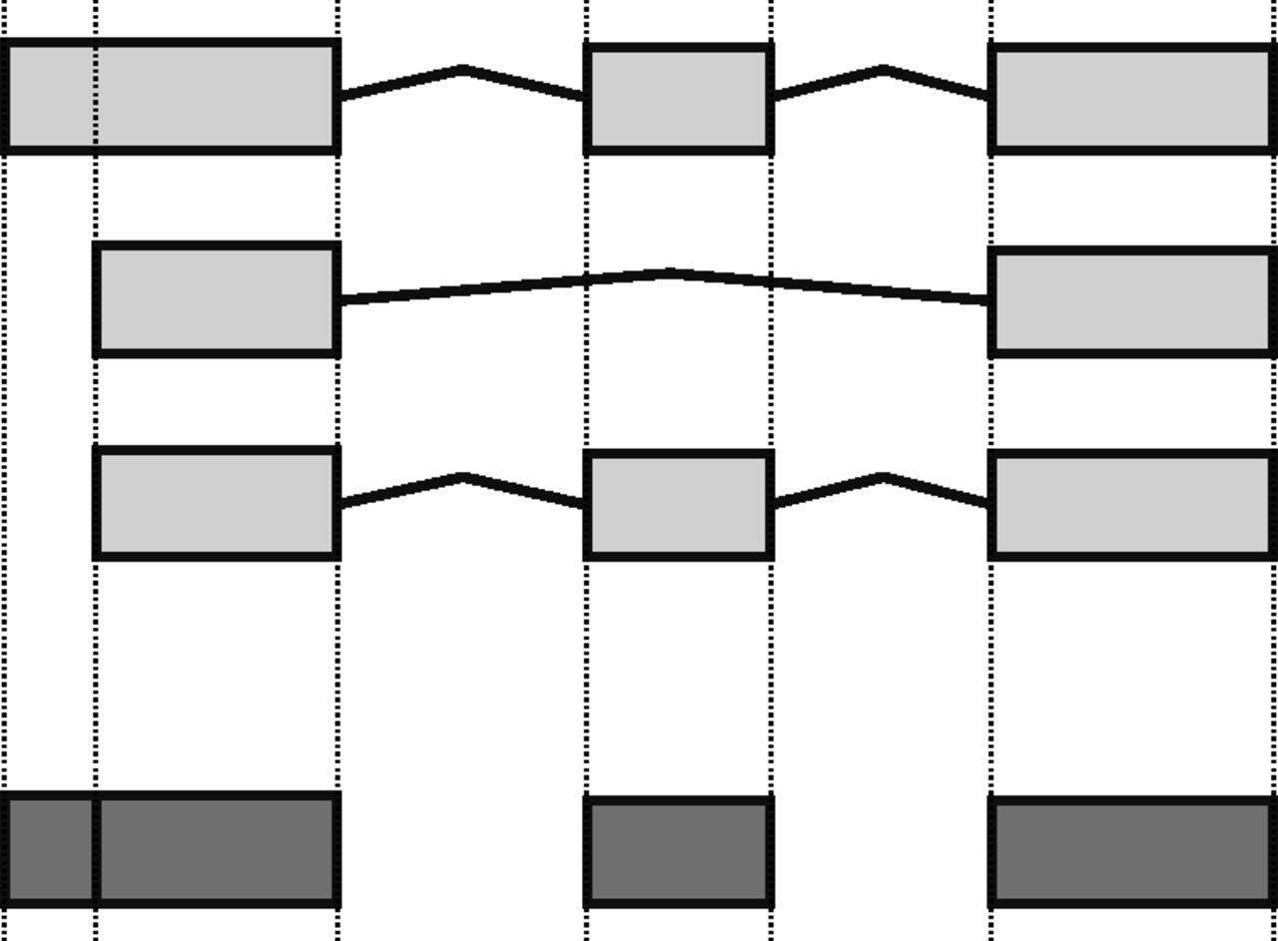
Gene vs. transcript level?
Transcript level biologically “real” but gene level much easier.
Most genes have one predominant transcript.
If really serious about finding splice variant differences, need Paired-End reads and 60-90M reads.
Anders S et al. Genome Res. 2012;22:2008-2017
Cufflinks suite designed for PE reads and transcript-level analysis. I don’t recommend it for SE reads and gene-level, unless gene models are poor for your species.

Slide 5
Software for RNA-Seq Statistical Analysis
edgeR – specifically for count data; well-documented and high quality.
Cufflinks – mainly a genome-based transcriptome assembler; statistics very limited.
limma – originally developed for microarray data, now adapted to handle count data after transformation.
DESeq2 – similar to edgeR; will not be covered

Slide 6
Cufflinks suite
Cufflinks
Assembles transcripts and groups transcripts into genes for 1 sample - creates a .gtf file
Assigns reads to transcripts probabilistically, using fractions of counts
Reports FPKM values at the transcript level; gene level FPKM values are sum of transcript FPKM values. DON’T USE THESE
Cuffcompare
Can compare assembled transcripts to reference .gtf for one or more samples.
Cuffmerge
Runs cuffcompare for multiple samples and/or reference .gtf
Creates one master .gtf file with old and new transcripts.
Cuffdiff
Takes a .gtf file and >=2 .bam files and does simple pairwise tests for differences at transcript level, gene level, etc.
Outputs FPKMs for each sample at transcript level & gene level (summed)
Output counts for each sample at transcript level & gene level (summed)

Slide 7
Initial QC
Should be done by facility and checked by you:
Overall sequencing quality
Base position vs. quality score
% alignment to genome
% falling in gene models
Was the sequencing successful?
not
Do the data for my samples make sense?

Slide 8
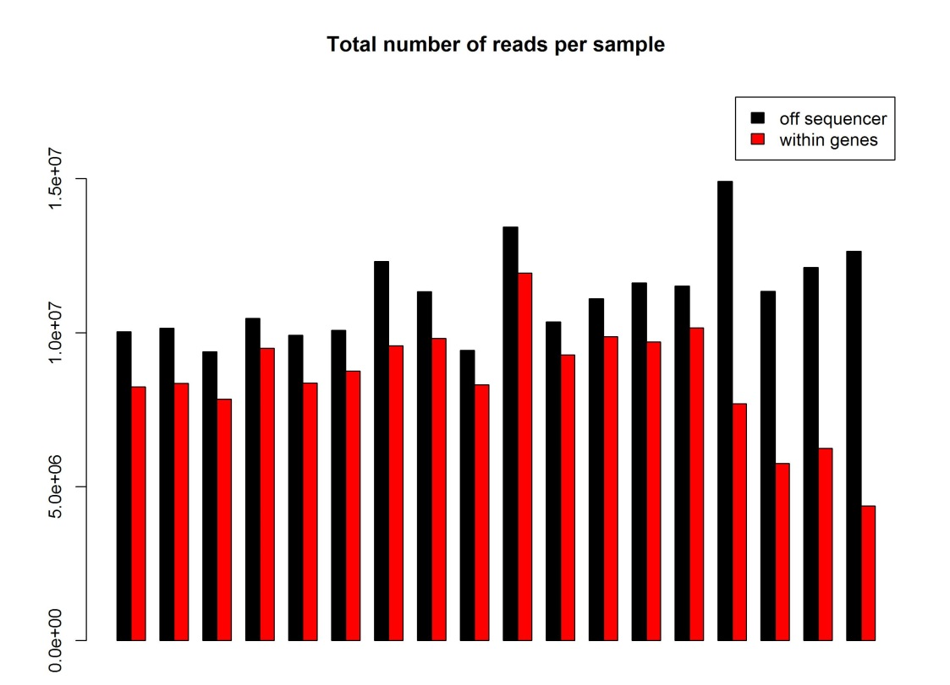
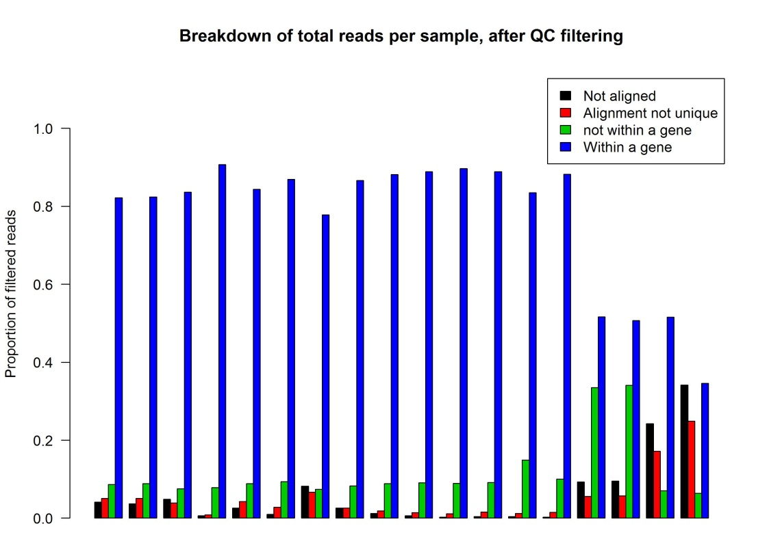
Initial QC in R
Check actual numbers of reads off sequencer and reads mapping uniquely within genes
Also assess the “fate” of reads lost, by percentage

Slide 9
Sample Quality Control Diagnostics (using R and Bioconductor)
Distributions of raw & normalized values
HC or PCA to cluster samples
Goal: ID low quality samples or batch effects

Slide 10
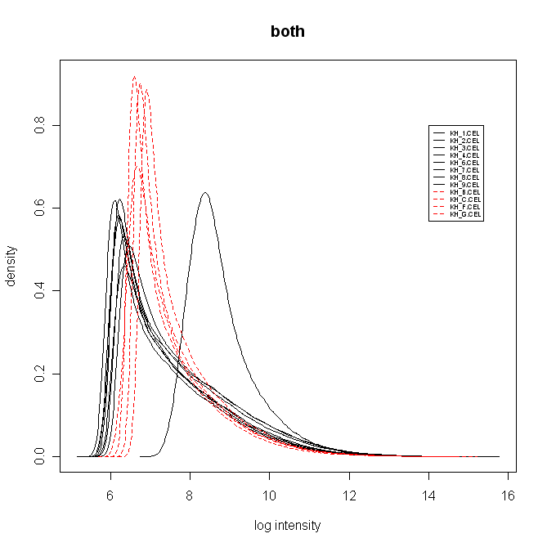
Distribution of Raw Counts log2(count + 0.5)
One outlier sample
Differences in overall shape between two processing batches
Don't want to see differences in overall shape of raw data between treatment groups!!

Slide 11
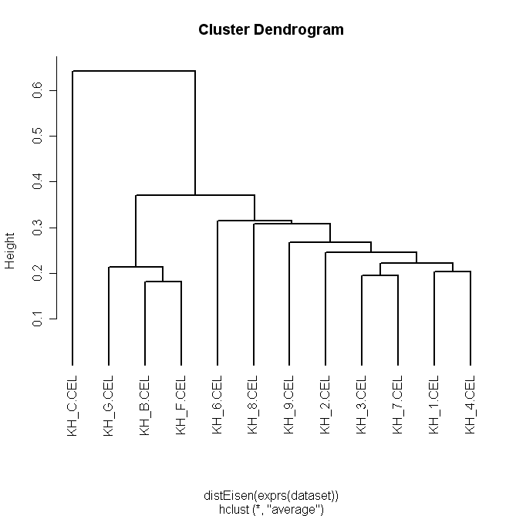
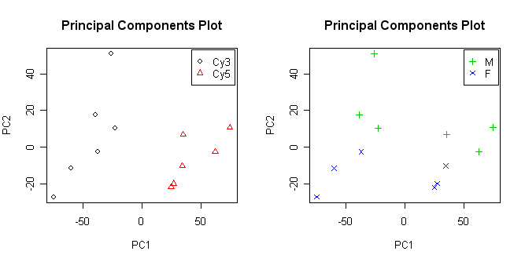
Simple clustering on samples

Slide 12
When to throw out a sample…
If suspect a sample of being low quality:
Go ahead and do normalization
Go through QC diagnostics again to see if the sample is still different from others.
If sample still very different from others, throw out!
If sample slightly different from others, judgment call:
How extensive are the defects?
How much of the data is usable?
Trade-off between cost of rerunning and quality of data
If decide to throw out any samples, re-do normalization on remaining samples.

Slide 13
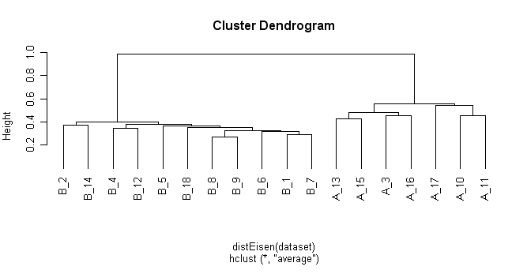
If see batch effects in raw data:
Do normalization and check to see if batch effects disappear
If still have batch effects, must account for it statistically when running model…

Slide 14
Data Pre-processing
1. Filtering out low/bad information
2. Normalization

Slide 15
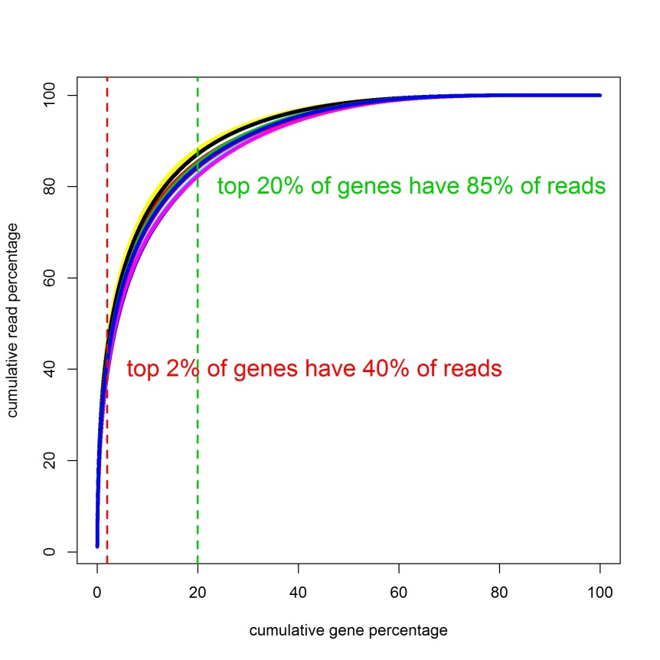
Filtering Low/Bad Information
Multi-reads
Do not map uniquely
Common in gene families
Leave out (featureCounts) or proportionately divide between possible genes (cufflinks)
Sequencing errors
Un-mapped reads just ignored
Most genes have few reads
Correct by filtering out

Slide 16
RNA-Seq Filtering
Common software to generate counts will output all genes even if 0 counts in all samples.
Large numbers of genes may have only a few reads total among all reps; real or sequencing errors?
What number of reads do you consider “real”?
Can filter out based on:
Total reads across all samples (e.g., < 10)
Require one or more samples to have > 1 CPM
0 total reads in one group (save for inspection)

Slide 17
Normalization Assumptions
Most methods of normalization assume:
Most genes are not changing
Changes are not all in same direction
If have reason to expect >40% of genes changing and/or most change in same direction , then don’t use regular normalization methods! Instead:
Spiked controls
Housekeeping genes**
Don’t normalize at all if will add more bias than removes

Slide 18
RNA-Seq Normalization
Total mapped reads differ between samples, but *assumed* should be the same
Longer genes will have higher read counts than shorter genes with same # mRNAs
1st solution: Reads (Fragments) Per Kilobase of gene per Million mapped reads (RPKM / FPKM)
Sequence content also known to affect read count
Longer genes still more likely to be called DE than shorter genes

Slide 19
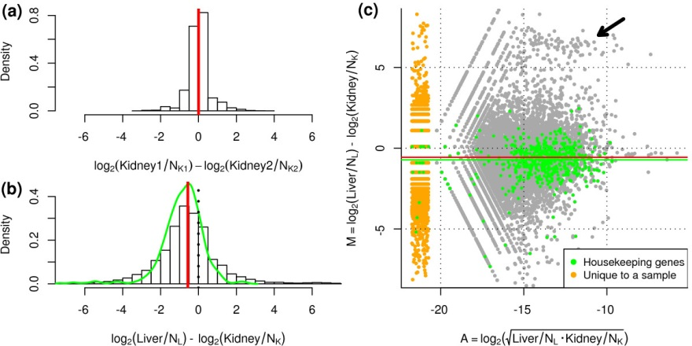
RNA-Seq Normalization II
Gene length and content less important when only comparing between samples, not between genes
But gene length bias in DE can affect data mining
Changes in high abundance genes can affect total pool
Robinson & Oshlack Genome Biology 2010, 11:R25
Gene A: 20
Gene A: 20
Total pool: 10 E8
Total pool: 5 E8
Solution: use scaling factors and/or subset of genes to estimate effective library size

Slide 20
RNA-Seq Normalization Methods for QC/clustering/heatmaps
R/edgeR – modified logCPM (Counts Per Million mapped reads)
Total mapped reads + extra normalization factor
Proportional offset to avoid zeros, log2-transformed
cufflinks – FPKM (Fragments Per Kilobase of gene per Million mapped reads)
Total mapped reads (all genes / bottom 75% / geometric) AND gene length
Will still yield values of zero
For optimal plotting need to add small constant and log2 transform.
R/limma – “voom” (mean-variance modeling at the observational level)
Total mapped reads + extra normalization factor
Constant offset to avoid zeros, log2-transformed

Slide 21
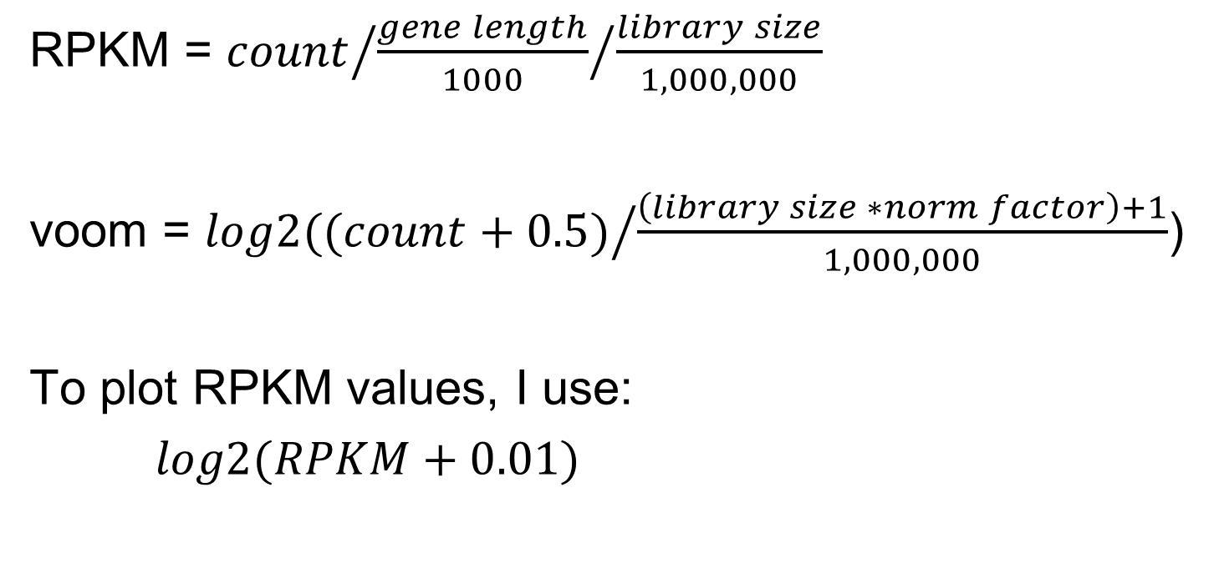
RPKM vs. “voom”
Use ½ or ¼ smallest RPKM value
In practice, edgeR’s cpm values almost identical to voom!

Slide 22
FPKM not recommended
Dillies et al. A comprehensive evaluation of normalization methods for Illumina high-throughput RNA sequencing data analysis. Brief Bioinform (2012) doi: 10.1093/bib/bbs046
“Based on three real mRNA and one miRNA-seq datasets, we confirm previous observations that RPKM and TC, both of which are still widely in use [40, 41], are ineffective and should be definitively abandoned in the context of differential analysis.” (emphasis mine)
Top methods: TMM (edgeR) and RLE (DESeq; geometric)

Slide 23
RNA-Seq Normalization Methods for statistical analysis
R/edgeR – raw counts
Total mapped reads + extra normalization factor accounted for in model
cufflinks – FPKM
For better statistical properties, add small constant and log2 transform.
R/limma – “voom”
Same as for QC
Also estimates weights from mean-variance trend to include in model

Slide 24
Files needed for Bioconductor
Read counts per feature in tab-delimited-text format, either 1 per sample or combined into one file.
Optional “Targets” file to describe the samples, depending on number of samples.
Use simple, short names with only letters, numbers, underscores and periods
Do not start column labels or text entries with numbers

Slide 25
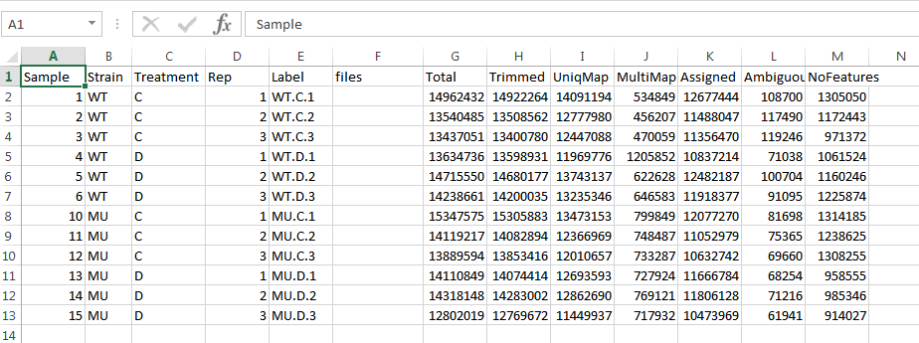
Targets File
One row per sample, plus header row.
Label column should have unique names.
files column should have name of count data file (will put this in in R)
Give treatment groups for each sample and read numbers (must be Total, Trimmed, UniqMap, MultiMap, Assigned, Ambiguous and NoFeatures for the demo codes to work properly)
In Excel, do File -> Save As -> Current Folder -> Save as type: Text (Tab delimited) (*.txt), File name: Targets.txt

Slide 26
A Note on Graphs in R
Graphing functions in R will open a new window for the graph.
Can save in this window, but for high-res graphics, use codes in Heatmap Demo.
Can open many (~20?) graphing windows at once using “x11()”
Some graphing functions will output the graphic to the working directory instead of opening a new window. These can be opened and viewed outside of R.

Slide 27
results.RNA[results.RNA$batch > 1 , 2:3 ] <- log2(matrix(1:10,nrow = 5, ncol = 2)) * test.data$value[i.type == "cDNA"]
How to make sense of this!?!?
First, look for <- , typically near the beginning
(or sometimes = as in goseq vignette)
If no <- or = , then not assigning results to anything (e.g., plots, writing to external files)

Slide 28
results.RNA[results.RNA$batch > 1 , 2:3 ] <- log2(matrix(1:10,nrow = 5, ncol = 2)) * test.data$value[i.type == "cDNA"]
<- is the assignment operator, and it means:
__put_results_here__ <- ___compute_this___

Slide 29
results.RNA[results.RNA$batch > 1 , 2:3 ] <- log2(matrix(1:10,nrow = 5, ncol = 2)) * test.data$value[i.type == "cDNA"]
Second, look for left parentheses (
the words just to the left are functions:
Can look up the help pages for functions:
?log2
?matrix
results.RNA[results.RNA$batch > 1 , 2:3 ] <- log2(matrix(1:10,nrow = 5, ncol = 2)) * test.data$value[i.type == "cDNA"]

Slide 30
results.RNA[results.RNA$batch > 1 , 2:3 ] <- log2(matrix(1:10,nrow = 5, ncol = 2)) * test.data$value[i.type == "cDNA"]
Identify the matching right parenthesis ) for each left parenthesis; everything in between are the arguments to that function
log2( matrix(1:10, nrow = 5, ncol = 2 ) )
matrix( 1:10, nrow = 5, ncol = 2 )
If more than 1 argument, will be separated by commas

Slide 31
results.RNA[results.RNA$batch > 1 , 2:3 ] <- log2(matrix(1:10,nrow = 5, ncol = 2)) * test.data$value[i.type == "cDNA"]
Next look for subsetting, indicated by $, [ or [[
$ - pulls out a named column from a data frame or named item from a list
[ - starts subsetting, if [ ] either a vector or list, if [ , ] a matrix or data frame, if [ [ ] ] a list
results.RNA[results.RNA$batch > 1 , 2:3 ]
test.data$value[ i.type == "cDNA“ ]

Slide 32
results.RNA[results.RNA$batch > 1 , 2:3 ] <- log2(matrix(1:10,nrow = 5, ncol = 2)) * test.data$value[i.type == "cDNA"]
Math symbols +, -, *, /, ^ have normal functions:
log2(matrix(1:10,nrow = 5, ncol = 2)) * test.data$value[i.type == "cDNA"]
==, !=, <, > ask for comparisons and yield logical (T/F) results
results.RNA$batch > 1
i.type == “cDNA"
: is a shorthand way to get all integers in a sequence
2:3
1:10
= see detailed explanation at end

Slide 33
Not in this example code, but used often:
%x% Special binary operators, x can be replaced by any valid name
sum( !( rownames( raw.data ) %in% gene.lengths$gene ) )
%in% asks whether the values on the left side are found in the values on the right side, and returns TRUE or FALSE for each value on the left side in a vector.

Slide 34
results.RNA[results.RNA$batch > 1 , 2:3 ] <- log2(matrix(1:10,nrow = 5, ncol = 2)) * test.data$value[i.type == "cDNA"]
Words in quotes are character data only, not objects or functions.
i.type == "cDNA"
What’s left? Any words not followed by a single = is an object in the workspace:
results.RNA[results.RNA$batch > 1 , 2:3 ]
test.data$value[i.type == "cDNA"]
Words followed by a single = are special cases:
matrix(1:10, nrow = 5, ncol = 2) see next slide…

Slide 35
= is also an assignment operator
(use == for “equal to”)
4 == 2 + 2
When outside (), = is equivalent to <-
a <- log2( 8 )
a = log2( 8 )
When inside (), = either names an argument:
RG <- read.maimages(targets$FileName, source = "genepix", wt.fun = f)
or creates a named column or list item:
Tally <- data.frame(number = 1:5, color = c("black", "red", "green", "blue“, "yellow"))

Slide 36
results.RNA[results.RNA$batch > 1 , 2:3 ] <- log2(matrix(1:10,nrow = 5, ncol = 2)) * test.data$value[i.type == "cDNA"]
Break it down into separate lines of code:
u <- matrix(1:10,nrow = 5, ncol = 2)
v <- log2( u )
w <- test.data$value
x <- i.type == “cDNA”
y <- w[ x ]
z <- results.RNA$batch > 1
results.RNA[ z , 2:3 ] <- v * y

Slide 37
hc.raw <- flashClust(dist(t(log2(pm(raw.demo)))), method=“average”)
Actual line of code from Affy_3prime_Demo
a <- pm( raw.demo )
b <- log2( a )
d <- t( b )
e <- dist( d )
hc.raw <- flashClust( e, method = “average”)

Slide 38
Try QC, filtering and normalization…
Open RStudio then open C:/RNASeq/QCandNormDemo.R
I’ll go through the first part of the codes with you, then you’ll have time to do some on your own
After the edgeR normalization, there are codes for manipulating file names and also FPKM and voom normalizations

