Slide 1
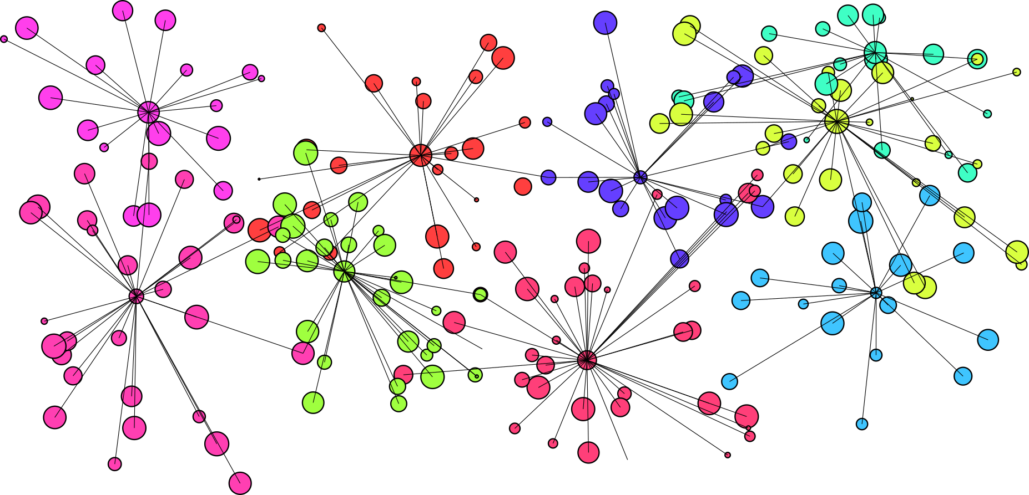
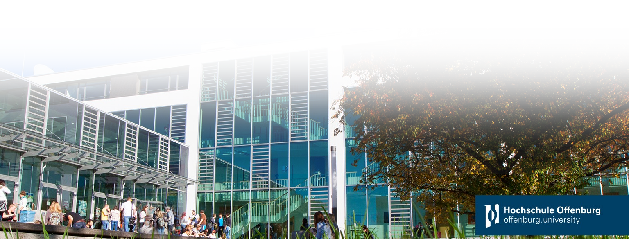

Python Implementation of the SUBSCALE algorithm
Speaker:
Stanislav Ramin
Supervisor:
Prof. Dr. rer. nat. Tobias Lauer
M. Sc. Jürgen Prinzbach
based on Java reference
Notes:
Welcome to the presentation of the subscale algorithm

Slide 2
Introduction
First implemented
University of Western Australia in 2016
Ph.D. Amardeep Kaur
Java
Enhanced at HS Offenburg
M.Sc. Jürgen Prinzbach
Java
M.Sc. Nicolas Kiefer
C++
CUDA for GPU support
Outline
What is clustering and why use it?
Subscale – Overview
Curse of dimensionality
Concept of clustering
Approaching the challenge
3. Calculation of DUs
Exploring greater clusters
Final Clustering
Performance Trade offs
Comparison
Why Python?
Python the slow poke
Notes:
Determine number of species from a multivariate dataset of flower exemplars
by examining the attributes of petals and sepals
No prior knowledge of the underlying data distribution

Slide 3
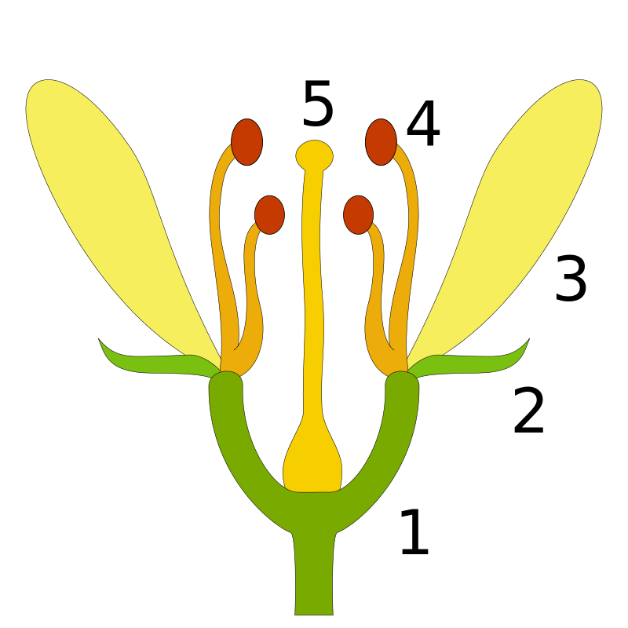
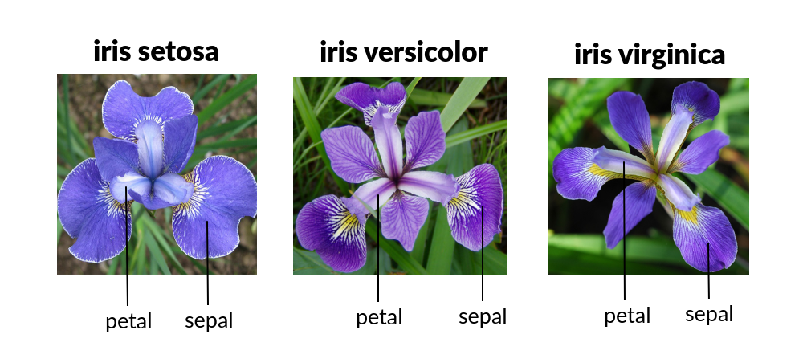
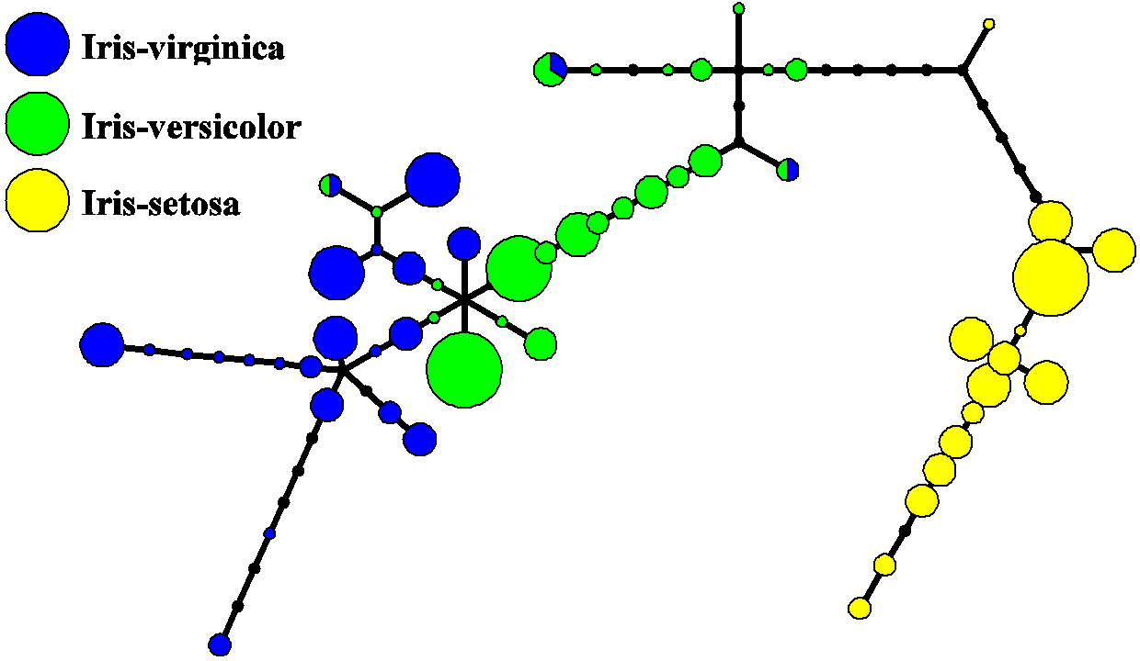

What is clustering and why use it? Example Iris Dataset $→$ Number of species?
Machine learning
Find Groups / Cluster
Field of Interest:
Data science, Biology, Medicine,
Data fraud, …
Example
# flowers / Rows: 150
Columns: 4 [petal-width, petal-height, sepal-width, sepal-height]
3 Classes:
petal
sepal
[0]
[1]
[2]
Notes:
Determine number of species from a multivariate dataset of flower exemplars
by examining the attributes of petals and sepals
No prior knowledge of the underlying data distribution

Slide 4
SUBSCALE - Overview
Bottom-up Subspace clustering
Good parallelization when data has a lot of dimensions
1. | 2. | 3. | 4. | 5. | 6.
Data projection | CoreSet creation | Calculation of Dense Units | Collision of Dense Units | Mapping of Subspaces | Final Clustering
Notes:
Traditional Clust. Alg.
Attempt to partition a DS in predefined number of clusters
Full dimensional space is clustered
Not able to find all Hidden Clusters (esp. in High Dim.)
Have less parallel structures and processing
Data dependance

Slide 5






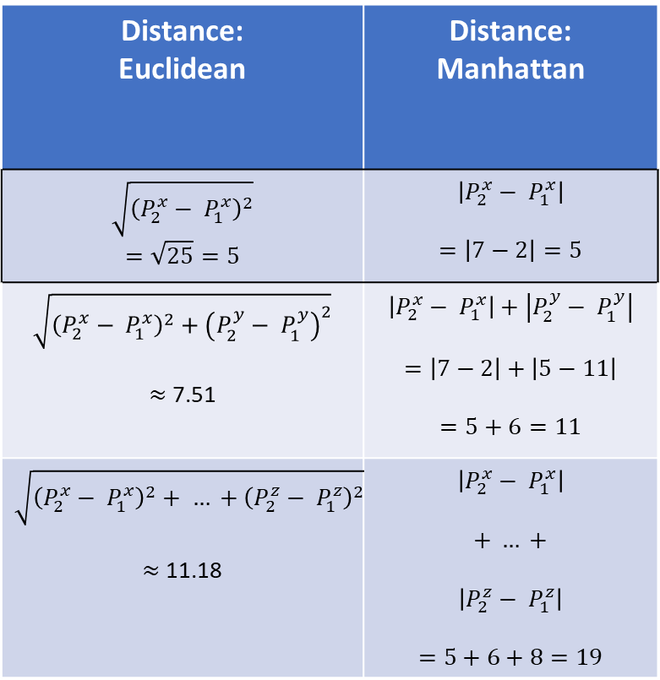


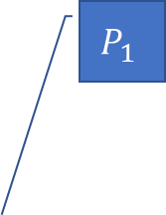
Curse of Dimensionality
Dimensional space of interest
Distance: Euclidean | Distance: Manhattan
$$\sqrt{{\left(P_{2}^{x}− P_{1}^{x}\right)}^{2}}$$ $$=\sqrt{25}=5$$ | $$\left|P_{2}^{x}− P_{1}^{x}\right|$$ $$=\left|7−2\right|=5$$
$$\sqrt{{\left(P_{2}^{x}− P_{1}^{x}\right)}^{2}+{\left(P_{2}^{y}− P_{1}^{y}\right)}^{2}}$$ $≈$ 7.51 | $$\left|P_{2}^{x}− P_{1}^{x}\right|+\left|P_{2}^{y}− P_{1}^{y}\right|$$ $$=\left|7−2\right|+\left|5−11\right|$$ $$=5+6=11$$
$$\sqrt{{\left(P_{2}^{x}− P_{1}^{x}\right)}^{2}+ … +{\left(P_{2}^{z}− P_{1}^{z}\right)}^{2}}$$ $≈$ 11.18 | $$\left|P_{2}^{x}− P_{1}^{x}\right|$$ $$+ … +$$ $$\left|P_{2}^{z}− P_{1}^{z}\right|$$ $$=5+6+8=19$$
$$P_{1}$$
$P_{1}^{x}=$ 2, $P_{1}^{y}=$ 11, $P_{1}^{z}=$ 5
$P_{2}^{x}=$ 7, $P_{2}^{y}=$ 5, $P_{2}^{z}=$ 13
1-dimensional space:
$P_{2}^{x}−$ $P_{1}^{x}$
2-d space:
$$\vec{\left({P_{2}^{x} \atop P_{2}^{y}}\right)}−\vec{\left({P_{1}^{x} \atop P_{1}^{y}}\right)}$$
3-d space:
$$\vec{\left(\begin{matrix}P_{2}^{x} \\ P_{2}^{y} \\ P_{2}^{z}\end{matrix}\right)}−\vec{\left(\begin{matrix}P_{1}^{x} \\ P_{1}^{y} \\ P_{1}^{z}\end{matrix}\right)}$$
$${\left\|x\right\|}_{2}=\sqrt{a^{2}+b^{2}}$$
b
${\left\|x\right\|}_{1}=$ $\left|a\right|+$ $\left|b\right|$
b
a
a
$$P_{2}$$
x
$$P_{1}$$
$$P_{2}$$
y
x
$$P_{1}$$
y
$$P_{2}$$
x
z
Notes:
Spheres depicted in a 3dim Space
Size of Spheres correspond to Pos. on z – axis.
The bigger the sphere the higher the z-axis value is.
Bec. of the high dimen. nature of this representation it is hard to recognize, which Spheres belong to together and which not.
This is because the space grows much more than the contained data.
Relative contrast between dense and not dense Spheres is reduced.
As consequence, Spheres appear equidistant from each other
In order to obtain a clearer view, we
Observe the spehres in a lower dimensional space by
Fold points from higher dimensions to lower
Skip the z-axis
The Spheres become more clustered to each other
Again skip y-axis now
This is a representation where clustred Spheres are becoming recognizeable as such at best.
Problem:
Euclidean = Airline
a density between points becomes preceptible
points become clinched to each other

Slide 6



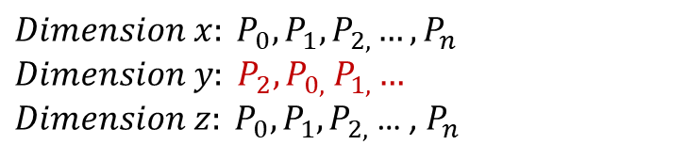








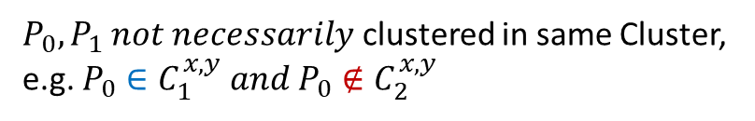



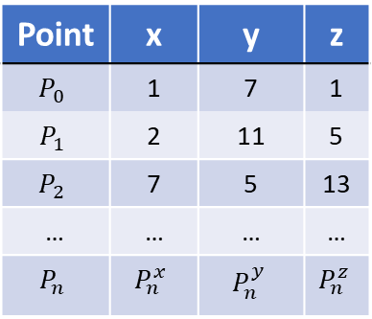
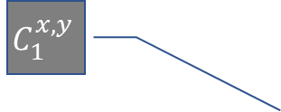


Concept of Clustering
Point | x | y | z
$$P_{0}$$ | 1 | 7 | 1
$$P_{1}$$ | 2 | 11 | 5
$$P_{2}$$ | 7 | 5 | 13
… | … | … | …
$$P_{n}$$ | $$P_{n}^{x}$$ | $$P_{n}^{y}$$ | $$P_{n}^{z}$$
The Apriori principle
Sorted by dimension
$${Dimension x: P}_{0},P_{1},P_{2,}…, P_{n}$$
$$Dimension y: P_{2},P_{0,} P_{1,}…$$
${Dimension z: P}_{0},P_{1},P_{2,}$… , $P_{n}$
$$C_{1}^{x,y,z}$$
3D Subspace
$$C_{1}^{x,y}$$
$$C_{1}^{x,z}$$
$$C_{1}^{y,z}$$
2D Subspace
$$C_{1}^{x,y}$$
$$C_{1}^{x}$$
$$C_{1}^{y}$$
$$C_{1}^{z}$$
1D Subspace
(no trivial cluster)
$$C_{1}^{x}$$
$$P_{0}$$
$$P_{0}$$
$$P_{1}$$
$$P_{1}$$
$$P_{0}$$
$$P_{1}$$
$$P_{2}$$
y
x
x
$P_{0},P_{1}$clustered in $C_{1}^{x}$
$P_{0},P_{1} not necessarily$ clustered in same Cluster,
e.g. $P_{0}∈C_{1}^{x,y} and P_{0}∉C_{2}^{x,y}$
Existent transition:
Desired transition :
Notes:
2nd Problem:
Cluster are only in subsets of all dimensions present.
Point values are for conception, not based on measurement. → Figures will not look exactly the same in reality.
C_{1}^{x, y} is the maximal subspace cluster for P_0, P_1
→ Still, search for trivial clusters, combine them later!

Slide 7





















Approaching the challenge
$$\left|{cs}_{3}\right|=7$$
$$\left|{cs}_{1}\right|=7$$
$$\left|{cs}_{2}\right|=6$$
Dense Unit
1. Data Projection
2. CoreSet creation
3. Calc. of Dense Units
4. Collision of Dense Units
5. Mapping to Subspaces
6. Final Clustering
$$τ=3$$
$τ$+1
Embrace clustering
Groups of Points instead of single points
Dimension
Pick one
Sort it
Core Set (CS) creation
Threshold: $\left|{cs}_{i}\right|≥τ+1$, ϵ > 0
$τ$ adjacent neighbours to point of reference
within ϵ distance
Example, resulted CSs: $\left[{cs}_{1},{cs}_{3L},{cs}_{3R}\right]$
Usage of „Dense Units“(DUs)
group $τ$+1 Points from a combination of a CS
Combination
$\left({n \atop k}\right)$ # of k-element sized subsets of n
$\left\{P_{a},P_{b}\right\}≡\left\{P_{b},P_{a}\right\}$
$P_{2}$, $P_{3}$, $P_{6}$, $P_{14}$, $P_{10}$, $P_{5}$, $P_{11}$, $P_{8}$, $P_{4}$, $P_{1}$
$${cs}_{1}$$
ϵ
$$\left|{cs}_{3L}\right|=5$$
$${cs}_{2}$$
ϵ
$${cs}_{3}$$
ϵ
$$\left|{cs}_{3R}\right|=2$$
$$pivot=5. element in {cs}_{3}$$
$P_{6}$, $P_{14}$, $P_{10}$, $P_{5}$, $P_{11}$
$P_{8}$, $P_{4}$
$${cs}_{3L}$$
$${cs}_{3R}$$
$$\left({\left|{cs}_{3}\right| \atop τ+1}\right)=\left({7 \atop 4}\right)=35$$
$$\left({\left|{cs}_{3L}\right| \atop 3}\right)×\left({\left|{cs}_{3R}\right| \atop 1}\right)=\left({5 \atop 3}\right)×\left({2 \atop 1}\right)=10×2=20$$
$$\sum{{DU}_{i}=30}$$
$$\left({\left|{cs}_{3L}\right| \atop 2}\right)×\left({\left|{cs}_{3R}\right| \atop 2}\right)=\left({5 \atop 2}\right)×\left({2 \atop 2}\right)=10×1=10$$
$$⇒\#DU\left({cs}_{3}\right)=35>\#DU\left({cs}_{3L}\right)+\#DU\left({cs}_{3R}\right)=30$$
Notes:
Performance points:
Only 1 CS at a time / no excessive DB scans
Remember last element as index from previous CS: CS_1! => CS_2 is redundant
Use last element as pivot
Skip all 4-element sized DUs in CS_31 -> were calc in CS1
Use only k $≤$ tau (3) points for CS_31
Use max(tau, len(CS_32)) for k

Slide 8
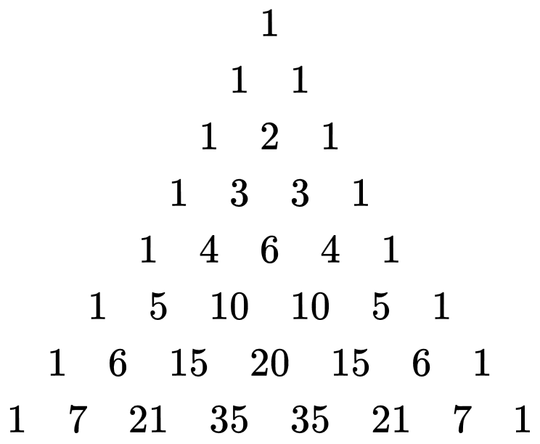
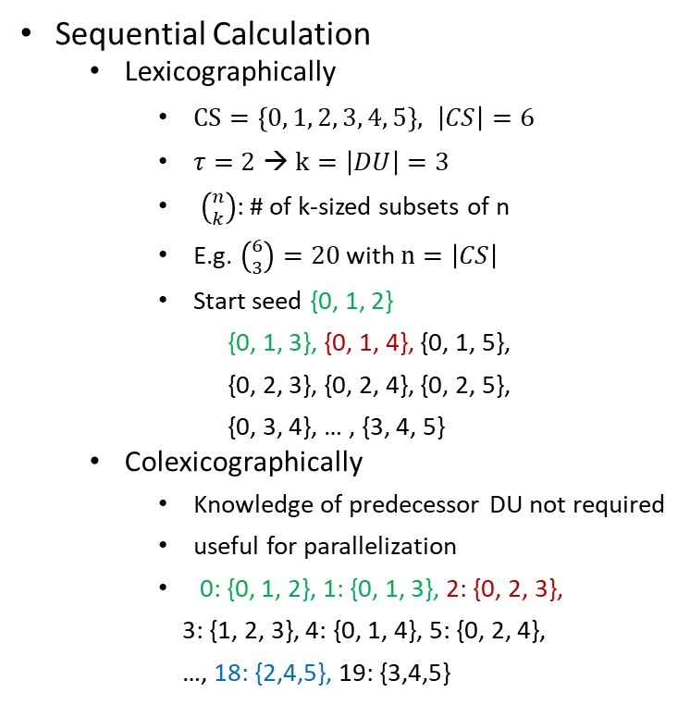
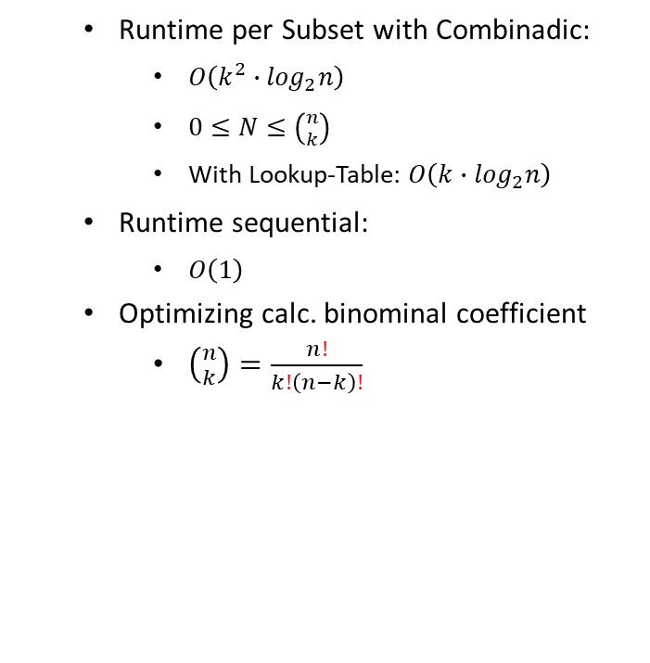

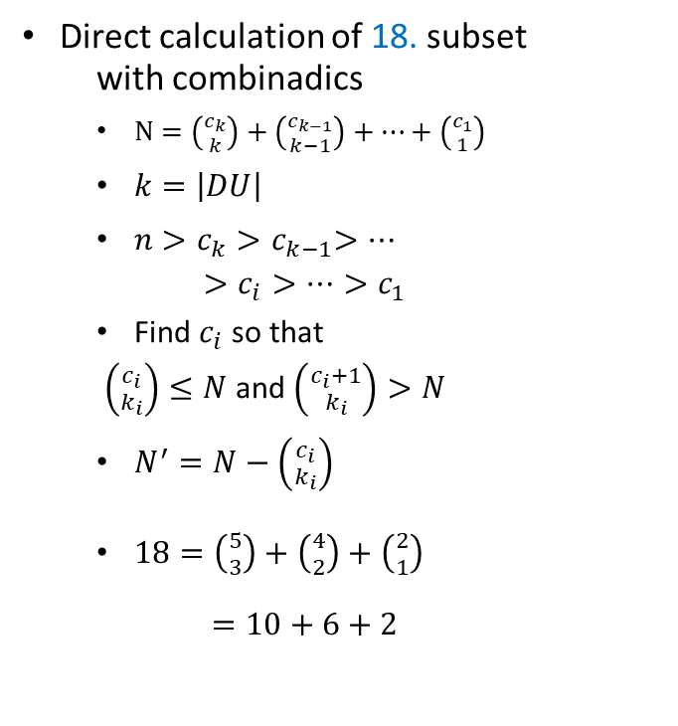

3. Calculation of DUs
Sequential Calculation
Lexicographically
$CS=\left\{0, 1, 2, 3, 4, 5\right\}, \left|CS\right|=6$
$τ=2$ → $k=\left|DU\right|=3$
$\left({n \atop k}\right)$: # of k-sized subsets of n
E.g. $\left({6 \atop 3}\right)=20$ with $n=\left|CS\right|$
Start seed {0, 1, 2}
{0, 1, 3}, {0, 1, 4}, {0, 1, 5},
{0, 2, 3}, {0, 2, 4}, {0, 2, 5},
{0, 3, 4}, … , {3, 4, 5}
Colexicographically
Knowledge of predecessor DU not required
useful for parallelization
0: {0, 1, 2}, 1: {0, 1, 3}, 2: {0, 2, 3},
3: {1, 2, 3}, 4: {0, 1, 4}, 5: {0, 2, 4},
…, 18: {2,4,5}, 19: {3,4,5}
Direct calculation of 18. subset
with combinadics
$N=\left({c_{k} \atop k}\right)+\left({c_{k−1} \atop k−1}\right)+…+\left({c_{1} \atop 1}\right)$
$k=\left|DU\right|$
$n>c_{k}{>c}_{k−1}>…$
$$>c_{i}>…>c_{1}$$
Find $c_{i}$ so that
$\left({c_{i} \atop k_{i}}\right)≤N$ and $\left({c_{i}+1 \atop k_{i}}\right)>N$
$N^{′}=N−\left({c_{i} \atop k_{i}}\right)$
$18=\left({5 \atop 3}\right)+\left({4 \atop 2}\right)+\left({2 \atop 1}\right)$
$$=10+6+2$$
Runtime per Subset with Combinadic:
$O\left(k^{2}∙\log_{2}n\right)$
$0≤N≤\left({n \atop k}\right)$
With Lookup-Table: $O\left(k∙\log_{2}n\right)$
Runtime sequential:
$O\left(1\right)$
Optimizing calc. binominal coefficient
$\left({n \atop k}\right)=\frac{n!}{k!\left(n−k\right)!}$
k = max($τ$+1 )
0 0 0 0
0 0 0
0 0
0
Example:$\left({6 \atop 2}\right)=15$
[3]
Notes:
Sequential calculation is a disadvantage
Bin(6, 3) = 20
Utilize the fact that
Any nat. Num. can be represented as a unique sum of k decreasing binomial coefficients
Pascal: with naive calculation faculty can become not computable

Slide 9
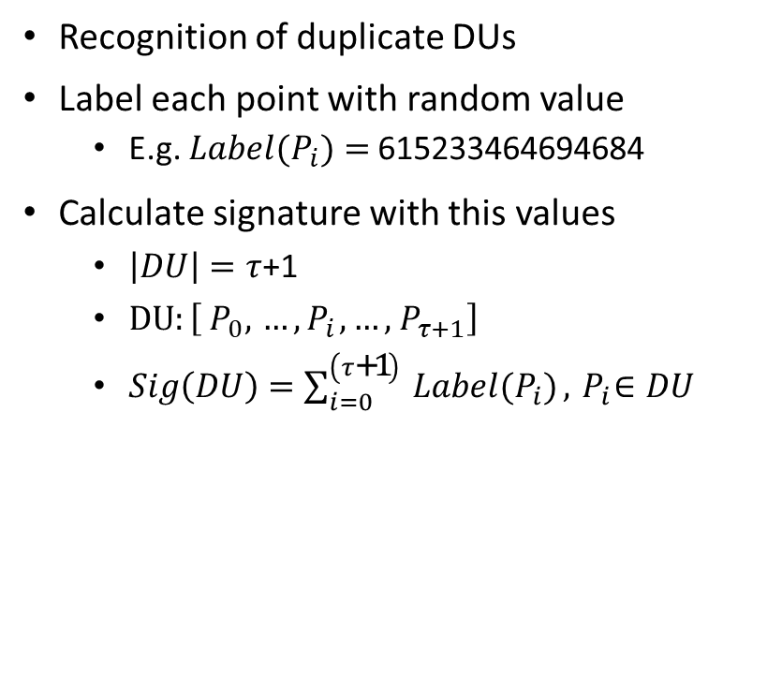
Exploring greater Clusters
1. Data Projection
2. CoreSet creation
3. Calc. of Dense Units
4. Collision of Dense Units
5. Mapping to Subspaces
6. Final Clustering
Recognition of duplicate DUs
Label each point with random value
E.g. ${Label(P}_{i})=$615233464694684
Calculate signature with this values
$\left|DU\right|=τ$+1
$DU:\left[{ P}_{0},{ …,P}_{i}, …,{ P}_{τ+1}\right]$
$Sig\left(DU\right)=\sum_{i=0}^{\left(τ\text{+1}\right) }{{Label(P}_{i})}, { P}_{i}∈DU$
Put it in a datastructure
[Sig, DU, Dims]
Sig as key
Dims contains one or more dimensions
E.g.
[615233464694684, [3, 9, 2, 42], [0, 8]]
[377328476218479, [3, 5, 2, 12], [0, 8]]
Find maximal subspaces
[Dims, Points]
E.g. [[0,8], {3, 9, 2, 42, 5, 12}]
Output to file
Notes:
Datastructure for Signatures: Combine Dimensions with same DUs
Datastructure for Subspaces: Combine Points from different DUs of same Subspace

Slide 10
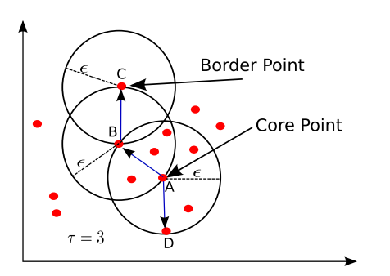

Final Clustering
1. Data Projection
2. CoreSet creation
3. Calc. of Dense Units
4. Collision of Dense Units
5. Mapping to Subspaces
6. Final Clustering
DBSCAN
Input for DBSCAN:
[Dims, Points]
min. $τ$ neighbours
ϵ distance
Output
List([Point, ClusterID])
Runtime for each Subspace
$O\left(n^{2}\right)$
$n=\left|Points\right|$ in [Dims, Points]
[4]
Notes:
Retrieve all „density reachable“ points to Core Point

Slide 11
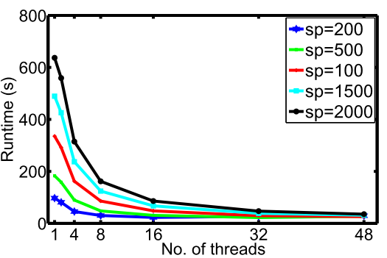
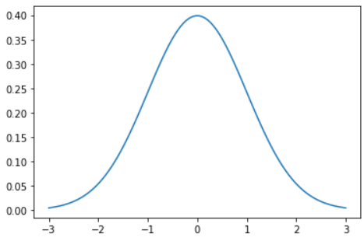
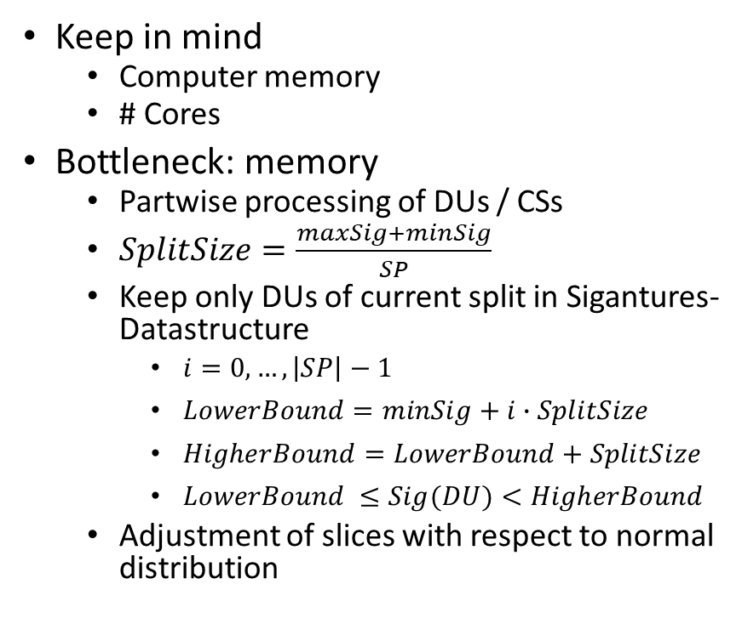
Performance Trade Offs
Keep in mind
Computer memory
# Cores
Bottleneck: memory
Partwise processing of DUs / CSs
$SplitSize=\frac{maxSig+minSig}{SP}$
Keep only DUs of current split in Sigantures-Datastructure
$i=0, …, \left|SP\right|−1$
$LowerBound=minSig+i∙SplitSize$
$HigherBound=LowerBound+SplitSize$
$LowerBound ≤Sig(DU)<HigherBound$
Adjustment of slices with respect to normal distribution
Parallelization with multicores
Dimensions
Slices
DUs
Increasing performance
[4]
Notes:
2 Points of interest.
Cores: levereage multicores for prallel processing
Parallelization

Slide 12
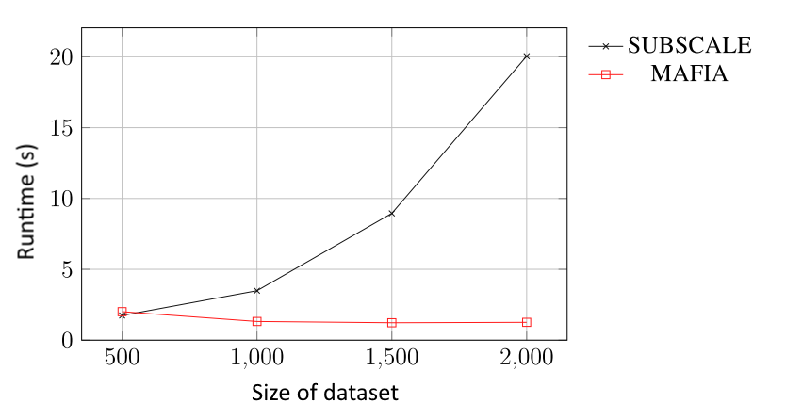
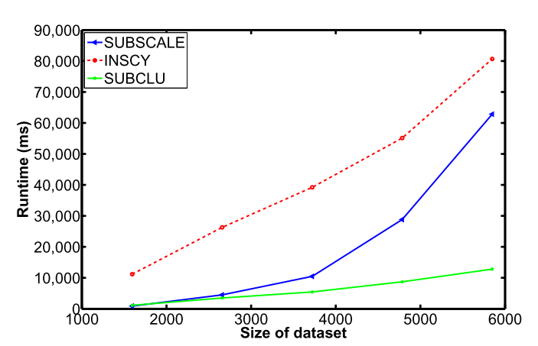
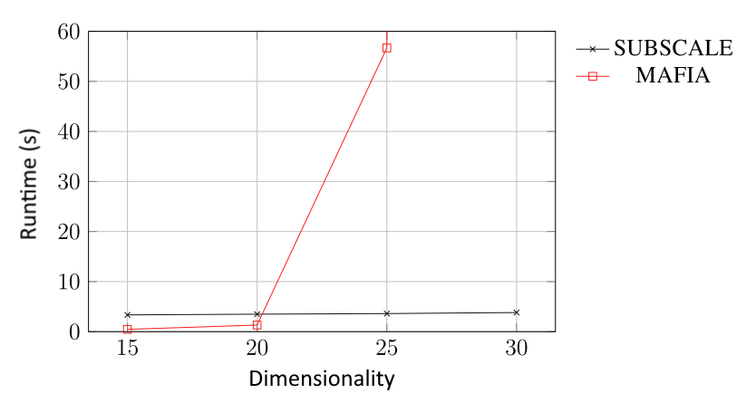
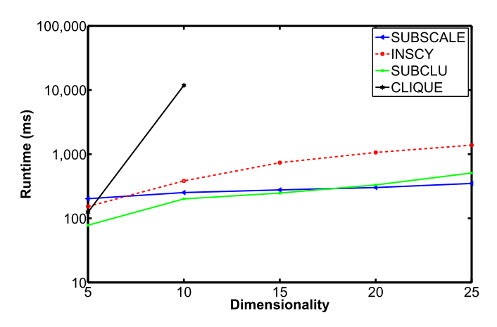
Comparison
Dimensionality:
20
Dimensionality:
20
Size of dataset:
Ca. 1600
Size of dataset:
1000
[5]
[4]
Notes:
Tides turn when Dimensions are raised.
5:
upper pic - number of dimensions: 20
Size of dataset: 1000
4: upper pic - number of dimensions: 20
Lower pic – size of dataset: ca. 1600

Slide 13
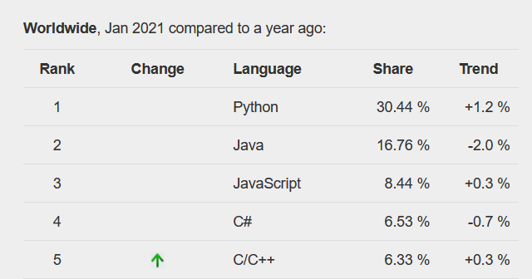
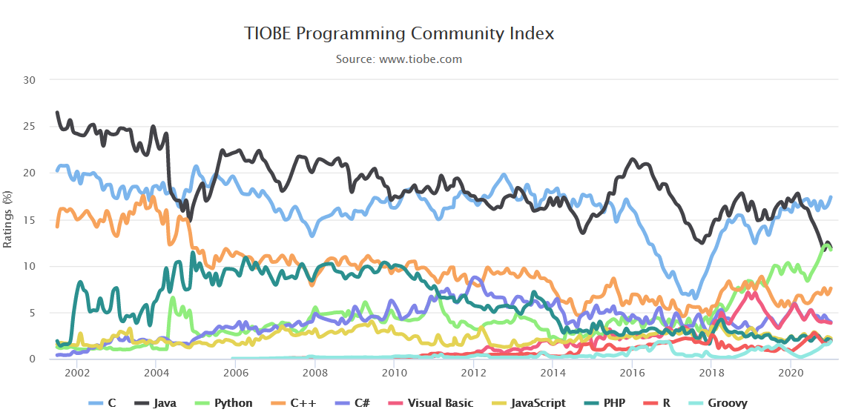
Why Python?
PYPL PopularitY:
Usability, System integration
State of the art for Machine learning
Front end for C and C++ programs
In Docker container
[6]
C
Python!
C++
[7]
Notes:
Python is top dog
C, C++ still popular
easier exploitation of performance with python

Slide 14
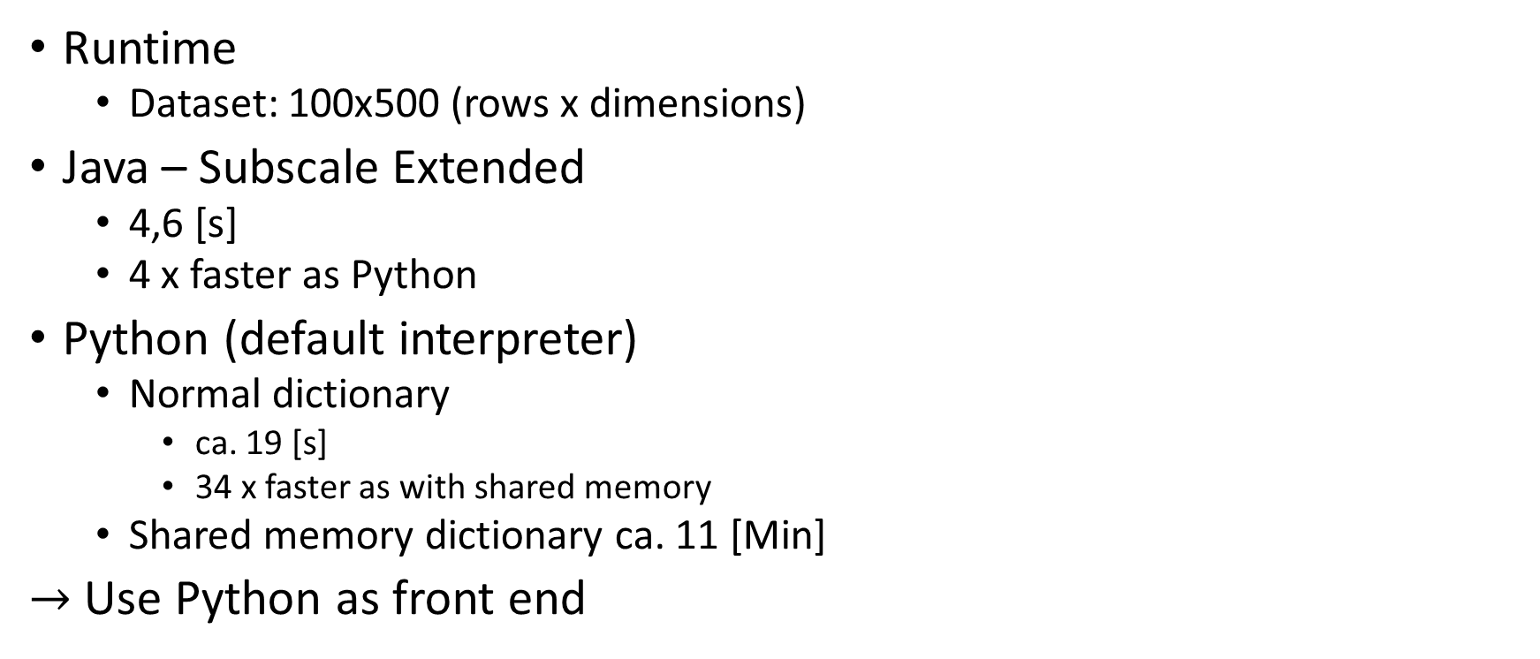
Python - The Slowpoke
Runtime
Dataset: 100x500 (rows x dimensions)
Java – Subscale Extended
4,6 [s]
4 x faster as Python
Python (default interpreter)
Normal dictionary
ca. 19 [s]
34 x faster as with shared memory
Shared memory dictionary ca. 11 [Min]
$→$ Use Python as front end

Slide 15
Sources
[0]: https://en.wikipedia.org/wiki/Iris_flower_data_set#/media/File:Principal_tree_for_Iris_data_set.png
[1]: https://de.wikipedia.org/wiki/Bl%C3%BCte#/media/Datei:Bluete-Schema.svg
[2]: https://morioh.com/p/eafb28ccf4e3
[3]: https://wikimedia.org/api/rest_v1/media/math/render/svg/23050fcb53d6083d9e42043bebf2863fa9746043
[4]: Amardeep Kaur (2016). “Fast and Scalable Subspace Clustering of High Dimensional Data”, Perth, Australia, The University of Western Australia
[5]: Nicolas Kiefer (2020) „Datenparalleles Subspace Clustering mit Grafikprozessoren“, Offenburg, Deutschland, Hochschule Offenburg
[6]: https://pypl.github.io/PYPL.html
[7]: https://www.tiobe.com/tiobe-index/

