Slide 1
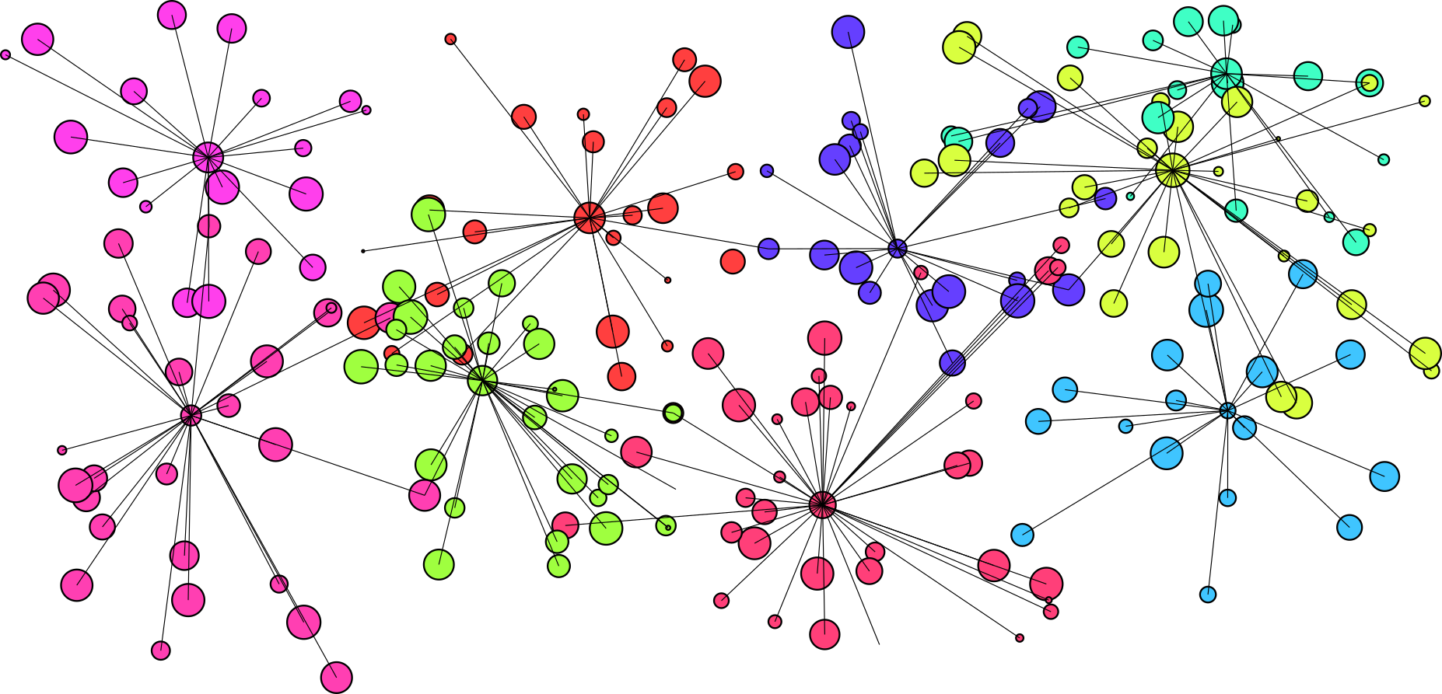
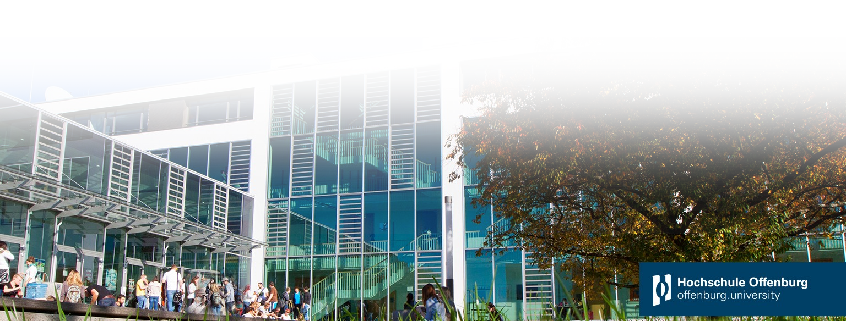

Python Implementation of the SUBSCALE algorithm
Speaker:
Stanislav Ramin
Supervisor:
Prof. Dr. rer. nat. Tobias Lauer
M. Sc. Jürgen Prinzbach
based on Java reference
Notes:
Welcome to the presentation of the SUBSCALE algorithm-implementation in Python.

Slide 2
Introduction
First implemented
University of Western Australia in 2014
Ph.D. Amardeep Kaur
Java
M.Sc. Nicolas Kiefer
C++
CUDA for GPU support
In 2020
Outline
Why Python?
Theory
Clustering
Problems
Solutions
Subscale Algorithm
Performance and Comparison
Trade offs SUBSCALE
Other Clustering Algorithms
Notes:
The algorithm was first implemented in 2014 in Java.
The latest reimplementation and enhancement has been done in C++ and CUDA with GPU-support, last year.
[1]: This presentation covers the
rationale behind the choice of the programming language
The theory
what clustering is
The problems
And how they can be solved
Then the algorithm is explained.
Finally, its performance is analyzed and comparison to other algorithms is performed.

Slide 3
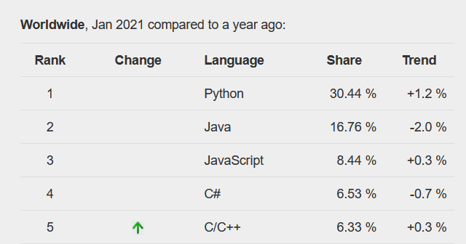
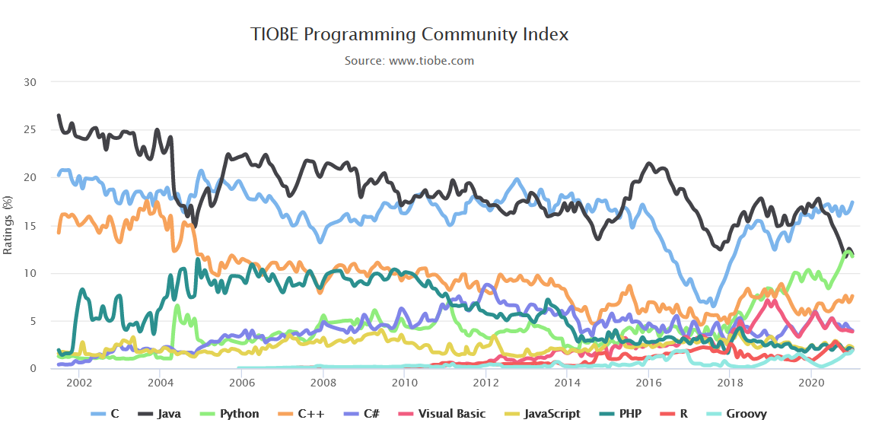
Why Python?
PYPL PopularitY:
Usability, System integration
State of the art for Machine learning
Front end for C and C++ programs
In Docker container
[7]
C
Python!
C++
[8]
Notes:
According to popular programming language indices, Python is currently the top dog among programming languages,
while C and C++ are still popular.
For usability reasons, Python is the state of the art for machine learning.
Researchers can harness C and C++ programs easier just by utilizing Python as a front-end and configuration suite.
Also, the system integration can be performed comfortably with docker containers.

Slide 4
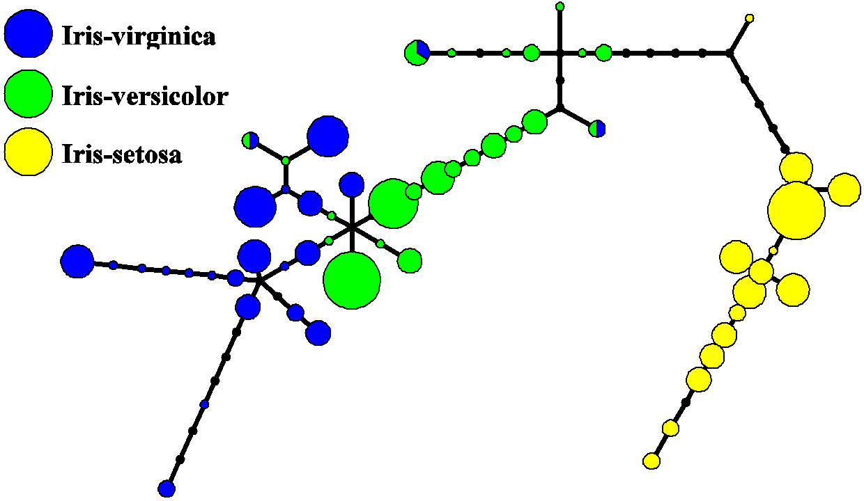
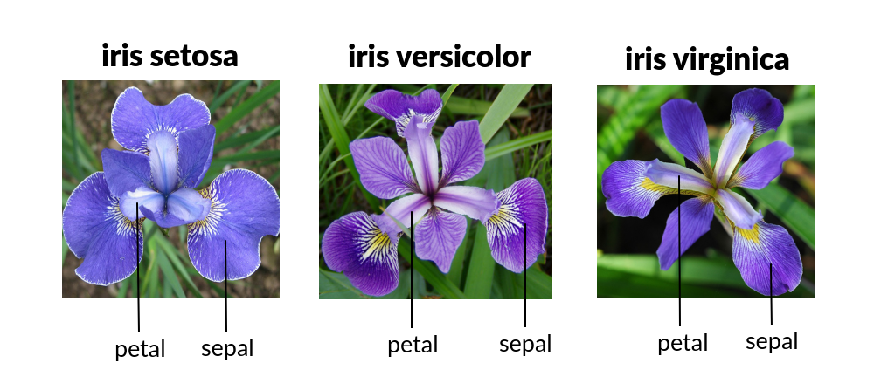
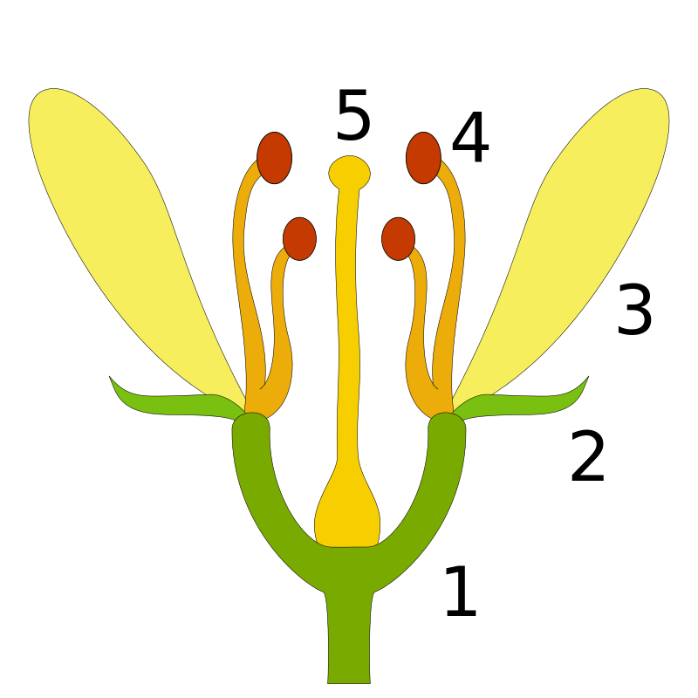


What is clustering and why use it? Example Iris Dataset $→$ Number of species?
Cluster
Set of $k≥$ Min_Points
Each P within ϵ distance
Field of Interest
Data science
Biology, Clinical diagnostics,
Data fraud, …
Example
# flowers / Rows: 150
Columns: 4
petal-width, petal-height
sepal-width, sepal-height
ϵ
petal
[0]
[1]
sepal
[2]
Notes:
So, what is clustering and what is the field of its application?
A density-based Cluster, is a group of points with a threshold of at least a specified amount of minimum points within a given distance.
[1]: Clustering can be applied to gain explorative insight into data from different fields of expertise.
[2]: For example: We could
determine the number of species from a multivariate dataset of 150 flower exemplars,
by examining the attributes of its petals and sepals.
Usually, there is no prior knowledge of the underlying data distribution.
We just know, that each specimen has 4 features. It is the width and height of the petals and the sepals.
Those attributes can be projected into a 4 dimensional space.
[3]As the result there should be 3 classes, so that each flower can be assigned to its most suitable cluster.
If we get a different amount of clusters or some specimen are matched together with other specimen then this might be of the cause that there is an another undiscovered species.
Or, only 2 clusters have been found. So maybe the expected third class is just an anomaly of one of the others?
[4]: E.g. As we see here, there is a cluster where it is not certain to which class the cluster belongs.

Slide 5


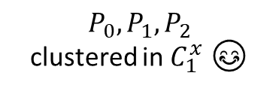





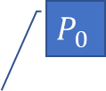










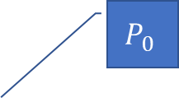
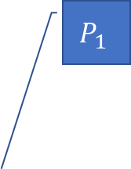
Curse of Dimensionality
Dimensional space of interest
$$P_{1}$$
$$P_{1}$$
$$P_{1}$$
d
$$P_{1}$$
?
y
d
$$P_{2}$$
$$P_{2}$$
y
$$P_{2}$$
$$P_{2}$$
y
x
x
z
z
x
x
Bottom-up clustering
Cluster in 1d space
Cluster in 2d space
Cluster in 3d space
$$P_{0}$$
$$C_{1}^{x}$$
$$P_{0}$$
$$C_{1}^{x,y,z}$$
$$C_{1}^{x,y}$$
$$P_{1}$$
$$P_{1}$$
$$C_{2}^{x,y}$$
$$P_{2}$$
y
$$P_{2}$$
x
$$P_{0},P_{1},P_{2}$$
clustered in $C_{1}^{x}$ 😊
y
x
x
z
$P_{1}∈C_{1}^{x,y} and P_{2}∉C_{1}^{x,y}$😒
$$P_{0},P_{1}∈C_{1}^{x,y,z}$$
Notes:
Bec. of the high dimensional nature of this 3-dimensional representation it is hard to recognize, which Points belong together and which not.
The reason for this, is because the volume of the space in dimensions grows much more, than the contained data within.
So, even when clustered points are only in few dimensions not similar, that is, when the distance in these few particular dimensions between points is much bigger compared to other dimensions, then, the overall similarity between the points drops.
So, the Relative contrast between dense and not dense points is reduced with each added dimension.
As a consequence, [0] points appear equidistant from each other
Thus, some potential clusters cannot be found
So, what if we don’t mind that only in very few dimensions the distance between points is too big to create a cluster?
[1]
Let’s say the final clustering would look like this, but we don’t know it yet. We still see the data as before, as black dots.
The Solution is: let’s reduce the dimensions!
[2]: In order to obtain a clearer view, the points are observed in a lower dimensional space by folding points from higher dimensions to lower ones.
When the z-axis is skipped, the Points appear to be more clustered to each other.
[3]: Then again, now the y-axis is skipped.
This is a representation where clustered Points are becoming recognizable as such at best.
From this observation we understand that if P_1 and P_2 were clustered in the 3d sp., then they would also be clustered in the 2 and the 1d. Space.
This approach can also be done the other way around: clusters could be created bottom-up!
[4]: Let’s consider an example where there exist 3 Points that are clustered in Cluster C_(1)^x in dimension x
[5]: Now, when computing 2 dim. clusters it can happen, that some Points that were before in the same cluster, are now located in different clusters.
In some traditional clustering algorithms this cluster [the cluster C_2^(x,y)] might have remained hidden.
[6]: Those algorithms would only reveal clusters that are present in all dimensions.

Slide 6


Solved Problems (I)
Problem 1
Only Points in full dimensional space are discovered
Solution 1
Search in all Subspaces of the features
$$P_{1}$$
$$P_{1}$$
Cluster in 3d space
$$P_{2}$$
$$P_{0}$$
y
$$C_{1}^{x,y,z}$$
$$P_{2}$$
$$P_{1}$$
$$P_{1}$$
x
$$P_{2}$$
z
y
$$P_{2}$$
$$P_{1}$$
x
$$P_{1}$$
z
z
$$P_{2}$$
$$P_{2}$$
x
$$P_{0},P_{1}∈C_{1}^{x,y,z}$$
y
x
$$P_{1}$$
…
z
$$P_{2}$$
y
Notes:
By utilizing the introduced technique 2 Problems are solved:
[1]: The first problem is, that the similarity of Points has to be observed in all dimensions. So, clusters in subspaces remain hidden.
[2]: This problem can be solved by determining clusters in every subspace.

Slide 7

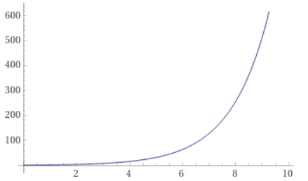

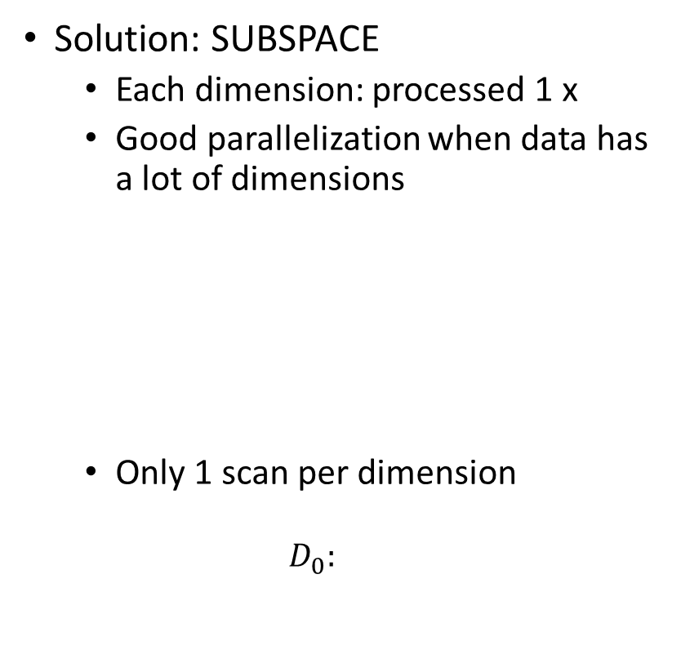





Solved Problems (II)
Problem 2
d: number of dimensions or features
$2^{d}$-1 possible subsets (subspaces)
Example:
For $d=3$
Subspaces $=7$
$$\left\{x, y, z, xy, xz, yz, xyz\right\}$$
Solution: SUBSPACE
Each dimension: processed 1 x
Good parallelization when data has a lot of dimensions
Only 1 scan per dimension
$$D_{0}:$$
Instructions
$$D_{0}:$$
CPU 1
Data
$$D_{1}:$$
CPU 2
$$D_{2}:$$
CPU 3
$$f\left(d\right)=2^{d}$$
$$P_{0}$$ | $$P_{1}$$ | $$P_{2}$$ | $$P_{…}$$ | $$P_{n}$$
Notes:
However, this solution leads to a consequential problem: The number of possible subspaces is the power set of the dimensions of the dataset.
[1]: For even 3 Dimensions there are already 7 subspaces.
[2]: Luckily, this problem can be solved with the idea introduced in the previous slides and the SUBSPACE algorithm that is based on it.
With some adaptions it has the advantage that
Each dimension is processed only once.
Each dimension can be scanned independently of other dimensions.
That’s enormously beneficial when the dataset has a lot of dimensions.
Points in each dimension have to be scanned only once.

Slide 8











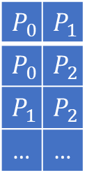




























SUBSCALE Overview
1. Data Projection
2. CoreSet creation
3. Calc. of Dense Units
4. Collision of Dense Units
5. Transfor- mation
6. Final Clustering
$$D_{0}$$
$${? \atop =}$$
$$D_{1}$$
$$P_{i}$$ | $$P_{j}$$
$$P_{x}$$ | $$P_{y}$$
$$\left|c_{2}\right|=5$$
DU
$${DU}_{1}$$
$${DU}_{2}$$
Dataset:
$$minPoints=2$$
$$P_{0}$$ | $$P_{1}$$
$$P_{0}$$ | $$P_{2}$$
$$P_{1}$$ | $$P_{2}$$
… | …
$$D_{0},D_{1},D_{2},…$$
$\left|c_{1}\right|=$ 4
DUs | Subspace
$$D_{0},D_{1},D_{2},…$$
$$P_{0}$$
$$P_{1}$$
$$P_{2}$$
$$P_{0}$$
$$P_{1}$$
$$P_{2}$$
$$P_{i}$$ | $$P_{j}$$
$$D_{0},D_{1}$$
$P_{0}$, $P_{1}$, $P_{2}$, $P_{3}$, $P_{4}$, $P_{5}$, $P_{6}$ $P_{7}$, …
$$P_{k}$$ | $$P_{l}$$
$$D_{0}$$
$$c_{1}$$
ϵ
ϵ
$$…$$
$$c_{2}$$
$$…$$
$$…$$
$c_{1} :P_{0}$, $P_{1}$, $P_{2}$, $P_{3}$
$$…$$
Subspace | Points
1d cluster:
$c_{1}$, $c_{2}$
$D_{0}$, $D_{1}$
$$P_{i}$$ | $$P_{j}$$ | $$P_{y}$$ | $$P_{k}$$ | $$P_{l}$$
$c_{1}$, $c_{2}$, … | …
$$c_{1}$$
$c_{1}$, $c_{2}$, …
$c_{1}$, $c_{2}$, … | … | …
$$D_{1}$$
$$P_{x}$$ | $$P_{j}$$ | $$P_{y}$$
$$D_{0}$$
$$D_{1}$$
$$D_{2}$$
$$…$$
Notes:
SUBSCALE embraces clustering by grouping Points and regrouping the resulted groups again and again.
First, Points from a Dataset, from one dimension, are chosen.
Then, 1dim. Clusters, consisting of this points are identified.
Each cluster contains at least a defined minimal amount of Points, called $minPoints$, within ϵ > 0 distance.
[3]: All of the found clusters are assigned to the current dimension.
[4]: This procedure is repeated for every dimension of the dataset.
Every cluster is so processed that all subsets of minPoints-size are determined: We call them DU.
A Check is performed to examine if there are same DU in different dimensions.
Found occurrences are stored in a table as records with DUs and associated dimensions.
Then a transformation of DUs and Subspaces is performed. Points from multiple DUs are resolved to Clusters of each Subspace.
Ultimately, the final clustering is performed with a common clustering algorithm on each Point-collection of the Subspace-records.

Slide 9
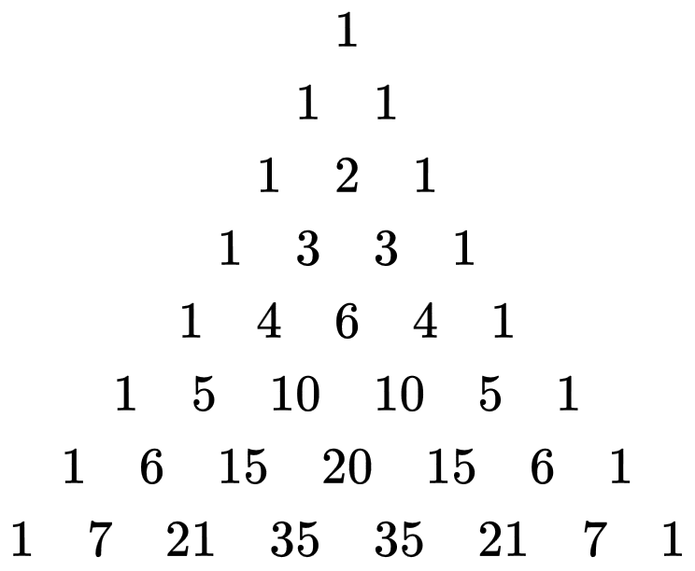

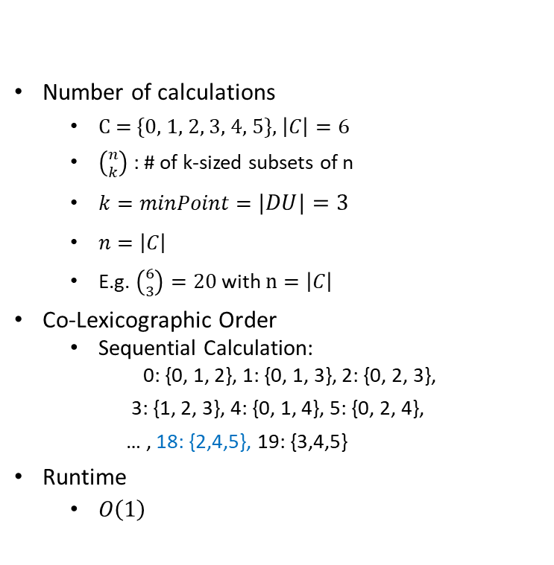

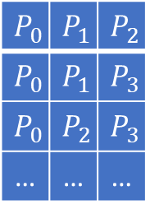
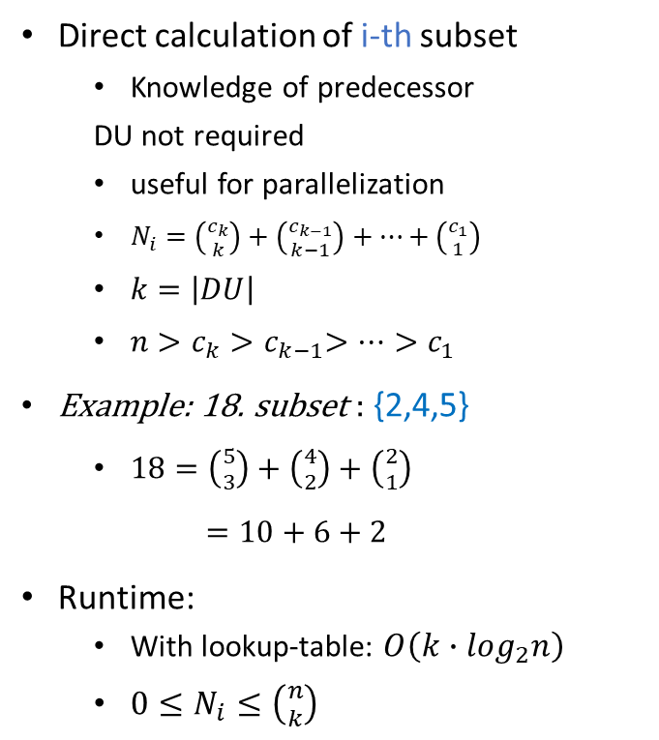

3. Calculation of DUs
DU
Number of calculations
C = {0, 1, 2, 3, 4, 5}, $\left|C\right|=6$
$\left({n \atop k}\right)$: # of k-sized subsets of n
$k=minPoint=\left|DU\right|=3$
$n=\left|C\right|$
E.g. $\left({6 \atop 3}\right)=20$ with $n=\left|C\right|$
Co-Lexicographic Order
Sequential Calculation:
0: {0, 1, 2}, 1: {0, 1, 3}, 2: {0, 2, 3},
3: {1, 2, 3}, 4: {0, 1, 4}, 5: {0, 2, 4},
… , 18: {2,4,5}, 19: {3,4,5}
Runtime
$O\left(1\right)$
Direct calculation of i-th subset
Knowledge of predecessor
DU not required
useful for parallelization
$N_{i}=\left({c_{k} \atop k}\right)+\left({c_{k−1} \atop k−1}\right)+…+\left({c_{1} \atop 1}\right)$
$k=\left|DU\right|$
$n>c_{k}{>c}_{k−1}>…>c_{1}$
Example: 18. subset : {2,4,5}
$18=\left({5 \atop 3}\right)+\left({4 \atop 2}\right)+\left({2 \atop 1}\right)$
$$=10+6+2$$
Runtime:
With lookup-table: $O\left(k∙\log_{2}n\right)$
$0≤N_{i}≤\left({n \atop k}\right)$
Optimizing: binominal coefficient
Pascal Triangle as lookup-table
$c :P_{0}$, $P_{1}$, $…$ , $P_{5}$
$$P_{0}$$ | $$P_{1}$$ | $$P_{2}$$
$$P_{0}$$ | $$P_{1}$$ | $$P_{3}$$
$$P_{0}$$ | $$P_{2}$$ | $$P_{3}$$
… | … | …
k = max( minPoints )
0 0 0 0
0 0 0
0 0
0
Example
$$15=\left({6 \atop 2}\right)$$
[3]
Notes:
While the first and the second step of the SUBSCALE algorithm is of a more trivial nature, steps 3 to 5 have to be particularly emphasized.
[1]: Clusters of adjacent-Points have to be combined to minPoints – sized subsets. These subsets are called DUs.
[2]: The number of DUs can be calculated with the Binomial Coefficient.
For example, we calculate 20 subsets from a 6-element sized cluster, where each subset has the size of 3 elements.
[3]: By utilizing the Co-Lexicographic order each DU can be calculated sequentially based on its predecessor.
The highlighted positions mark the changes in each step.
The numbers in the curly braces are the selected points.
With such a specification, the calculation of the next element is processed super quick, namely in constant runtime!
[4]: Since this calculation is a good expandable bottleneck of this algorithm, there is also the option to compute a particular DU out of order, without knowledge of the predecessor.
And independent computation is beneficial for parallel computation.
For parallel computation it is possible to utilize the fact that Any nat. Num. can be represented as a unique sum of k-decreasing binomial coefficients.
The c’s in the upper area of the binomial coefficient, are the wanted positions of the points in the DU.
For example, the 18. subset would contain the numbers {2, 4, 5}
We see that the sum of the combinations is indeed 18.
Since the binomial coefficient consists of the factorial, the runtime of such a calculation with a naïve approach would be pretty high.
But, with a lookup-table the runtime can be dramatically reduced. This approach can be combined with the sequential calculation.
[5]: Incidentally, the lookup table can be quickly computed as the so-called Pascal triangle.
The computation is based on successive addition of predecessor values; thus, it is super quick!

Slide 10
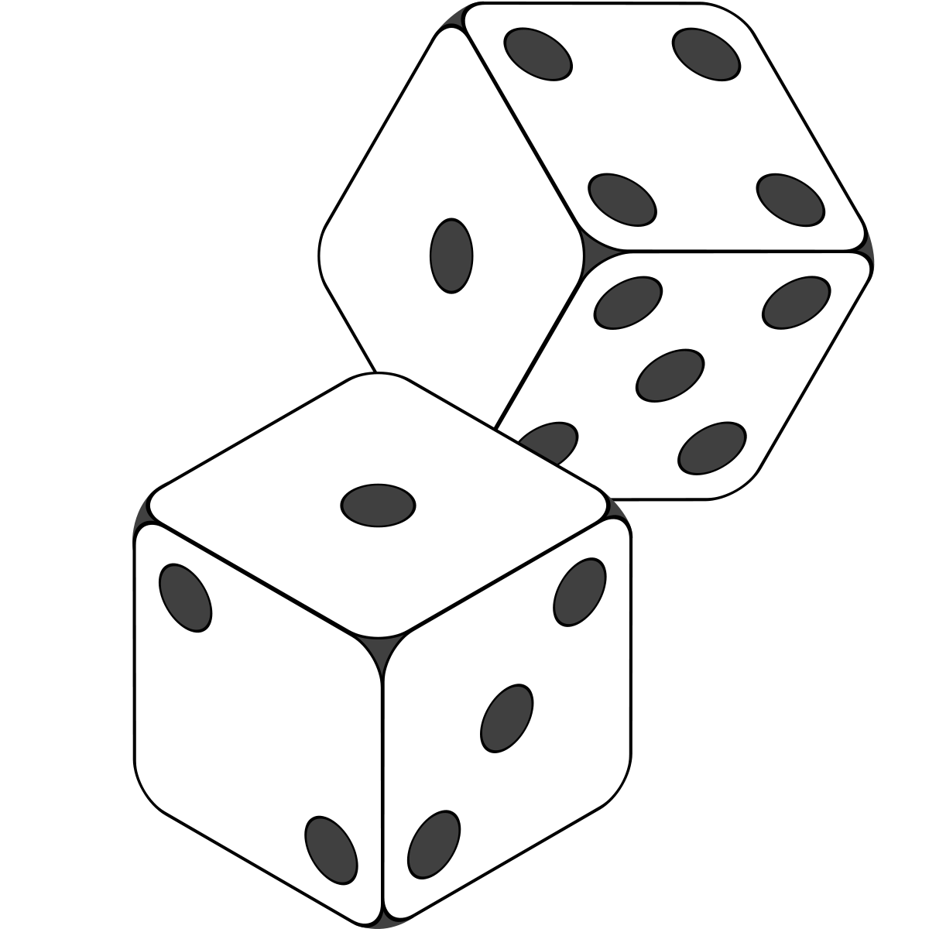






















4. Collisions
1. Data Projection
2. CoreSet creation
3. Calc. of Dense Units
4. Collision of Dense Units
5. Transfor- mation
6. Final Clustering
Label each point with random value
E.g. ${Label(P}_{i})=$615233464694684
$$D_{0}$$
$${? \atop =}$$
$$D_{1}$$
$${DU}_{1}$$
$$P_{1}$$ | $$P_{2}$$
$$P_{x}$$ | $$P_{y}$$
$${DU}_{2}$$
Already in table
!
!
$${Sig(DU}_{1})={ Sig(DU}_{2})$$
[4]
Collision
table:
Signature | DUs | Subspace
$${Sig(DU}_{1})$$
$$P_{1}$$ | $$P_{2}$$
$$D_{0}$$
$$D_{1}$$
Signature Calculation
$$\sum_{i=0}^{\left(minPoints\right) }{{Label(P}_{i})}, { P}_{i}∈DU$$
$${Sig(DU}_{x})$$
$$P_{x}$$ | $$P_{y}$$
$$D_{1}$$
$$P_{x}$$ | $$P_{y}$$
$${DU}_{x}$$
$$\text{615233464694684}$$
$$\text{291648717326937}$$
Notes:
Since there could exist same DUs in different dimensions they have to be identified as such.
After all this is the point where subspace clustering comes into the picture.
So right after the computation of the DUs, they are compared in order to find higher subspaces.
[1]: First, before and independently of all of the SUBSCALE computation steps, all Points of the dataset are labeled once with a high random value.
[2]: Later, in Step 4, the Sum of the labels for each DU is calculated.
[3]: Then the signatures of the DUs are compared.
If there is no record in the collision table, then a [4] new entry is created.
If there is already a record, then the [5] dimension is appended to it.

Slide 11














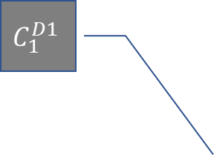





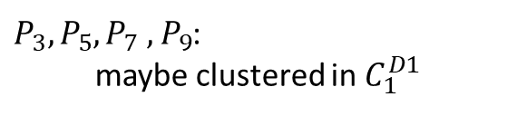
5. Mapping
Potential cluster in 1d space
1. Data Projection
2. CoreSet creation
3. Calc. of Dense Units
4. Collision of Dense Units
5. Transfor- mation
6. Final Clustering
Signature | DUs | Subspace
$${Sig(DU}_{1})$$
$$P_{1}$$ | $$P_{2}$$ | $$P_{3}$$
$$D_{0}$$
$$D_{1}$$
$$C_{1}^{D1}$$
$${Sig(DU}_{2})$$
$$P_{3}$$ | $$P_{5}$$ | $$P_{7}$$
$$D_{0}$$
$${Sig(DU}_{3})$$
$$P_{3}$$ | $$P_{5}$$ | $$P_{9}$$
$$D_{0}$$
$${Sig(DU}_{4})$$
$$P_{3}$$ | $$P_{4}$$ | $$P_{5}$$
$$D_{0}$$
$$D_{1}$$
$$D_{1}$$
$P_{3},P_{5},P_{7}$ $,P_{9}$:
maybe clustered in $C_{1}^{D1}$
Subspace | Points
$D_{0}$, $D_{1}$
$$P_{1}$$ | $$P_{2}$$ | $$P_{3}$$ | $$P_{4}$$ | $$P_{5}$$
$$D_{1}$$
$$P_{3}$$ | $$P_{5}$$ | $$P_{7}$$ | $$P_{9}$$
Notes:
After that, the dimensions and the points within DUs have to be rearranged.
[1]: In this process, the points from different DUs have to be matched and unified to same subspaces.
[2]: Points that are present in multiple DUs (like Points 3 and 5 in DU 2 and 3) are added only once.
[3]: The points in the resulted record are likely still clustered in the respective subspace.
This makes them favorable candidates for the final clustering.

Slide 12
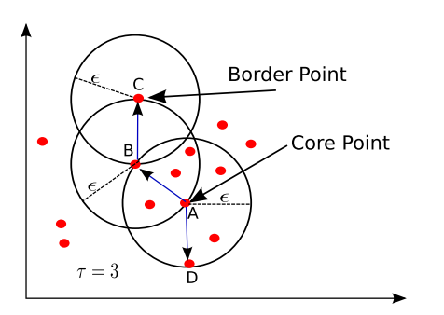


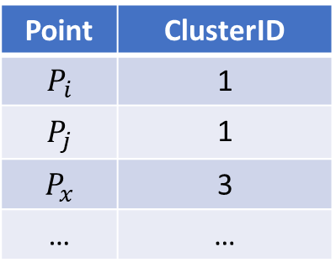
Final Clustering
Input for DBSCAN:
[Dims, Points]
Output
1. Data Projection
2. CoreSet creation
3. Calc. of Dense Units
4. Collision of Dense Units
5. Mapping to Subspaces
6. Final Clustering
DBSCAN
Subspace | Points
$D_{0}$, $D_{1}$
$$P_{i}$$ | $$P_{j}$$ | $$P_{y}$$ | $$P_{k}$$ | $$P_{l}$$
$$D_{1}$$
$$P_{x}$$ | $$P_{j}$$ | $$P_{y}$$
Point | ClusterID
$$P_{i}$$ | 1
$$P_{j}$$ | 1
$$P_{x}$$ | 3
… | …
[5]
Notes:
For the final clustering [1] each record from the subspaces data structure is processed with a full dimensional clustering algorithm, for example DBSCAN.
[2]: The Output for each Subspace-Points record is listed as multiple records where each Point has a corresponding Cluster ID.

Slide 13
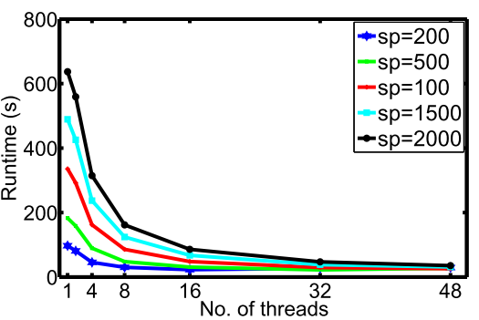

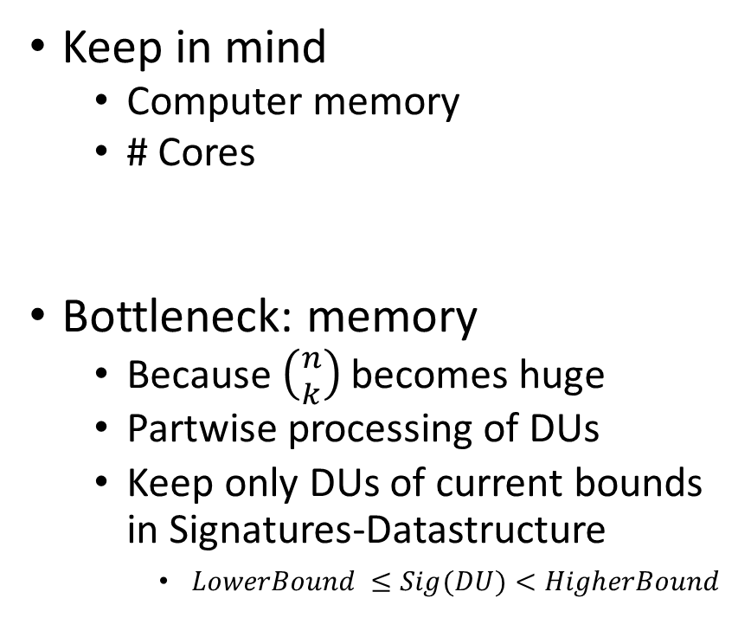


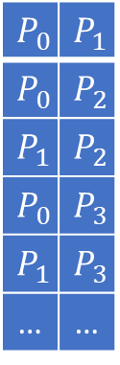
Performance Trade Offs
$$t=0$$
DU
Parallelization approaches with multicores
DUs
Bounds
Dimensions
$$t=1$$
Keep in mind
Computer memory
# Cores
Bottleneck: memory
Because $\left({n \atop k}\right)$ becomes huge
Partwise processing of DUs
Keep only DUs of current bounds in Signatures-Datastructure
$LowerBound ≤Sig(DU)<HigherBound$
Lower
Bound
$$P_{0}$$ | $$P_{1}$$
$$P_{0}$$ | $$P_{2}$$
$$P_{1}$$ | $$P_{2}$$
$$P_{0}$$ | $$P_{3}$$
$$P_{1}$$ | $$P_{3}$$
… | …
Higher
Bound
Increasing performance
SP $\sim$ RAM
[5]
Notes:
When it comes to performance there are 2 Points of interest:
First: There is the computer memory for storing DUs
and second: multiple Processor Cores can be harnessed to leverage the computation of DUs with parallel processing.
[1]: The main bottleneck, that can be tuned, is the memory because the number of combinations can become huge and the DUs might not fit into the memory at once.
[2]: So, in order to be able to calculate all DUs, they have to be calculated [3] in parts at different time.
That is achieved by calculating the lower, and higher bounds of signatures.
[4]: This figure describes how the algorithm copes in the theoretical case, when there is a shortage of memory.
The SplitFactor determines the number of the bounds and is proportional to them.
[5]: The higher the specified SplitFactor is, the less memory is used at once and the better the DU computation is performed with increasing amount of parallelization.
[6]: Parallelization can be approached by the following spots:
As already described, by the calculation of DUs
bounds of signatures
and Dimensions can be partitioned.

Slide 14
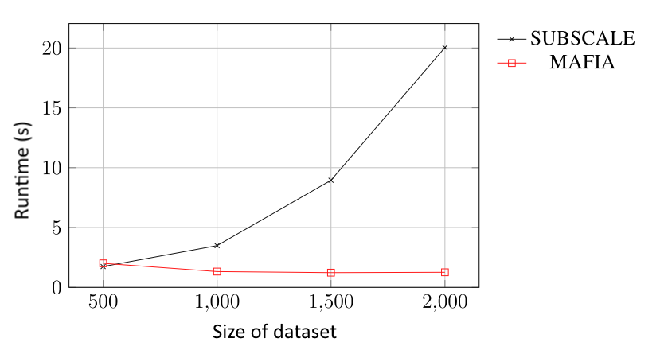
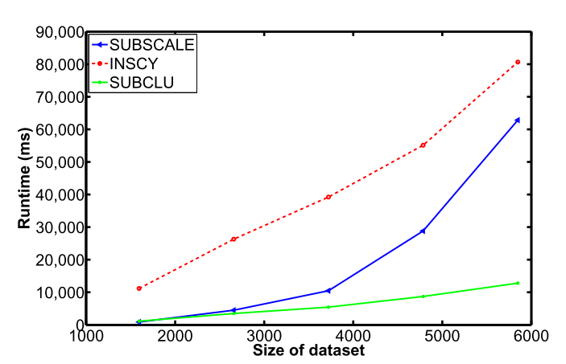
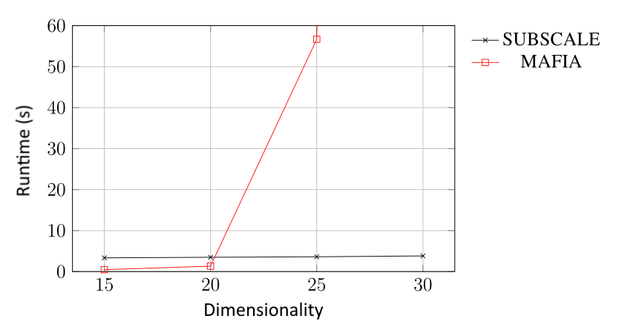
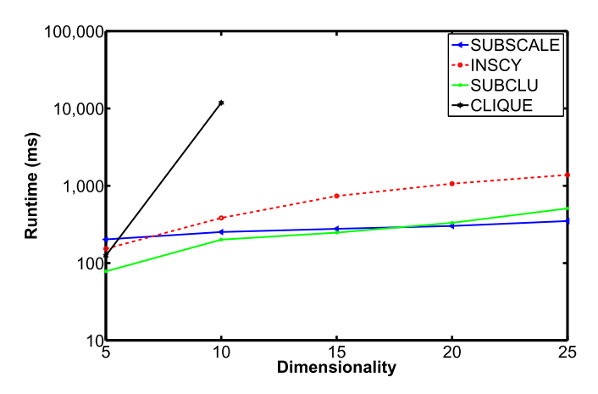
Comparison
Dimensionality:
20
Dimensionality:
20
Size of dataset:
1600
Size of dataset:
1000
[6]
[5]
Notes:
By observing the figures, it can be noticed, that with a constant dimensionality, other algorithms are superior to SUBSCALE.
The lower the runtime, the better.
[1]: But, the tides turn, when dimensions are increased and SUBSCALE can prove it’s superiority.
5:
upper pic - number of dimensions: 20
Size of dataset: 1000
4: upper pic - number of dimensions: 20
Lower pic – size of dataset: ca. 1600

Slide 15
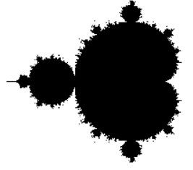
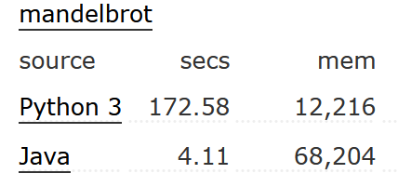
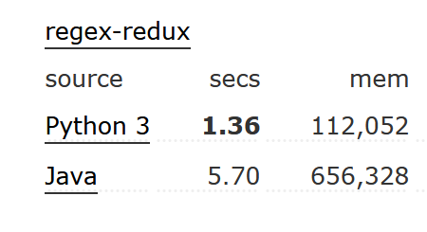
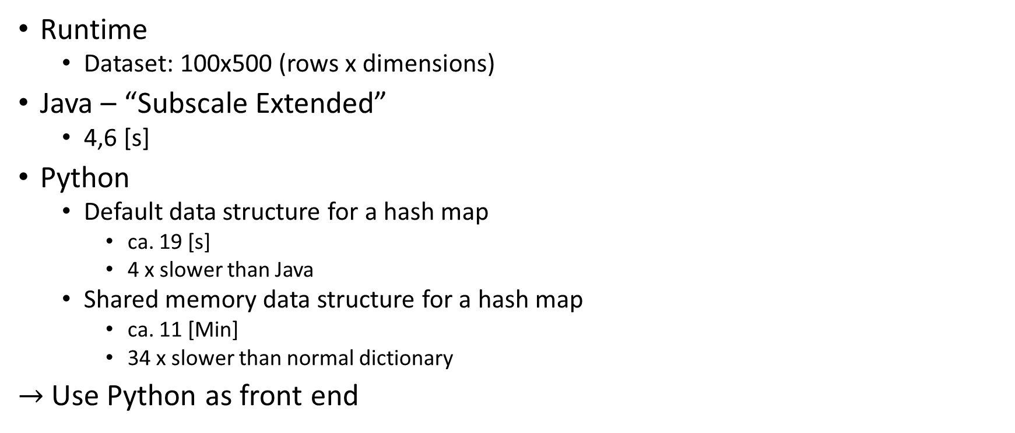
Python - The Slowpoke
Runtime
Dataset: 100x500 (rows x dimensions)
Java – “Subscale Extended”
4,6 [s]
Python
Default data structure for a hash map
ca. 19 [s]
4 x slower than Java
Shared memory data structure for a hash map
ca. 11 [Min]
34 x slower than normal dictionary
$→$ Use Python as front end
VS.
Notes:
As an interpreted language, Python is in its default execution as expected slower than other Programming-Languages, when it comes to algorithmic tasks, like the calculation of the Mandelbrot-fractal instead of its specialization, [1]: the string-based operations on data.
[2]:
By reimplementing SUBSCALE without utilizing specialized programming libraries, I also determined the following serious speed-related facts:
In the latest Java implementation of the algorithm, the runtime for a dataset of 100 rows times 500 features
added up to just 4,6 seconds.
[3]: In contrast to that, it took Python 19 [s] to complete the algorithm with the same parameters.
This, was 4 times slower than Java.
[4]: Meanwhile, just by using a hash-map data structure with shared-memory-support, the runtime has extended up to 34 times. This is crucial, because shared-memory-access is necessary for high performant multi or many-core parallelization.
For evaluation purposes only small test-data was used. And we should keep in mind, that the Runtime scales with a tremendous magnitude dependent on the number of DUs.
[5]: So, at last, it could turn out, that using Python as a front-end configuration suite might be the best decision.

Slide 16
Python: my Outlook list
Multi- / Manycore support
Performance improvement with specialized libraires
Numpy
Use Python as front end suite for C++ implementation
Notes:
My further proceeding implementation will be in the field of multicore CPU and manycore GPU support.
The next performance improvement can be achieved with specialized libraries like numpy, for CPU computation.
This library can exploit the ability of looping quickly through vectorized data.
Ultimately, Python can be harnessed as a front-end suite for the C++ implementation of the algorithm.

Slide 17
?
Link to this document: https://bit.ly/2KXjdnw
Notes:
https://drive.google.com/file/d/1OLchvJKbAVOHWEF5SjGqRQGMU2cB5pTG/view?usp=sharing
https://bit.ly/2KXjdnw

Slide 18
Sources
[0]: https://en.wikipedia.org/wiki/Iris_flower_data_set#/media/File:Principal_tree_for_Iris_data_set.png
[1]: https://de.wikipedia.org/wiki/Bl%C3%BCte#/media/Datei:Bluete-Schema.svg
[2]: https://morioh.com/p/eafb28ccf4e3
[3]: https://wikimedia.org/api/rest_v1/media/math/render/svg/23050fcb53d6083d9e42043bebf2863fa9746043
[4]: https://de.wikipedia.org/wiki/Datei:2-Dice-Icon.svg
[5]: Amardeep Kaur (2016). “Fast and Scalable Subspace Clustering of High Dimensional Data”, Perth, Australia, The University of Western Australia
[6]: Nicolas Kiefer (2020) „Datenparalleles Subspace Clustering mit Grafikprozessoren“, Offenburg, Deutschland, Hochschule Offenburg
[7]: https://pypl.github.io/PYPL.html
[8]: https://www.tiobe.com/tiobe-index/

