Slide 1

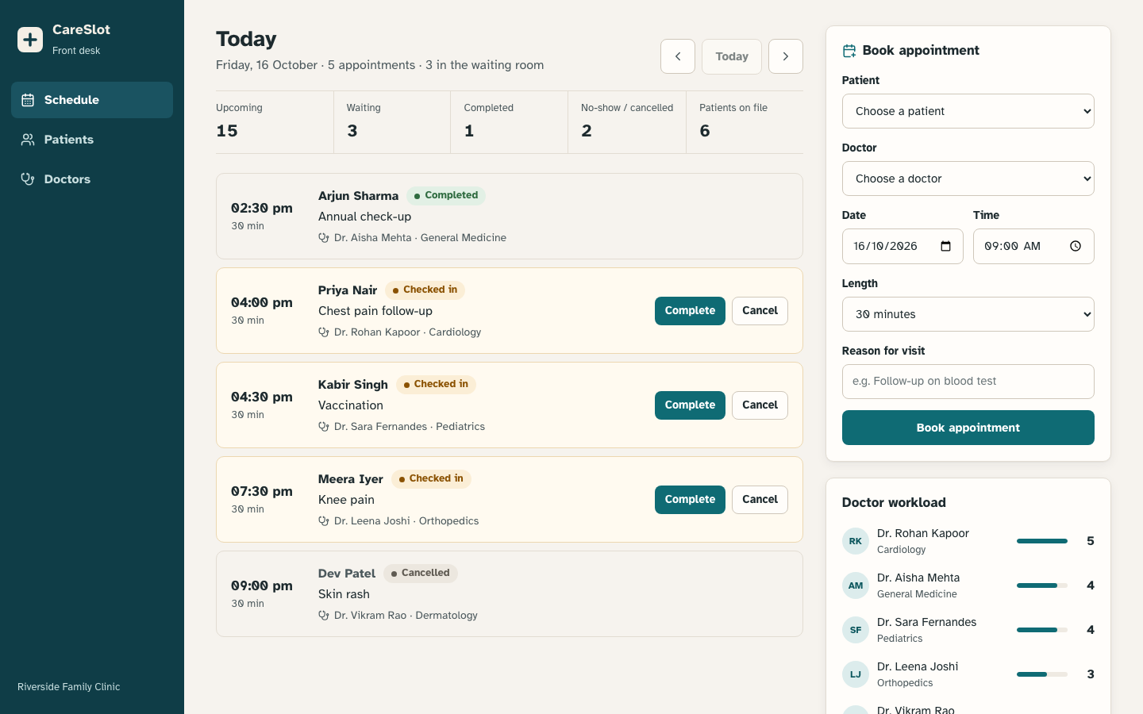
CareSlot
Clinic appointment scheduling, shipped from laptop to a monitored Kubernetes cluster
DevOps Final Capstone · Session 21
github.com/MadaraUchiha-tech/devsecops-python
Notes:
Hi, I'm <your name>. This is CareSlot, a clinic appointment scheduler, and the DevSecOps pipeline that takes it from my laptop to a monitored Kubernetes cluster.

Slide 2
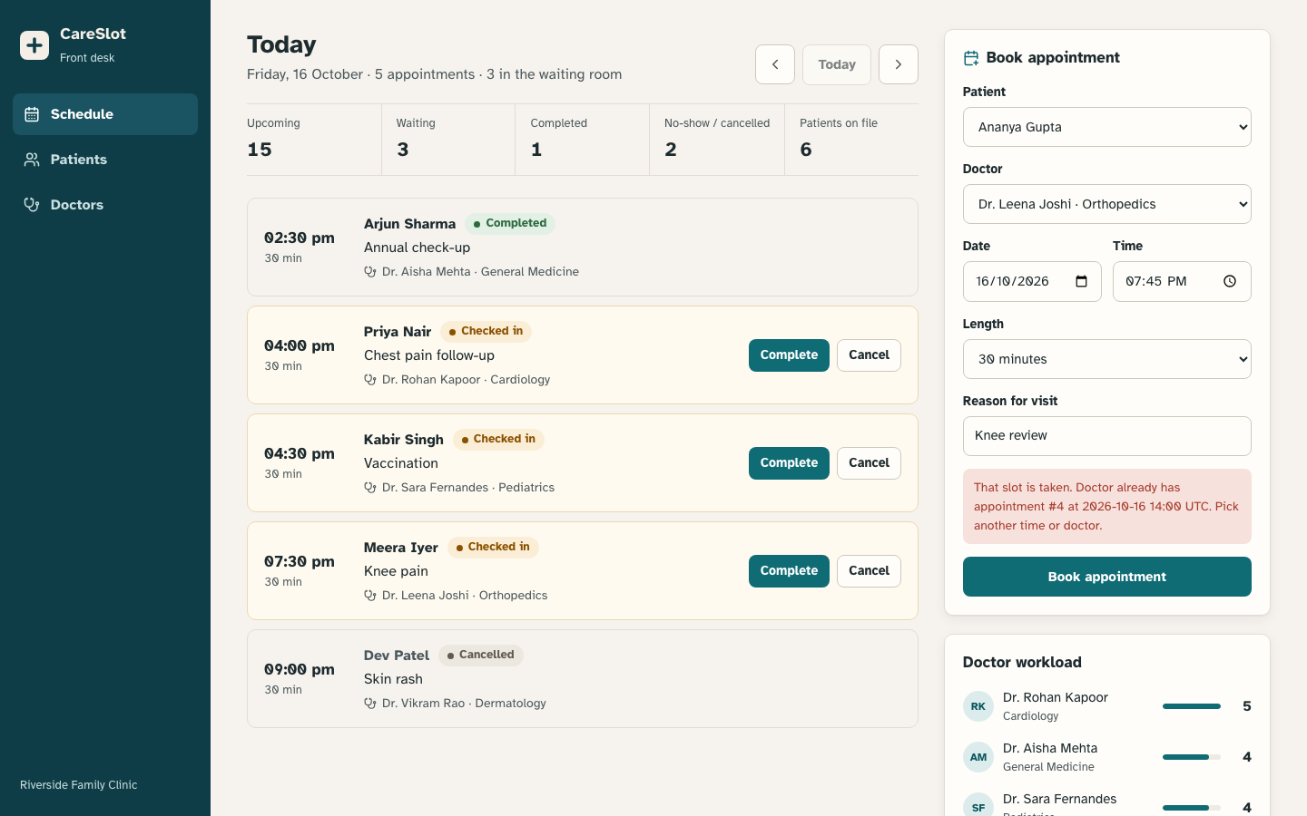



Front desks double-book doctors
Small clinics still schedule on paper or shared spreadsheets. CareSlot replaces that with one source of truth.
Double booking
Two receptionists book the same doctor at the same time. The API refuses overlapping slots with a 409.
No view of the waiting room
Check-in, completion, cancellations and no-shows are tracked as a status workflow.
Uneven doctor workload
A live workload panel shows upcoming visits per doctor; doctors can go off duty.
The booking form rejects a slot that overlaps an existing visit
Notes:
Small clinics still book on paper or in spreadsheets. Two receptionists can book the same doctor at the same time, and nobody knows who is in the waiting room. CareSlot fixes that; its main rule is that a doctor can never be double-booked.

Slide 3
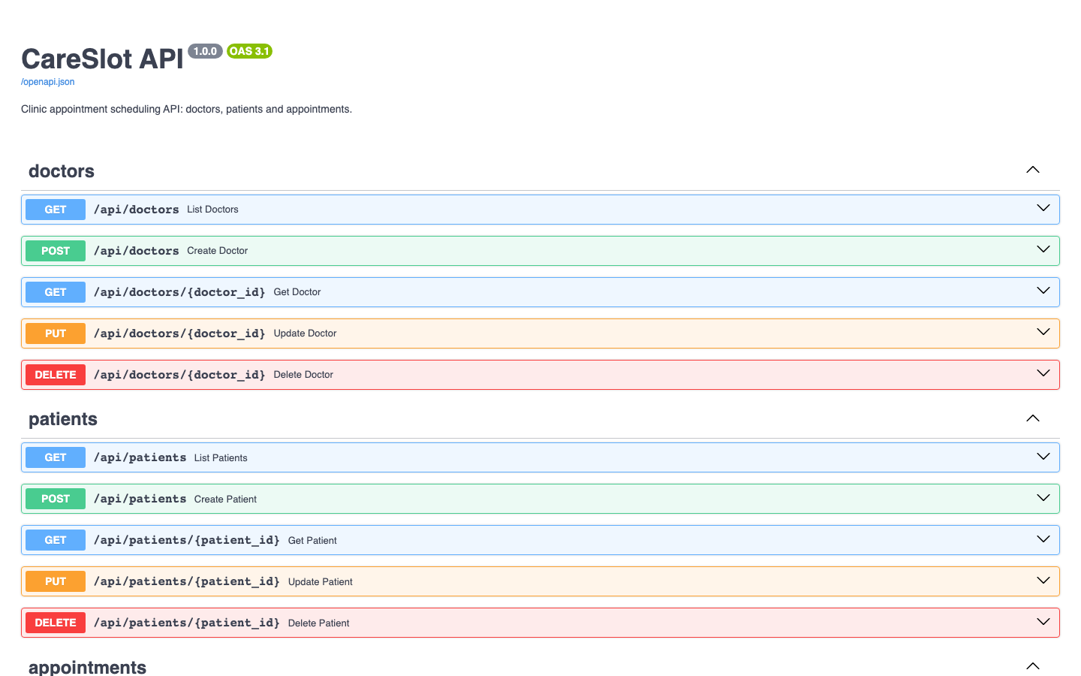
The application: React, FastAPI, PostgreSQL
16
21
5
REST endpoints across doctors, patients, appointments
pytest cases, 94% line coverage
appointment states with enforced transitions
SCHEDULED → CHECKED_IN → COMPLETED; cancel or mark no-show along the way
Overlapping bookings for a doctor return 409 with the clashing visit
Alembic owns the schema; demo data seeded behind a Postgres advisory lock
/health (liveness), /ready (DB check), /metrics (Prometheus) for Kubernetes
Notes:
React front desk, FastAPI backend, Postgres. Appointments follow a workflow, and a booking that overlaps one the doctor already has comes back as a 409 conflict.

Slide 4








Tech stack
Application
React 19 · Vite · FastAPI · SQLAlchemy · Alembic · Postgres 16
Quality
pytest · pytest-cov · Ruff lint + format
Containers
Multi-stage Docker · Compose · nginx-unprivileged · non-root
CI/CD
GitHub Actions · GHCR · SHA-tagged images · kind smoke test
Security
Trivy image, secret and IaC scans · SARIF · Pod Security
Infrastructure
Terraform modules · AWS VPC · EKS · IAM · KMS
Kubernetes
Helm 3 · ingress-nginx · HPA · Argo CD (GitOps)
Observability
kube-prometheus-stack · ServiceMonitor · Grafana
Notes:
Read across the layers quickly: app, quality, containers, CI, security, infra, Kubernetes, observability.

Slide 5
Architecture: Git is the only way into the cluster
Developer
git push
GitHub Actions
test · build · scan
GHCR
image:<git-sha>
Git: values.yaml
tag ← <git-sha>
Argo CD
auto-sync, self-heal
Kubernetes · namespace careslot
Terraform
AWS VPC + EKS
Ingress
/ and /api
Frontend ×2
Nginx, uid 101
Backend 2–6
FastAPI + HPA
PostgreSQL
StatefulSet + PVC
Browser → Ingress. Every change arrives as a Git commit; nobody runs kubectl apply by hand.
Prometheus
Grafana
Notes:
Push, Actions tests and scans, images go to GHCR tagged with the commit SHA, CI writes that SHA into Git, Argo CD syncs the cluster, Prometheus scrapes, Grafana shows it.

Slide 6
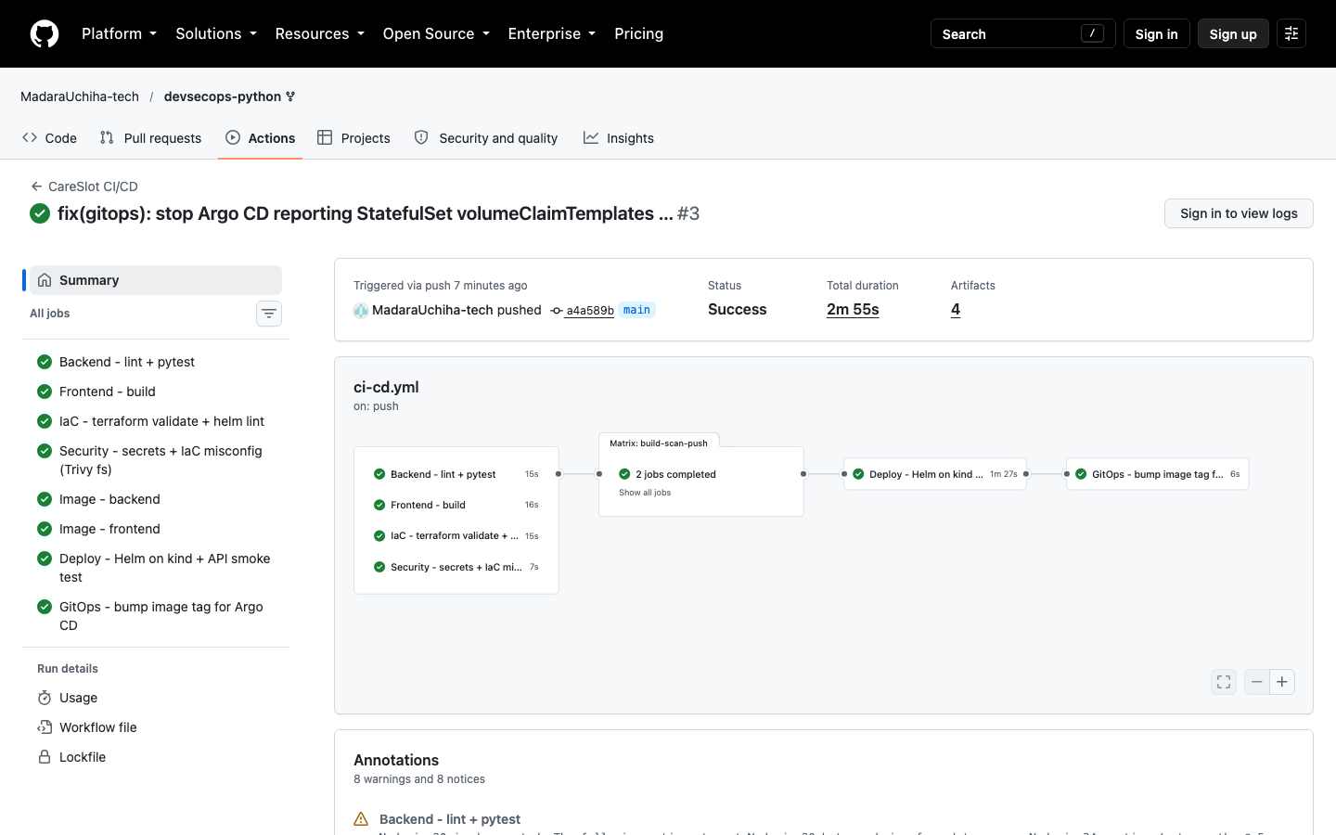
CI/CD: nothing reaches the registry untested or unscanned
1 Quality gates
Ruff + pytest · npm build · terraform validate · helm lint · Trivy secrets
2 Build
Backend and frontend images, tagged with the commit SHA (never latest)
3 Trivy gate
Fail on any fixable HIGH/CRITICAL CVE; SARIF to GitHub Security
4 Push
Only scanned images go to ghcr.io/madarauchiha-tech/careslot-*
5 Smoke test
kind cluster + helm upgrade --install + book a real appointment
Run #3: all 8 jobs green in 2m 55s · images in GHCR tagged a4a589b…
6 GitOps promote
CI commits the SHA into values.yaml; Argo CD rolls it out
Notes:
Four quality gates run in parallel. The images are built once, Trivy scans them, and only clean images are pushed. Then a throwaway kind cluster installs the chart and books a real appointment before anything is promoted.

Slide 7
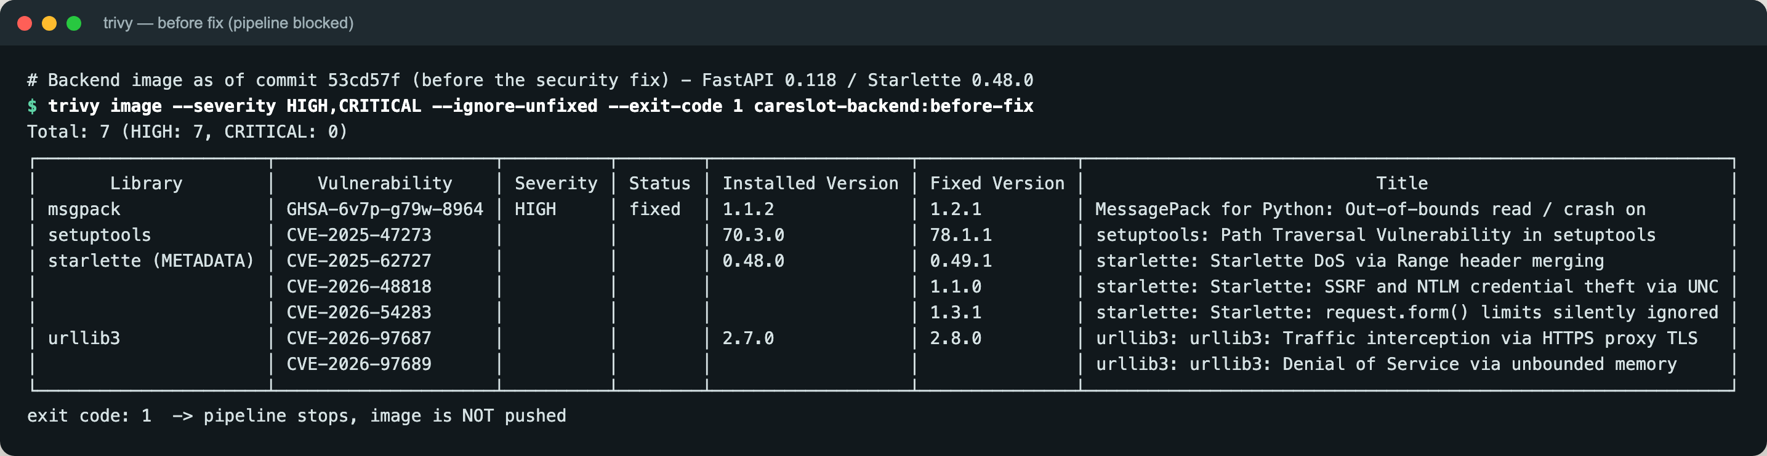
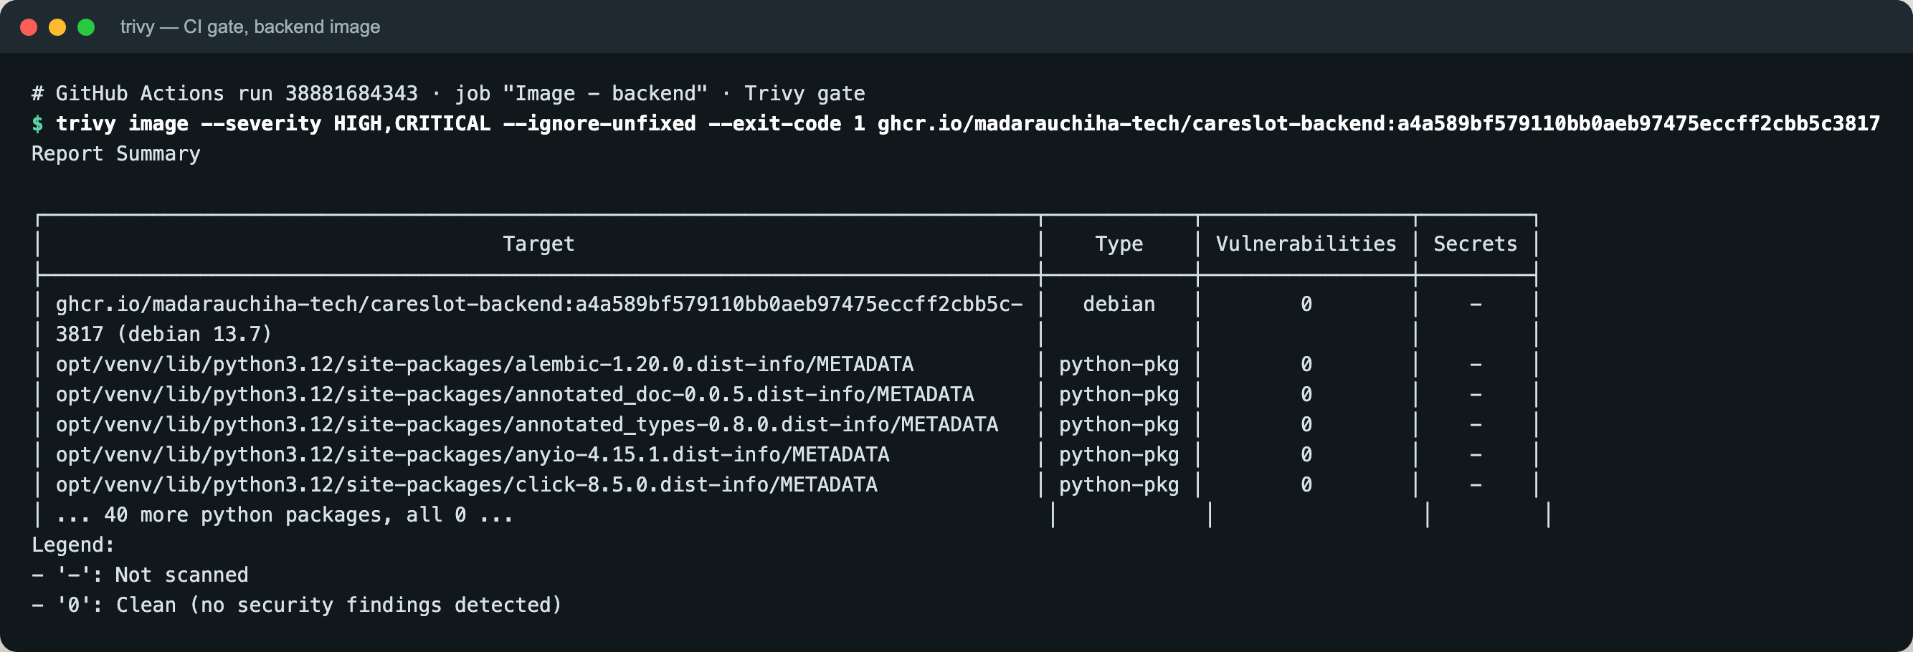
DevSecOps: Trivy blocked a real vulnerability
7
0
HIGH CVEs in the first backend image
fixable HIGH/CRITICAL in both images now
CVE-2025-62727 · Starlette 0.48.0
A request with many overlapping Range headers made Starlette do quadratic work merging them: a few requests could pin a CPU (denial of service). Fixed in 0.49.1.
Fix: upgrade FastAPI/Starlette, and strip pip and setuptools (and their vendored urllib3) from the runtime image.
Also: Trivy secret scan (blocking) · IaC scan led to KMS-encrypted EKS secrets and a read-only Postgres rootfs · non-root pods, all capabilities dropped
Notes:
Trivy caught a real one: CVE-2025-62727 in Starlette 0.48, a Range-header denial of service. I upgraded the stack and stripped pip out of the runtime image; both images now scan with zero fixable HIGH or CRITICAL issues.

Slide 8
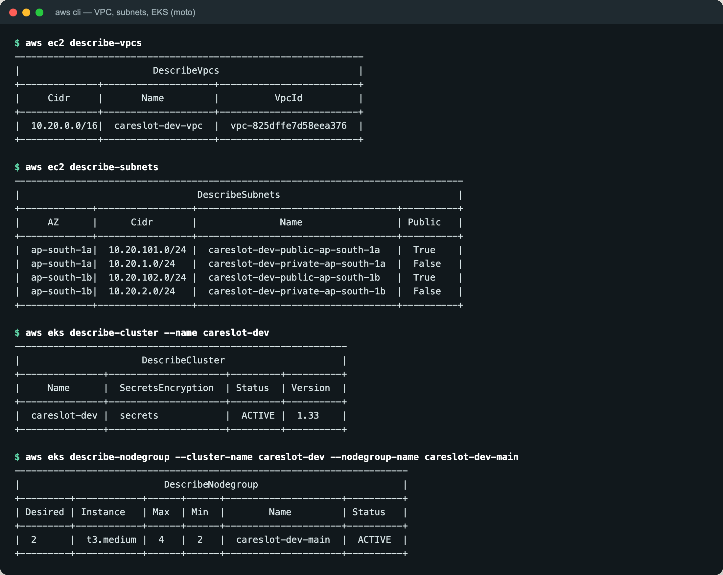
Infrastructure as Code: VPC + EKS in Terraform
VPC 10.20.0.0/16 · ap-south-1
28
resources: plan → apply → destroy, all clean
ap-south-1a
ap-south-1b
Public subnet
10.20.101.0/24 · NAT gateway
Public subnet
10.20.102.0/24 · ELB-tagged
Two modules (vpc, eks), variables with validation, tfvars.example; no credentials in Git
Full lifecycle verified: init, plan, apply, destroy (28 resources)
Remote state ready: S3 backend + DynamoDB lock (commented in versions.tf)
Private subnet
10.20.1.0/24 · worker nodes
Private subnet
10.20.2.0/24 · worker nodes
EKS careslot-dev · Kubernetes 1.33
managed node group t3.medium ×2 (max 4) · KMS-encrypted secrets · audit logs
Notes:
Terraform modules for the VPC and EKS: two public and two private subnets, NAT, a managed node group, KMS-encrypted secrets. I ran plan, apply and destroy, 28 resources each way.

Slide 9

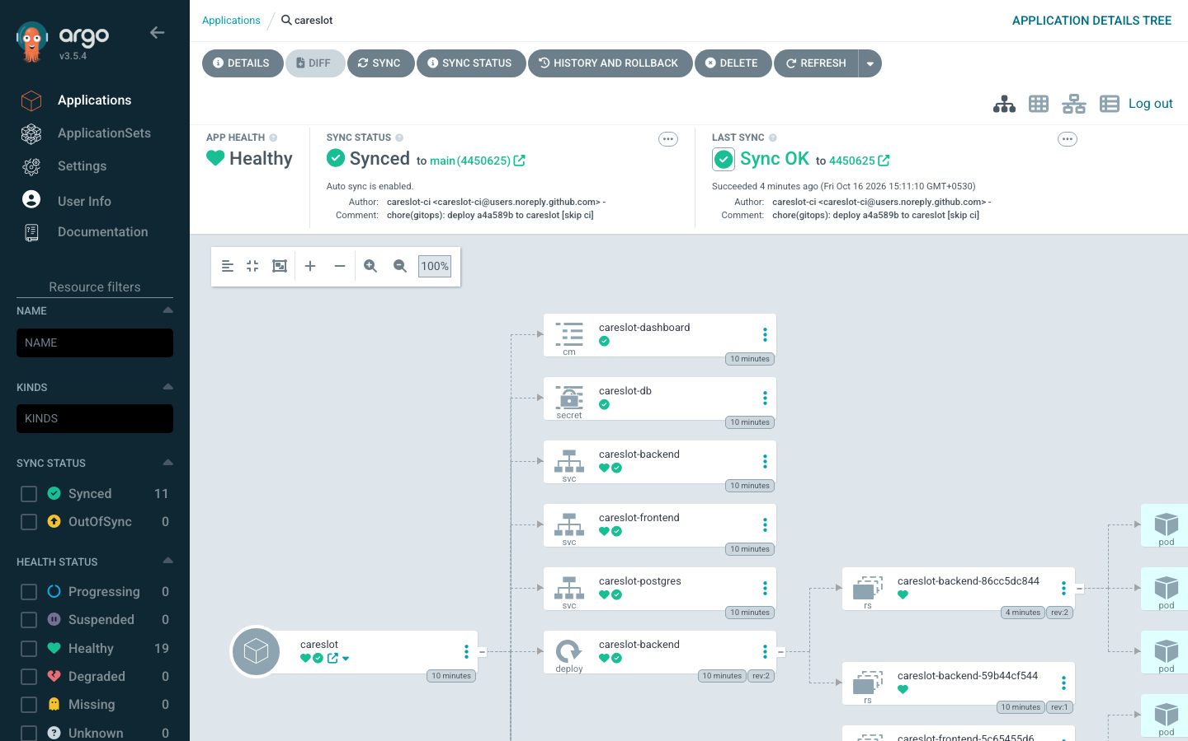



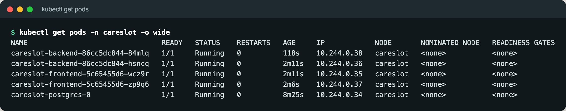
Kubernetes, Helm and GitOps with Argo CD
Helm chart
Deployments ×2, ClusterIP Services, Postgres StatefulSet, Secret, Ingress, HPA, ServiceMonitor, dashboard
Hardened pods
runAsNonRoot, read-only rootfs, caps dropped, Pod Security baseline, quotas
Argo CD
Auto-sync from main, prune, self-heal: a manual scale-down was reverted in seconds
Ingress
careslot.local: / → frontend, /api → FastAPI (ingress-nginx on minikube)
Notes:
Helm chart: two replicas each, ClusterIP services, an Ingress that splits / and /api, an HPA from 2 to 6, non-root pods, Pod Security on the namespace. Argo CD does the deploying.

Slide 10
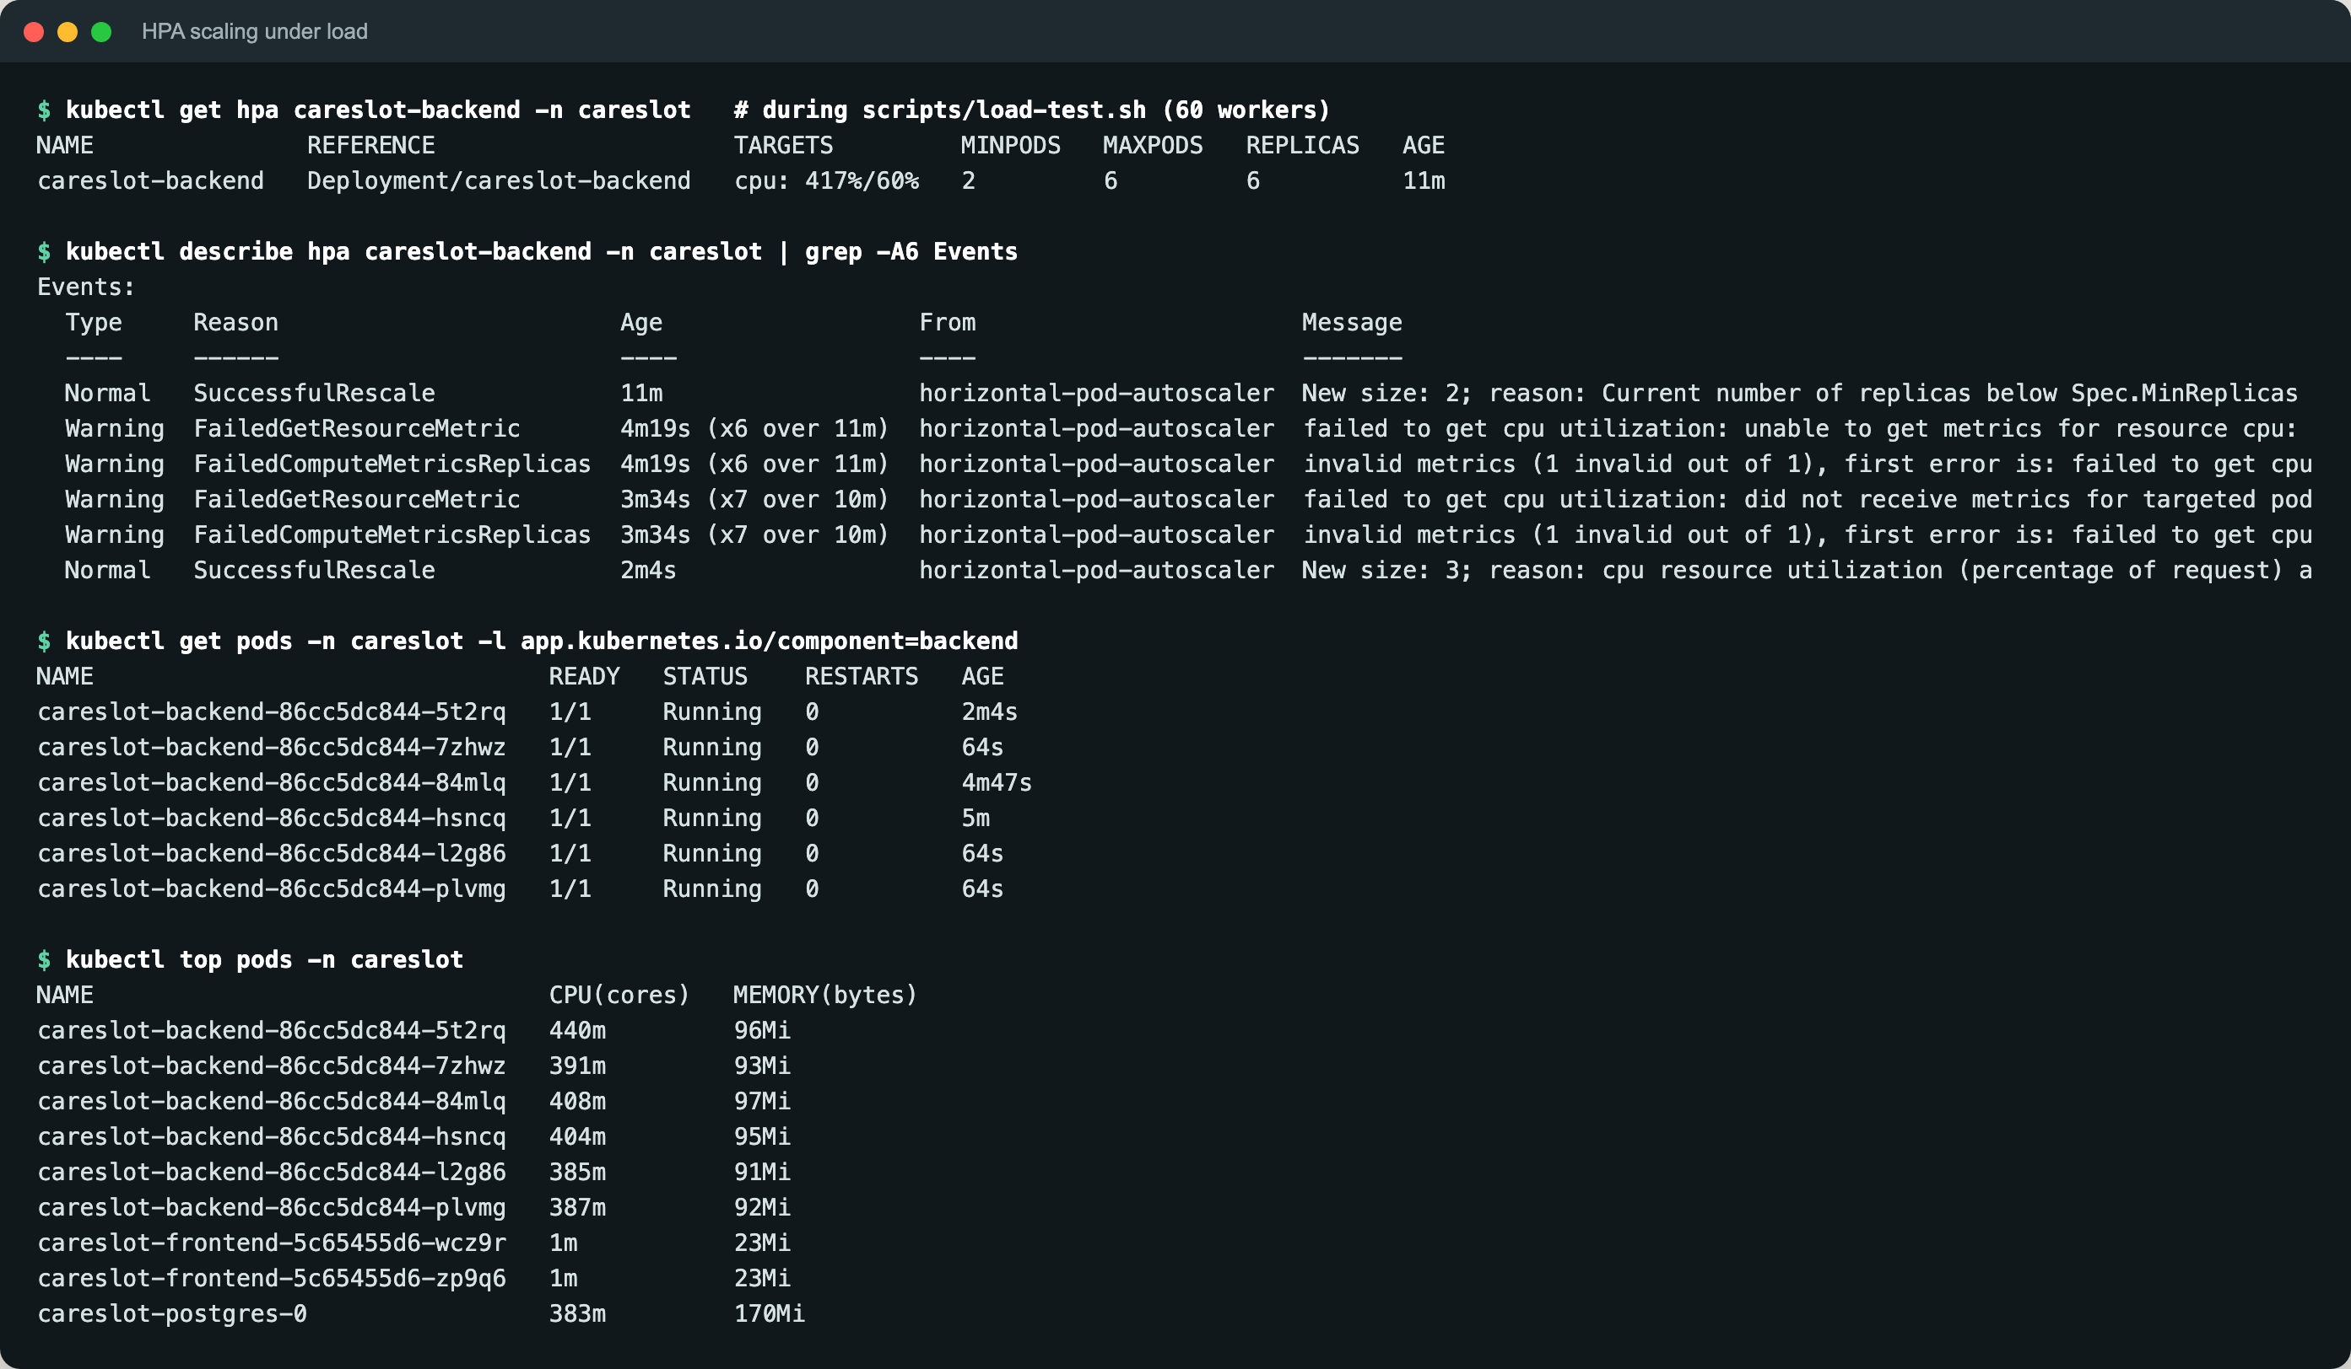
Autoscaling under load: 2 → 6 backend pods
Load test 15:14–15:18 at ~200 req/s (60 workers). CPU peaked at 462% of request vs a 60% target; HPA hit its max of 6, then scaled back to 2 after the 2-minute stabilisation window.
Notes:
metrics-server feeds CPU to the HPA. Under 60 concurrent workers the backend went from 2 to 6 pods, the configured maximum; it scales back down after a 2-minute stabilisation window.

Slide 11
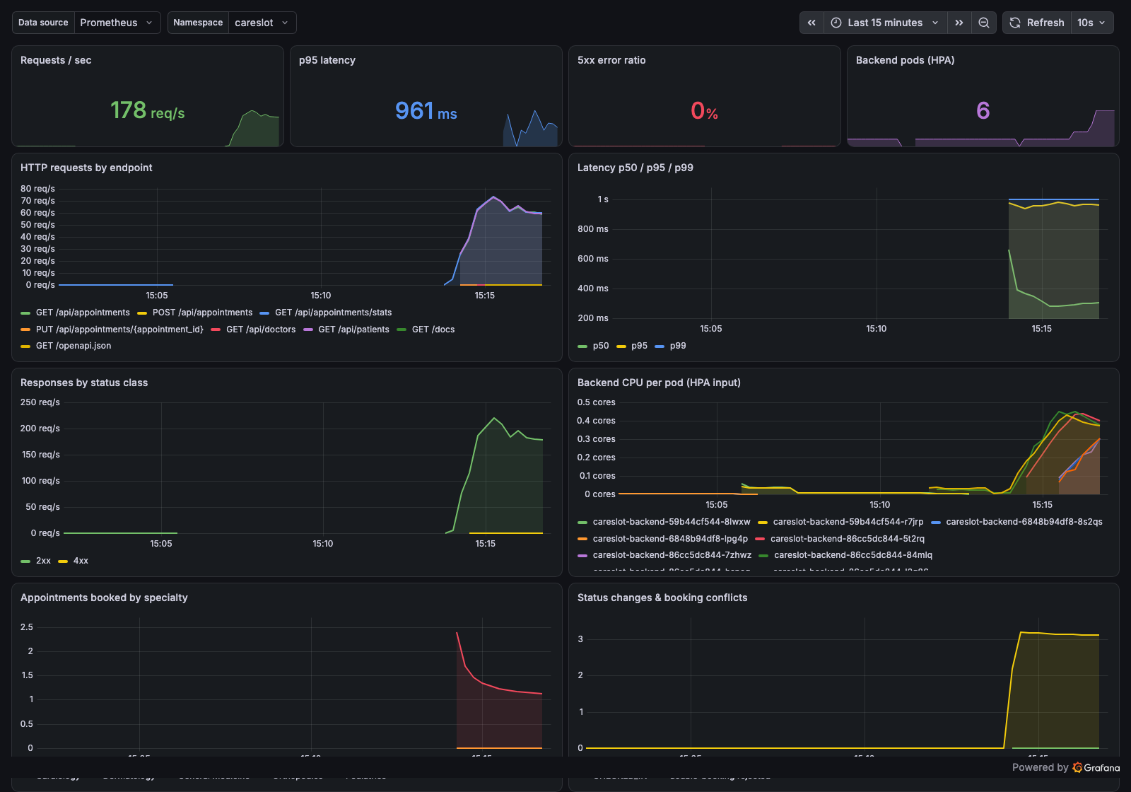
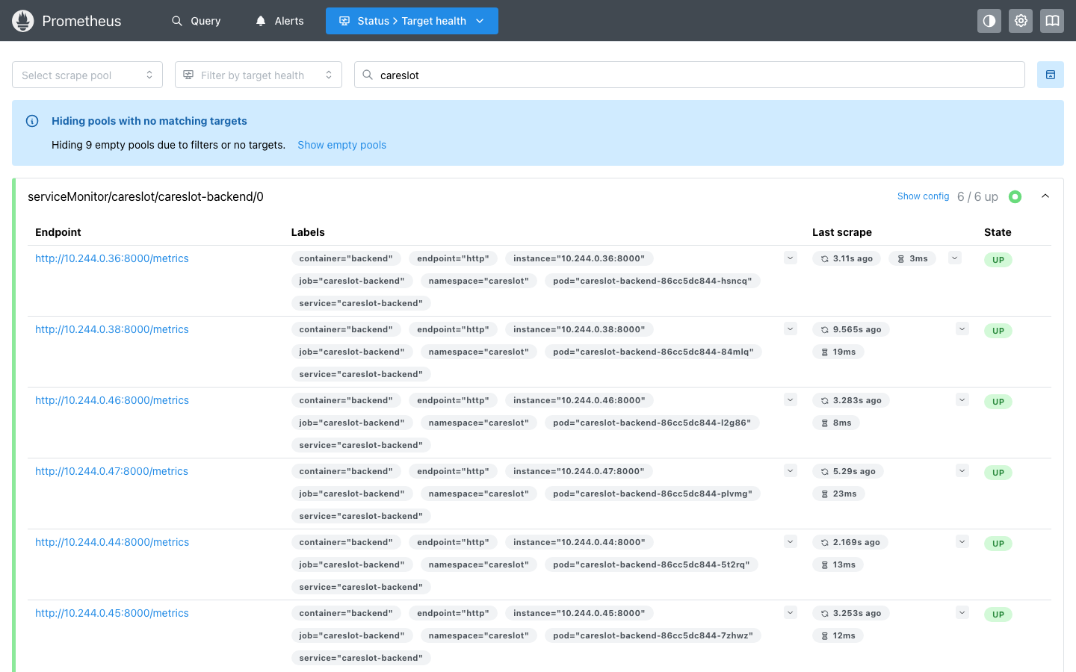
Observability: Prometheus scrapes, Grafana explains
ServiceMonitor → 6/6 backend targets UP
HTTP rate, p50/p95/p99 latency, 5xx ratio, CPU per pod
Business metrics: bookings by specialty, status changes, rejected double-bookings
Dashboard ships in the Helm chart (ConfigMap + Grafana sidecar)
Notes:
A ServiceMonitor gets Prometheus scraping /metrics. Grafana shows traffic, latency, errors, CPU per pod, and business metrics like bookings by specialty and rejected double-bookings.

Slide 12


Key learnings
Scanners find real problems
Starting order is a deployment concern
Trivy failed the very first image on a DoS CVE. The fix was a dependency bump plus a smaller runtime image.
Two replicas racing Alembic crash-looped. An advisory lock and a wait-for-db init container fixed it.
GitOps makes the cluster boring
Starter code had real bugs
CI writes the SHA to Git; Argo CD does the rest, and kubectl drift is reverted automatically.
Ingress pointed at the wrong port, service names didn't match, the HCL didn't parse. Troubleshooting is the job.
Notes:
Pick two or three in your own words.

Slide 13

Thank you
Live walkthrough next: code → CI run → Terraform → Argo CD → kubectl → Prometheus → Grafana
github.com/MadaraUchiha-tech/devsecops-python
ghcr.io/madarauchiha-tech/careslot-backend · careslot-frontend
Notes:
Now the live walkthrough.

