Slide 1
GROUP 20 EVALUATION OF DAIRY PRODUCTION IN IDAKHO WARD, IKOLOMANI CONSTITUENCY ,KAKAMEGA COUNTY

Slide 2
RESEACHERS NAME ADM KIPCHIRCHIR DENIS DIP/ANPD/9838/19 BENARD O. MOGENI DIP/ANPD/9995/19 VICTOR MWENDWA DIP/ANPD/9822/19 PURITY KEYA DIP/ANPD/10276/19 ROSE TANUI DIP/ANPD/10279/19 CHRISTINE LUKEYA DIP/ANPD/9967/19 SUPERVISOR : Mr. TOWET

Slide 3
ABSTRACT
Despite the growth of farming over the years, there is imbalance in milk production experienced in different farms based on the approach from different farm managers and farmers. Majority of them still fail to understand the connection between dairy productivity and farming practices. Without a careful analysis of the patterns of benefits reaped from good farming practices, we cannot accept the face value that dairy farming can be both fulfilling and satisfying. The purpose of this study is to evaluate dairy production in Idakho Location,Ikolomani Sub-county, Kakamega County.

Slide 4
CONT.
The study sought to establish the extent in which breeds kept, farming system and diseases affect milk production. The target population of this study included farm manager the herd`s man and generally farmers at large in Idakho location. A questionnaire with both open and closed question was used. The study concluded that in Idakho, the breeds kept and disease management practices had no effect in the level of milk production. Farming system was the contributing factor since the farm had it`s flock grazed on pastures which are seasonal and are of poor quality.

Slide 5
INTRODUCTION Background information
Idakho practices various farming activities such as fish farming, maize production, horticulture, agroforestry and apiary which are done under small scale. The farm is currently run under Lurambi sub county government of Kakamega on resource allocation. The resources from the Centre are collected to the government as revenue.

Slide 6
STATEMENT OF THE PROBLEM
Milk production enterprise has a lot of benefits ranging from creation of jobs, generation of income ,security and food as source of protein to human diet .however beside the environmental conditions being favourable for dairy development ,the demand for milk is projected to grow due to increased population and lack of a substitute of milk, which has led to the continuous decline of milk in Idakho central ward.
Therefore this challenges can be addressed through utilization of available resources e.g. The available piece of land which can accommodate varieties of fodder and pasture to improve nutrition to the milk producing livestock so as to improve on feed security .this can be realized through different farming practices e.g. weeding, top dressing ,gap filling of the existing pastures.

Slide 7
GENERAL OBJECTIVES
The study was intended to evaluate dairy production in Idakho central ward
SPECIFIC OBJECTIVES
To examine performance of various breeds in Idakho central ward.
.To evaluate the production system used in rearing milk production livestock in Idakho central ward.
.To review the health management practices for milk producing livestock in Idakho central ward.

Slide 8
To review health management practices for milk producing livestock in Idakho central ward.

Slide 9
JUSTIFICATION
The reason for conducting this research was to evaluate dairy production in Idakho Central Ward. Idakho is still under developing state therefore the adoption of new technology will contribute more towards development and production level. It`s important to improve dairy farming so that county government can strategies on how to expand and sustain dairy production in Idakho central ward as a source of revenue and employment to rural people.

Slide 10
METHODOLOGY
The researcher used primary method to collect data i.e. Stratified sampling, photographing and secondary data which was provided from documented records of dairy production. The research was done under population of 35 cows. The population was grouped into strata of 5 samples. 35 cards were made to represent the population size. The cards are then labeled 1 to 5 in each stratum and then one card is picked at random to represent the group.

Slide 11
RESULTS AND DISCUSSION Table 1:Sample of Breeds kept in Idakho and their level of production
.
Name of the breed | Morning (litres) | Evening (litres) | Total
Rocky (Friesian) | 2.0 | 1.0 | 3.0
Francis( cross) | 2.5 | 1.0 | 3.5
Ayu ( Ayrshire) | 2.5 | 2.0 | 4.5
Mery (Friesian) | 2.0 | 1.0 | 3.0
Florina ( guensey) | 3.0 | 1.5 | 4.5
C012( Ayrshire) | 2.0 | 1.5 | 3.5
Nora (Zebu) | 1.5 | 1.0 | 2.5
A015 (Ayrshire) | 3.0 | 2.0 | 5.0
Jacob (Ayrshire) | 4.0 | 2.5 | 6.5
Zack (Zebu) | 2.5 | 2.0 | 4.5

Slide 12
Discussion
From the findings of our research dairy production is low. the research study was that the breeds kept were indigenous, crosses, exotic breeds eg Ayrshire Friesian, Guernsey, and jersey breeds tends to produce more than the Friesians under the same environment, this is not due to the fact that Ayrshire breeds are fed on a different diet, but it’s due to the fact that they are relatively tolerant to environmental conditions. A pure breed Ayrshire has a potential of producing 25 litres per day and a Friesian has a potential of 40 to 50 litres of milk per day under good management. This is literally opposite to the researchers expectations where Friesian could have been leading in production. Therefore breeds kept was not a contributing factor.

Slide 13
Chart 1.0: Disease management practices

Slide 14
Discussion
Spraying is done monthly for the control of external parasites e.g: ticks. Usually, acaricides are used rotationally by class i.e from synthetic pyrethroid-amitraz-organophosphate to ensure maximum control.
Deworming is done after every three months to control internal parasites.
Vaccination is done incase of the outbreak of diseases e.g Foot and mouth disease, which was done 2019 due to the outbreak in the region.

Slide 15
continue
Isolation is rare, but is done incase of contagious diseases so that animal affected doesn’t spread the disease to others.
Incase of infection, treatment is always done before the condition over well the animal.
Other disease management practices include; observation of hygiene, removal of poisonous plants, provision of adequate nutritious feeds and supplements and wilting of pasture to check on metabolic disorders.

Slide 16
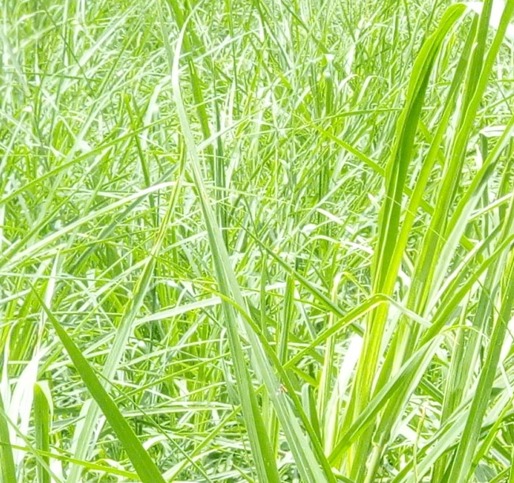
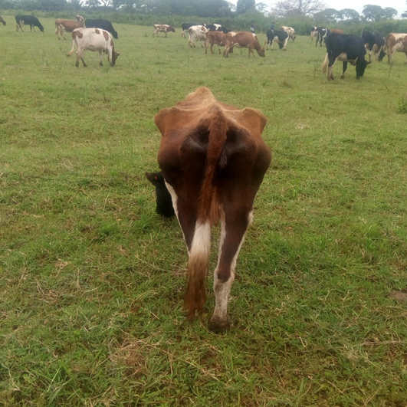
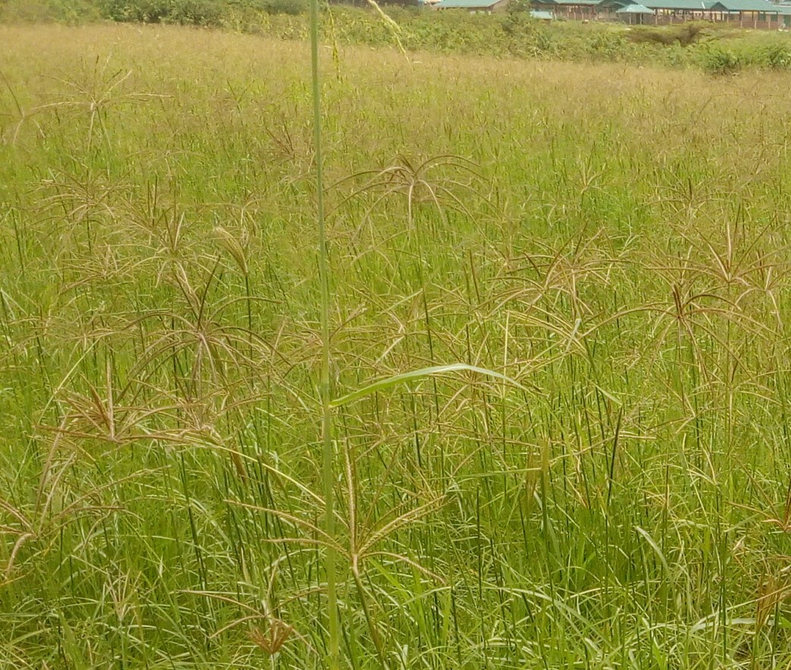
Picture 1.0:Farming system practiced
1} Herding
2} Nappier grass
3} Boma Rhodes

Slide 17
Discussion.
The farm practices semi-intensive system of production. The photo above shows that animals depend on short pastures with minimum nutrients that can't meet the demand energy for maintenance and production, with partial supplementation with nappier, boma rhodes and dairy meal which are provided only when available.
The research sought out that, cases of metabolic disorders arises from inadequate feeding of farm animals.i.e. Ketosis exist in the farm unnoticed by the farm manager. This fact was ascertained from the dairy records.
That 20 - 30 days about a month after calving milk production decreases gradually to all cow's and most of the animal exhibit signs of anorexia, emaciation, decrease of milk yield and some of them totally cease to feed on concentrates during milking.

Slide 18
Conclusion
The breeds kept was partially a contributing factor since the farmers rear breeds which are genetically low milk yielders.
Having semi-intensive as production as feeding system ,the feeds were limited ,of poor quality and much energy is spent in the movement while grazing rather than in milk synthesis
In Idakho central ward, the diseases are not well managed.Management practices such as vaccination,spraying ,Deworming,isolating the sick ones,treating the sick ones are not adhered to hence,influence the level of production.

Slide 19
RECOMMENDATIONS
The farmers should adopt rearing of dairy breeds which consume less feeds utilize feeds efficiently and are high milk yielders and are high milk yielders(Exotic breeds e.g Ayrshire ,Guernsey , Jeysey )
The farmers should practice intensive system to minimize energy loss during grazing, establish more fodder inclusive of legumes under proper management and conserve during surplus production and apply new technologies of home made feed formulation and practice dry feeding (feeding of sllage and hay)which will increase feed quality and quantity.
The farmers and farm Managers should intensify supplementation of feeds by planting leguminous feeds yellow maize for silage making and commercial feeds, since the study sought out that low milk production was due to inadequate and poor quality feeding.
The farmers should attend more trainings on disease management practice and economic importance of disease

