Slide 1
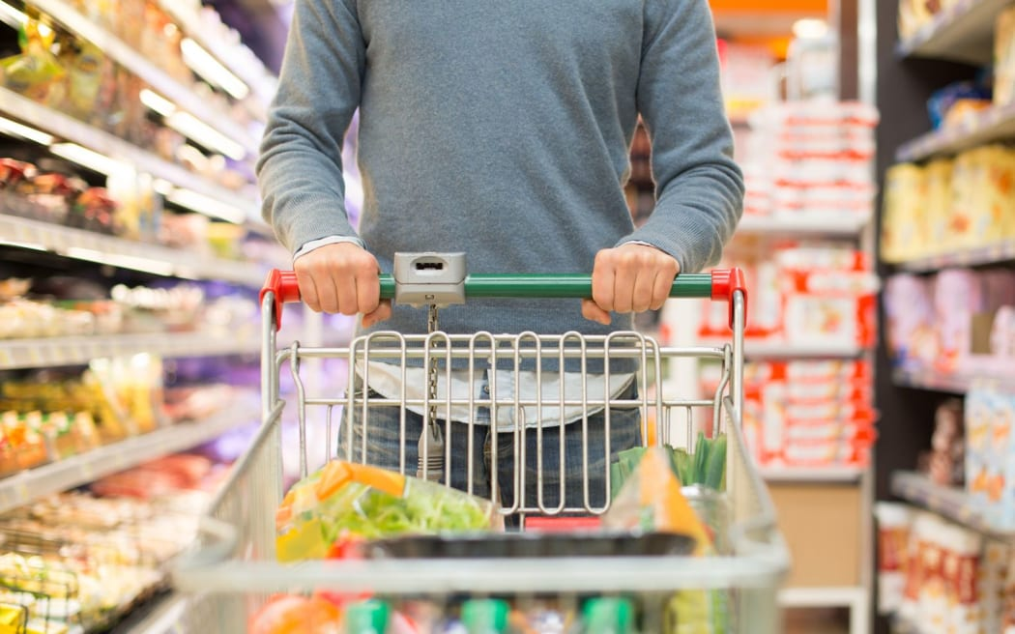
Comparative study on recommendation systems of leading Ecommerce websites Amazon , BigBasket & Flipkart
DONE BY
19MIA1037 B N Shrikirthi
19MIA1066 Madasu Deepika
19MIA1069 G.Harinisri
19MIA1080 Hanchate Samyuktha

Slide 2
OBJECTIVE AND MOTIVATION:
In this era of massive data growth and innovations, people often face distress in decision making when it comes to choosing products for themselves. Everyday new products are launched and new products are introduced in the e-commerce we often use. So the dependency on recommendation systems has grown in a unimaginable way. Recommendation systems have become widely popular due to surge of information and this led us to do our comparative study between three massive e commerce web sites.
Amazon, Flipkart and big basket are one of the leading e-commerce websites and customers take the recommendations given by these web sites into serious consideration. An ample amount of sales for these three web sites is given by their respective recommendation systems. So we are comparing three e commerce websites Amazon, Flipkart and big basket. In this project we are aiming to compare the recommendation systems of these three websites and we will be applying Machine Learning algorithms. After applying the ML algorithms we will be comparing which algorithm gives best recommendations for the given E-commerce website. We will be applying some such as KNN, cosine similarity algorithms and then see which algorithm gives good accuracy for the respective Ecommerce platform.

Slide 3
Dataset description
1) BigBasket Products- BigBasket Entire Product List (~28K datapoints) Analyzing BB Products and their performance across. Dataset name : BigBasket Product.csv.This dataset contains 10 attributes with simple meaning and which are described as follows:
1. index - That is the serial number
2. product - Title of the product
3. category - Category into which product has been classified
4. sub_category - Subcategory into which product has been kept
5. brand - Brand of the product
6. sale_price - Price at which product is being sold on the site
7. market_price - Market price of the product
8. type - Type into which product falls
9. rating - Rating the product has got from its consumers
10. description - Description of the dataset present in detail

Slide 4
2) Flipkart - Flipkart Products Dataset name: Products.csv This is a pre-crawled dataset, taken as subset of a bigger dataset (more than 5.8 million products) that was created by extracting data from Flipkart.com, a leading Indian eCommerce store.
This dataset has following fields: 1. product_url 2. product_name 3. productcategorytree 4. pid 5. retail_price 6. discounted_price 7. image 8. isFKAdvantage_product 9. description 10. product_rating 11. overall_rating 12. brand 13. product_specifications

Slide 5
3) AMAZON: Amazon product data from https://jmcauley.ucsd.edu/data/amazon/
Dataset name : product.csv
This dataset contains product reviews and metadata from Amazon, including 142.8 million reviews spanning May 1996 - July 2014.
This dataset includes reviews (ratings, text, helpfulness votes),
product metadata (descriptions, category information, price, brand, and image features), and links (also viewed/also bought graphs).
reviewerID - ID of the reviewer, e.g. A2SUAM1J3GNN3B
asin - ID of the product, e.g. 0000013714
reviewerName - name of the reviewer
helpful - helpfulness rating of the review, e.g. 2/3 6)
reviewText - text of the review
overall - rating of the product
summary - summary of the review
unixReviewTime - time of the review (unix time)

Slide 6
TOOLS
Google colaboratory for exploratory data analysis, preprocessing / cleaning, model planning ,model building and evaluation.
Tableau / power BI for data visualization.

Slide 7
ALGORITHMS
1) TF-IDF: TF-IDF stands for term frequency-inverse document frequency. Term frequency works by looking at the frequency of a particular term you are concerned with relative to the document. There are multiple measures, or ways, of defining frequency:Number of times the word appears in a document (raw count). Term frequency adjusted for the length of the document (raw count of occurences divided bynumber of words in the document). Logarithmically scaled frequency (e.g. log(1 + raw count)). Boolean frequency (e.g. 1 if the term occurs, or 0 if the term does not occur, in the document). Inverse document frequency looks at how common (or uncommon) a word is amongst the corpus. IDF is calculated as follows where t is the term (word) we are looking to measure the commonness of and N is the number of documents (d) in the corpus (D).

Slide 8
2) COSINE SIMILARITY: Using the Cosine Similarity, Mathematically, it measures the cosine of the angle between two vectors projected in a multi-dimensional space. The output value ranges from 0–1. 0 means no similarity, whereas 1 means that both the items are 100% similar. It is often used to measure document similarity in text analysis.Our recommendation model takes both the pre-processed features and the user’s preferences as input. Then, the user’s input and add it as a row to the metadata. The model then vectorizes the word soup using CountVectorizer function from the scikit-learn python library. CountVectorizer takes documents (different strings) and returns a tokenized matrix. Each word soup is encoded intofrequencies of words in that word soup. Our recommendation model utilizes all properties and the metadata to calculate and find the most similar item to the user input. We use the cosine function to compute the similarity scorebetween products, where each product will have a similarity score with every other product ineach of our dataset.
3) KNN: Content based approach utilizes a series of discrete characteristics of an item in order to recommend additional items with similar properties.KNN is a machine learning algorithm tofind clusters of similar users based on common product ratings, and make predictions usingthe average rating of top-k nearest neighbors

Slide 9
RESULTS FOR CONTENT BASED RECOMMENDER SYSTEM USING TF-IDF AND COSINE SIMILARITY
RESULT FOR BIGBASKET:
0 Nutties Chocolate Pack
1 5 Star Chocolate Bar
2 Dairy Milk Silk - Hazelnut Chocolate Bar
3 Perk - Chocolate, Home Treats, 175.5 g, 27 Units
4 Dark Milk Chocolate Bar
5 Dairy Milk Silk Mousse - Chocolate Bar
6 Dark Milk Chocolate Bar
7 Chocolate Bar - Fuse
8 Choclairs Gold Coffee
9 5 Star Chocolate Home Pack, 200 g, 20 unit

Slide 10
RESULT FOR FLIPKART:
Enter the name of the product: Style Foot Bellies Top
Recommended products are:
Ladela Bellies
Klaur Melbourne Bellies
Mobiroy Bellies
Oggo Deo Bellies
Bootwale Bellies

Slide 11
RESULT FOR AMAZON:
7522 0.284619 Jessica Simpson I Fancy You Women Eau De Parfu...
341 0.265153 Pheromone By Marilyn Miglin For Women. Eau De ...
1526 0.163313 Sarah Jessica Parker Lovely Eau de Parfum Spra...
2244 0.132577 Sex In The City Kiss by Instyle Parfums Eau De...
6806 0.123196 Jimmy Choo Women Eau De Parfum Spray, 3.3 Ounce
6390 0.098751 Karen Low Pure Pink Eau De Parfum Spray for Wo...
3810 0.095380 Sensual By Johan B Perfume for Women 2.8 Oz / ...
5685 0.090665 Sex In The City Love for Women, Eau De Parfum ...
951 0.079455 Paris Hilton by Paris Hilton for Women - 1.7 O...
903 0.074957 PALOMA PICASSO For Women By PALOMA PICASSO Eau..

Slide 12
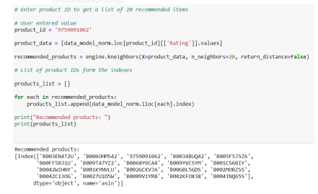
RESULTS FOR COLLABORATIVE FILTERING USING KNN
For amazon

Slide 13
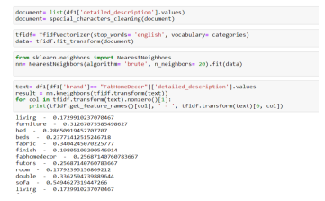
FOR FLIPKART

Slide 14
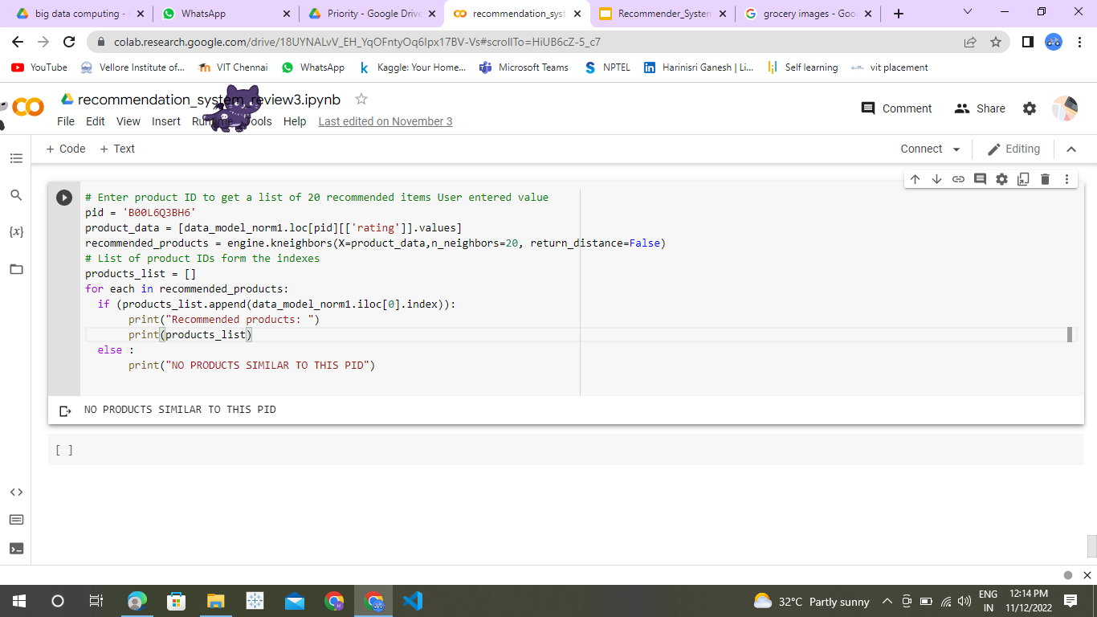
FOR BIGBASKET

Slide 15
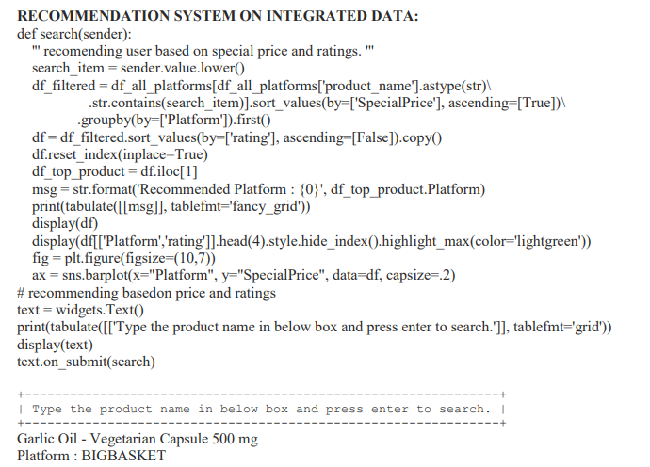

Slide 16
