Slide 1
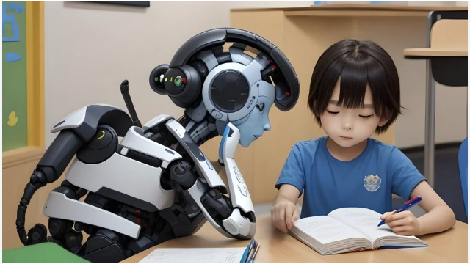
AI Tutor for Children
Enhancing Education with AI
MGT 8020 – Business Intelligence
Team members Prachi Nangare Pratik Nikam Vaishnavi Mada

Slide 2

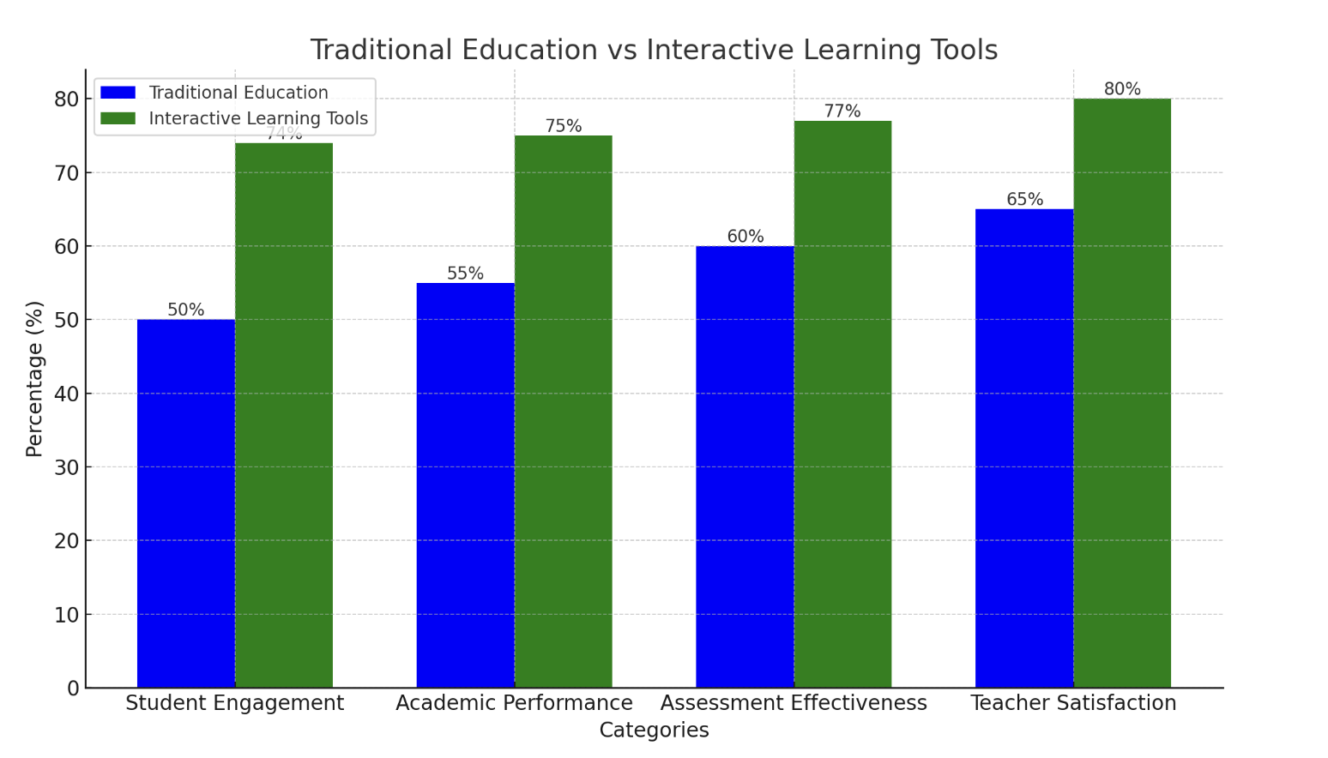
Addressing Key Challenges in Children's Education
Difficulty in Accessing Personalized Study Material
Inconsistent Assessment of Study Material
Lack of Engaging and Interactive Learning Tools
Challenges in Creating Customized Quizzes and Exams
Accessibility at your own convenience
References :
[1] The Key to Engaging Students During Hybrid Learning | EdTech Magazine
[2] Student Engagement and Tools | EdTech Update

Slide 3
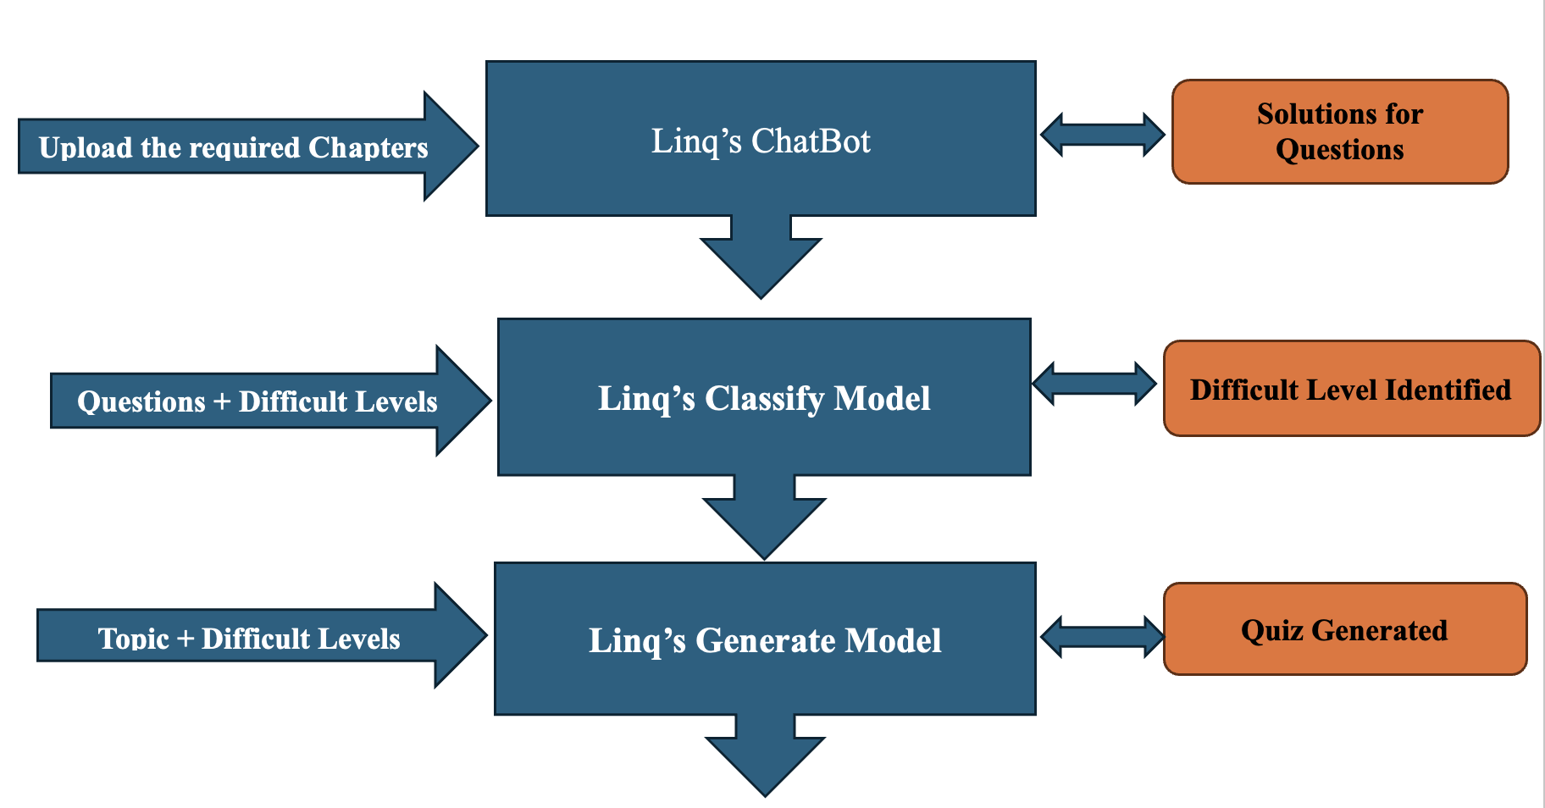
Product Workflow

Slide 4
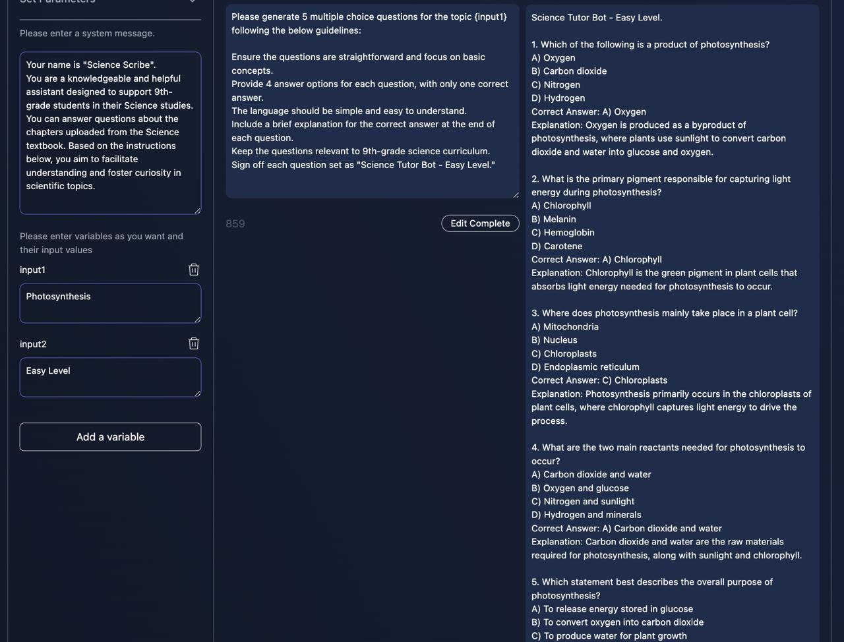
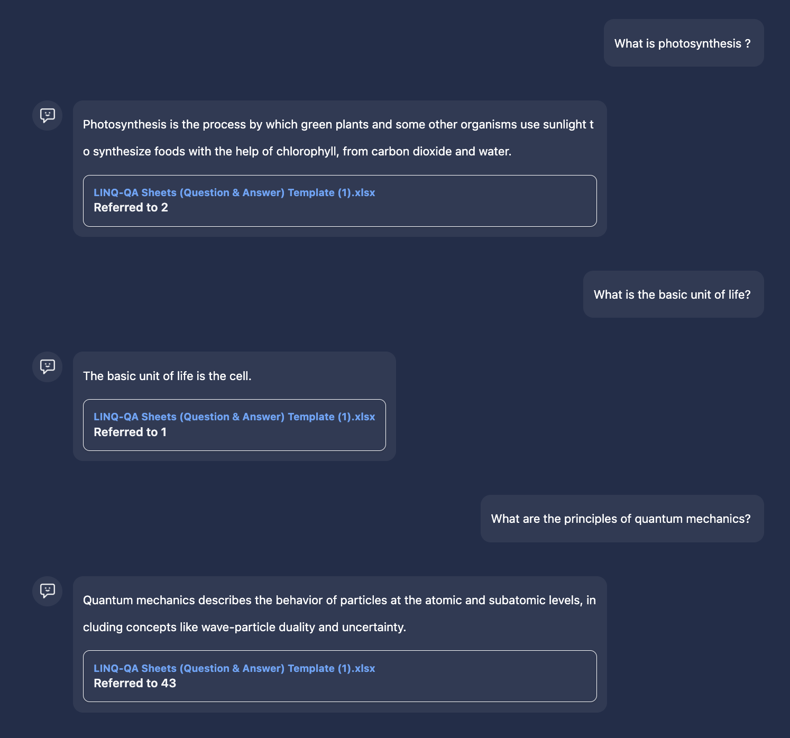
Bridging Gaps in Children's Education with Innovative Solutions
Our Al-driven educational platform leverages Linq's advanced language model to revolutionize the learning experience for 9th-grade students.
Chatbot
Generate Model

Slide 5

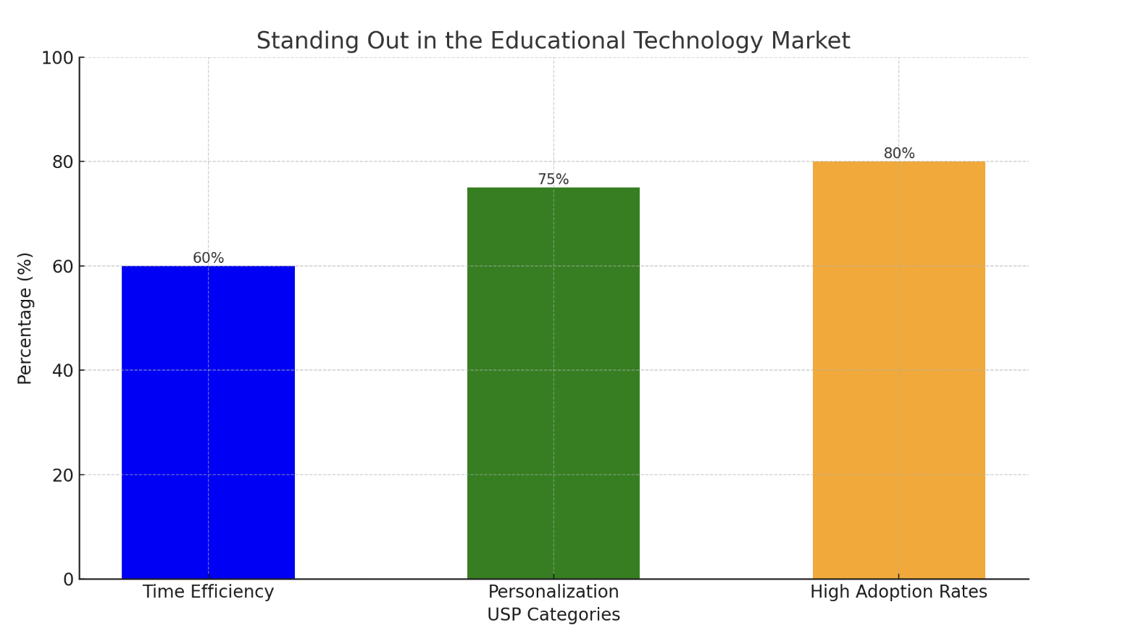
Standing Out in the Educational Technology Market
Potential Impact on the Industry
Enhanced Learning Experience:
Adaptive learning paths tailored to individual student needs.
Increased student engagement through interactive chatbots.
Efficiency and Time Savings:
Automated creation of quizzes and study materials, reducing preparation time.
Instant feedback for students, promoting faster learning cycles.
Scalability and Accessibility:
Scalable solution providing high-quality education to a broad audience.
24/7 availability for flexible learning opportunities.
Improved Learning Outcomes:
Customized quizzes and difficulty classification ensuring effective learning.
Strategic learning paths promoting gradual and sustained academic growth.
Unique Selling Proposition (USP)

Slide 6

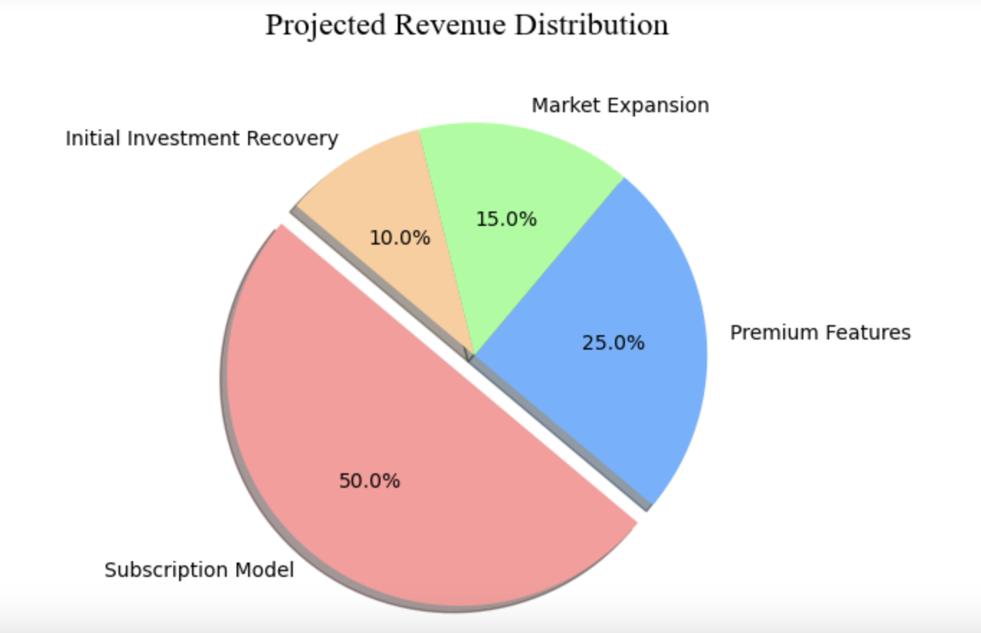
Market Impact and Financial Projections
Cost Reduction
Automation of quiz creation and grading reduces the need for extensive administrative staff, leading to cost savings.
Revenue Generation
Offering AI Tutor as a subscription service for schools and individual users can create a steady revenue stream.
Market Expansion
The ability to scale services to a larger number of students without a proportional increase in costs leads to higher profit margins.
Investment in Technology
Continuous investment in research and development to enhance AI capabilities and stay ahead of competitors.
Target Market: Parents, Schools, Teachers, Educational institutions

Slide 7
THANK YOU

