Slide 1










uogcgd
@uogct
Indie Game Development
CT6018
ZAYD JUNGLEE

Slide 2


BUSINESS PLAN
Setting up your company business plan
“Starting an indie gaming company is going to be a lot of work. Don’t let that discourage you, because it is worth it in the long run. You are going to be going head to head with some of the biggest companies in the industry, such as Activision and Blizzard.
Don’t be intimidated by that either; you can set the world on fire if you have a great game and a solid marketing plan.”
Kalen Smith – Entrepreneur and a Freelance Business Writer

Slide 3

WHAT’S ON THE MENU TODAY?
Writing up a 10-page business plan
Executive summary
Business of the company
Product description
Market
Competition
Marketing
Organisation
SWOT analysis
Financial requirements
Contracts and legal implications

Slide 4

REQUIREMENTS FOR THE ASSIGNMENT
Devise a 10-page business plan, with a starting budget of £100k.
Include sections such as
Executive summary, the registered business / company, product description, target audience, competitive survey, marketing plan, organisation structure, risk assessment, financial requirements, cash flow forecast and address contracts and legal implications in setting yourself up as an indie game developer
Devise a suitable strategy to market your game
Consider expanding your business plan by using various online marketing methods such as social media (Facebook and Twitter), presskit(), competitions, crowdsourcing (e.g. Kickstarter or Indiegogo), alphafunding or submitting to various indie game databases and forums
All sections should be supported with references to justify your write up!

Slide 5

BUSINESS OF THE COMPANY
This section should outline the purpose of the business and how it intends to provide a viable solution to managing the game
Business Summary and History
What does the company do?
How long has the company been around?
What is the intended flagship game title?
Industry overview
In what sector does the company intend to work in?
E.g. Social Networking industry?
Provide references to justify this
Who are the existing big players?
Current situation of the company
How much experience does the company have?
Goals and Objectives
How many games do you intend to release?
How much money do you intend to make by the end of 12 months?
Provide references to justify this
When and where do you intend to start development?
Key success factors
How does the company intend to achieve its successes?
What factors will influence this?

Slide 6


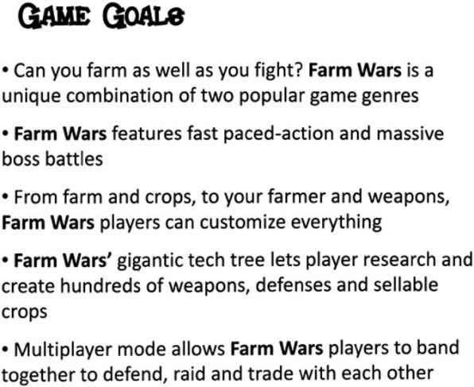
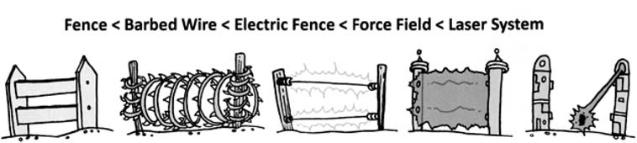
PRODUCT DESCRIPTION
This section should outline the intended game to be developed
Detailed description of product
What are the USPs of the game?
What kind of game is it?
Who is the audience?
What is its rating?
How long will it take to play?
Game goals
Why should people play your game?
Aim for around 5 “back-of-the-box” goals
Gameplay summary
What is it like to play your game?
What options are available in your game?

Slide 7

MARKET
This section should outline how the market is currently set, based on the intended method for distributing your game
Most of you will be targeting mobile / social media
Target market profile
How is Facebook and games working?
How is the iOS market for games?
How is the Android market for games?
Estimated sales
How much do you think you could make in each market, each year?
Rules of purchase
How is your game being distributed?
What’s “free” vs “paid” about it?

Slide 8

COMPETITION
This section should outline your top competitors with a summary of what their games provide and how yours counters this
Direct competitors
Who are the big players in the mobile industry?
What game title have they released?
Indirect competitors
What titles have consoles have that are similar to yours?
What other games will be your competition upon market release?
Pricing
How does pricing compare across the various channels for distributing their games?
Summarise your concept’s market position and reasons for success
Pros and cons descriptions of competitive titles with sales figures, if you can get them.

Slide 9

MARKETING
This section should outline how you intend to get your game out there
Positioning
Which categories does your game fit?
Sales strategy and tactics
How will you obtain sales?
What enticements can you introduce to get people to buy into your game?
How do you get the public involved?
Web Presence
Set up your own one-page web site?
Use the doPressKit() template web site
Create downloadable advertisement such as interactive banners, stickers, badges, personalised characters?
Social media
How do you intend to promote your game via social media?
Twitter presence?
Facebook presence?
Blog / Vlog / YouTube of progress?
PR / Media
Which major indie game development web sites can you publicise your work on?
How do you intend to maintain this?
List of keywords / slogans that describe your game

Slide 10


ORGANISATION
This section should outline whether you are the sole developer, or whether you intend to set yourself up as an indie game studio with small team of developers
Profile of each member
Who is the person?
What experience do they have?
What role will they play in the company?
Ownership
How much of the company will each member own?
Third party requirements
Will you need to hire temporarily? If so, who?

Slide 11

SWOT ANALYSIS
This section should outline in an honest way, the strengths, weaknesses, opportunities and threats that the business potentially has
Being a new company
What are the benefits and consequences of setting up a new business?
Relationship with other companies
How do you keep other channels / distributors of your game interested in your title?
Changing industry
How is the industry affecting the status of your game?
What are my strengths, as a person and as a business?
What are my weaknesses?
What opportunities do I see on the horizon?
What threats could seriously harm my business?

Slide 12

FINANCIAL REQUIREMENTS
This section should outline in brief how you intend to fund your game and sources in which you could get funds from
Using Kickstarter
How can kickstarter help?
Using IndieGoGo
How can Indiegogo help?
Using your own funds
Where are you going to obtain additional funds from?
Friends, family, games jam events?
Costing summary
Start with a basic breakdown for how much it would cost to fund your first year
Refer to last week’s lecture notes
Based on the sales of how much you intend to charge for your game(s), at what point do you consider breaking even?

Slide 13


LEGAL IMPLICATIONS
This section should outline from a legal perspective what you need to consider, such as copyright, patenting and use of third party resources
What is a copyright, and what exactly does it mean to have a copyright on a work?
What can and cannot be protected by copyright?
How do I obtain a copyright for my work? Do I need to register it formally? What can or can’t be protected by copyright?
How long does copyright last for your game?

Slide 14

SELF STUDY
Design a Word Document using the headings in this lecture as an outline / starting point for filling in aspects of your business plan
Ensure you theme your document with appropriate logos, font styles, colours and screenshot
Read follow-up links in each section in this PowerPoint to gain more insight into each area
Continue development of prototype
Update your Student Portfolios – remember a minimum of 12 posts!
Next Week: NO LECTURE
Week 6 is a formative feedback session regarding your core mechanic
You are required to present your indie game to rest of the class – this is compulsory!

Slide 15



THANK YOU
BELIEVE THAT EVERYTHING CAN WORK
http://ct.glos.ac.uk
zjunglee@glos.ac.uk

