Slide 1

WIPRO NGA Program – Embedded LSP
Capstone Project Presentation – 7th March, 2025
Project Title Here – Multi-Party Conference Chat (MPCC)
Presented by - Maddali Santhosh
www.rpsconsulting.in

Slide 2

Introduction
Overview :
The system follows a Client-Server model.
Clients communicate with the each other including server
The server handles multiple clients
Objective :
The primary objective of this presentation is to develop a real-time chat system for multiple users.
Implement a Client-Server architecture
Support multiple concurrent users with minimal resource usage.
2024 - RPS Consulting all rights reserved

Slide 3
Problem STATEMENT :
• Real-time communication is essential for collaboration.
• Existing solutions are complex or require high infrastructure.
• Need a lightweight, efficient CLI-based chat system.
• Must support multiple users with minimal resource consumption.
.
Project Scope :
User Registration & Authentication
Real-time Multi-Client Communication
Message Broadcasting
Encryption & Security
Logging & Session Management
2024 - RPS Consulting all rights reserved

Slide 4
Technologies Used :
🛠️ Programming Language: C
🖥️ Networking: TCP Sockets
📌 Concurrency Handling: select() System Call
📁 File Handling:
📜 Security & Encryption: XOR-based Encryption
2024 - RPS Consulting all rights reserved

Slide 5
methadology
Requirement Analysis :
Identified the need for real-time chat with multiple users.
Defined key featured such as message broadcasting,authentication and encryption.
System Design:
Designed a Client-Server Architecture using TCP sockets.
Planned security features like XOR encryption and user authentication.
Defined logging mechanisms for tracking user activity.
Development & Implementation:
Implemented the server and client using C programming and TCP sockets.
Implemented message encryption and user authentication.
Used select() for handling multiple clients in a single process.
Testing & Debugging:
Unit testing individual functions (authentication, message encryption).
Integration testing to check server-client communication.
Stress testing to evaluate performance with multiple users.
Deployment & Maintenance:
Server runs on Linux-based systems.
Logs user activity for future analysis.
2024 - RPS Consulting all rights reserved

Slide 6
Implementation
Client-Server Communication:
The server listens for client connection using socket(), bind(), listen().
the client connects using connect() and messages are exchanged using send() & recv().
User Registration & Authentication:
User details are encrypted using XOR and stored in registered_users.txt
Authentication is performed by checking encrypted credentials.
Message Broadcasting:
Server receives a message and forwards it to all connected clients.
Implemented using a loop with send() function.
Handling Multiple Clients (Concurrency):
Uses the select() system call to manage multiple connections.
No need for multi-threading or separate process.
Logging & Security:
All user sctivities and messages are logged in server_log.txt.
Messages and passwords are encrypted before storage.
2024 - RPS Consulting all rights reserved

Slide 7
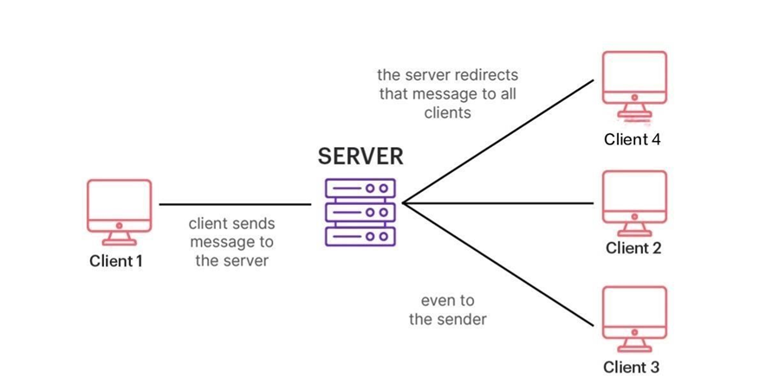
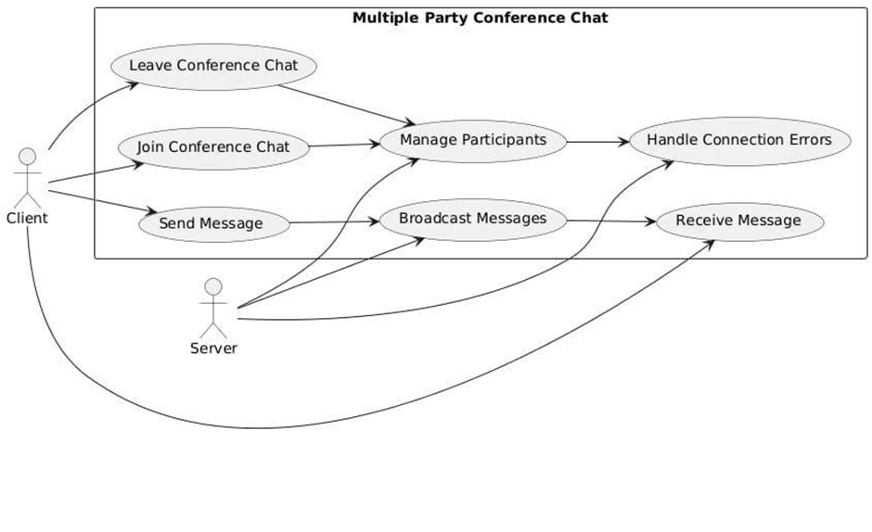

Architecture and Use case Diagrams
Fig 1,2: The diagram shows how the "Client" interacts with the MPCC system to join a chat, send and receive messages, manage participants, and leave the chat. The "Server" handles broadcasting messages and managing connection errors.
2024 - RPS Consulting all rights reserved

Slide 8
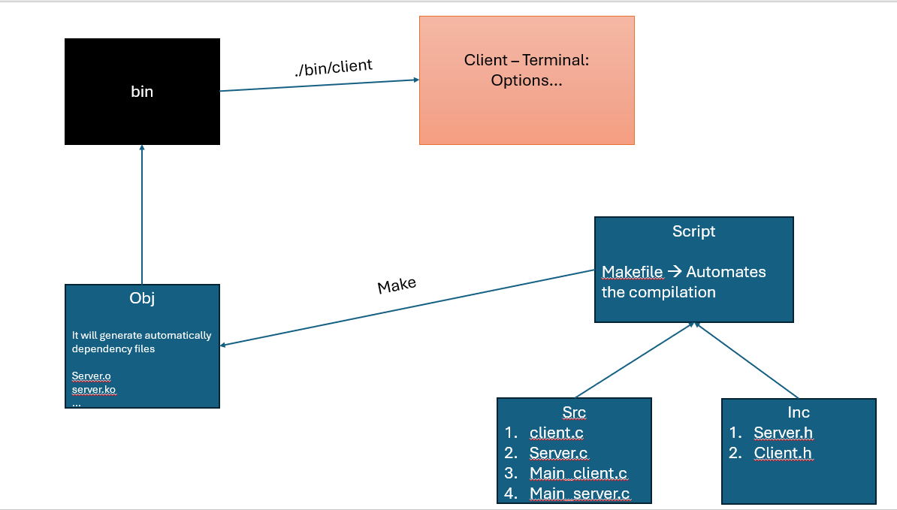
Detailed pictorial explanation of how it works
2024 - RPS Consulting all rights reserved

Slide 9
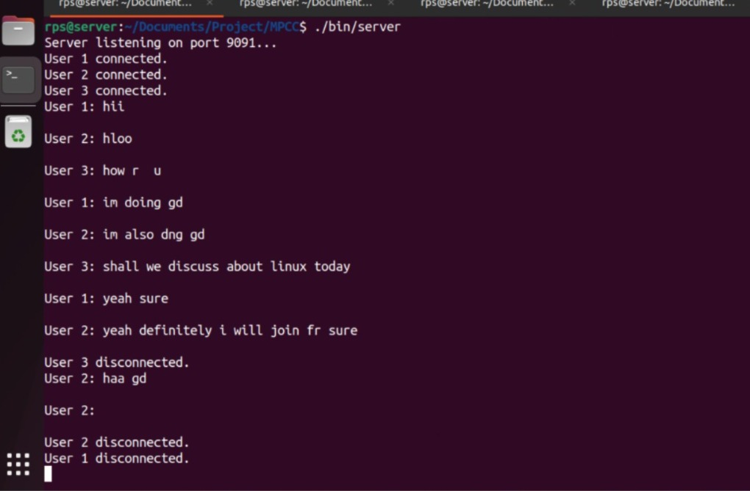
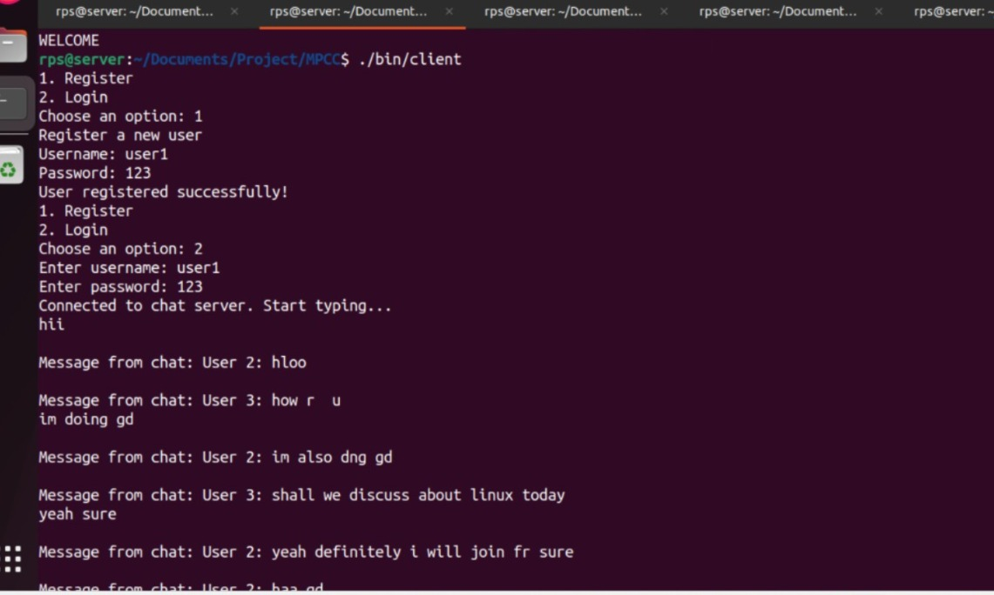
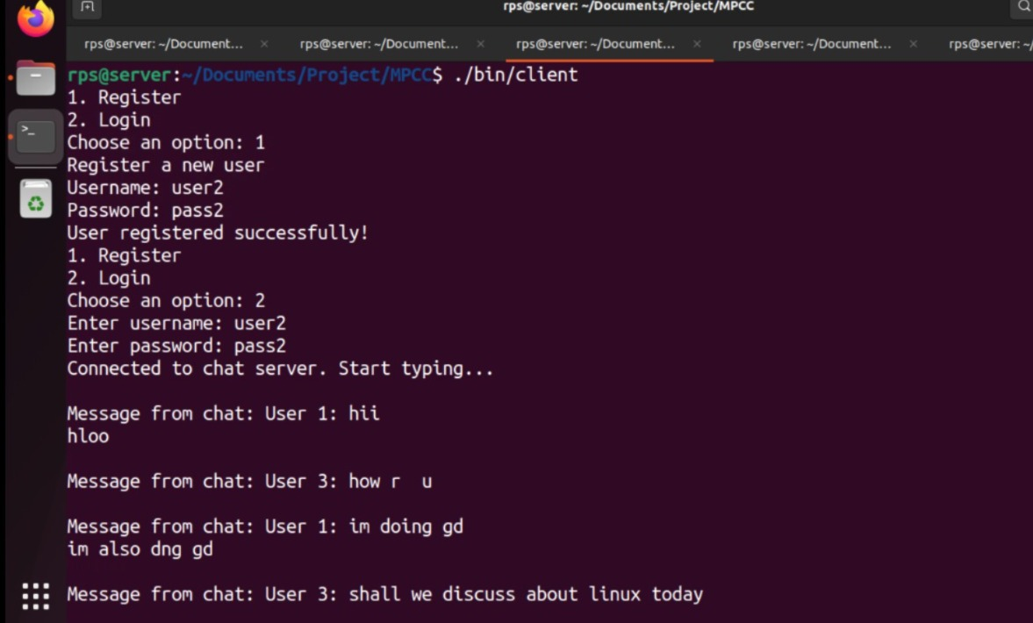
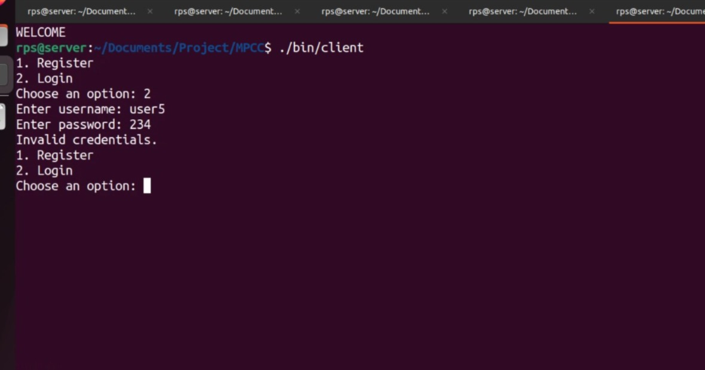
Results and execution reports
This is at server side
New Registration,sending & receiving messages between clients
Invalid Credentials of client
User2 registered,able to send & receive messages
2024 - RPS Consulting all rights reserved

Slide 10
Results & Analysis
✅ Key Findings :
Real-time messaging and logging work efficiently.
Secure authentication prevents unauthorised access.
Handles multiple clients with minimal resources usage.
Stability & Reliability Improvements
✅ Success Rate & Major Failures:
Overall Success Rate: Satisfied
Major Failures Identified:
Successfully implemented multi-client chat system.
The disconnected client can see the chat history in textfile.
Scenario | Checking | Status | Result
New Register | Login | Successful | Enter into chat
Existing Register | Login | Failure | Exit chat
2024 - RPS Consulting all rights reserved

Slide 11
Q&A SESSION
2024 - RPS Consulting all rights reserved

