Slide 1
Iterators
New For Loop
Lab 05

Slide 2
What is a
reference?

Slide 3
References
In Java, any variable that refers to an Object is a reference variable.
The variable stores the memory
address of the actual Object.
Notes:
All variables in Java that refer to Objects are called references. Reference variables store the location / memory address of the actual Object. For most situations, the value stored in a reference is a memory address.

Slide 4
References
String x = "Chuck";
String y = x;
x and y store the same memory address.
x
y
0x2B3
0x2B3
0x2B3
"Chuck"
Notes:
In this example, x and y both the store the location / address of Chuck. There is only one String containing Chuck. There are two reference variables storing the location / address of Chuck.
For this example, x==y is true. x==y compares the values stored in x and y. x and y both store the same location / address.
For this example, x.equals(y) is true. x.equals(y)compares the contents of the Objects referred to by x and y. Chuck is being compared to Chuck.

Slide 5
References
String x = "Chuck";
String y = "Chuck";
x and y store the same memory address.
x
y
0x2B7
0x2B7
0x2B7
"Chuck"
Notes:
In this example, x and y both the store the location of Chuck. There is only one String containing Chuck. There are two reference variables storing the location / address of Chuck.
For this example, x==y is true. x==y compares the values stored in x and y. x and y both store the same location / address.
For this example, x.equals(y) is true. x.equals(y)compares the contents of the Objects referred to by x and y. Chuck is being compared to Chuck.

Slide 6
References
String x = new String("Chuck");
String y = new String("Chuck");
x and y store different memory addresses.
y
x
0x2FE
0x2B7
0x2FE
0x2B7
"Chuck"
"Chuck"
Notes:
In this example, x stores the location / address of a String Object that stores the value Chuck. y also stores the location of a different String Object that stores the value Chuck. x and y do not store the same location / address.
For this example, x==y is false. x and y do not store the same location / address.
For this example, x.equals(y) is true.

Slide 7
References
String x = "Chuck";
String y = "Chuck";
x = null;
x
y
0x2B7
0x2B7
0x2B7
null
"Chuck"
Notes:
In this example, x and y both the store the location / address of Chuck. There is only one String containing Chuck. There are two reference variables storing the location / address of Chuck.
At the start, x==y is true.
x is then referred to null. x now stores null. y was in no way changed. y still stores the address of Chuck.
After changing the value of x, x==y is false.

Slide 8
References
String x = "Chuck";
String y = new String("Chuck");
x and y store different memory addresses.
y
x
0x2FE
0x2B7
0x2FE
0x2B7
"Chuck"
"Chuck"
Notes:
In this example, x stores the location / address of a String Object that stores the value Chuck. y also stores the location of a different String Object that stores the value Chuck. x and y do not store the same location / address.
For this example, x==y is false. x and y do not store the same location / address.
For this example, x.equals(y) is true.

Slide 9
Contest Puzzlers
How many String object does this code create?
String x = new String("Chuck");
String y = x;
Notes:
In this example, x and y both the store the location / address of Chuck. There is only one String containing Chuck. There are two reference variables storing the location / address of Chuck.
For this example, x==y is true. x==y compares the values stored in x and y. x and y both store the same location / address.
For this example, x.equals(y) is true. x.equals(y)compares the contents of the Objects referred to by x and y. Chuck is being compared to Chuck.

Slide 10
Contest Puzzlers
String x = new String("Chuck");
String y = x;
0x5E9A06
"Chuck"
x
y
0x2B3
0x2B3
0x2B3
"Chuck"
Notes:
In this example, x and y both the store the location / address of Chuck. There is only one String containing Chuck. There are two reference variables storing the location / address of Chuck.
For this example, x==y is true. x==y compares the values stored in x and y. x and y both store the same location / address.
For this example, x.equals(y) is true. x.equals(y)compares the contents of the Objects referred to by x and y. Chuck is being compared to Chuck.

Slide 11
Contest Puzzlers
How many String object does this code create?
String x = new String("Chuck");
String y = "Chuck";
Notes:
In this example, x and y both the store the location / address of Chuck. There is only one String containing Chuck. There are two reference variables storing the location / address of Chuck.
For this example, x==y is true. x==y compares the values stored in x and y. x and y both store the same location / address.
For this example, x.equals(y) is true. x.equals(y)compares the contents of the Objects referred to by x and y. Chuck is being compared to Chuck.

Slide 12
Contest Puzzlers
String x = new String("Chuck");
String y = "Chuck";
0x5E9A06
"Chuck"
x
y
0x2B3
0x2B3
0x2B3
"Chuck"
Notes:
In this example, x and y both the store the location / address of Chuck. There is only one String containing Chuck. There are two reference variables storing the location / address of Chuck.
For this example, x==y is true. x==y compares the values stored in x and y. x and y both store the same location / address.
For this example, x.equals(y) is true. x.equals(y)compares the contents of the Objects referred to by x and y. Chuck is being compared to Chuck.

Slide 13
Contest Puzzlers
How many String object does this code create?
String x = new String("Chuck");
String y = new String("Chuck");
Notes:
In this example, x and y both the store the location / address of Chuck. There is only one String containing Chuck. There are two reference variables storing the location / address of Chuck.
For this example, x==y is true. x==y compares the values stored in x and y. x and y both store the same location / address.
For this example, x.equals(y) is true. x.equals(y)compares the contents of the Objects referred to by x and y. Chuck is being compared to Chuck.

Slide 14
Contest Puzzlers
String x = new String("Chuck");
String y = new String("Chuck");
0x5E9A06
"Chuck"
y
x
0x2FE
0x2B7
0x2FE
0x2B7
"Chuck"
"Chuck"
Notes:
In this example, x and y both the store the location / address of Chuck. There is only one String containing Chuck. There are two reference variables storing the location / address of Chuck.
For this example, x==y is true. x==y compares the values stored in x and y. x and y both store the same location / address.
For this example, x.equals(y) is true. x.equals(y)compares the contents of the Objects referred to by x and y. Chuck is being compared to Chuck.

Slide 15
Contest Puzzlers
String x = new String("Chuck");
String y = new String("Chuck");
String z = "Chuck";
0x5E9A06
"Chuck"
y
x
0x2FE
0x2B7
0x2FE
0x2B7
"Chuck"
"Chuck"
Notes:
In this example, x and y both the store the location / address of Chuck. There is only one String containing Chuck. There are two reference variables storing the location / address of Chuck.
For this example, x==y is true. x==y compares the values stored in x and y. x and y both store the same location / address.
For this example, x.equals(y) is true. x.equals(y)compares the contents of the Objects referred to by x and y. Chuck is being compared to Chuck.

Slide 16
references.java

Slide 17
Iterators

Slide 18
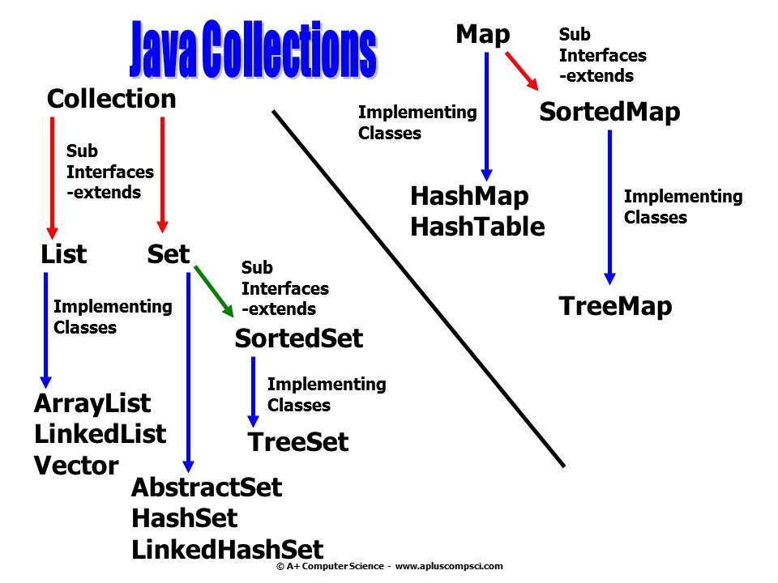
Iterable

Slide 19
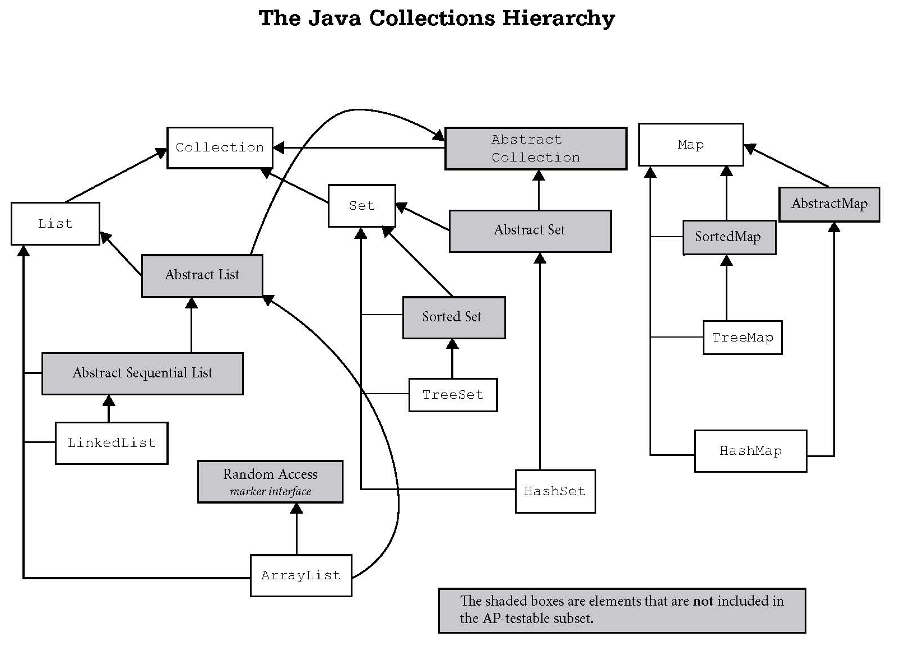
Iterable

Slide 20
Java Iterators
Collection, List, and Set all have methods
that return iterators.
Iterators allow you to go from item to item
through a collection.
Map does not have an iterator, but it does have
a keySet() method that returns a Set of all keys.
You can get an iterator from the Set.

Slide 21
What is an Iterator?
An Iterator provides a standard way to access
all of the references stored in a collection.
For some Collections, TreeMap and HashSet for
instance, the underlying data structures are
not sequentially organized like an array. For
example, a tree has nodes all over the place.
2
1
3
4
Notes:
An Iterator provides a uniform way to traverse a data structure.
As ArrayList, LinkedList, and Set all have Iterators, you can access the references in these structures using the same set of methods. Iterators create uniformity and make accessing the data structure references a similar process.

Slide 22
What is an Iterator?
By using the Iterator, the references from a
Collection can be accessed in a more standard
sequential-like manner without having to
manipulate the underlying Collection
data structure.
1
2
3
4

Slide 23
Iterator
Interface

Slide 24
next()
You don’t call a constructor to create an iterator. You create your collection and then ask it for an iterator:
ArrayList<String> words;
words = new ArrayList<String>();
words.add("at");
words.add("is");
words.add("of");
Iterator<String> it = words.iterator();
Notes:
An iterator provides a standard way to access all of the items in a data structure.
An iterator allows movement from one reference to the next.
When the next() method is called, the next reference in the list is returned and the iterator moves to the next reference.
The next methods movement is based on the data structure that the iterator is working on.

Slide 25
Iterator frequently used methods
Name | Use
E next() | returns a reference to the next item
void remove() | removes the last ref returned by next
boolean hasNext() | checks to see there are more items
import java.util.Iterator;

Slide 26
next()
ArrayList<String> words;
words = new ArrayList<String>();
words.add("at");
words.add("is");
words.add("of");
words.add("us");
Iterator<String> it = words.iterator();
System.out.println(it.next());
OUTPUTat
Notes:
An iterator provides a standard way to access all of the items in a data structure.
An iterator allows movement from one reference to the next.
When the next() method is called, the next reference in the list is returned and the iterator moves to the next reference.
The next methods movement is based on the data structure that the iterator is working on.

Slide 27
next()
OUTPUT
at is of us
ArrayList<String> words;
words = new ArrayList<String>();
words.add("at");
words.add("is");
words.add("of");
words.add("us");
Iterator<String> it = words.iterator();
System.out.println(it.next());
System.out.println(it.next());
System.out.println(it.next());
System.out.println(it.next());
Notes:
When the next() method is called, a reference to the current item is returned and the iterator moves up one spot.
How does this happen? The Iterator saves the current position of the iterator. When the next() method is called, the old position is returned and the next position is saved as the current position of the iterator. Each time next() is called, the next position becomes the current position.

Slide 28
next()
ArrayList<String> words;
words = new ArrayList<String>();
words.add("at");
Iterator<String> it = words.iterator();
System.out.println(it.next());
System.out.println(it.next());
OUTPUT
at error
A NoSuchElementException is thrown.
Notes:
When the next() method is called, a reference to the current item is returned and the iterator moves up one spot.
How does this happen? The Iterator saves the current position of the iterator. When the next() method is called, the old position is returned and the next position is saved as the current position of the iterator. Each time next() is called, the next position becomes the current position.

Slide 29
iteratorone.java

Slide 30
hasnext.java

Slide 31
hasNext()
ArrayList<String> words;
words = new ArrayList<String>();
words.add("at");
words.add("is");
words.add("of");
Iterator<String> it = words.iterator();
while(it.hasNext())
{
System.out.println(it.next());
}
OUTPUTat is of

Slide 32
hasNext()
Note that if you don’t use generics, Java only knows it’s some kind of Object.
ArrayList<String> words;
words = new ArrayList<String>();
words.add("at");
words.add("is");
words.add("of");
Iterator it = words.iterator();
while(it.hasNext())
{
System.out.println(it.next());
}
This would output the same thing:
OUTPUTat is of

Slide 33
hasNext()
But I couldn’t call any String methods:
Iterator it = words.iterator();
while(it.hasNext())
{
System.out.println(it.next().length());
}

Slide 34
hasNext()
Now I can:
Iterator<String> it = words.iterator();
while(it.hasNext())
{
System.out.println(it.next().length());
}

Slide 35
Inside the next( ) method

Slide 36
next()
list
at
is
of
us
Iterator it = list.iterator();
it
curr = null next = "at"
Notes:
An iterator essentially points to an area in front of each reference. It starts out pointing in front of the 1st reference.

Slide 37
next()
method next() { curr = next next = next ref in the collection return curr }
Notes:
When the next() method is called, a reference to the current item is returned and the iterator moves up one spot.
How does this happen? The Iterator saves the current position of the iterator. When the next() method is called, the old position is returned and the next position is saved as the current position of the iterator. Each time next() is called, the next position becomes the current position.

Slide 38
next()
curr = null next = “at”
“at”
list
“is”
at
is
of
us
method next() { curr = next next = next ref in the collection return curr }
it
Notes:
An iterator essentially points to an area in front of each reference. It starts out pointing in front of the 1st reference.

Slide 39
next()
list
at
is
of
us
it
it.next();
next moves the iterator up one spot and returns a reference to the 1st item.
Notes:
When the next() method is called, a reference to the current item is returned and the iterator moves up one spot.
How does this happen? The Iterator saves the current position of the iterator. When the next() method is called, the old position is returned and the next position is saved as the current position of the iterator. Each time next() is called, the next position becomes the current position.
In the example above, next() causes the iterator to slide past "at" and stop in front of "is". next() returns the reference to "at".
So, behind the scenes, "at" is returend and "is" is saved as the new current position.

Slide 40
remove()
The Iterator remove method removes the last element iterated over.
I.e. the last element returned by the next() method.

Slide 41
remove()
ArrayList<String> words;
words = new ArrayList<String>();
words.add("at");
words.add("is");
words.add("of");
Iterator<String> it = words.iterator();
System.out.println(it.next());
it.remove();
System.out.println(it.next());
System.out.println(words);
OUTPUT
at is [is, of]

Slide 42
remove()
list
at
is
of
us
it
Iterator it = list.iterator();
Notes:
When the next() method is called, a reference to the current item is returned and the iterator moves up one spot.
How does this happen? The Iterator saves the current position of the iterator. When the next() method is called, the old position is returned and the next position is saved as the current position of the iterator. Each time next() is called, the next position becomes the current position.

Slide 43
remove()
list
at
is
of
us
it
it.next();
next moves the iterator one spot and returns a reference to at.
Notes:
When the next() method is called, a reference to the current item is returned and the iterator moves up one spot.
How does this happen? The Iterator saves the current position of the iterator. When the next() method is called, the old position is returned and the next position is saved as the current position of the iterator. Each time next() is called, the next position becomes the current position.
In the example above, next() causes the iterator to slide past "at" and stop in front of "is". next() returns the reference to "at".

Slide 44
remove()
list
at
is
of
us
it
it.remove();
remove always modifies the last reference returned by next.
Notes:
Remove always removes the last reference returned by a call to next() or previous(). Remove can only be called after a call to next() or previous().
next()
remove()
remove() //blows up

Slide 45
remove()
list
is
of
us
it
it.next();
next moves the iterator one spot and returns a reference to is.
Notes:
When the next() method is called, a reference to the current item is returned and the iterator moves up one spot.
How does this happen? The Iterator saves the current position of the iterator. When the next() method is called, the old position is returned and the next position is saved as the current position of the iterator. Each time next() is called, the next position becomes the current position.
In the example above, next() causes the iterator to slide past "at" and stop in front of "is". next() returns the reference to "at".

Slide 46
remove()
ArrayList<String> words;
words = new ArrayList<String>();
words.add("at");
words.add("is");
words.add("of");
Iterator<String> it = words.iterator();
curr = null, next = “at”
out.println(it.next()); curr = “at”, next = “is”
it.remove(); curr = null, next = “is”
it.remove();
OUTPUT
at error
Notes:
Remove always removes the last reference returned by a call to next() or previous(). Remove can only be called after a call to next() or previous().
next()
remove()
remove() //blows up

Slide 47
remove()
list
at
is
of
us
it

Slide 48
remove()
list
at
is
of
us
it
next moves the iterator up one spot and returns a reference to the 1st item.
it.next();
Notes:
When the next() method is called, a reference to the current item is returned and the iterator moves up one spot.
How does this happen? The Iterator saves the current position of the iterator. When the next() method is called, the old position is returned and the next position is saved as the current position of the iterator. Each time next() is called, the next position becomes the current position.
In the example above, next() causes the iterator to slide past "at" and stop in front of "is". next() returns the reference to "at".

Slide 49
remove()
list
at
is
of
us
it
remove always modifies the last reference returned by next.
it.remove();
Notes:
Remove always removes the last reference returned by a call to next() or previous(). Remove can only be called after a call to next() or previous().
next()
remove()
remove() //blows up

Slide 50
remove()
list
is
of
us
remove call blows up because there was no call to next; thus, there was no reference to modify.
it
it.remove();
Throws an IllegalStateException
Notes:
Remove always removed the last reference returned by a call to next() or previous(). Remove can only be called after a call to next() or previous().
next()
remove()
remove() //blows up

Slide 51
An iterator doesn’t store anything!
When you make an iterator, it’s not storing a separate copy of the list. It simply manages the list for you and expects you to use it exclusively.

Slide 52
ConcurrentModificationException
ArrayList<String> words;
words = new ArrayList<String>();
words.add("at");
words.add("is");
words.add("of");
Iterator<String> it = words.iterator();
System.out.println(it.next());
words.remove(1);
System.out.println(it.next());
OUTPUT
at error
Notes:
Remove always removes the last reference returned by a call to next() or previous(). Remove can only be called after a call to next() or previous().
next()
remove()
remove() //blows up

Slide 53
No error if you don’t use Iterator again
ArrayList<String> words;
words = new ArrayList<String>();
words.add("at");
words.add("is");
words.add("of");
Iterator<String> it = words.iterator();
System.out.println(it.next());
words.remove(1);
OUTPUT
at
Notes:
Remove always removes the last reference returned by a call to next() or previous(). Remove can only be called after a call to next() or previous().
next()
remove()
remove() //blows up

Slide 54
Okay … but not okay
ArrayList<String> words;
words = new ArrayList<String>();
words.add("at");
words.add("is");
words.add("of");
Iterator<String> it = words.iterator();
System.out.println(it.next());
words.remove(1);
it = words.iterator();
System.out.println(it.next());
System.out.println(it.next());
OUTPUT
at at of
Notes:
Remove always removes the last reference returned by a call to next() or previous(). Remove can only be called after a call to next() or previous().
next()
remove()
remove() //blows up

Slide 55
What wrong with this?
List <String>list = new ArrayList<String>();
list.add("1");
list.add("2");
list.add("3");
Iterator <String>iter = list.iterator ();
iter.remove();
iter = list.iterator();
while (iter.hasNext())
System.out.print((String)iter.next());

Slide 56
IllegalStateException is thrown
You must call next() before remove()!
List <String>list = new ArrayList<String>();
list.add("1");
list.add("2");
list.add("3");
Iterator <String>iter = list.iterator ();
iter.remove();
iter = list.iterator();
while (iter.hasNext())
System.out.print((String)iter.next());

Slide 57
What’s wrong with this loop?
int totalLengths(ArrayList<String> list) { Iterator<String> iter = data.iterator(); int total = 0; while (iter.hasNext()) { if (iter.next().length() < 5) total += iter.next().length(); } return total; }
int totalLengths(ArrayList<String> list) { Iterator<String> iter = data.iterator(); int total = 0; while (iter.hasNext()) { if (iter.next().length() < 5) total += iter.next().length(); } return total; }
Notes:
We’re assuming the goal is to get one item at a time and do two things with it. This doesn’t do that.

Slide 58
The fix: call next() once
int totalLengths(ArrayList<String> list) { Iterator<String> iter = data.iterator(); int total = 0; while (iter.hasNext()) {
String word = iter.next(); if (word.length() < 5) total += word.length(); } return total; }

Slide 59
removeone.java
removetwo.java

Slide 60
the new for loop

Slide 61
new for loop
In an enhanced for loop, Java will automatically create an Iterator and use it to iterate through the array or Collection.
for (int num : array)
for (Integer value : list)

Slide 62
new for loop
ArrayList<Integer> list;
list = new ArrayList<Integer>();
list.add(3);
list.add(9);
for (Integer num : list)
System.out.print(num + " ");
OUTPUT
3 9 2

Slide 63
newforone.java

Slide 64
Start work
on Lab 5

