Slide 1
ListIterator
Interface

Slide 2
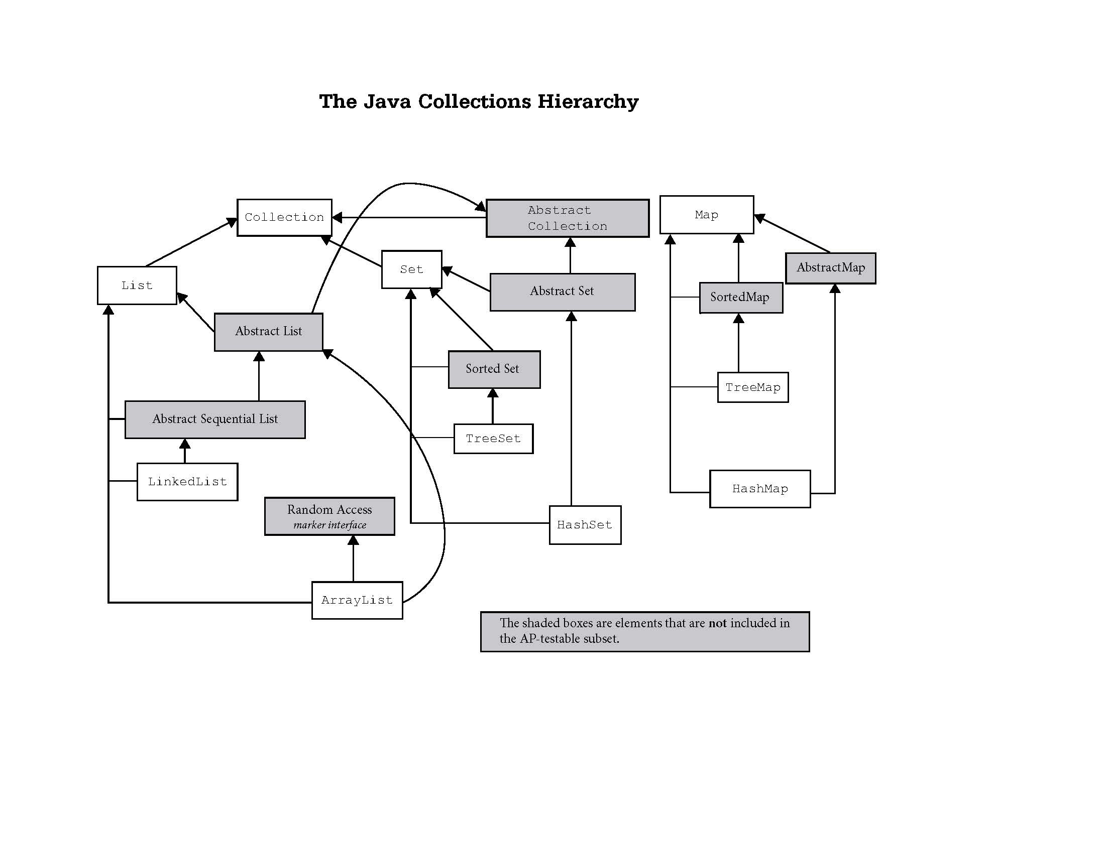
Iterable

Slide 3
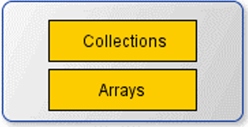
Iterator
Iterable
produces
ListIterator
produces
Utility classes

Slide 4
Iterator frequently used methods
Name | Use
next() | returns a reference to the next item
remove() | removes the last ref returned by next
hasNext() | checks to see there are more items
import java.util.Iterator;

Slide 5
ListIterator frequently used methods
Name | Use
next() | returns a reference to the next item
remove() | removes the last ref returned by next or previous
hasNext() | checks to see there are more items
add() | adds in a new item at the current location
set() | sets the last ref returned by next or previous
previous() | goes back and returns a ref to prev item
import java.util.ListIterator;

Slide 6
ListIterators
ArrayList<String> words;
words = new ArrayList<String>();
words.add("at");
words.add("is");
words.add("of");
words.add("us");
ListIterator<String> it = words.listIterator();
System.out.println(it.next());
System.out.println(it.next());
OUTPUTat is
Notes:
When the next() method is called, a reference to the current item is returned and the iterator moves up one spot.
How does this happen? The Iterator saves the current position of the iterator. When the next() method is called, the old position is returned and the next position is saved as the current position of the iterator. Each time next() is called, the next position becomes the current position.

Slide 7
listiteratorone.java

Slide 8
previous()
ArrayList<String> words;
words = new ArrayList<String>();
words.add("at");
words.add("is");
words.add("of");
words.add("us");
ListIterator<String> it = words.listIterator();
System.out.println(it.next());
System.out.println(it.next());
System.out.println(it.previous());
OUTPUTat is is
Notes:
When the next() method is called, the next reference in the list is returned and the iterator moves up one spot.
When the previous() method is called, the previous reference in the list is returned and the iterator moves back one spot.

Slide 9
previousone.java

Slide 10
previous()
ArrayList<String> words;
words = new ArrayList<String>();
words.add("at");
words.add("up");
words.add("or");
ListIterator<String> it = words.listIterator();
it.next();
it.next();
it.next();
System.out.println(it.previous());
System.out.println(it.previous());
it.set("33");
System.out.println(words);
OUTPUT or up [at, 33, or]
Notes:
When the previous() method is called, the previous reference in the list is returned and the iterator moves back one spot.
The set() method always modifies the last reference returned by a next() or previous() call.

Slide 11
previoustwo.java

Slide 12
set()
ArrayList<String> words;
words = new ArrayList<String>();
words.add("at");
words.add("is");
words.add("us");
ListIterator<String> it = words.listIterator();
System.out.println(it.next());
it.set("###");
System.out.println(it.next());
System.out.println(words);
OUTPUT
at
is
[###, is, us]
Notes:
The set() method always modifies the last reference returned by a next() or previous() call.

Slide 13
set()
list
at
is
us
it

Slide 14
set()
list
at
is
us
it
next moves the iterator up one spot and returns a reference to the 1st item.
it.next();
Notes:
When the next() method is called, a reference to the current item is returned and the iterator moves up one spot.
How does this happen? The Iterator saves the current position of the iterator. When the next() method is called, the old position is returned and the next position is saved as the current position of the iterator. Each time next() is called, the next position becomes the current position.
In the example above, next() causes the iterator to slide past "at" and stop in front of "is". next() returns the reference to "at".

Slide 15
set()
list
###
is
us
it
set always modifies the last reference returned by next or previous.
it.set("###");
Notes:
The set() method always modifies the last reference returned by a next() or previous() call.
The set method can be called multiple times on the same spot.

Slide 16
set()
list
###
is
us
it
next moves the iterator up one spot and returns a reference to the 2nd item.
it.next();
Notes:
When the next() method is called, a reference to the current item is returned and the iterator moves up one spot.
How does this happen? The Iterator saves the current position of the iterator. When the next() method is called, the old position is returned and the next position is saved as the current position of the iterator. Each time next() is called, the next position becomes the current position.

Slide 17
setone.java
settwo.java

Slide 18
add()
ArrayList<String> words;
words = new ArrayList<String>();
words.add("is");
words.add("us");
ListIterator<String> it = words.listIterator();
it.add("##");
System.out.println(it.next());
System.out.println(it.next());
System.out.println(it.previous());
it.set("##");
System.out.println(words);
OUTPUT
is
us
us
[##, is, ##]
Notes:
An iterator essentially points to an area in front of each reference. It starts out pointing in front of the 1st reference.
The add() method always adds the new reference in front the iterator’s current position.

Slide 19
add()
list
is
us
it
Notes:
An iterator essentially points to an area in front of each reference. It starts out pointing in front of the 1st reference.
The add() method always adds the new reference in front the iterator’s current position.

Slide 20
add()
list
##
is
us
it
add always adds the new item in front of the current spot.
it.add("##");
Notes:
An iterator essentially points to an area in front of each reference. It starts out pointing in front of the 1st reference.
The add() method always adds the new reference in front the iterator’s current spot/position.

Slide 21
add()
list
##
is
us
it
next moves the iterator up one spot and returns a reference to the 2nd item.
it.next();
Notes:
When the next() method is called, a reference to the current item is returned and the iterator moves up one spot.
How does this happen? The Iterator saves the current position of the iterator. When the next() method is called, the old position is returned and the next position is saved as the current position of the iterator. Each time next() is called, the next position becomes the current position.

Slide 22
add()
list
##
is
us
it
next moves the iterator up one spot and returns a reference to the 3rd item.
it.next();
Notes:
When the next() method is called, a reference to the current item is returned and the iterator moves up one spot.
How does this happen? The Iterator saves the current position of the iterator. When the next() method is called, the old position is returned and the next position is saved as the current position of the iterator. Each time next() is called, the next position becomes the current position.

Slide 23
add()
list
##
is
us
it
previous backs the iterator up one spot and returns a reference to the 3rd item.
it.previous();
Notes:
When the previous() method is called, the previous reference in the list is returned and the iterator moves back one spot.

Slide 24
add()
list
##
is
##
it
set always modifies the last reference returned by next or previous.
it.set("##");
Notes:
The set() method always modifies the last reference returned by a next() or previous() call.

Slide 25
add()
ArrayList<String> words;
words = new ArrayList<String>();
words.add("is");
words.add("us");
ListIterator<String> it = words.listIterator();
it.add("5");
it.add("4");
it.add("3");
it.add("2");
System.out.println(words);
OUTPUT
[5, 4, 3, 2, is, us]
Notes:
An iterator essentially points to an area in front of each reference. It starts out pointing in front of the 1st reference.
The add() method always adds the new reference in front the iterator’s current position.

Slide 26
add()
ArrayList<String> words;
words = new ArrayList<String>();
words.add("is");
words.add("us"); words.add(0, "5");
words.add(0, "4");
words.add(0, "3");
words.add(0, "2");
System.out.println(words);
OUTPUT
[2, 3, 4, 5, is, us]
Notes:
An iterator essentially points to an area in front of each reference. It starts out pointing in front of the 1st reference.
The add() method always adds the new reference in front the iterator’s current position.

Slide 27
add()
Does the add method add each new element at the same index?
[is, us]
add 5, 4, 3, and then 2
[5, 4, 3, 2, is, us]
No, it addes each successive element in front of the “current” element.
Notes:
An iterator essentially points to an area in front of each reference. It starts out pointing in front of the 1st reference.
The add() method always adds the new reference in front the iterator’s current position.

Slide 28
add()
Do you have to call next() before add()?
[is, us]
add 5, 4, 3, and then 2
[5, 4, 3, 2, is, us]
No. Otherwise you wouldn’t be able to add before the first element.
Notes:
An iterator essentially points to an area in front of each reference. It starts out pointing in front of the 1st reference.
The add() method always adds the new reference in front the iterator’s current position.

Slide 29
addone.java
addtwo.java

Slide 30
Which methods move the “cursor”?
next()
remove()
hasNext()
add()
set()
previous()
next()
remove()
hasNext()
add()
set()
previous()

Slide 31
modification rule
Modifications via the set and remove methods are always applied to the reference returned by the last next or previous call.
Pay attention to the direction you are going.
Iterator only goes one direction.
ListIterator can go either direction.

Slide 32
the new for loop

Slide 33
new for loop
In an enhanced for loop, Java will automatically create an Iterator and use it to iterate through the array or Collection.
for (int num : array)
for (Integer value : list)

Slide 34
new for loop
ArrayList<Integer> list;
list = new ArrayList<Integer>();
list.add(3);
list.add(9);
for (Integer num : list)
System.out.print(num + " ");
OUTPUT
3 9 2

Slide 35
newforone.java

Slide 36
the new for loop
new

Slide 37
The Java 8 forEach() method
Java 8 added Streams to Java
ArrayList<Integer> list;
list = new ArrayList<Integer>();
list.add(3);
list.add(9);
list.add(2);
list.forEach( System.out::println );
OUTPUT
3 9 2
System.out::println is called a Method Reference

Slide 38
The Java 8 forEach() method
The input to the forEach method is a Consumer.
ArrayList<Integer> list;
list = new ArrayList<Integer>();
list.add(3);
list.add(9);
list.add(2);
list.forEach( name -> {
System.out.print(name + " ");
} );
OUTPUT
3 9 2
Here the input is a lambda expression.

Slide 39
Java8forEach.java

Slide 40
Start work
on Lab 5

