Slide 1
Divide and Conquer
Algorithms
0 ( N Log2N )

Slide 2
Divide and Conquer
32
16
16
8
8
8
8
4
4
4
4
4
4
4
4

Slide 3
The Merge Sort

Slide 4
Merge Sort
The merge sort splits the list to be sorted into two ~equal halves.
Each pair of arrays is then merged back together, putting the elements in order during the merge.

Slide 5
N | Bubble | Selection | Insertion | Merge | Quick
10,000 | 268,337 | 172,188 | 112,927 | 1,354 | 1,251
20,000 | 1,153,151 | 698,674 | 461,337 | 3,266 | 2,167
30,000 | 2,608,569 | 1,500,900 | 1,003,081 | 5,153 | 3,622
40,000 | 4,616,671 | 2,678,436 | 1,736,024 | 7,259 | 5,162
50,000 | 7,256,359 | 4,331,037 | 2,885,653 | 8,673 | 6,439
60,000 | 10,316,054 | 5,965,544 | 4,086,762 | 13,304 | 8,664
70,000 | 14,760,440 | 8,406,086 | 5,481,356 | 13,352 | 9,916
80,000 | 18,946,896 | 10,907,601 | 6,936,996 | 13,933 | 11,119
90,000 | 24,215,815 | 13,973,373 | 9,193,457 | 16,549 | 12,253
100,000 | 30,075,729 | 17,215,122 | 1,1014,322 | 18,453 | 12,940
N is the number of integers in the array.

Slide 6
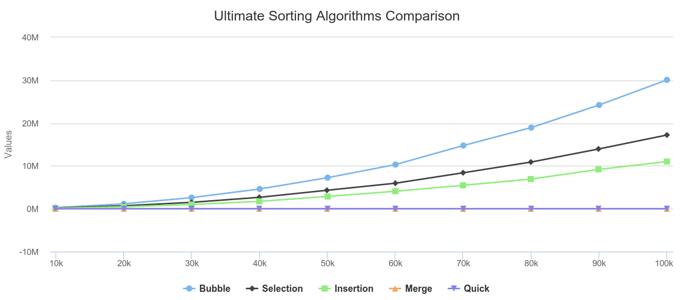

Slide 7
Merge Sort (cont’d)
The divide and conquer approach of the merge sort
Put each element into its own list of one element. | 72 83 40 90 51 30 18 75

Slide 8
Merge Sort (cont’d)
The divide and conquer approach of the merge sort
Put each element into its own list of one element. | 72 83 40 90 51 30 18 75
Merge every two lists above into a single sorted list | 72 83 40 90 30 51 18 75

Slide 9
Merge Sort (cont’d)
The divide and conquer approach of the merge sort
Put each element into its own list of one element. | 72 83 40 90 51 30 18 75
Merge every two lists above into a single sorted list | 72 83 40 90 30 51 18 75
Merge every two lists above into a single sorted list | 40 72 83 90 18 30 51 75

Slide 10
Merge Sort (cont’d)
The divide and conquer approach of the merge sort
Put each element into its own list of one element. | 72 83 40 90 51 30 18 75
Merge every two lists above into a single sorted list | 72 83 40 90 30 51 18 75
Merge every two lists above into a single sorted list | 40 72 83 90 18 30 51 75
Merge the two lists above into the final sorted list | 18 30 40 51 72 75 83 90

Slide 11
Merge Sort (cont’d)
void sort(Object[] list) {
sort(list, 0, list.length - 1);
}
This is a convenience method. If the array is full the user is not required to pass parameters for fromIndex and toIndex.
Notes:
Separating the list into smaller parts (the recursive part);

Slide 12
Merge Sort (cont’d)
void sort(Object[] list, int fromIndex, int toIndex)
{
mergeSort(list, fromIndex, toIndex - 1);
}
This method allows the user to pass the number of elements in the array as the ending parameter.
I.e. sort(list, key, 0, count);

Slide 13
Merge Sort (cont’d)
void mergeSort(Object[] list, int low, int high) {
if (low < high)
{
int mid = (low+high) / 2;
mergeSort(list, low, mid);
mergeSort(list, mid+1, high);
merge(list, low, mid, high);
}
}
Notes:
Separating the list into smaller parts (the recursive part);

Slide 14
Merge Sort (cont’d)
@SuppressWarnings({"unchecked", "rawtypes"})
void merge(Object[] list, int low, int mid, int high)
{
int length = high - low + 1;
int temp[] = new int[length];
for(int i = 0; i < length; i++)
temp[i] = list[low+i];
int m1 = 0;
int m2 = mid – low + 1;

Slide 15
Merge Sort (cont’d)
int m2 = mid - low + 1;
for(int i = 0; i < length; i++) {
if(m2 <= high-low) {
if(m1 <= mid-low) {
if(((Comparable) temp[m1]).compareTo(temp[m2])>0)
list[i+low] = temp[m2++];
else
list[i+low] = temp[m1++];
}
else
list[i+low] = temp[m2++];
}
else
list[i+low] = temp[m1++];
}
}

Slide 16
Merge Sort
1 . . 32
1 . . 16
17 . . 32
1 . . 8
9. . 16
17 . .25
26 . . 32
Merge sort chops in half repeatedly to avoid processing the whole list at once.

Slide 17
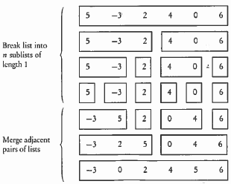
a[0] a[1] a[2] a[3] a[4] a[5]

Slide 18
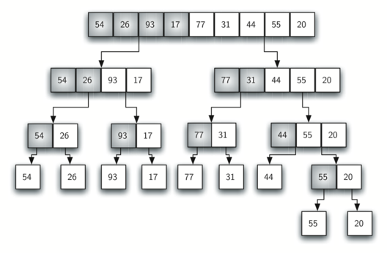
mergeSort, but with a right-hand split
splitting

Slide 19
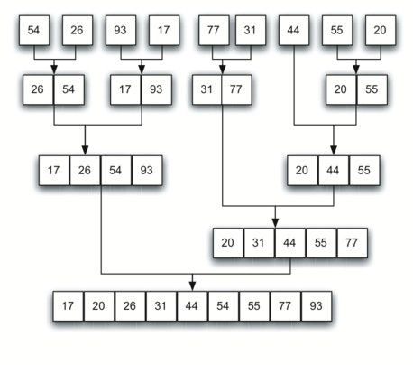
merging

Slide 20
Merge Sort in Action
Original List Integer[] stuff = {90,40,20,30,67,10};
pass 1 - 40 90 20 30 67 10
pass 2 - 20 40 90 30 67 10
pass 3 - 20 40 90 30 67 10
pass 4 - 20 40 90 10 30 67
pass 5 - 10 20 30 40 67 90

Slide 21
mergeSort Algorithm
void mergeSort(Comparable[] stuff, int front, int back)
{
int mid = (front+back)/2;
if(mid==front) return;
mergeSort(stuff, front, mid);
mergeSort(stuff, mid, back);
merge(stuff, front, back);
}
Collections.sort( ) uses the mergeSort.
Arrays.sort( ) uses mergeSort for objects.

Slide 22
void merge(Comparable[] stuff, int front, int back)
{
Comparable[] temp = new Comparable[back-front];
int i = front, j = (front+back)/2, k =0, mid =j;
while( i<mid && j<back) {
if(stuff[i].compareTo(stuff[j])<0)
temp[k++]= stuff[i++];
else
temp[k++]= stuff[j++];
}
while(i<mid)
temp[k++]= stuff[i++];
while(j<back)
temp[k++]= stuff[j++];
for(i = 0; i<back-front; ++i)
stuff[front+i]=temp[i];
}
Merge
W/Objects

Slide 23
Merge Sort Animation
visualgo.net/bn/sorting

Slide 24
Merge Sort Animation
visualgo.net/bn/sorting

Slide 25
MergeSort has a N*Log₂N BigO.
void mergeSort(Comparable[] . . .
{
int mid = (front+back)/2;
if(mid==front) return;
mergeSort(stuff, front, mid);
mergeSort(stuff, mid, back);
}
O(log n)
Notice this version doesn’t call the merge method.

Slide 26
MergeSort has a N*Log₂N BigO.
void mergeSort(Comparable[] . . .
{
int mid = (front+back)/2;
if(mid==front) return;
mergeSort(stuff, front, mid);
mergeSort(stuff, mid, back);
merge(stuff, front, back);
}
O(nlog n)
O(n)

Slide 27
MergeSort has a N*Log₂N BigO.
The mergeSort method alone has a Log₂N run time because it repeatedly cuts the partitions in half.
The merge method alone has an N run time because it must loop each entire partition.
The BigO is n*log(n) because the mergeSort method calls the merge method.

