Slide 1
Divide and Conquer
Algorithms
0 ( N Log2N )

Slide 2
Divide and Conquer
32
16
16
8
8
8
8
4
4
4
4
4
4
4
4

Slide 3
The Quick Sort

Slide 4
Quick Sort
Quick sort finds a pivot value. All numbers
greater than the pivot move to the right and all numbers less move to the left.
This process is then recursively applied to the partitions left and right of the pivot.
Arrays.sort( ) uses the quickSort
if sorting primitives.

Slide 5
Quick Sort
1 . . 32
1 . . 22
23 . . 32
1 . . 19
20. . 22
23 . .25
26 . . 32
Quick sort chops up the list into smaller pieces as to avoid processing the whole list at once.

Slide 6
Quick Sort
[14, 5, 2, 1, 15, 6, 16, 4, 9, 8, 7] [9, 5, 2, 1, 7, 6, 8, 4, 14, 16, 15] [4, 5, 2, 1, 7, 6, 8, 9, 14, 16, 15] [2, 1, 4, 5, 7, 6, 8, 9, 14, 16, 15] [1, 2, 4, 5, 7, 6, 8, 9, 14, 16, 15] [1, 2, 4, 5, 7, 6, 8, 9, 14, 16, 15] [1, 2, 4, 5, 6, 7, 8, 9, 14, 16, 15] [1, 2, 4, 5, 6, 7, 8, 9, 14, 15, 16]
Quick sort chops up the list into smaller pieces as to avoid processing the whole list at once.

Slide 7
Quick Sort
14 | 5 | 2 | 1 | 15 | 6 | 16 | 4 | 9 | 8 | 7
9 | 5 | 2 | 1 | 7 | 6 | 8 | 4 | 14 | 16 | 15
4 | 5 | 2 | 1 | 7 | 6 | 8 | 9 | 14 | 16 | 15
2 | 1 | 4 | 5 | 7 | 6 | 8 | 9 | 14 | 16 | 15
1 | 2 | 4 | 5 | 7 | 6 | 8 | 9 | 14 | 16 | 15
1 | 2 | 4 | 5 | 7 | 6 | 8 | 9 | 14 | 16 | 15
1 | 2 | 4 | 5 | 6 | 7 | 8 | 9 | 14 | 16 | 15
1 | 2 | 4 | 5 | 6 | 7 | 8 | 9 | 14 | 15 | 16
Quick sort chops up the list into smaller pieces as to avoid processing the whole list at once.

Slide 8
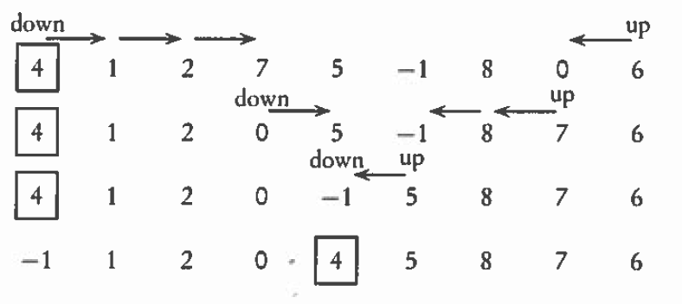
partition Algorithm
4, 1, 2, 7, 5, -1, 8, 0, 6

Slide 9
quickSort Algorithm
public void sort(int[] array) {
sort(array, 0, array.length - 1);
}
void quickSort(int[] stuff, int low, int high) {
if (low < high)
{
int spot = partition(stuff, low, high);
quickSort(stuff, low, spot - 1);
quickSort(stuff, spot + 1, high);
}
}

Slide 10
partition Algorithm
int partition(int[] stuff, int low, int high)
{
int pivot = stuff[low];
int i = low;
int j = high;
while(i < j) {
while (i < j && array[i] <= pivot) { i += 1; }
while (i <= j && array[j] >= pivot) { j -= 1; }
if (i < j) {
swap(array, i, j);
}
}
swap(array, low, j);
return j;
}

Slide 11
quickSort Algorithm
private static void swap(int[] array, int i, int j) {
if (i >= 0 && j >= 0 && i < array.length && j < array.length) {
int tmp = array[i];
array[i] = array[j];
array[j] = tmp;
}
}

Slide 12
The quickSort has a N*Log₂N BigO.
The quickSort method alone has a Log₂N run time, but cannot be run without the partition method.
The partition method alone has an N run time and can be run without the quickSort method.
quickSort
Partition

Slide 13
Speed

Slide 14
Runtime Analysis
for( int i=0; i<20; i++)
System.out.println(i);
for( int j=0; j<20; j++)
for( int k=1; k<200; k*=2)
System.out.println(j*k);
Which section of code would execute the fastest?

Slide 15
Runtime Analysis
ArrayList<Integer> iRay;
iRay = new ArrayList<Integer>();
for( int i=0; i<20; i++)
iRay.add(i);
ArrayList<Double> dRay;
dRay = new ArrayList<Double>();
for( int j=0; j<20; j++)
dRay.add(0,j);
Which section of code would execute the fastest?

Slide 16
Sorting (cont’d)
Time
n²
n log n
n
n 10 100 1000
n² 100 10,000 1,000,000
n log n 10 200 3000
Notes:
When n is large enough, An² eventually overtakes Bn⋅log n no matter how small A is and how large B.

Slide 17
General Big O Chart
for N^2 Sorts
Name Best Case Avg. Case Worst
Selection Sort O(N²) O(N²) O(N²)
Bubble Sort O(N²) O(N²) O(N²)
Insertion Sort O(N) * O(N²) O(N²)
* If the data is sorted, Insertion sort should only make one pass
through the list. If this case is present, Insertion sort would have
a best case of O(n).

Slide 18
General Big O Chart
for NLogN Sorts
Name Best Case Avg. Case Worst
Merge Sort O(N log₂ N ) O(N log₂ N ) O(N log₂ N )
QuickSort O(N log₂ N ) O(N log₂ N ) O(N²) *
* QuickSort can degenerate to N². It typically will degenerate on
sorted data if using a left or right pivot. Using a median pivot will
help tremendously, but QuickSort can still degenerate on certain
sets of data. The split position determines how QuickSort behaves.

Slide 19
Continue work
on Lab22

