Slide 1
Companion AI Tool
COMP230 Component

Slide 2
Companion AI
Using a behaviour tree
Should be adaptable to most animals
My version currently designed for falcons
Easy to add, remove and alter branches

Slide 3
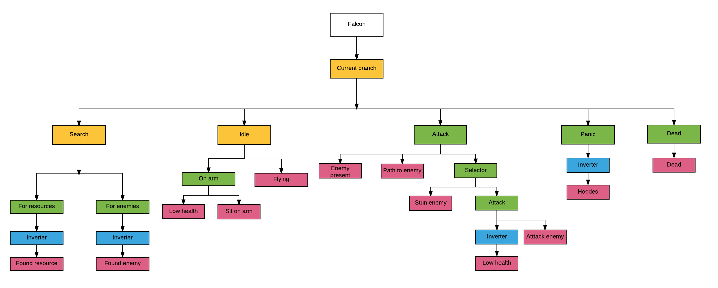
Branches

Slide 4
Scope
Branches just call functions from companion
Functions can easily be changed depending on companion animal
Once the base nodes are working adding and altering branches is easy
Scope depends on number of branches

