Slide 1
COMP230 Components
BSc United

Slide 2
PCG Navigable Mountains
COMP230 Component

Slide 3
Companion AI Tool
COMP230 Component

Slide 4
Companion AI
Using a behaviour tree
Should be adaptable to most animals
My version currently designed for falcons
Easy to add, remove and alter branches

Slide 5
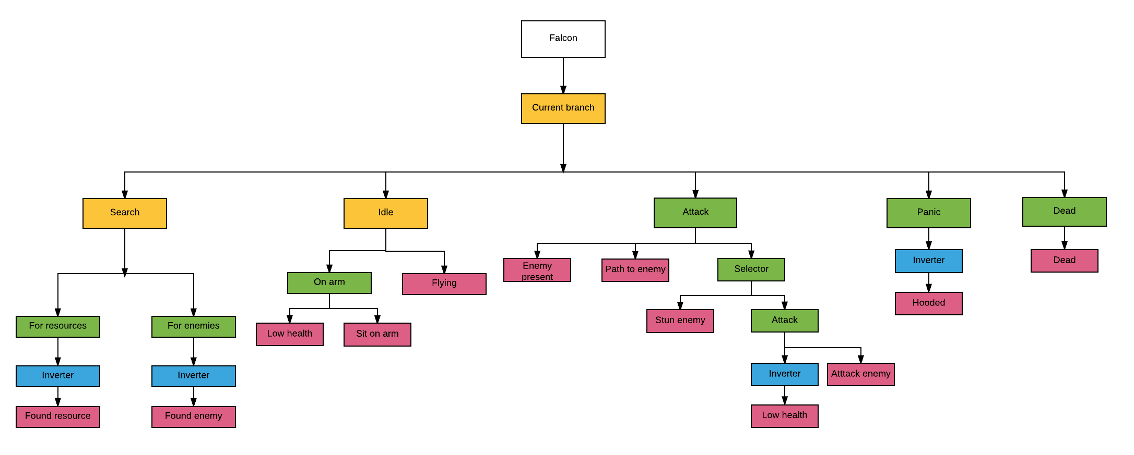
Branches

Slide 6
Scope
Branches just call functions from companion
Functions can easily be changed depending on companion animal
Once the base nodes are working adding and altering branches is easy
Scope depends on number of branches

Slide 7
Commercial Feasibility
Game making tool so could be sold on Unity Asset store
Best selling Unity Assets are normally $50+
Behaviour tree tool on Asset store are either general tools or for enemies

Slide 8
Components Combined
COMP230 Component

Slide 9
Pathfinding
Both components require pathfinding
Paths generated with terrain can be passed into AI to guide player
AI will only find enemies and objects if player can reach them

