Slide 1
COMP230 Components
BSc United

Slide 2
Procedurally Generated Navigable Mountain terrain
Thomas Easterbrook

Slide 3
High Concept and title
-Generating a mountain terrain randomly
-Allow for varying input to change mountains
-Makes sure the terrain is navigable

Slide 4
Target audience and market
-Small groups and individuals who would rather buy then make a mountain terrain
-Similar business model as SpeedTree
-pricing strategy which varies based

Slide 5
USP and how it differs from competitors
-Generates random terrain which can be implemented to others projects
-terrain can vary in complexity
-terrain is navigable proven by A star

Slide 6
The design and technical and production feasibility
-Component uses A star pathfinding
Perlin Noise
-Produces random terrains that can vary in size and complexity

Slide 7
Commercial viability
-previous companies like speedTree prove it possible
-Allows user to pay a set value and avoid having to generate the terrain
-allows for quicker development
-potential to work for bigger games companies and films lie speedTree

Slide 8
Companion Animal AI
Maddie Kay

Slide 9
Companion AI - High Concept
Tool for companion AI
Adaptable to most animals
Current version designed for falcons
Uses a behaviour tree

Slide 10
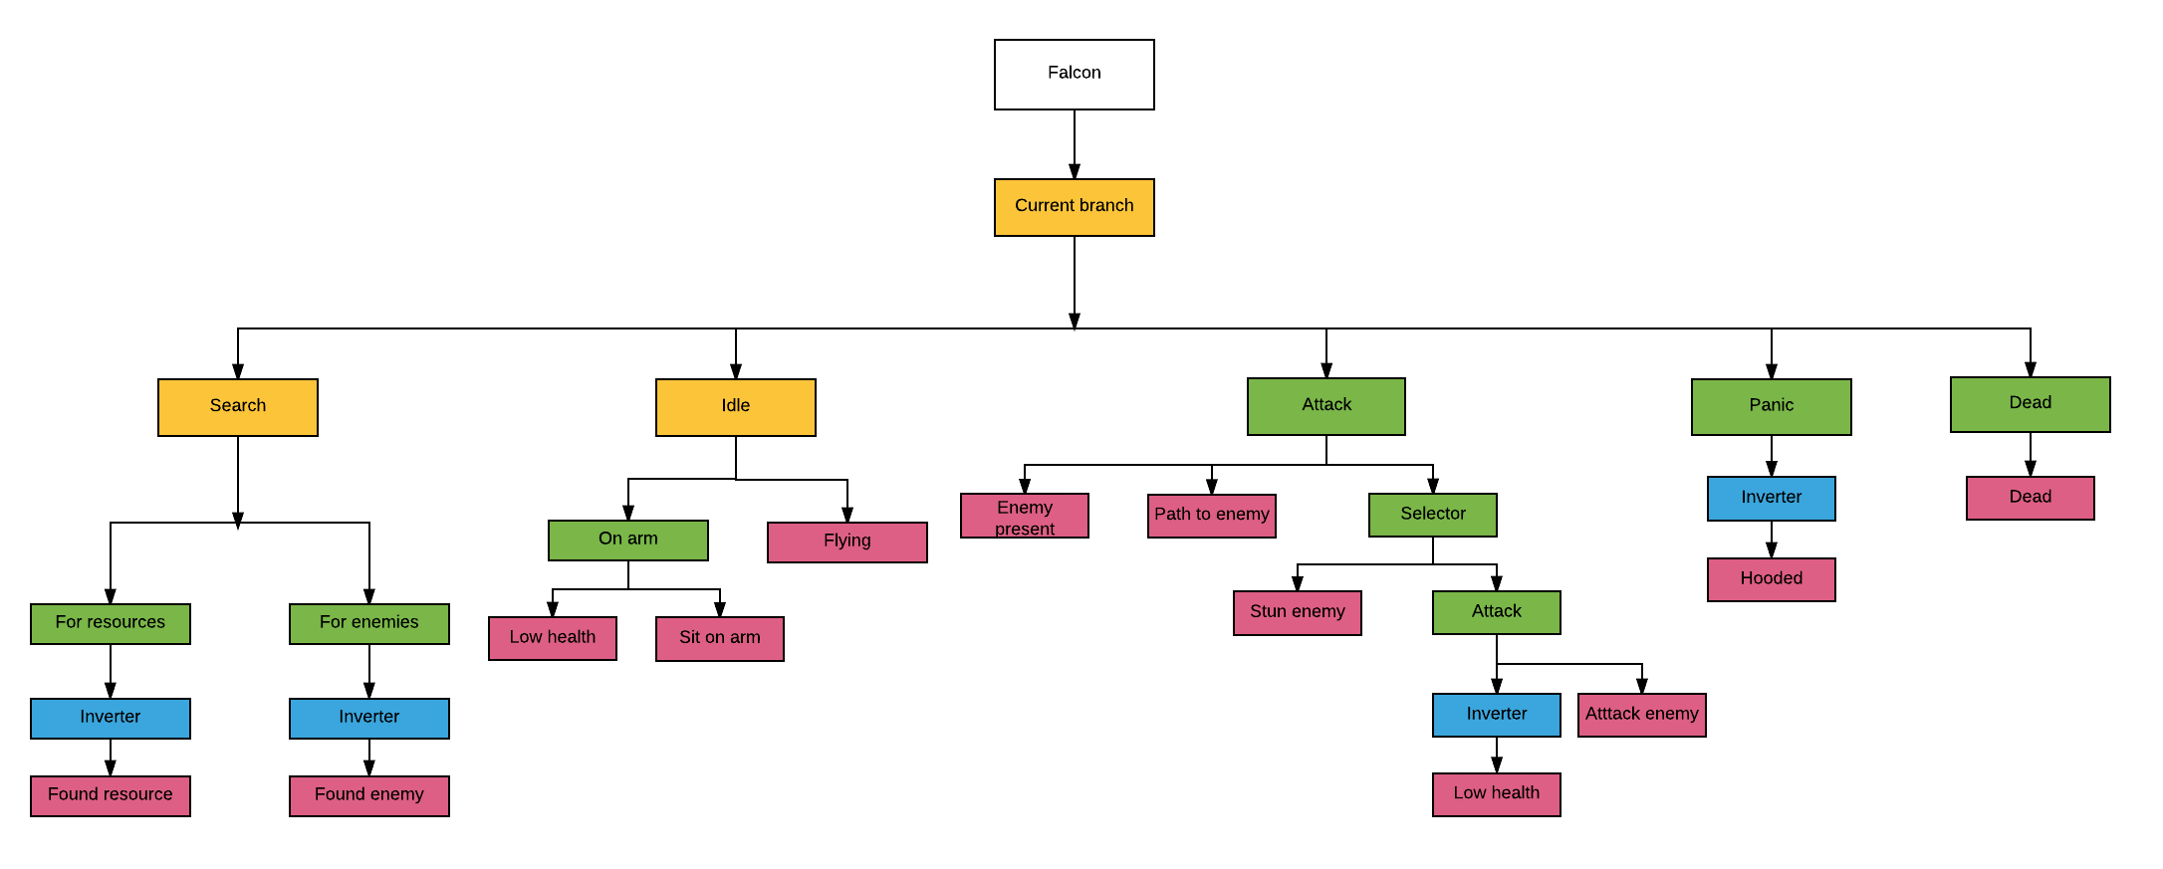
Branches

Slide 11
Market Research
Companions common in games
Need a balance between annoying and useful
Useful behaviours seemed to be:
Finds resources
Leads the way
Doesn’t hinder the player

Slide 12
Target Market
Unity users
Unity Asset store
Quick prototyping
Developers with little code experience

Slide 13
Commercial Feasibility
Game making tool so could be sold on Unity Asset store
Best selling Unity Assets are normally $50+
Behaviour tree tool on Asset store are more general tools

Slide 14
Technical Feasibility
Scope depends on number of branches
Branches just call functions from companion
Once the base nodes work adding and altering branches is easy

Slide 15
Components Combined
COMP230 Component

Slide 16
Pathfinding
Both components require pathfinding
Paths generated with terrain can be passed into AI to guide player
AI will only find enemies and objects if player can reach them

Slide 17
Demo

Slide 18
Questions

