Slide 1
“grintar”; An R package to analyze, visualize and distribute data from a physical exercise ergometer model.
Marc Teunis^{1*}, Jan-Willem Lankhaar^{2*}, Shirley Kartaram¹, Eric Schoen³, Raymond Pieters^{1,4}
1) Innovative Testing in Life Sciences & chemistry, University of Applied Sciences, Utrecht
2) Institute for ICT, HBO-ICT , University of Applied Sciences, Utrecht
3) TNO, Zeist
4) Institute for Risk Assessment Sciences, Utrecht University, Utrecht
*Both authors contributed equally to this work

Slide 2


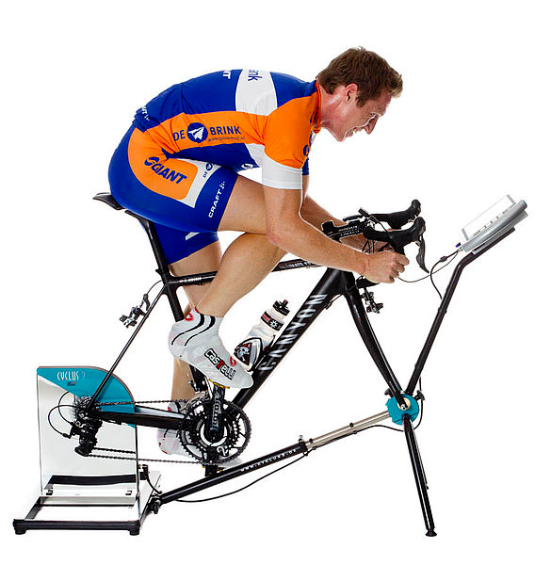
The experiment
15 healthy young men, trained to cycle at least twice a week
5 treatmens: 4 different bike ergometer exercises, 1 baseline rest condition
Dietary and training restrictions during the experiment
Approximately 120 biological parameters
3 different biological matrices
8 sampling times
Total dimensions dataset: >40,000 rows and 12 columns

Slide 3


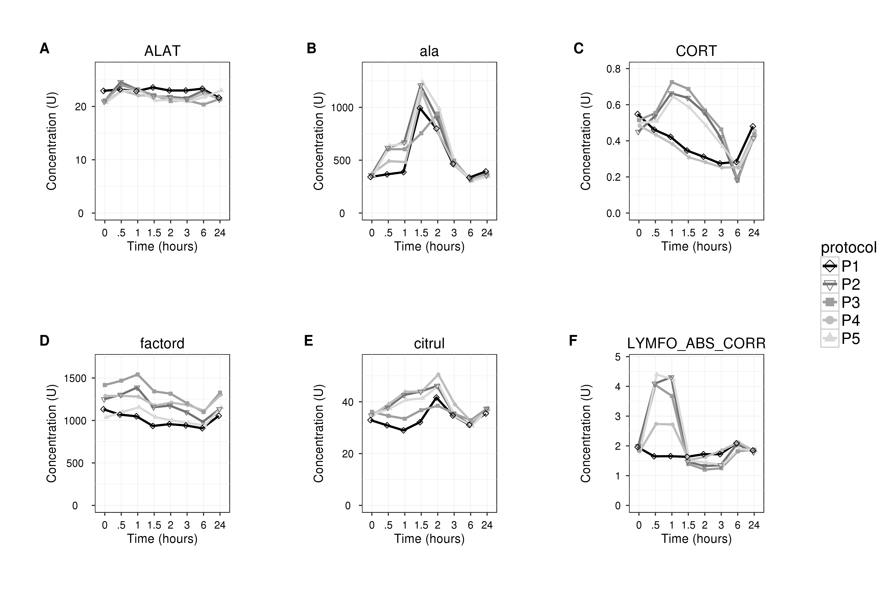
The data workflow
Lab 1
Parameters
a, b, c ...
Lab 1
Parameters
d, e, f ...
Lab 1
Parameters
g, h, I ...
Lab 1
Parameters
j, k, l ...
Lab 1
Parameters
m, n, o ...
Assays
Raw-data
Combined, annotated data-set
Results

Slide 4
The R code as a package {grintar}
Data, code, analysis, documentation, output (images reports and anlysis) all in one place
Easy to share data & code with collaborators
Easy to accompany publications with data and analysis
Easy to use for reproduction or further research in the future (by us or others)
Illustrative teaching materials (data, case examples, exercises, examples, vignettes, workflows)

Slide 5
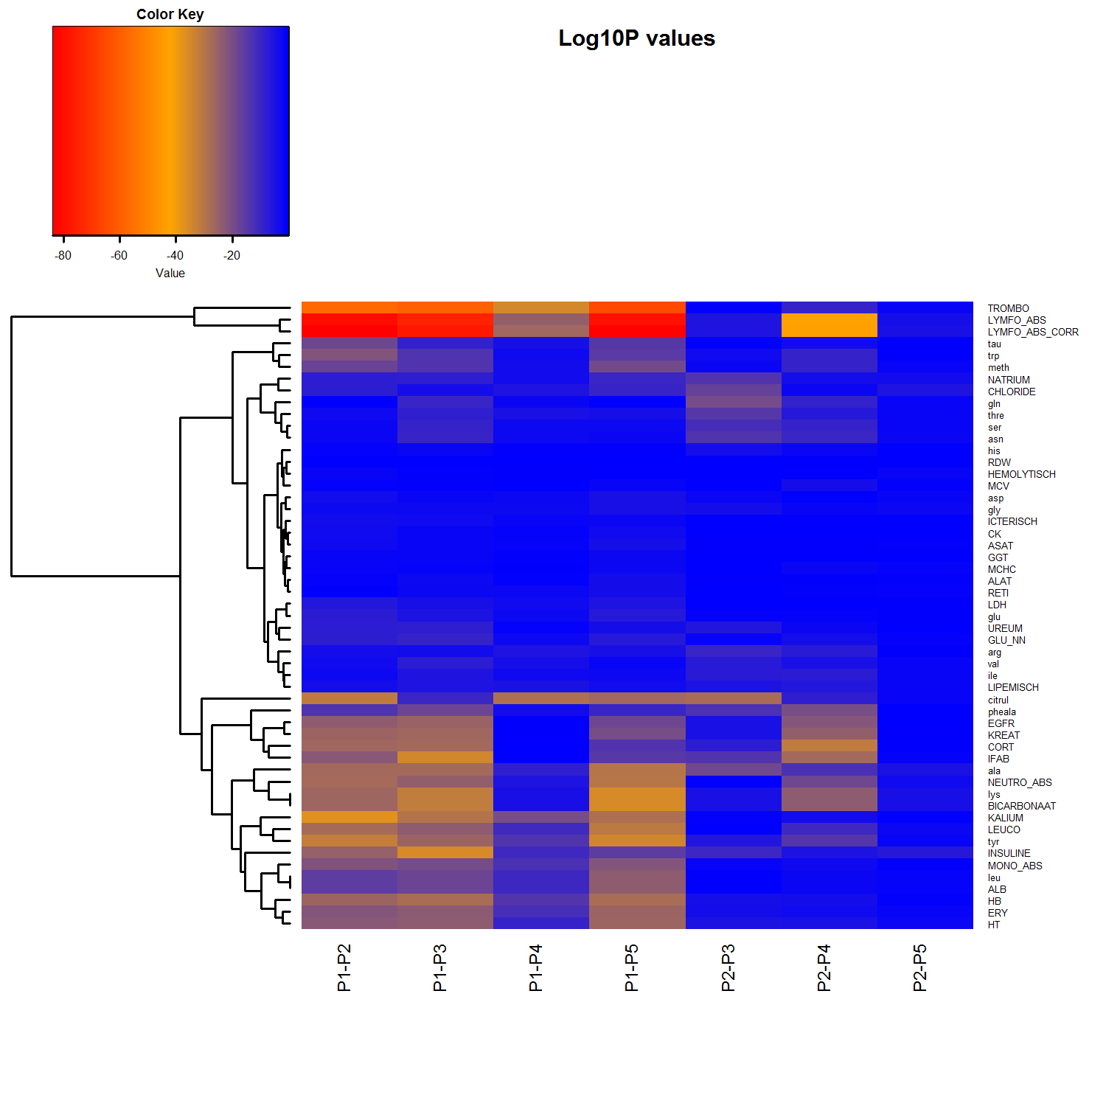
Output example: create_graph_heatmap()
install.packages("gplots")
library(gplots)
install.packages("ColorBrewer")
library(RColorBrewer)
my_palette <- colorRampPalette(c("blue", "orange", "red"))(n = 44*85-1)
## wrapper for heatmap.2 function from
## gplots
create_graph_heatmap <- function(MATRIX,
FILENAME,
TITLE){
png(filename = FILENAME,
width = 15*300,
height = 15*300,
res = 300,
pointsize = 12)
heatmap.2(MATRIX,
main = TITLE,
notecol = "black",
density.info = "none",
trace ="none",
margins =c(13,13),
col=my_palette,
breaks = col_breaks_P,
dendrogram = 'none',
Colv = "NA",
symm = FALSE,
symkey=FALSE,
symbreaks = FALSE,
scale="none")
dev.off()
}
########################################
# Applying function:
create_graph_heatmap(MATRIX = matrix_contrasts,
FILENAME = "./images/heatmaps/all_contrasts.png",
TITLE = "Log10P values")

