Slide 1
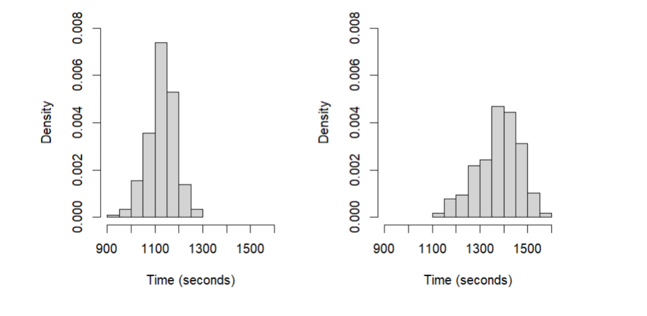
Female vs. Male Times
Histogram of fastest male time to complete the Parkrun
Histogram of fastest female time to complete the Parkrun

Slide 2
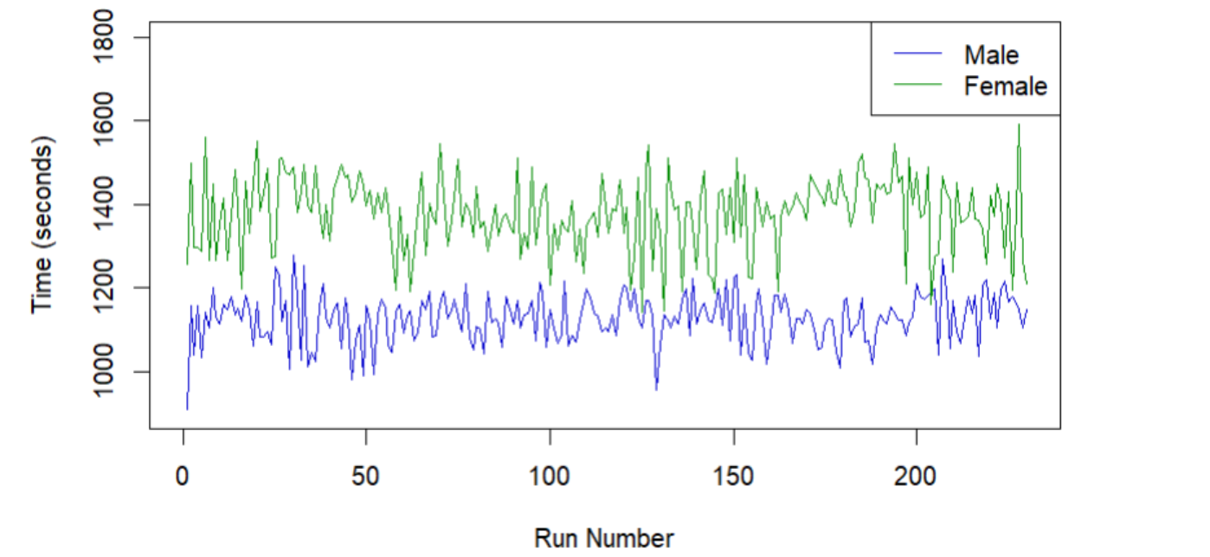
Changes Over Time
Line graph of run number against time taken to complete run

