Slide 1




HACKAURA
HACK, CREATE, ELEVATE

Slide 2

TEAM DETAILS
TEAM NAME: HIGHWINGS
TEAM ID: HA26077
DOMAIN: IoT
PROBLEM STATEMENT: Smart Parking and Traffic Management

Slide 3

KEY FEATURES
Automated Entry and Exit Gate
Real-Time Parking Status
Parking Slot Monitoring
Automatic Parking Timer & Billing
Payment Dashboard

Slide 4

TECH STACK
Hardware
ESP32
Web / Dashboard
HTML
Servo Motor (Gate control)
IR Sensors (slot detection)
LCD Display
CSS
JavaScript
Networking / Data
Wi-Fi (ESP32 connectivity)
I2C protocol (LCD display)
Software
Embedded C / C++ programming
Arduino IDE

Slide 5
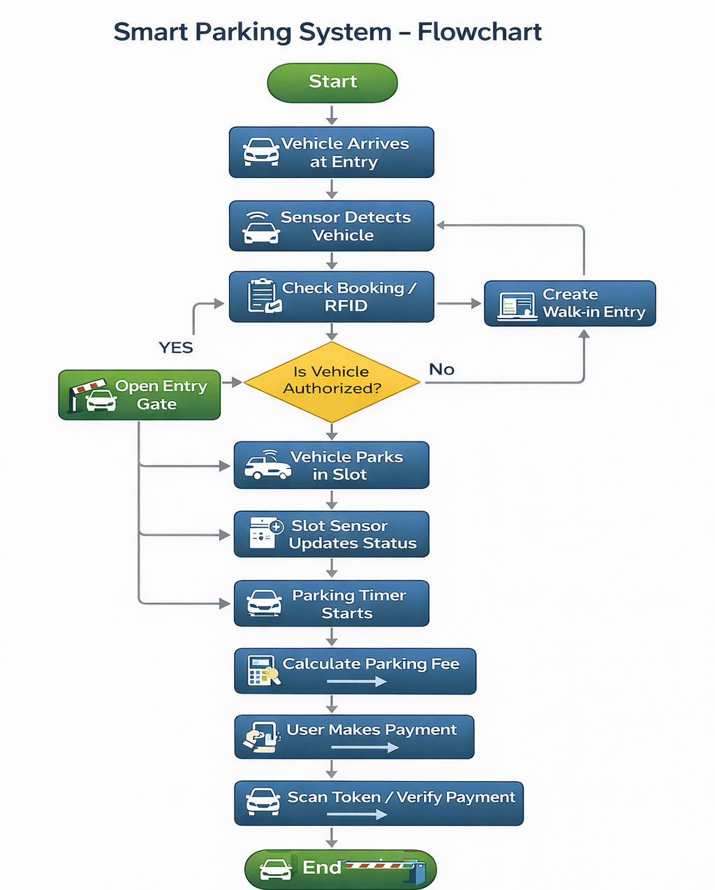
Implementation :

Slide 6

SCALABILITY
Expandable System
More parking slots and sensors can be added easily.
Multi-location Support
The system can be implemented in multiple parking areas like malls, airports, and offices.
Cloud Integration
Data can be stored and accessed from cloud servers for large-scale management
User Growth Support
The system can handle increasing numbers of users and vehicles
Smart City Integration
Can be integrated with other smart city services in the future.

Slide 7

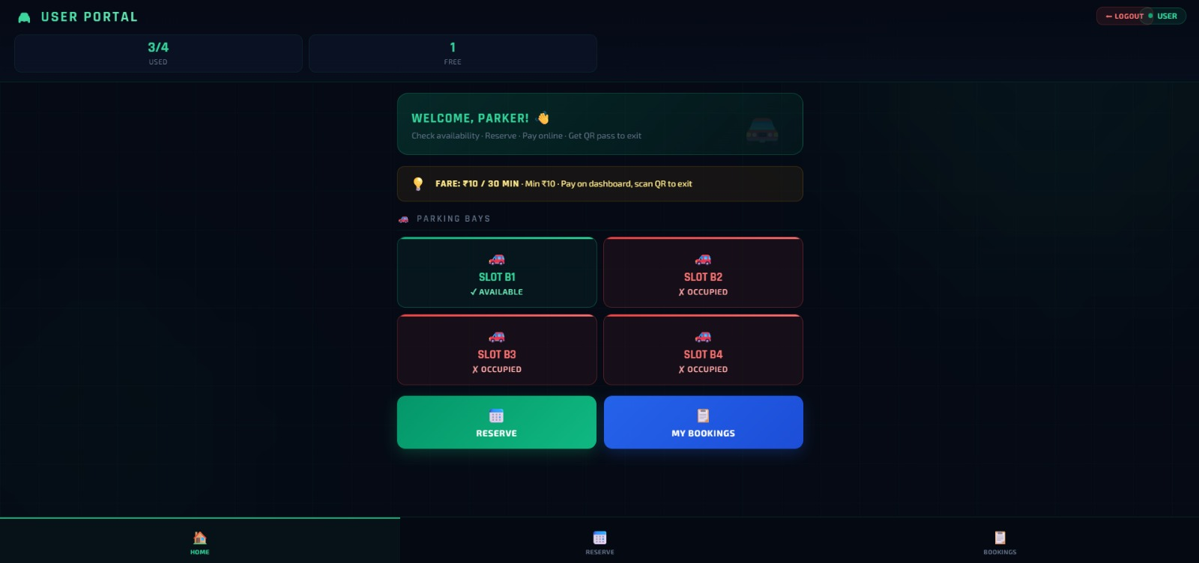
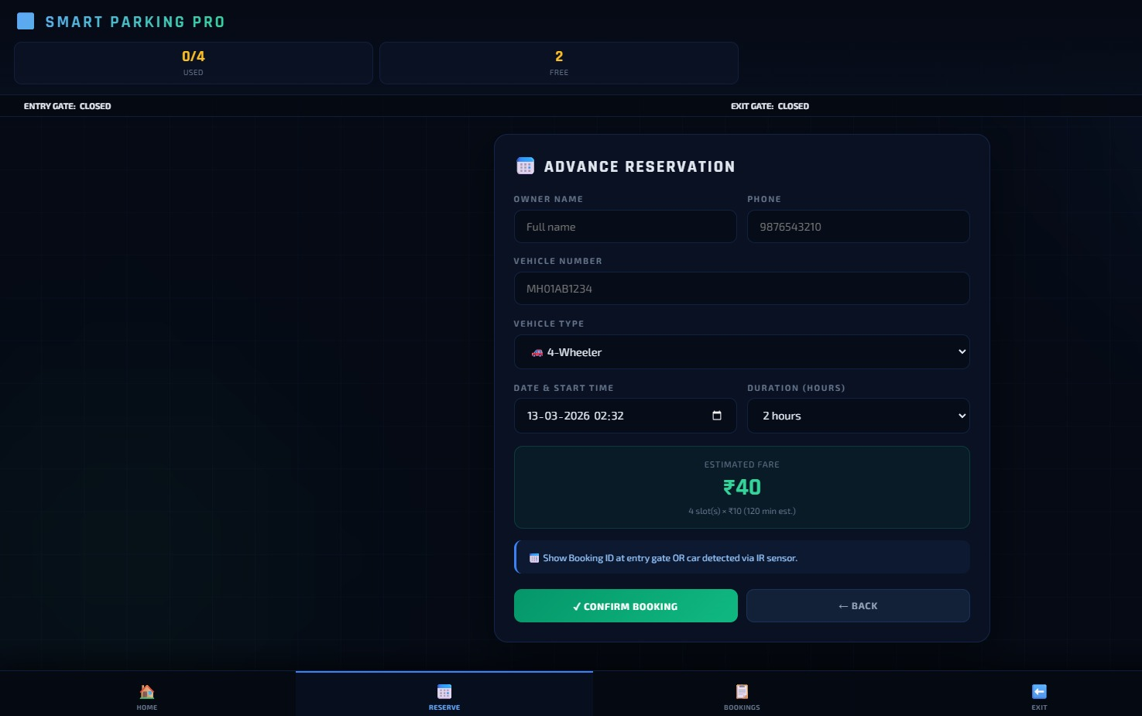
INTERFACE
Fig: USERPAGE
Fig: RESERVATION PAGE

Slide 8
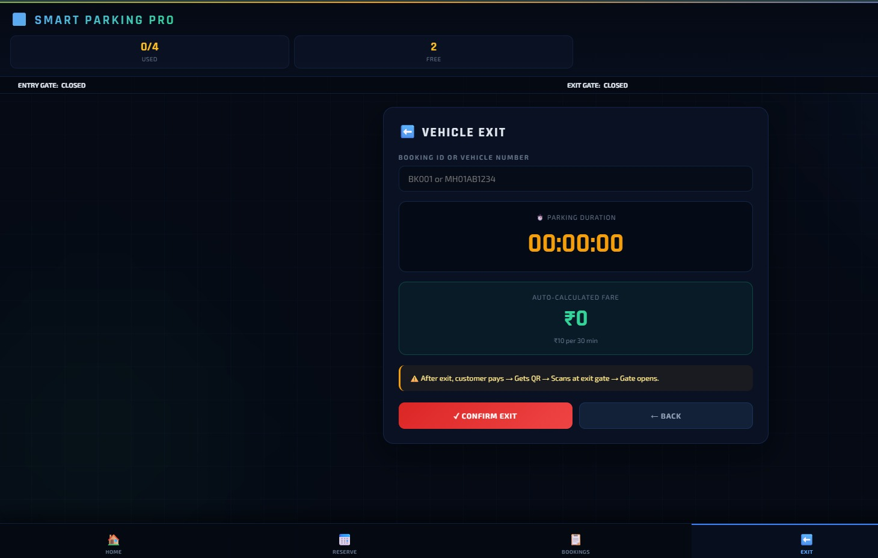
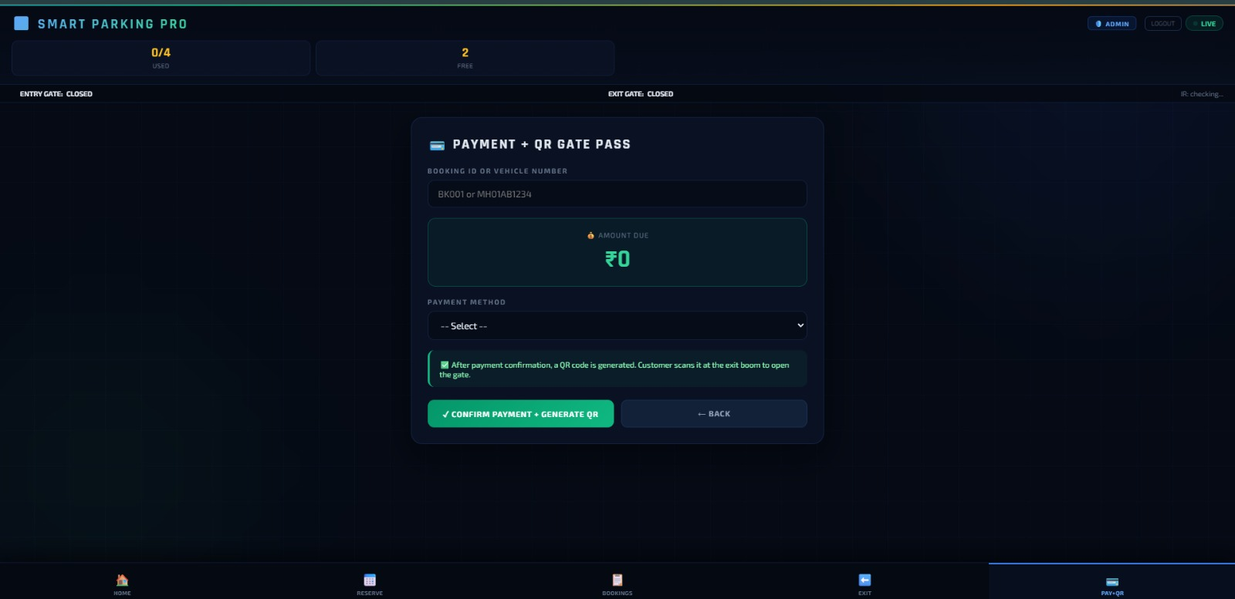
Continue:
Fig: EXITPAGE
Fig: PAYMENT PAGE

Slide 9
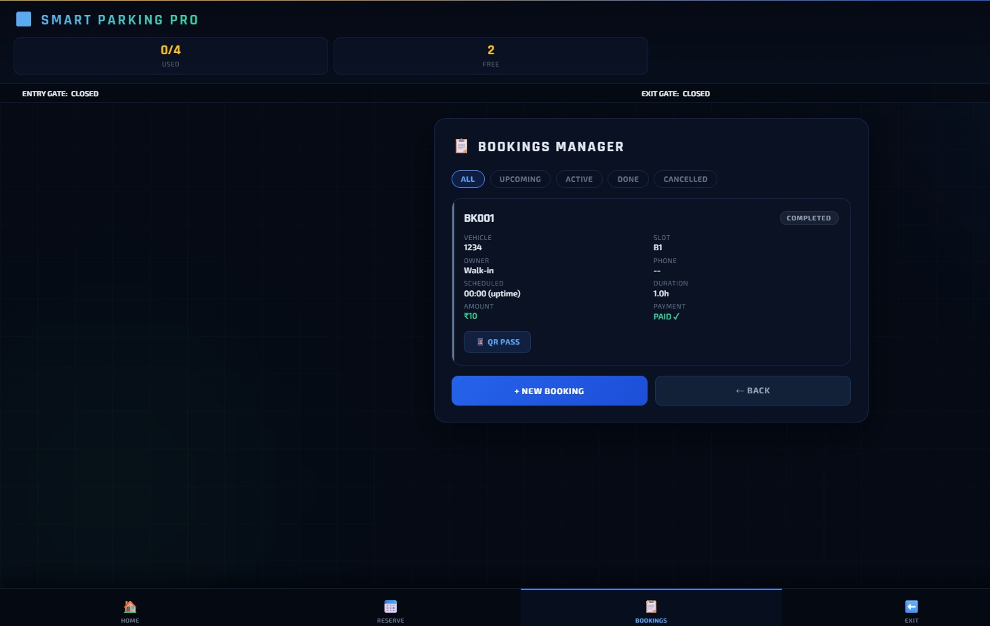
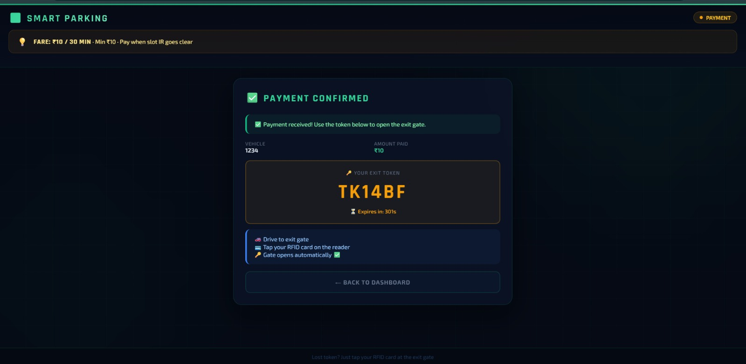
Continue:
Fig: TOKEN
Fig: BOOKING PAGE

Slide 10

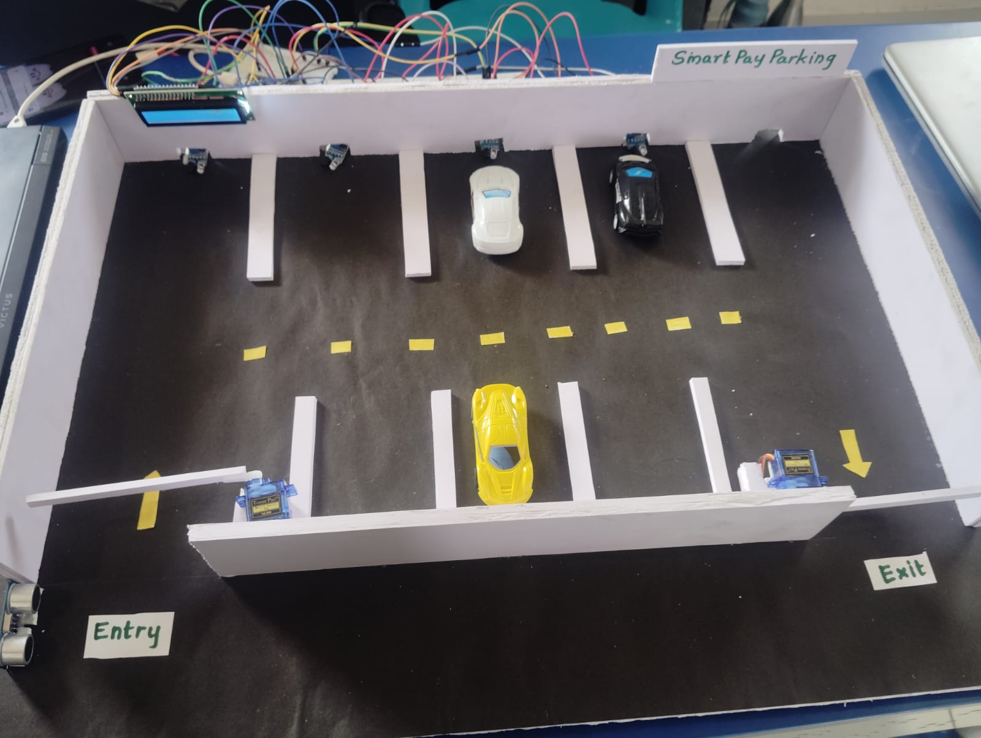
Continue:
Fig: ADMIN PAGE
Fig: PROTOTYPE

Slide 11

CONCLUSION
The Smart Parking System provides an efficient solution to manage parking spaces.
The system reduces traffic congestion and saves time and fuel.
It helps drivers quickly find available parking slots.
Automation improves parking management and reduces manual effort.
This system can be further expanded and integrated into smart city infrastructure.

Slide 12

THANK YOU

