Slide 1
Customer support-Automation of ticket creation
PIP1004 University Project-II
Review-2
Batch Number: CCS-G31
Roll Number | Student Name
20211ccs0086 | Mohammad T
20211ccs0066 | Greeshma R
20211ccs0060 | Mubarak
20211ccs0054 | Vignesh G
20211ccs0041 | Mohammed Faizan
Under the Supervision of,
Professor: Dr. Syed Siraj Ahmed
School of Computer Science & Engineering
Presidency University

Slide 2
Introduction
The project aims to tackle the inefficiencies of manual ticket creation in customer support systems by automating key processes using Artificial Intelligence (AI) and Natural Language Processing (NLP). Since Review 1, significant progress has been made in implementing foundational components and addressing initial challenges.
Progress Achieved:
Implemented an email parsing module using NLP for extracting customer complaints and auto-generating tickets.
Integrated Retrieval-Augmented Generation (RAG) to enhance responses with historical ticket data.
Established a basic framework for ticket classification and routing.
Challenges Encountered: 1. Achieving high accuracy in classifying multilingual tickets.
2. Balancing system performance during the integration of advanced frameworks like LangChain.
3. Designing workflows for incomplete ticket data follow-ups.

Slide 3
Literature Review
Ticket Automation: Using NLP and ML models for parsing customer queries and automating ticket creation.
Retrieval-Augmented Generation (RAG): Leveraging RAG for context-aware ticket responses by referencing historical data.
AI Workflow Optimization: Integration of LangChain for multi-step decision-making and automated follow-ups.
Sentiment Analysis: Employing AI-based tools to prioritize customer tickets based on urgency and sentiment.
Scalability: Parallel processing for handling a large volume of tickets.
Real-World Applications: Reference studies on scalable ticketing systems, their deployment challenges, and customer experience improvements.

Slide 4
Proposed Method (Updates Since Review 1)
Email Parsing & Ticket Creation (Completed):
NLP-based module extracts key information (e.g., issue type, customer ID).
Tickets are auto-generated with structured data for further processing.
Retrieval-Augmented Generation (RAG) (Ongoing):
Retrieves relevant information from historical tickets to improve response quality.
Enhances decision-making by analyzing past resolutions.
LangChain Integration (Initial Phase):
Designed a workflow for intelligent ticket routing based on sentiment and urgency.
Basic template-based auto-responses under testing.
Parallel Processing (Planned):
Conducting initial tests to manage multiple tickets simultaneously.
Ensuring scalability without compromising accuracy.

Slide 5
Objectives
Refine Ticket Classification Accuracy: Employ advanced NLP models like transformers for improved multilingual support.
Implement Sentiment-Based Ticket Prioritization: Design and test an AI model to identify ticket urgency and rank them accordingly.
Develop Workflow for Incomplete Tickets: Automate follow-up emails and notifications for tickets with missing details.
Prepare for Large-Scale Testing: Simulate real-world ticket scenarios to evaluate system performance.

Slide 6
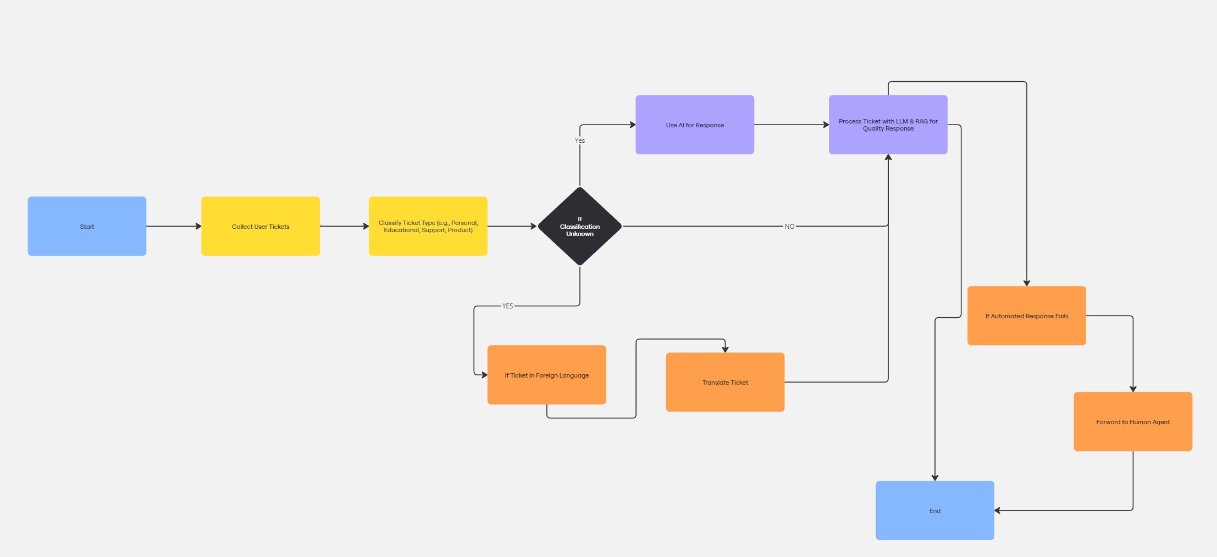
Methodology

Slide 7
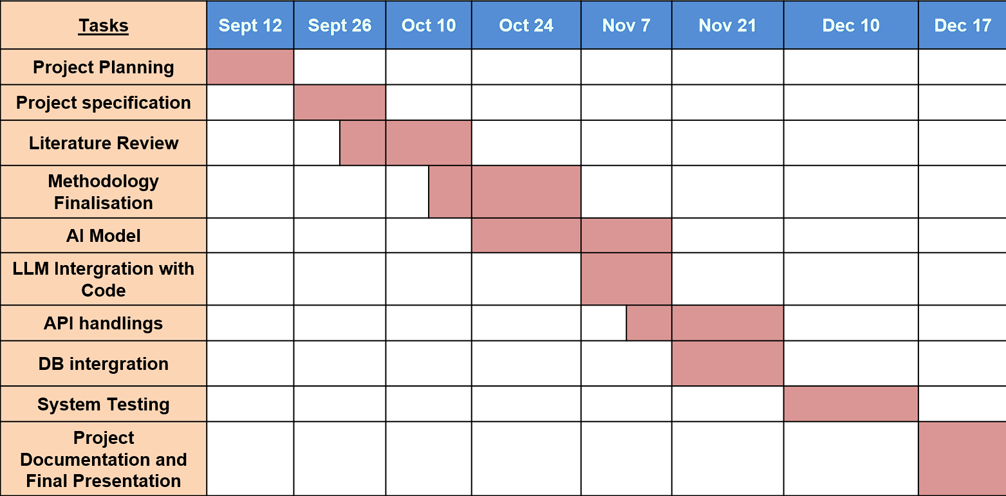
Timeline of Project

Slide 8
Expected Outcomes (By Review 3)
Achieve 90% accuracy in ticket classification across multiple languages.
Successfully process and resolve 100 tickets simultaneously using parallel processing.
Demonstrate a fully integrated end-to-end workflow for ticket handling, including follow-ups.
Develop a basic dashboard for tracking ticket statuses and system performance metrics.

Slide 9
Conclusion
The project is progressing as planned, with foundational modules implemented and advanced features under development. Efforts are focused on improving accuracy, scalability, and workflow efficiency to deliver a robust automated ticketing solution.

Slide 10
References
https://www.scitepress.org/Papers/2024/128072/128072.pdf
https://www.researchgate.net/publication/337509813_A_Study_in_the_Automation_of_Service_Ticket_Recognition_using_Natural_Language_Processing
https://ceur-ws.org/Vol-3239/paper17.pdf
https://www.researchgate.net/publication/381461839_Retrieval_Augmented_Generation_RAG_based_Restaurant_Chatbot_with_AI_Testability
https://ieeexplore.ieee.org/ielx7/6287639/8948470/09234428.pdf
https://jcoms.fesb.unist.hr/pdfs/v17n1_1024_tolciu.pdf
https://www.researchgate.net/publication/337509813_A_Study_in_the_Automation_of_Service_Ticket_Recognition_using_Natural_Language_Processing
https://www.researchgate.net/publication/339986693_AI-based_chatbots_in_customer_service_and_their_effects_on_user_compliance
https://www.researchgate.net/publication/381036706_Application_of_Chatbots_and_Virtual_Assistants_in_Ticket_Booking_System
https://www.sciencedirect.com/science/article/abs/pii/S1567422321000703
https://www.researchgate.net/publication/371057143_Design_and_Implementation_of_an_AI_Chatbot_for_Customer_Service
https://www.emerald.com/insight/content/doi/10.1108/REGE-07-2021-0120/full/html
https://www.darpa.mil/attachments/AIFull.pdf

Slide 11
Thank You

