Slide 1
Customer support-Automation of ticket creation
PIP1004 University Project-II
Review-3
Batch Number: CCS-G31
Roll Number | Student Name
20211ccs0086 | Mohammad T
20211ccs0066 | Greeshma R
20211ccs0060 | Mubarak
20211ccs0054 | Vignesh G
20211ccs0041 | Mohammed Faizan
Under the Supervision of,
Professor: Dr. Syed Siraj Ahmed
School of Computer Science & Engineering
Presidency University

Slide 2
Introduction
Project Goal: Automate customer ticket management using AI-powered technologies like Natural Language Processing (NLP), Retrieval-Augmented Generation (RAG), and LangChain for enhanced scalability, accuracy, and efficiency.
Current Status:
Email parsing and ticket generation fully implemented.
RAG module integrated for enhanced response accuracy.
Initial workflows for sentiment-based routing and follow-ups under testing.
Key Focus Areas for Review 3: 1. Improving multilingual support for ticket classification.
2. Scaling the system to handle higher ticket volumes with parallel processing.
3. Enhancing workflow automation with LangChain and LangGraph.

Slide 3
Literature Survey
1. Multilingual NLP Models:
Studies on transformer-based models like BERT for handling diverse languages in ticket classification.
2. Advanced Workflow Automation:
LangChain’s applications in chaining complex AI models for decision-making.
3. Scalability Techniques:
Research on parallel processing and load balancing for AI-driven systems.
4. Customer Experience Trends:
Impact of AI on customer satisfaction and operational efficiency in large-scale support environments.

Slide 4
Proposed Method (Updates since Review 2)
1. RAG Improvements:
Enhanced data retrieval mechanisms to improve the contextual accuracy of responses.
Integrated customer feedback data into the RAG repository for better recommendations.
2. Sentiment-Based Routing:
Tested AI models for classifying tickets based on urgency and sentiment.
Achieved preliminary accuracy of 85% in prioritizing high-urgency tickets.

Slide 5
Proposed Method (Updates since Review 2)
3. Workflow Enhancements:
Refined LangChain workflows for multi-step automation, including follow-ups and intelligent ticket routing.
Began integration of LangGraph for managing complex workflows.
4. Scalability Tests:
Conducted initial parallel processing trials, handling up to 50 tickets simultaneously.
Optimized load balancing to prevent delays during peak ticket volumes.

Slide 6
Objectives
Achieve 90% Accuracy: Refine multilingual ticket classification and sentiment detection.
Enhance Workflow Automation: Fully integrate LangChain and LangGraph for seamless ticket routing.
Scale System Capacity: Successfully handle 100+ tickets simultaneously with parallel processing.
Real-Time Monitoring and Analytics: Develop dashboards for real-time performance tracking and actionable insights.

Slide 7
Methodology
Phase 1: Email Parsing and Ticket Generation (Completed)
Developed an NLP-based module for structured ticket creation.
Reduced manual effort and errors in ticket generation.
Phase 2: RAG Integration (Completed)
Enhanced response accuracy using historical ticket data.
Leveraged customer feedback for informed resolutions.
Phase 3: Sentiment-Based Routing (Ongoing)
AI-driven sentiment analysis for ticket prioritization.
Initial results: 85% accuracy, targeting 90% by Review 4.

Slide 8
Methodology
Phase 4: Workflow Automation (Ongoing)
Implementing LangChain and LangGraph for managing multi-step workflows.
Auto-follow-ups and template-based responses under testing.
Phase 5: Scalability Testing (Ongoing)
Conducting parallel processing trials to handle simultaneous tickets.
Focused on maintaining performance and minimizing latency during high loads.

Slide 9
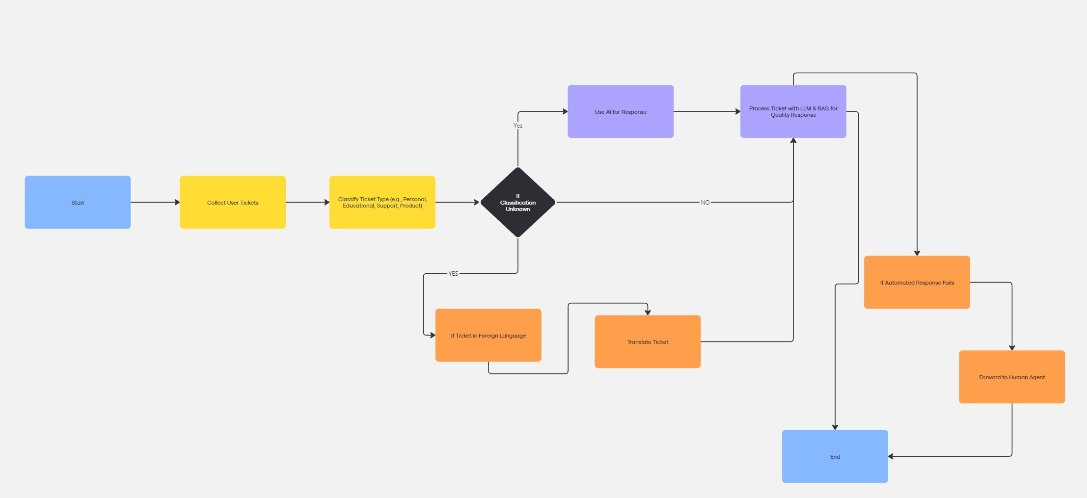
Methodology

Slide 10
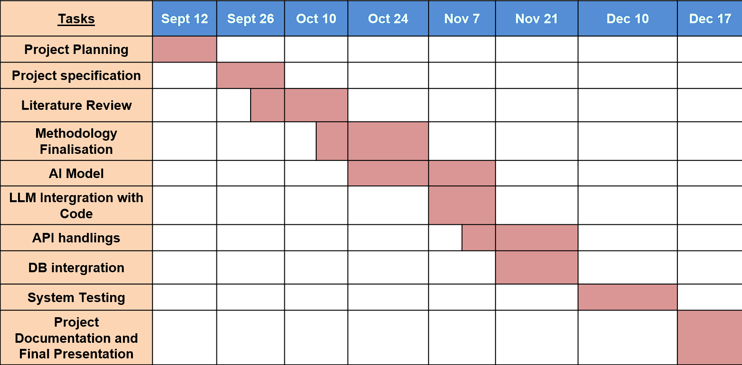
Timeline of Project

Slide 11
Expected Outcomes (By Review 4)
Fully functional end-to-end automated ticketing system.
Real-time performance monitoring via dashboards.
System capable of handling 100+ tickets simultaneously with high accuracy.
Comprehensive workflow automation for ticket routing and follow-ups.

Slide 12
Conclusion
The project is on track to meet its goals, with significant progress in ticket generation, workflow automation, and scalability. The team is focused on addressing remaining challenges and optimizing system performance to deliver a robust solution by the final review.

Slide 13
References
https://www.scitepress.org/Papers/2024/128072/128072.pdf
https://www.researchgate.net/publication/337509813_A_Study_in_the_Automation_of_Service_Ticket_Recognition_using_Natural_Language_Processing
https://ceur-ws.org/Vol-3239/paper17.pdf
https://www.researchgate.net/publication/381461839_Retrieval_Augmented_Generation_RAG_based_Restaurant_Chatbot_with_AI_Testability
https://ieeexplore.ieee.org/ielx7/6287639/8948470/09234428.pdf
https://jcoms.fesb.unist.hr/pdfs/v17n1_1024_tolciu.pdf
https://www.researchgate.net/publication/337509813_A_Study_in_the_Automation_of_Service_Ticket_Recognition_using_Natural_Language_Processing
https://www.researchgate.net/publication/339986693_AI-based_chatbots_in_customer_service_and_their_effects_on_user_compliance
https://www.researchgate.net/publication/381036706_Application_of_Chatbots_and_Virtual_Assistants_in_Ticket_Booking_System
https://www.sciencedirect.com/science/article/abs/pii/S1567422321000703
https://www.researchgate.net/publication/371057143_Design_and_Implementation_of_an_AI_Chatbot_for_Customer_Service
https://www.emerald.com/insight/content/doi/10.1108/REGE-07-2021-0120/full/html
https://www.darpa.mil/attachments/AIFull.pdf

Slide 14
Thank You

