Slide 1



KONGU ENGINEERING COLLEGE
PERUNDURAI ERODE-638060
MSc SOFTWARE SYSTEMS
22ISP71- PROJECT WORK
Deep Learning based Seasonality and Trend Detection in Demand Forecasting
Presented by :
MOHAMED SHAHUL ANAS S
(22ISR027)
IV MSC (SS)
Guided by :
Mr. A.Vijay M.Sc ME
Assistant Professor,
Department of CT-PG,
Kongu Engineering College,
Perundurai.

Slide 2
INTRODUCTION
The project addresses the issue of inaccurate sales forecasting in time-series data.
Traditional models struggle to capture both seasonal trends and temporal dependencies, leading to poor forecasting accuracy.
The proposed solution is a Hybrid Deep Learning (HDL) model employing BiLSTM for bidirectional temporal learning, CNN–LSTM for spatial and sequential modeling, and CNN–BiLSTM for trend-based pattern detection.
This hybrid deep learning framework delivers more accurate and reliable forecasting, transforming sales prediction in dynamic retail environments.

Slide 3
Objectives
Improve sales forecasting accuracy using a hybrid deep learning model combining CNN and BiLSTM.
Capture both spatial and temporal patterns to better detect seasonal and trend-based sales behaviors.
Provide reliable demand predictions to support effective inventory and business decision-making.

Slide 4
LITERATURE SURVEY
S.No | Title of the paper | Name of the Journal | Authors | Methodology proposed | Research Gap
1 | Deep Learning based Seasonality and Trend Detection (2025) | IEEE Access | Tamilarasan Kannadasan | CNN,LSTM | Existing models fail to capture both trend & seasonality
2 | Deep AR: Probabilistic Forecasting with RNN (2021) | arXiv | Salinas et al. | RNN with autoregression | Lack of scalability in probabilistic modeling

Slide 5
S.No | Title of the paper | Name of the Journal | Authors | Methods proposed | Research gap
3 | Sales Forecast in E-commerce using CNN (2017) | arXiv | Kui Zhao, Can Wang | CNN | CNN alone may not capture time dependencies
4 | LSTM-Based Forecasting in E-commerce (2019) | arXiv | Kasun Bandara et al. | LSTM | Ignores spatial sales correlations

Slide 6
S.No | Title of the paper | Name of the journal | Authors | Methods Proposed | Research gap
5 | Multimodal NN for Demand Forecasting (2022) | arXiv | Nitesh Kumar et al. | CNN + Sentiment Embedding | Limited integration of contextual data.
6 | Hybrid SARIMA-CNN-LSTM Model (2024) | IJCJ | Adekunle Ajiboye | SARIMA + CNN + LSTM Ensemble | High computational complexity

Slide 7
S.No | Title of the Paper | Name of the journal | Authors | Methods Proposed | Research Gap
7 | A Short-Term Load Forecasting Method Using Integrated CNN and LSTM Network | IEEE Access | Rafi, Deeba, Hossain | Integrated CNN-LSTM for load forecasting | Emphasizes energy forecasting; retail demand still unaddressed
8 | Domain Fusion CNN-LSTM for Short-Term Power Consumption Forecasting | IEEE Access | Shao, Pu, Zhang, Kim | Domain-fusion CNN-LSTM | Focused on power consumption; lacks retail application

Slide 8
S.no | Title of the paper | Name of the Journal | Authors | Methods proposed | Research Gap
9 | Time Series Forecasting with Conditional CNN (2024) | Springer | Anastasia Borov | Conditional CNN | Not tested on seasonal business data
10 | Survey of Deep Time Series Models (2025) | Springer | David Salinas | Various deep learning models | Missing hybrid interpretability

Slide 9
S.no | Title of the paper | Name of the journal | Authors | Methods Proposed | Research Gap
11 | Comprehensive Survey on Time Series Models (2025) | Wiley | Zhang | ARIMA, DL, Transformer | High-level summary, lacks domain-specific focus
12 | Demand Forecasting in SCM using DL (2023) | MDPI | Deepika M | LSTM, CNN, GAN | Application limited to SCM only

Slide 10
S.no | Title of the paper | Name of the journal | Authors | Methods Proposed | Research Gap
13 | Sales Forecasting via RNNs & Transformers (2022) | JSAI | Valles-Perez | RNN + Transformer | Transformers alone may be overkill for small data
14 | CNN-LSTM for Stock Price Prediction (2020) | arXiv | Sidra Mehtab, Jaydip Sen | CNN + LSTM | Limited to finance lacks generalization
15 | Forecasting using CNN-LSTM-GRU (2023) | IJETT | Rizky Naufal, Antoni Wibowo | CNN + LSTM + GRU | Resource-heavy triple-model setup

Slide 11
EXISTING SYSTEM
Traditional machine learning models such as Logistic Regression, Random Forest, and SVM often struggle to handle non-linear sales trends, noisy data, and seasonal variations in retail forecasting.
These models are limited in capturing complex relationships and temporal dependencies present in time-series data.
Existing hybrid deep learning systems often fail to fully integrate both local spatial information and long-term temporal dependencies, reducing their overall forecasting accuracy.
Convolutional layers are strong in extracting spatial features like local sales spikes but require a complementary temporal component to model sequential dependencies over time.

Slide 12
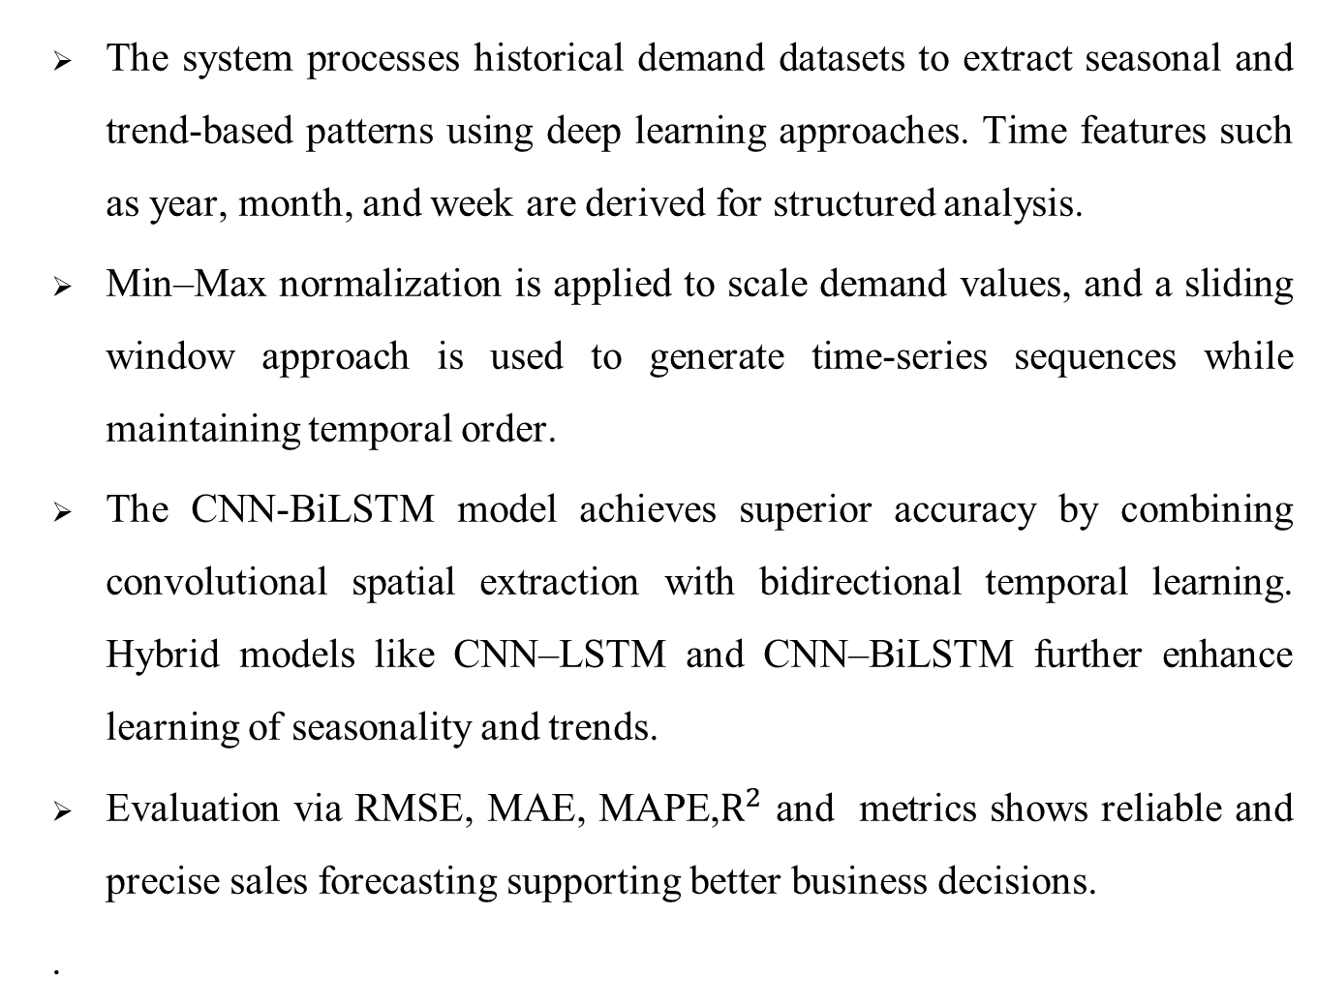
PROPOSED SYSTEM
The system processes historical demand datasets to extract seasonal and trend-based patterns using deep learning approaches. Time features such as year, month, and week are derived for structured analysis.
Min–Max normalization is applied to scale demand values, and a sliding window approach is used to generate time-series sequences while maintaining temporal order.
The CNN-BiLSTM model achieves superior accuracy by combining convolutional spatial extraction with bidirectional temporal learning. Hybrid models like CNN–LSTM and CNN–BiLSTM further enhance learning of seasonality and trends.
Evaluation via RMSE, MAE, MAPE,$R^{2}$ and metrics shows reliable and precise sales forecasting supporting better business decisions.
.

Slide 13
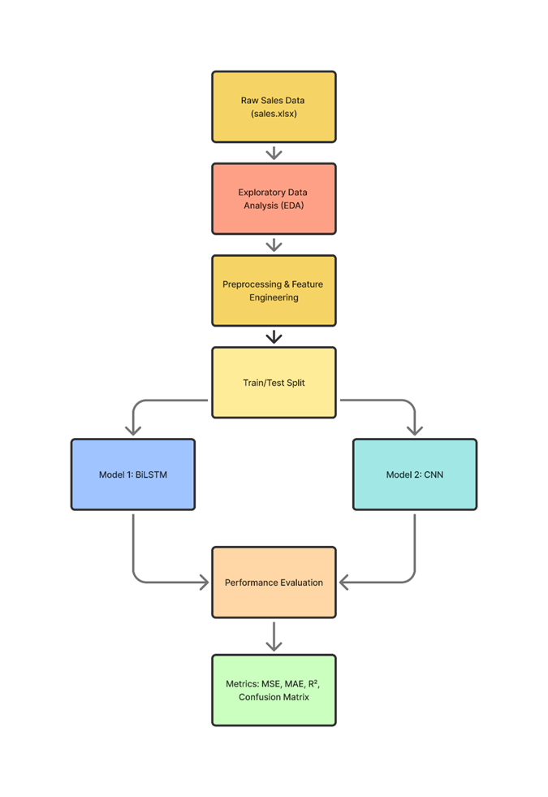
SYSTEM FLOW DIAGRAM

Slide 14
MODULE IDENTIFICATION
1. Data Acquisition & Exploration Module
  Dataset Collection
  Feature Extraction
2. Data Preprocessing Module
  Normalization
  Data Cleaning & Aggregation
3. Seasonal & Trend Analysis Module
  Time-Series Decomposition
  Autocorrelation Analysis
4. Sequence Generation Module
  Sliding Window Method
  Input-Output Pair Generation

Slide 15
MODULE IDENTIFICATION
5. Dataset Splitting Module
  Training Set
  Testing Set
6. Model Construction Module
  BiLSTM Model
  Hybrid CNN-LSTM Model
  Hybrid CNN-BiLSTM Model
7. Model Training Module
  Training Parameters
  Optimization Process
8. Prediction & Evaluation Module
  Prediction
  Evaluation Metrics

Slide 16
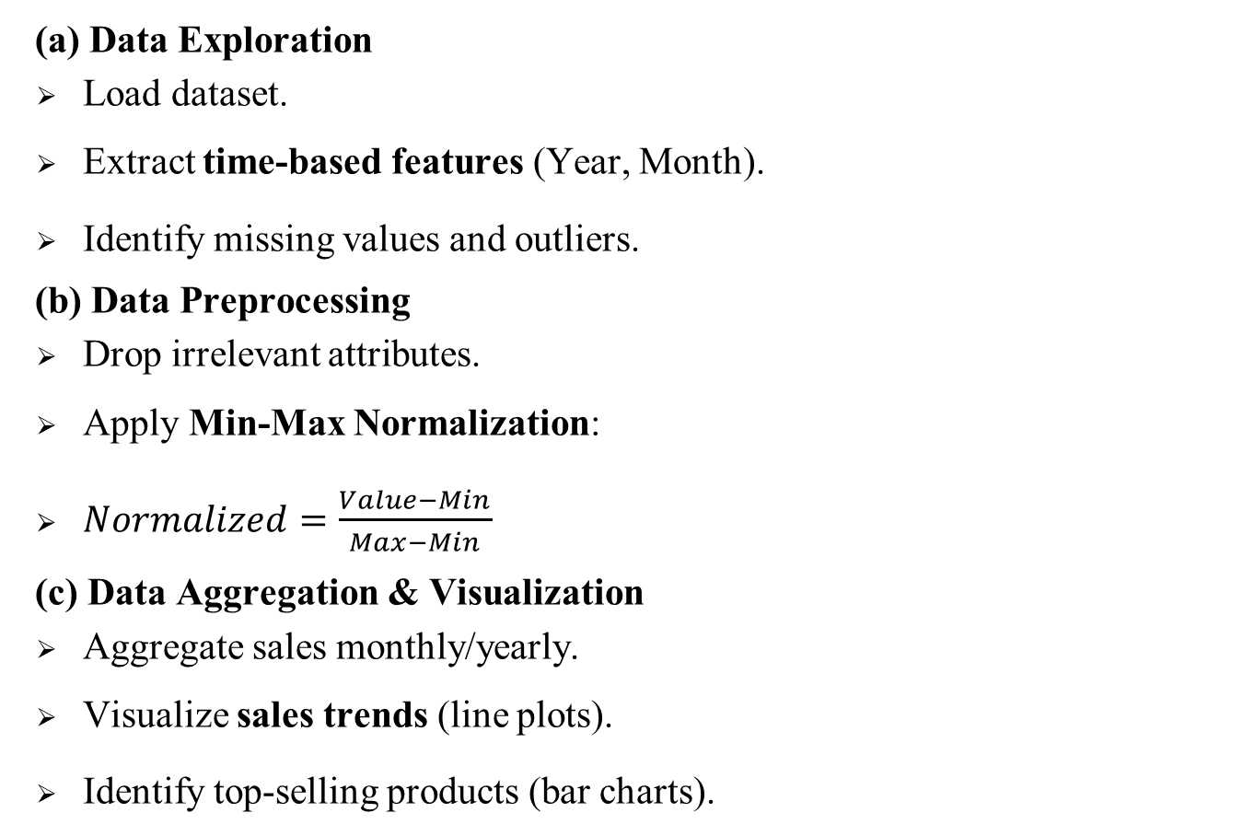
MODULE DESCRIPTION
(a) Data Exploration
Load dataset.
Extract time-based features (Year, Month).
Identify missing values and outliers.
(b) Data Preprocessing
Drop irrelevant attributes.
Apply Min-Max Normalization:
$Normalized=\frac{Value−Min}{Max−Min}$
(c) Data Aggregation & Visualization
Aggregate sales monthly/yearly.
Visualize sales trends (line plots).
Identify top-selling products (bar charts).

Slide 17
MODULE DESCRIPTION
(d) Seasonal Analysis
Decompose sales into:
  Trend (Tt) – long-term growth/decline.
  Seasonality (St) – repeating patterns (e.g., December spikes).
  Residuals (Rt) – random variations.
( e) Autocorrelation Analysis
Identify how past sales values affect future sales.
Helps select lag values for sequence generation.
(f) Sequence Preparation
Sliding Window:
  Input: past w days of sales.
  Output: next day sales.

Slide 18
MODULE DESCRIPTION
(g) Data Splitting
80% training, 20% testing.
(h) Model Construction
BiLSTM Model – captures bidirectional temporal dependencies in sales sequences.
CNN–LSTM Model – CNN layers extract local features → LSTM layers learn sequential patterns → Dense layer predicts demand.
CNN–BiLSTM Model – CNN layers extract spatial features → BiLSTM layers capture forward and backward dependencies → Dense layer outputs final forecast
(i) Model Training
Epochs = 60, Batch Size = 20.

Slide 19
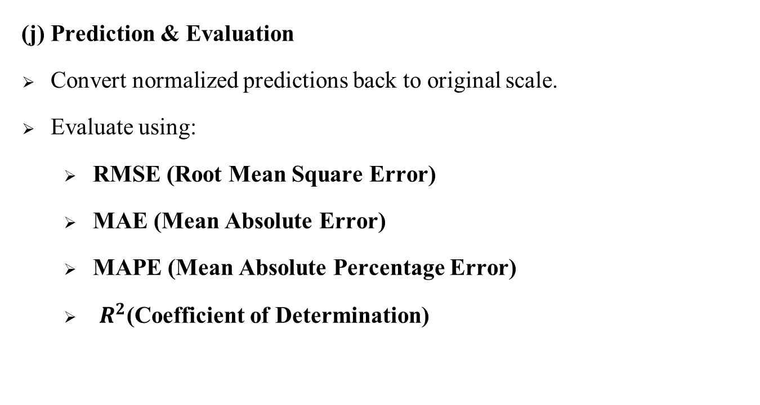
MODULE DESCRIPTION
Loss = MSE.
Optimizer adjusts weights to minimize error.
(j) Prediction & Evaluation
Convert normalized predictions back to original scale.
Evaluate using:
  RMSE (Root Mean Square Error)
  MAE (Mean Absolute Error)
  MAPE (Mean Absolute Percentage Error)
  $R^{2}$(Coefficient of Determination)

Slide 20

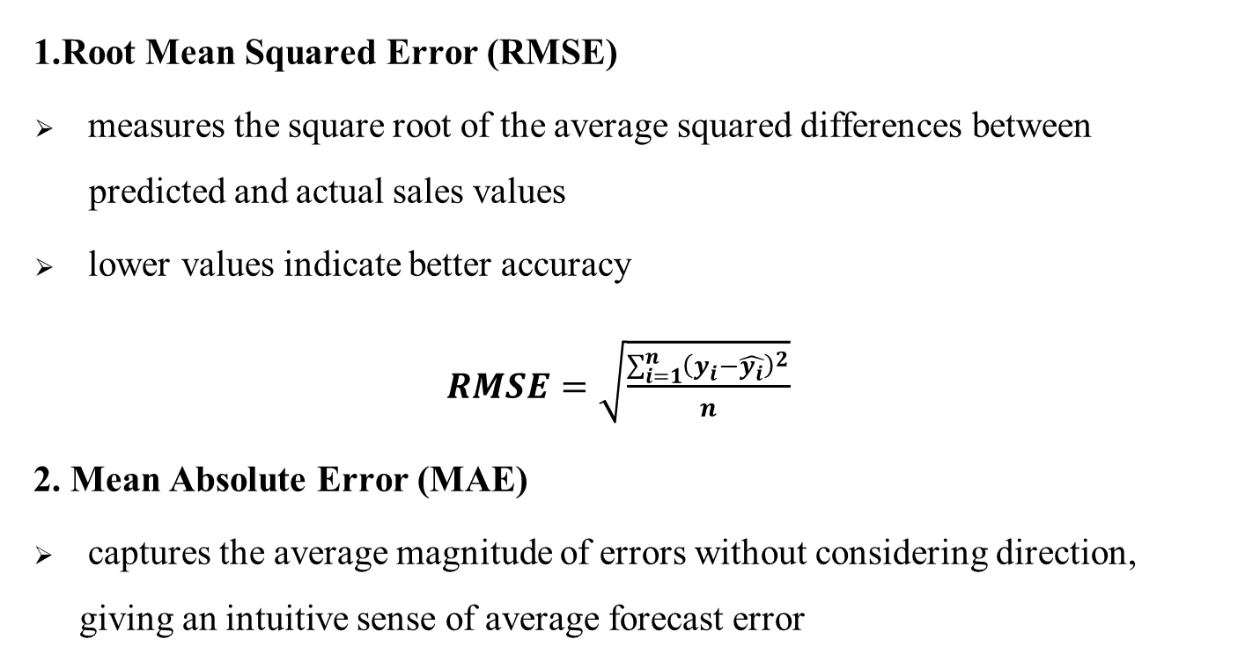
PREDICTION & EVALUATION
1.Root Mean Squared Error (RMSE)
measures the square root of the average squared differences between .predicted and actual sales values
lower values indicate better accuracy
$RMSE=\sqrt{\frac{\sum_{i=1}^{n}{{\left(y_{i}−\hat{y_{i}}\right)}^{2}}}{n}}$
2. Mean Absolute Error (MAE)
captures the average magnitude of errors without considering direction, giving an intuitive sense of average forecast error
$$MAE=\frac{1}{n}\sum_{i=1}^{n}{\left|y_{i}−\hat{y_{i}}\right|}$$

Slide 21
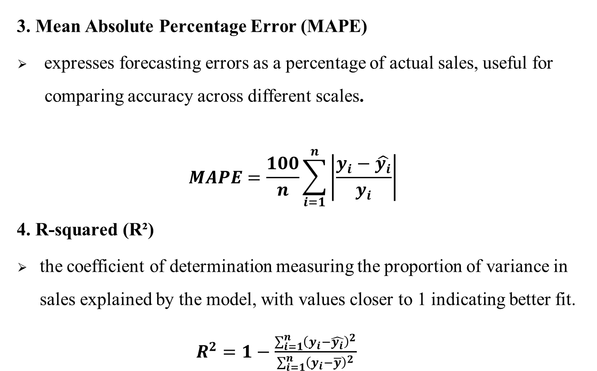
PREDICTION & EVALUATION
3. Mean Absolute Percentage Error (MAPE)
expresses forecasting errors as a percentage of actual sales, useful for .comparing accuracy across different scales.
$$MAPE=\frac{100}{n}\sum_{i=1}^{n}{\left|\frac{y_{i}−\hat{y_{i}}}{y_{i}}\right|}$$
4. R-squared (R²)
the coefficient of determination measuring the proportion of variance in sales explained by the model, with values closer to 1 indicating better fit.
$R^{2}=1−\frac{\sum_{i=1}^{n}{{\left(y_{i}−\hat{y_{i}}\right)}^{2}}}{\sum_{i=1}^{n}{{\left(y_{i}−\overline{y}\right)}^{2}}}$

Slide 22
DATASET DESCRIPTION
Attributes: date, internal_client_id, product_id, product_name, product_ean, category, sub_category, city_name, units_sold, mrp, selling_price, gross_merchandise_value, gross_selling_value
Number of Records: ~43,034
Format: Excel file (.xlsx)
Dataset: Custom Sales Dataset (provided by EQREV company)

Slide 23
PREPROCESSING TECHNIQUES
Data Cleaning: Missing values in sales and duplicate records are removed or imputed to ensure dataset quality.
Normalization: Numerical features like sales, prices, and gross merchandise values are scaled using Min-Max scaling to a standard range between 0 and 1, ensuring balanced influence during training.
Categorical Encoding: Categorical attributes such as product category, sub-category, and city name are converted to numerical representations using one-hot encoding or label encoding methods for deep learning input compatibility.

Slide 24
PREPROCESSING TECHNIQUES
Outlier Treatment: Abnormally high sales spikes or price values are identified and handled to prevent distortion of the training process.
Feature Engineering: Time-based features such as year, month, day of the week, and weekend indicators are extracted from date information to enhance seasonal and temporal pattern learning.
Sequence Generation: A sliding window method is used to segment the cleaned and normalized data into sequential time-series samples, preserving temporal order for input to BiLSTM, CNN-LSTM, and CNN-BiLSTM models.

Slide 25
Tools and Technologies
Programming Language: Python
Libraries/Frameworks: TensorFlow/ Keras, Scikit-learn, Pandas, Numpy, Matplotlib, Seaborn
Platform: Google Colab / Jupyter Notebook
Visualization: Line Plot (Actual vs Predicted), Loss Curve, Feature Correlation Heatmap
Dataset: EQREV company – Customer Sales Dataset(Sales.xlsx)

Slide 26
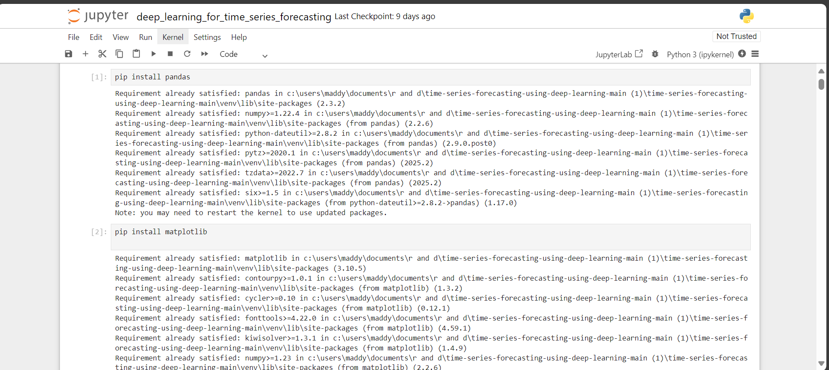
SCREENSHOTS
Installing packages

Slide 27
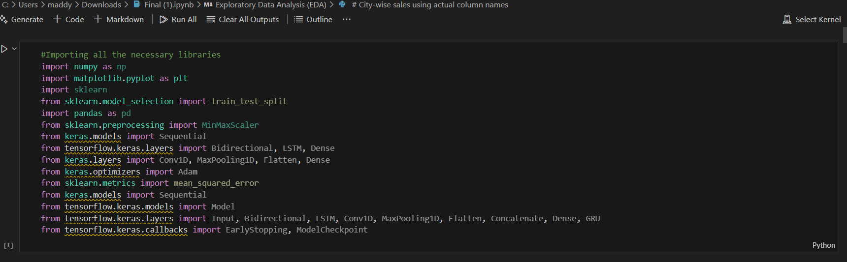
SCREENSHOTS
Importing the necessary modules

Slide 28
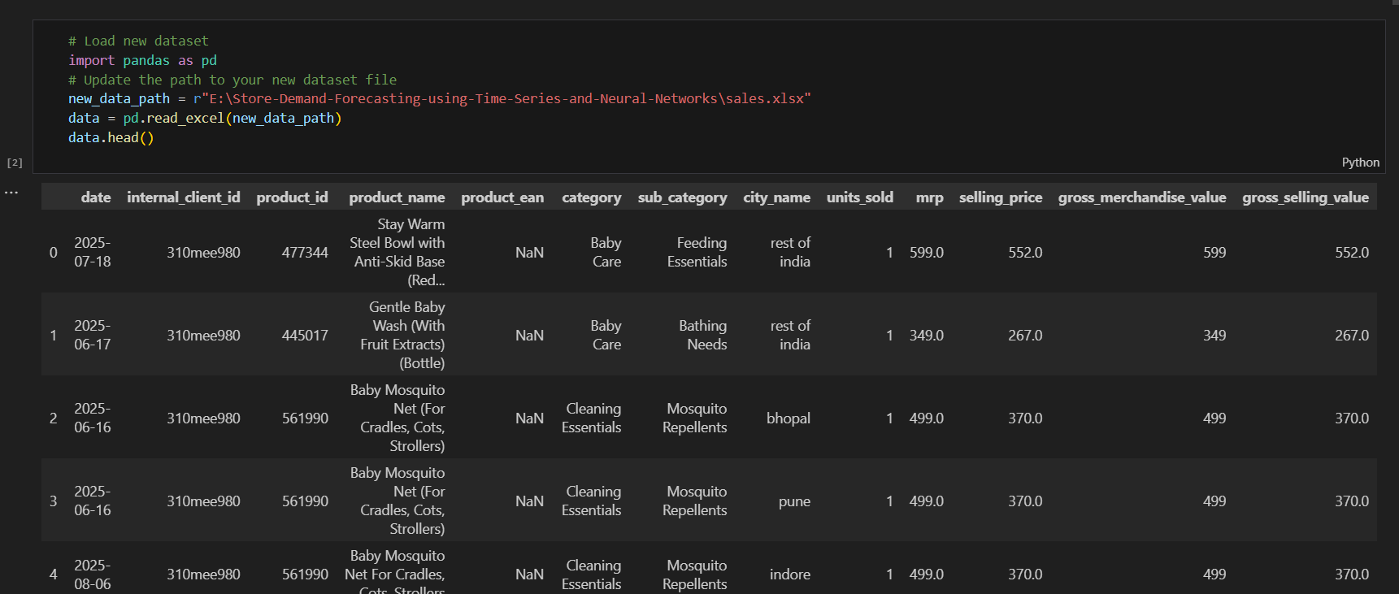
SCREENSHOTS
Downloading the Dataset

Slide 29
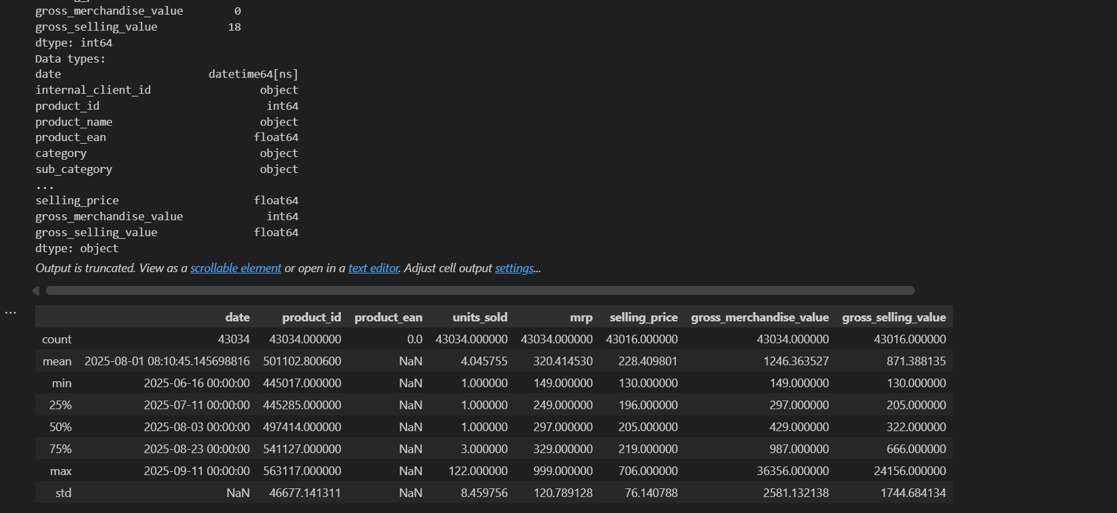
SCREENSHOTS
Dataset Description

Slide 30
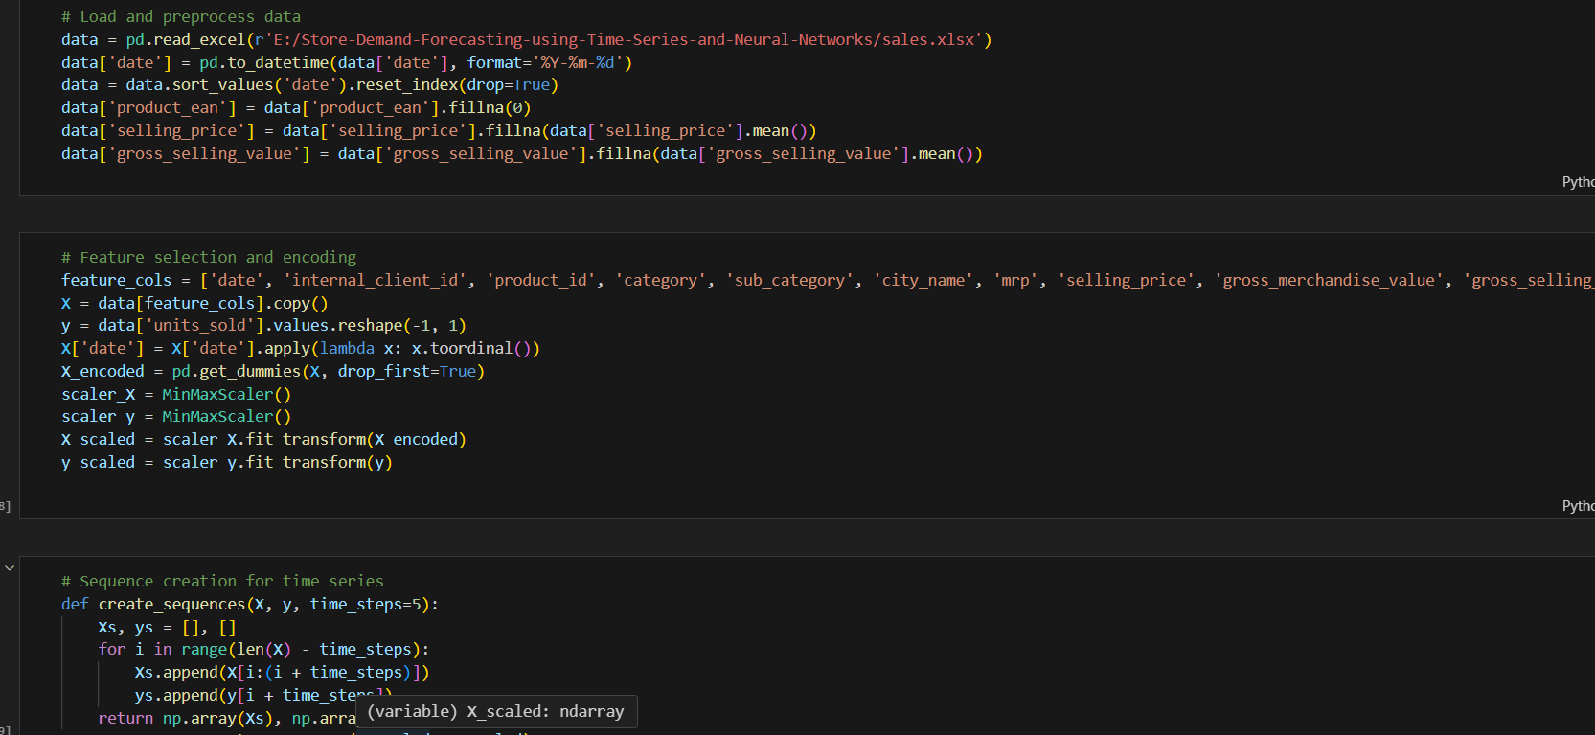
SCREENSHOTS
Data preprocessing

Slide 31
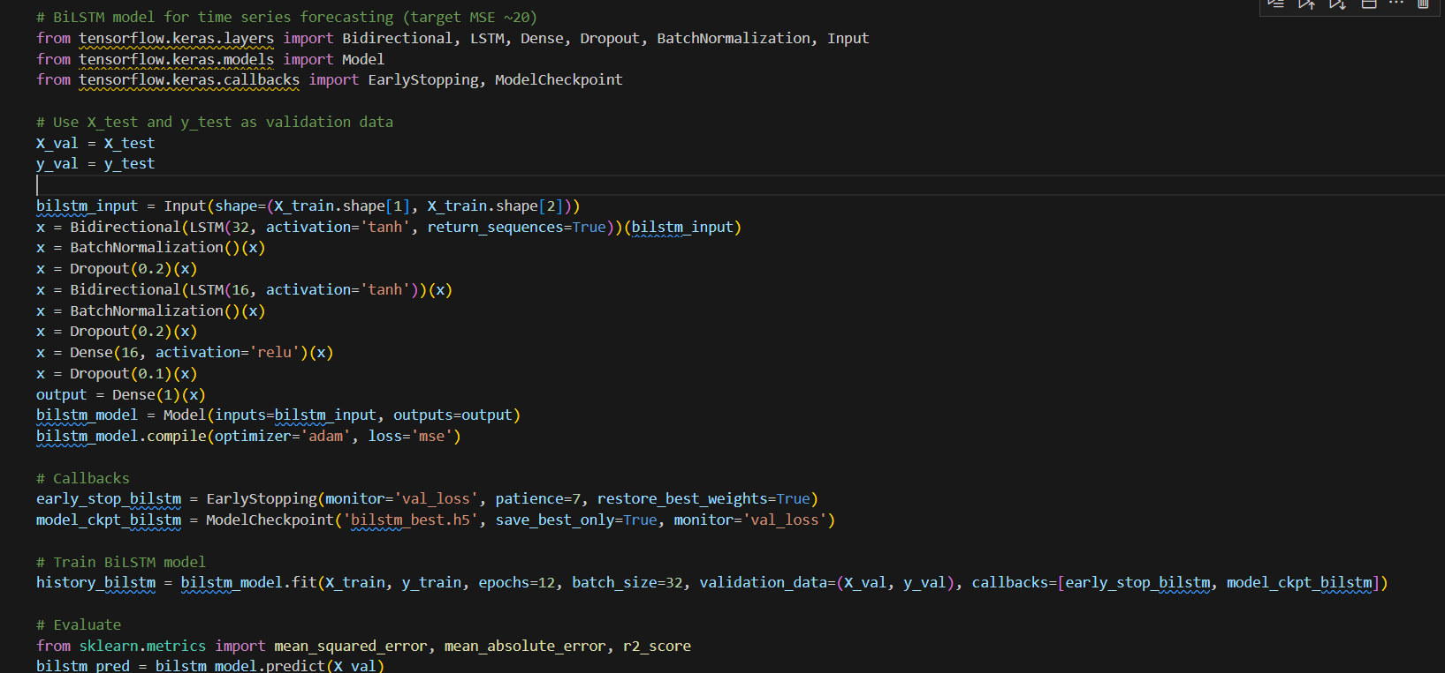
SCREENSHOTS
BiLSTM Model

Slide 32
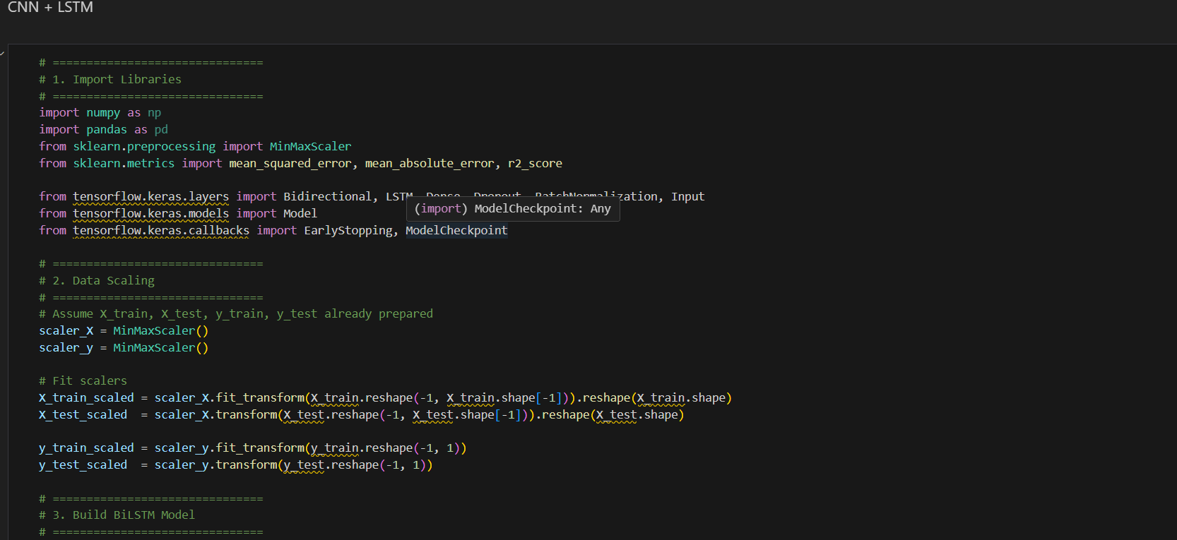
SCREENSHOTS
HYBRID CNN-LSTM Model

Slide 33
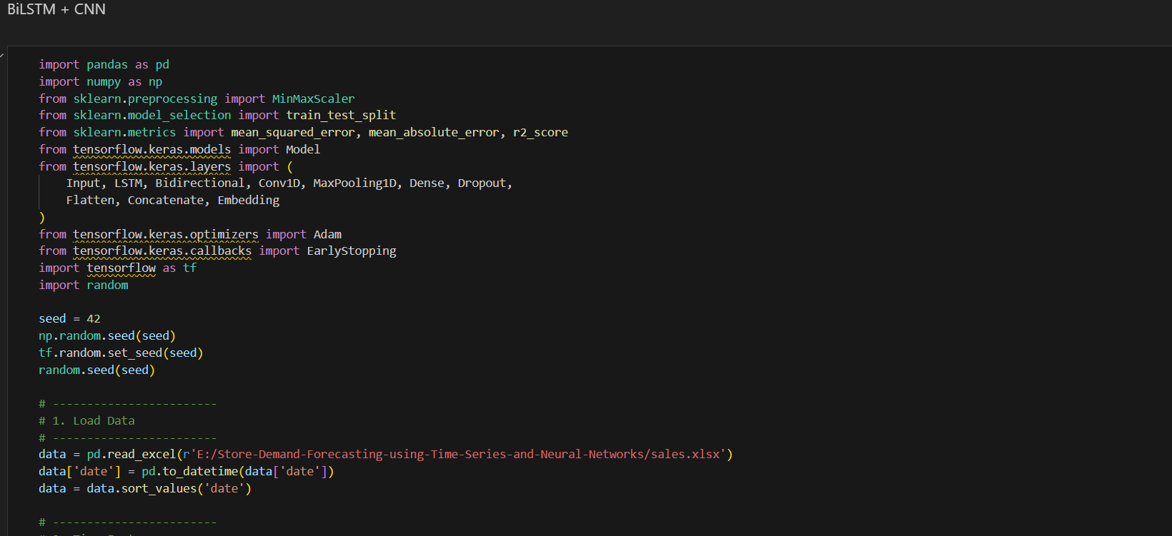
SCREENSHOTS
BiLSTM-CNN Model

Slide 34
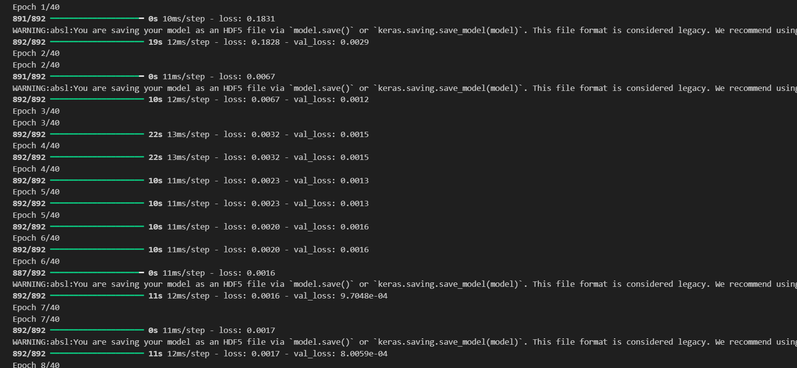
SCREENSHOTS
Epoch output after training

Slide 35
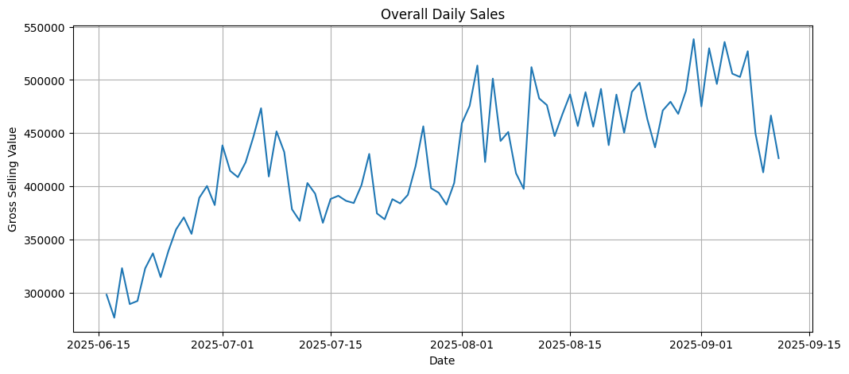
SCREENSHOTS
Daily Sales

Slide 36
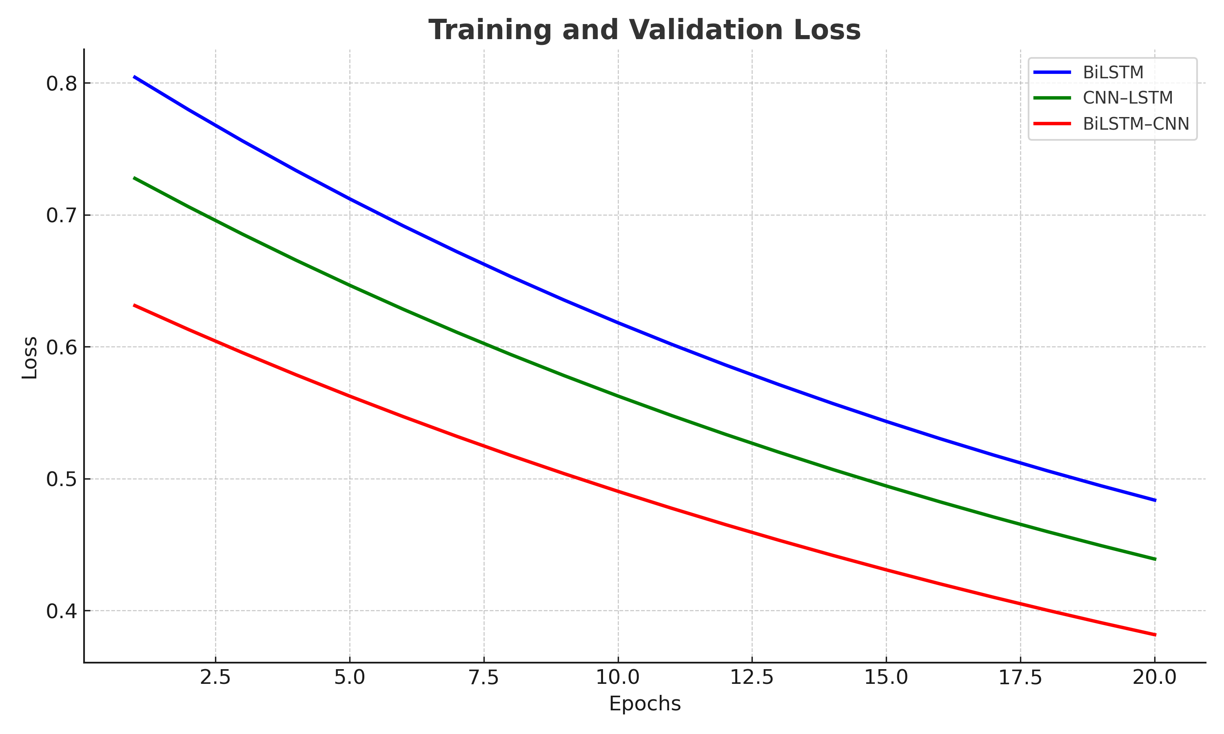
SCREENSHOTS
Output of the comparing model

Slide 37
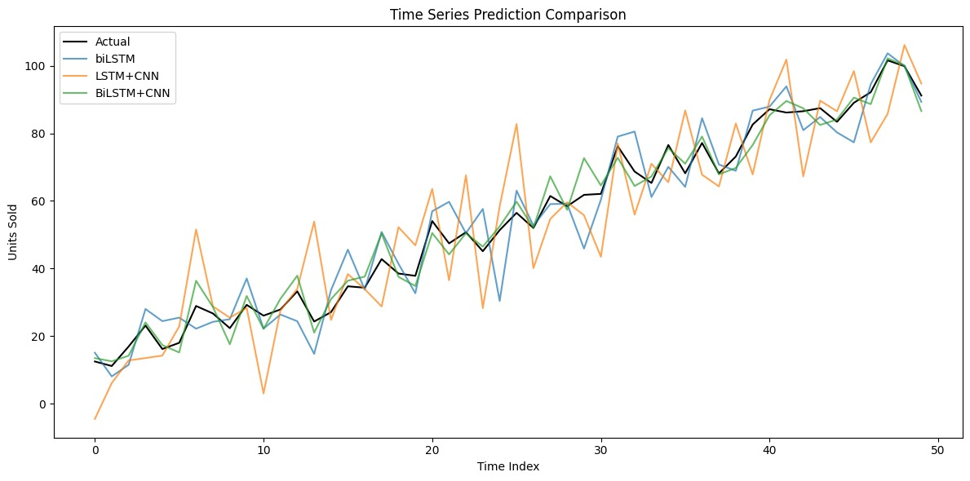
SCREENSHOTS
Train and validation

Slide 38



SCREENSHOTS
Final result
BiLSTM:
CNN-LSTM:
CNN-BiLSTM:

Slide 39
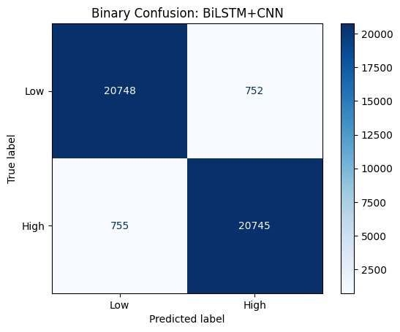
SCREENSHOTS
Confusion matrix

Slide 40
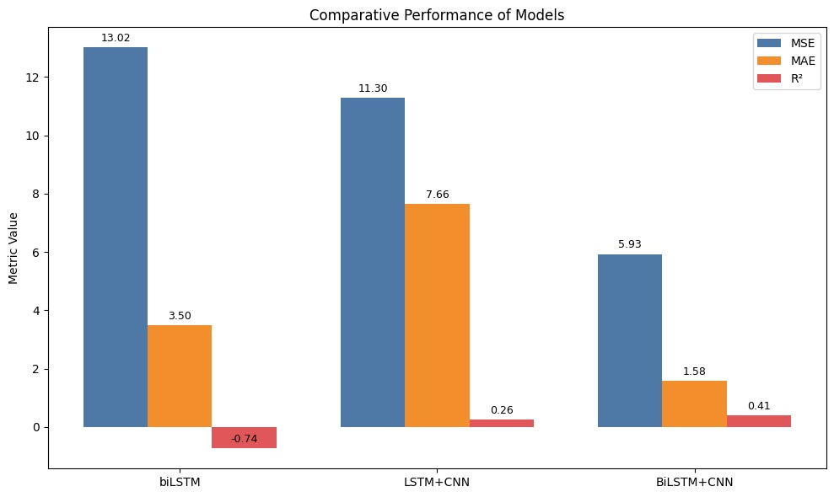
SCREENSHOTS
Comparison of BiLSTM,CNN-LSTM ,BiLSTM-CNN

Slide 41
PERFORMANCE ANALYSIS
MODELS | MSE | MAE | R²
BiLSTM | 13.02 | 3.50 | -0.74
LSTM+CNN | 11.30 | 7.66 | 0.26
BiLSTM+CNN | 5.93 | 1.58 | 0.41

Slide 42
CONCLUSION
The proposed BiLSTM, CNN–LSTM, and BiLSTM–CNN hybrid models outperform traditional models (MLP, CNN, LSTM) in demand forecasting, achieving higher MSE,MAE,R2.
By combining CNN’s ability to extract local temporal patterns and LSTM/BiLSTM’s ability to capture sequential dependencies, the hybrid system provides more reliable seasonality and trend detection.
This supports businesses in sales forecasting, inventory planning, and decision-making, ultimately reducing costs and improving operational efficiency.

Slide 43
Future Enhancements
Incorporate external factors such as holidays, promotions, and economic indicators for more accurate forecasting.
Use attention mechanisms or transformer-based architectures (like BERT or GPT for time series) to improve long-range dependency modeling.
Implement real-time prediction systems for live business applications.
Extend the model for multivariate forecasting (e.g., predicting not just sales, but also revenue, profit, or customer demand).
Deploy the trained model into a cloud-based dashboard (with visualization tools like Power BI or Tableau) for user-friendly decision support.

Slide 44
Thank You !!

