Slide 2
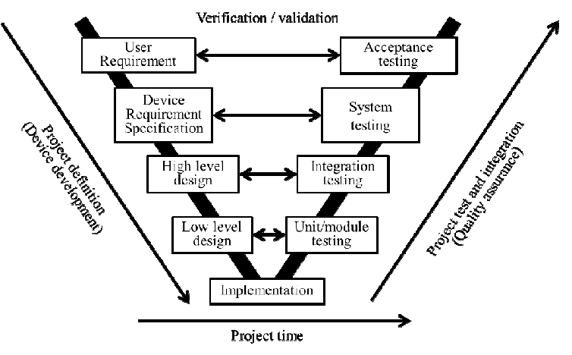
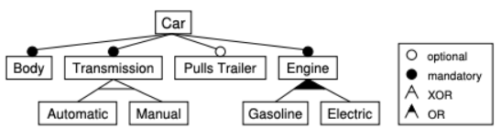
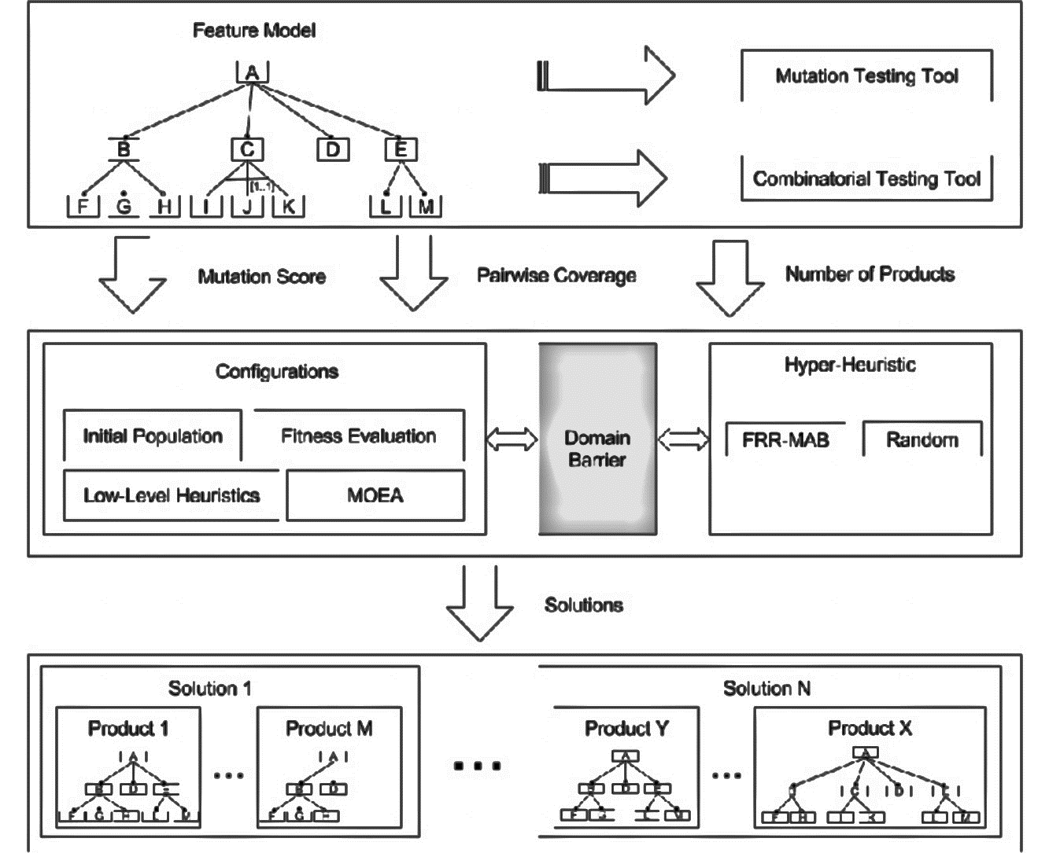
Product A
Product B
Product C
Feature Catalog
Product Configuration
Platform Artifacts

Slide 3
Pro
Product A

