Slide 1
🛡️ ENDPOINT DEFENSE & INTEGRITY AUDITING
Windows Registry Change
Monitoring System
Enterprise Defensive Edition (v2.4.0) — Sub-Second Auditing & Active Threat Remediation
• Architect & Developer: Piyush (@Made-by-Piyush99)
• Platform: Windows 10 / 11 / Server (Dual 64-bit & WOW64 Bitness)
• Stack: Python 3.14 • Win32 API • DPAPI Encryption • SQLite3 WAL • Tkinter SOC UI

Slide 2
THREAT LANDSCAPE & ATTACK SURFACE
The Core Problem: Malware Persistence via Registry
High-Value Target Vectors
• Over 90% of modern Windows malware exploits the Registry for persistence.
• Allows payloads to survive reboots without requiring user interaction.
• Ransomware tampers with safe-boot and backup policies.
• Attackers hijack system configurations to disable antivirus real-time shields.
MITRE ATT&CK Mappings
• T1547.001: HKCU/HKLM Run & RunOnce autostart keys.
• T1547.004: Winlogon Userinit & Shell executable replacement.
• T1546.012: Image File Execution Options (IFEO) debugger backdoors.
• T1562.001: Tampering Defender policies to blind endpoint security.
Defensive Solution
• Continuous sub-second differential scanning (1s - 60s).
• Dual-bitness reflection (64-bit and 32-bit WOW6432Node).
• Static PE file hashing & unquoted path checks.
• Instant one-click active threat remediation.

Slide 3
ENGINEERING DESIGN & PIPELINE
Multi-Threaded System Architecture & Data Flow
1. Sensitive Hives
• Define high-risk target hives in config.json.
• Run, RunOnce, Winlogon, Policies, IFEO.
• Dual 64-bit and WOW64 view enumeration.
2. Integrity Baseline
• Snapshot capture with SHA-256 verification.
• Store in JSON & encrypted SQLite vault.
• Reference point for zero-false-positive diffs.
3. Detection Engine
• Background daemon scans every 1s-60s.
• O(N) state differential calculation.
• Identifies ADDED, DELETED, and MODIFIED keys.
4. Action & Forensics
• Cascading non-blocking desktop popups.
• One-click atomic value deletion.
• Pillow infographics and CSV/JSON reports.

Slide 4
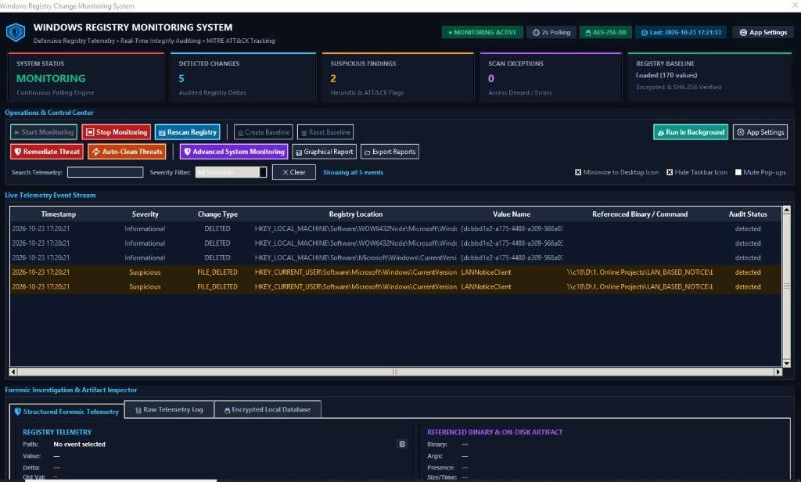
PRIMARY REAL-TIME SOC INTERFACE
Operations & Control Center Dashboard (v2.4.0)
Core Dashboard Capabilities
• Segmented 3-Ribbon Toolbar: Primary surveillance, threat defense actions, and live telemetry search.
• Zero Clipping: Guaranteed 100% button visibility across all screen resolutions.
• 5 KPI Scorecards: Real-time system status, change counter, suspicious findings, and baseline health.
• Glowing Stealth Trigger: 'Run in Background' button with dedicated teal styling.
• Live Telemetry Grid: Color-coded rows with instant right-click context actions.

Slide 5
INCIDENT RESPONSE & PERSISTENCE SANITIZATION
Active Threat Remediation Engine: Neutralizing Malware
Atomic Value Deletion Engine
• One-Click Threat Remediation: Instantly delete rogue autorun entries and disabled Defender keys directly from the live event log.
• Win32 advapi32.dll & winreg: Performs atomic deletion on the live Windows Registry without requiring host reboot.
• Auto-Clean Threats: Automated batch detection and bulk sanitization of all active un-remediated high-risk events.
• Visual Status Feedback: Neutralized rows receive an instant green [REMEDIATED] badge; live threat counter auto-decrements.
Hardware-Encrypted Audit Trail
• Windows DPAPI Vault: SQLite database encrypted using machine TPM and user SID credentials via crypt32.dll.
• Zero Plaintext Secrets: Configuration tokens and remediation audit logs are protected against offline theft.
• remediations Table: Stores UTC timestamp, actor, full registry path, value name, and deleted payload data for compliance.
• VACUUM & Optimization: Built-in database maintenance and integrity verification tools.

Slide 6
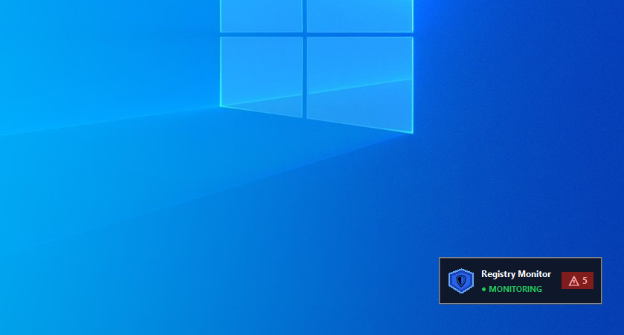
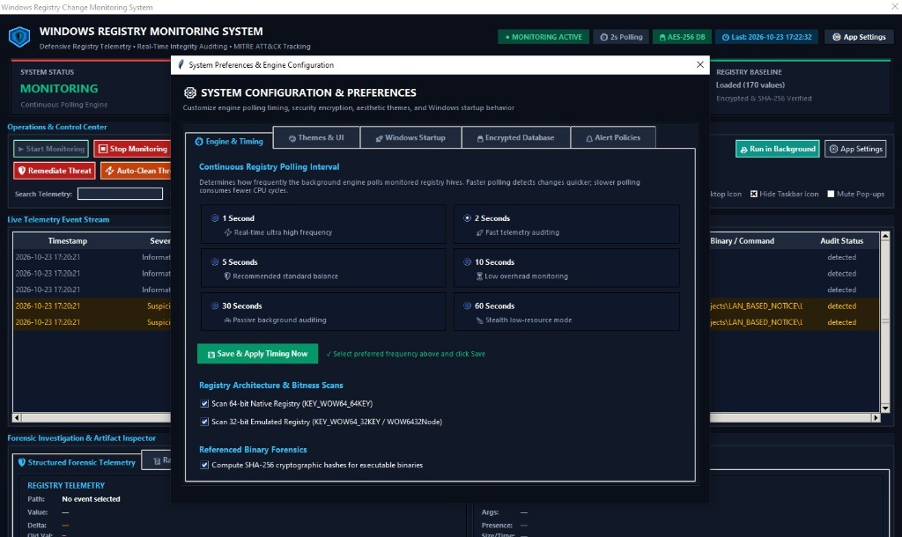
CONTINUOUS BACKGROUND DEFENSE
Stealth Background Monitoring & Fast Polling Engine
Movable Desktop Gadget Widget
• Frameless topmost floating widget displaying real-time status pill and live change counter badge.
• Click or double-click to restore the main application; drag anywhere on the screen.
Dynamic Timing Controller
• 6 selectable timing cards (1s to 60s) with direct 'Save & Apply Timing Now' button.

Slide 7
TESTING BENCHMARKS & CRYPTOGRAPHIC VERIFICATION
Quality Assurance & Production Distribution
Automated Test Suite (100% Passed)
• 65 Total Unit Tests passing in 4.45s with zero regressions.
• test_change_detector.py: 47 unit tests verifying state diffing, false-positive suppression, and static PE hashing.
• test_settings_and_db.py: 18 unit tests validating DPAPI ciphers, timing engine, and atomic threat remediation.
• Rigorous edge-case coverage: Access Denied permissions, type mutations, and thread-safe queue consumption.
Production Binaries & SHA-256 Hashes
• Standalone Portable Executable (.exe):
WindowsRegistryMonitor.exe (80.22 MB)
SHA-256: 8BEE859BA0DA4527E1FEE42F4B946A21A102FB170BBFFA2724F5BDC56BD649FC
• Setup Wizard Installer (.exe):
RegistryMonitorSetup.exe (81.08 MB)
SHA-256: 61B5C2109D5B3A150D989102D8EB04AC7C6A1A51D246445C7D724E2F69E50DD7
• Deployment: Inno Setup 7 LZMA2/ultra64 solid compression with administrative privilege elevation.

Slide 8
PROJECT CONCLUSION & IMPACT
Summary, Learning Outcomes & Open-Source Links
Key Learning Outcomes
• Mastery of Windows Registry architecture, binary subkeys, and WOW64 reflection.
• In-depth understanding of malware persistence mechanisms and evasion tactics.
• Hands-on implementation of blue team defensive integrity auditing.
• Production-grade endpoint engineering with hardware DPAPI cryptography and responsive GUI.
Project Links & Credits
• Lead Architect: Piyush (@Made-by-Piyush99)
• GitHub Repository:
https://github.com/Made-by-Piyush99/Windows-Registry-Monitoring
• Latest Release (v2.4.0):
https://github.com/Made-by-Piyush99/Windows-Registry-Monitoring/releases/tag/v2.4.0
• License: MIT Open Source License
• Thank You! Q&A Session Welcome.

