Slide 1
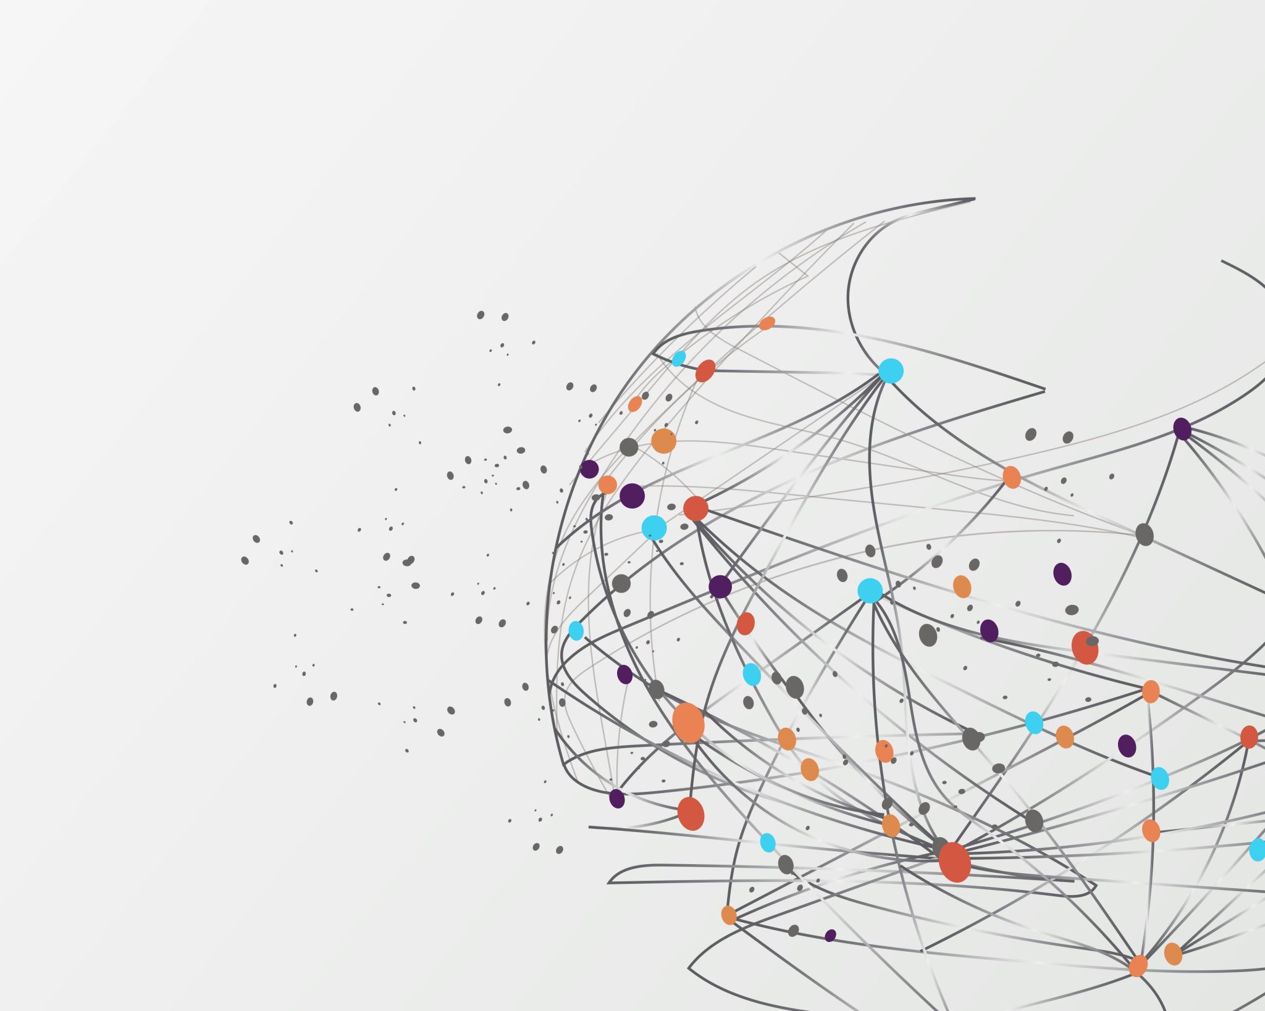
Assignment 3 – Flow Map
by Elena Gaus
and Madeleine Pinkelnig
Notes:
Welcome to the presentation of Mel and I – we decided to work with the Flow Map plugin and created a project with its help.

Slide 2



Goals
Create a flow map to visualize migration
Immigration and emigration from and to Austria in 2020
Use of Leaflet
Notes:
For our project we defined a set of goals:
The first goal of ours was to create a flow map. One of the most interesting datasets for this kind of visualization is in our opinion migration data. This way we can showcase the movement of many people and it may also imply the relationship of people to other countries (for example: the most immigrants in 2020 were Germans)
For the task, we decided to use data the immigrations and emigrations from and to Austria in the year of 2020. We obtained the according data from Statistik Austria.
Mel and I have chosen to use Leaflet because we wanted to get to know the flow map plugin. Additionally, we preferred Leaflet because it is an open-source library and therefore we have the full control over our map.

Slide 3
Purpose
Presenting real-world migration data
Visualizing where the people came from or where they emigrated
Show HOW MANY people migrated
Notes:
ZWECK
Darstellung von Ein- und Auswanderungen (reale Daten, die wir im Internet gefunden haben)
Visualisierung der CSV-Daten
Nicht wie die anderen, wollen wir darstellen, wo die Leute davor gewohnt haben, nciht was ihre Nationalität ist
In unserer Visualisierung soll man außerdem sehen können, WIEVIELE Leute ein- und WIEVIELE ausgewandert sind

Slide 4
Work steps
1
find suitable data
2
Customize the data
3
coding
4
more coding?
Ask Mel
Ask mel
5
Presentation
6
documentation
georeference
Notes:
Find suitable data
Customize the data so that it has all the properties that the flowchart plugin needs

Slide 5

Our Leaflet Map

Slide 6
Problems we had
Getting suitable data
Putting data into the right form

Slide 7

Possible improvements / Future Steps
Visualize more than one year
Showcase the number of people more visually

