Slide 1
FaceCCTV
Deep Learning Models, Image Enhancement, API, Mobile App

Slide 2
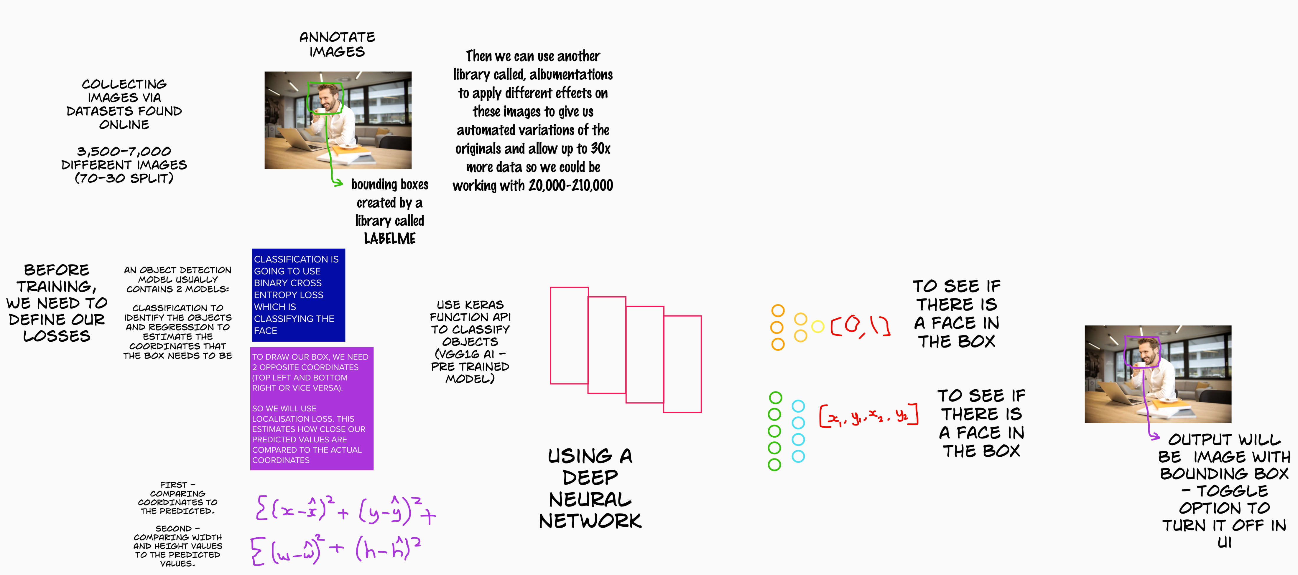
Face Detection Model

Slide 3
Image Enhancement
Uses a third party model to enhance the faces after detection –
passes through API

Slide 4
API
Basic Workflow:
1. Upload image to API
2. Face Detection
3. Image Enhancement
4. Pass back to user
5. Download image

Slide 5
Mobile App
As much functionality as the web and desktop apps.
Safer than web app (impossible to sabotage/hijack if downloaded from a safe place or once installed).

