Slide 1
Lab 3
FK Constraint, and Basic SELECT
Dr. Sara Yousef
CPIT 240
Spring 2015

Slide 2
Lab Objectives
After this lab, you should be able to:
1. Create table-level and foreign key constraints
2. Use the basic SELECT SQL statement
3. Restrict and sort data using the SELECT SQL statement

Slide 3
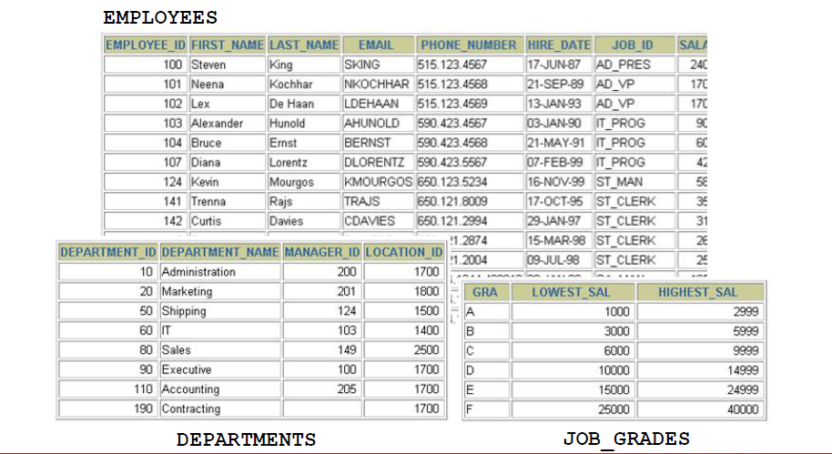
Tables Used in the Course

Slide 4
Tables Used in the Course
The following main tables will be used in this lab:
EMPLOYEES table: Gives details of all the employees
DEPARTMENTS table: Gives details of all the departments
JOB_GRADES table: Gives details of salaries for various grades

Slide 5
Notes
NOTE: The structure and data for all the tables are provided in Appendix A.
NOTE: To use these tables, run the hr_main.sql script in the hr_setup.zip files.
NOTE: To remove these tables, run the hr_drop.sql script in the hr_setup.zip files.

Slide 6
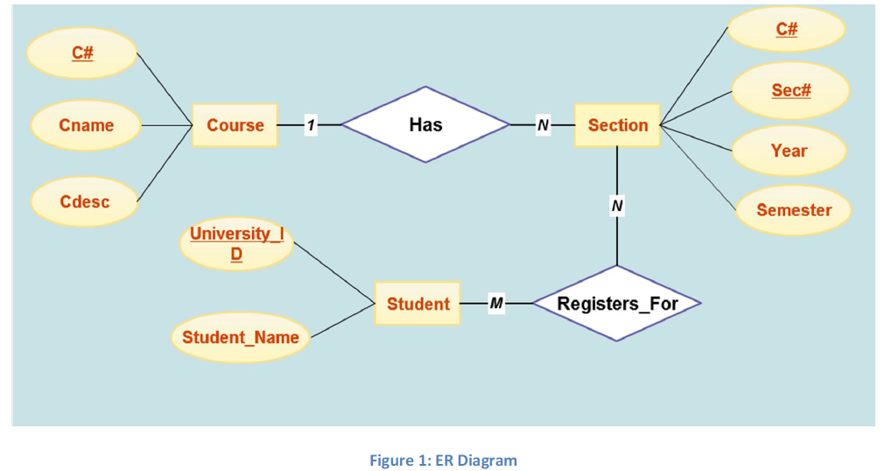
Registration Database
In the first part of this lab, we are going to create a set of table to implement a simple university registration system
Figure 1 shows the ER Diagram

Slide 7
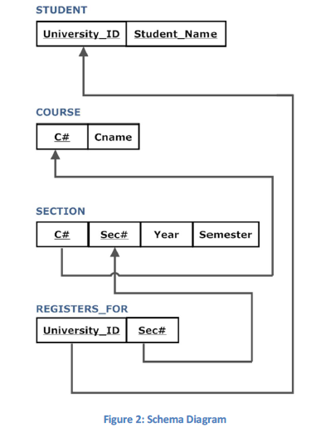
Registration Database

Slide 8
Registration Database
SQL STATEMENT 1
CREATE TABLE tablename(
column datatype [DEFAULT expr],...,
[CONSTRAINT constraint_name] constraint_type (column,...));
In the syntax:
constraint_name The name you want for the constraint
constraint_type UNIQUE, FOREIGN KEY, PRIMARY KEY, and CHECK

Slide 9
TRY THIS!!!!

Slide 10
TRY THIS!!!!

Slide 11
TRY THIS!!!!

Slide 12
Foreign Key Constraint
The FOREIGN KEY (or referential integrity) constraint designates a column or combination of columns as a foreign key and establishes a relationship between a primary key or a unique key in the same table or a different table.
In the example depicted, DEPARTMENT_ID has been defined as the foreign key in the EMPLOYEES table (dependent or child table); it references the DEPARTMENT_ID column of the DEPARTMENTS table (the referenced or parent table).

Slide 13
Foreign Key Constraint
Guidelines
A foreign key value must match an existing value in the parent table or be NULL.
Foreign keys are based on data values and are purely logical, rather than physical, pointers.
FOREIGN KEY constraints can be defined at the column or table constraint level. A composite foreign key must be created by using the table-level definition.

Slide 14
Foreign Key Constraint
SQL STATEMENT 2
CREATE TABLE tablename(
column datatype [DEFAULT expr],...
[CONSTRAINT constraint_name] FOREIGN KEY (column,...)
REFERENCES tablename (column,...)
[ON DELETE CASCADE | SET NULL]);
In the syntax:
constraint_name The name you want for the constraint
FOREIGN KEY Defines the column in the child table at the table-constraint level
REFERENCES Identifies the table and column in the parent table
ON DELETE CASCADE Deletes the dependent rows in the child table when a row in the parent table is deleted
ON DELETE SET NULL Converts dependent foreign key values to null

Slide 15
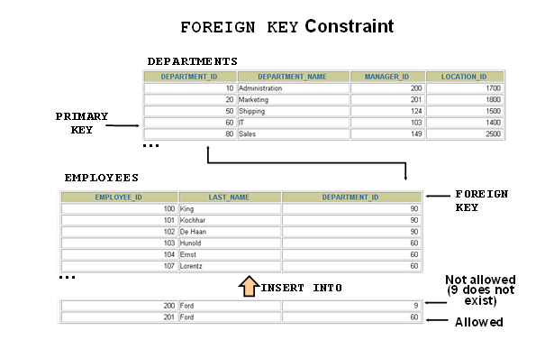
Foreign Key Constraint

Slide 16
Foreign Key Constraint
The example in the image defines a FOREIGN KEY constraint on the DEPARTMENT_ID column of the EMPLOYEES table, using table-level syntax.
The name of the constraint is EMP_DEPTID_FK.
The foreign key can also be defined at the column level, provided the constraint is based on a single column.
The syntax differs in that the keywords FOREIGN KEY do not appear. For example:

Slide 17
Foreign Key Constraint

Slide 18
TRY THIS!!!!

Slide 19
TRY THIS!!!!

Slide 20
Writing SQL Statements
Using the following simple rules and guidelines, you can construct valid statements that are both easy to read and easy to edit:
SQL statements are not case sensitive (unless indicated).
SQL statements can be entered on one or many lines.
Keywords cannot be split across lines or abbreviated.
Clauses are usually placed on separate lines for readability and ease of editing.
Indents should be used to make code more readable.
Keywords typically are entered in uppercase; all other words, such as table names and columns, are entered in lowercase.
In SQL*Plus, you are required to end each SQL statement with a semicolon (;)

Slide 21
BASIC SELECT Statement
A SELECT statement retrieves information from the database. With a SELECT statement, you can use the following capabilities:
Projection: Choose the columns in a table that are returned by a query. Choose as few or as many of the columns as needed.
Selection: Choose the rows in a table that are returned by a query. Various criteria can be used to restrict the rows that are retrieved.
Joining: Bring together data that is stored in different tables by specifying the link between them. SQL joins are covered in more detail when covering more advanced SELECT statements.

Slide 22
BASIC SELECT Statement

Slide 23
BASIC SELECT Statement
SQL STATEMENT 3
SELECT *| {[DISTINCT] column | expression [alias],...}
FROM table;
SELECT identifies the columns to be displayed.
FROM identifies the table containing those columns.
In the syntax:
SELECT is a list of one or more columns
* selects all columns
DISTINCT suppresses duplicates
column|expression selects the named column or the expression
alias gives selected columns different headings
FROM table specifies the table containing the columns

Slide 24
BASIC SELECT Statement
You can display all columns of data in a table by following the SELECT keyword with an asterisk (*).
In the next example, the department table contains four columns: DEPARTMENT_ID, DEPARTMENT_NAME, MANAGER_ID, and LOCATION_ID
The table contains eight rows, one for each department.

Slide 25
TRY THIS!!!!

Slide 26
TRY THIS!!!!
You can also display all columns in the table by listing all the columns after the SELECT keyword.
For example, the following SQL statement (like the next example) displays all columns and all rows of the DEPARTMENTS table:

Slide 27
BASIC SELECT Statement
You can use the SELECT statement to display specific columns of the table by specifying the column names, separated by commas.
The next example displays all the department numbers and location numbers from the DEPARTMENTS table.

Slide 28
TRY THIS!!!!

Slide 29
BASIC SELECT Statement
In the SELECT clause, specify the columns that you want, in the order in which you want them to appear in the output.
For example, to display location before department number going from left to right, you use the following statement:

Slide 30
Using Arithmetic Expressions
You can use arithmetic operators in any clause of a SQL statement (except the FROM clause).
Note: With the DATE data type, you can use the addition and subtraction operators only.
Arithmetic Operators:

Slide 31
TRY THIS!!!!

Slide 32
Using Arithmetic Expressions
Operator Precedence
If an arithmetic expression contains more than one operator, multiplication and division are evaluated first.
If operators in an expression are of the same priority, then evaluation is done from left to right.
You can use parentheses to force the expression that is enclosed by parentheses to be evaluated first.
Rules of Precedence:
Multiplication and division occur before addition and subtraction.
Operators of the same priority are evaluated from left to right.
Parentheses are used to override the default precedence or to clarify the statement.

Slide 33
TRY THIS!!!!

Slide 34
Using Arithmetic Expressions
USING ARITHMETIC with Null Values
Null Values
If a row lacks a data value for a particular column, that value is said to be null or to contain a null.
A null is a value that is unavailable, unassigned, unknown, or inapplicable. A null is not the same as a zero or a space. Zero is a number, and a space is a character.
Columns of any data type can contain nulls. However, some constraints (NOT NULL and PRIMARY KEY) prevent nulls from being used in the column.
In the COMMISSION_PCT column in the EMPLOYEES table, notice that only a sales manager or sales representative can earn a commission. Other employees are not entitled to earn commissions. A null represents that fact.

Slide 35
TRY THIS!!!!

Slide 36
Using Arithmetic Expressions
If any column value in an arithmetic expression is null, the result is null.
For example, if you attempt to perform division with zero, you get an error.
However, if you divide a number by null, the result is a null or unknown.
In the next example, employee King does not get any commission. Because the COMMISSION_PCT column in the arithmetic expression is null, the result is null.

Slide 37
TRY THIS!!!!

Slide 38
ALIASEs
A column alias:
Renames a column heading
Is useful with calculations
Immediately follows the column name
The optional AS keyword may be used between the column name and alias
Requires double quotation marks if it contains spaces or special characters or is case sensitive
Specify the alias after the column in the SELECT list using a space as a separator.
By default, alias headings appear in uppercase. If the alias contains spaces or special characters (such as # or $), or is case sensitive, enclose the alias in double quotation marks (" ").

Slide 39
TRY THIS!!!!

Slide 40
Concatenation Operator
You can link columns to other columns, arithmetic expressions, or constant values to create a character expression by using the concatenation operator (||).
Columns on either side of the operator are combined to make a single output column.
In the example, LAST_NAME and JOB_ID are concatenated, and they are given the alias Employees.
Notice that the employee last name and job code are combined to make a single output column.
The AS keyword before the alias name makes the SELECT clause easier to read.

Slide 41
TRY THIS!!!!
Null Values with the Concatenation Operator
If you concatenate a null value with a character string, the result is a character string. LAST_NAME || NULL results in LAST_NAME.

Slide 42
TRY THIS!!!!
Literal Character Strings
A literal is a character, a number, or a date that is included in the SELECT list and that is not a column name or a column alias. It is printed for each row returned.
Date and character literals must be enclosed by single quotation marks (' '); number literals need not be so enclosed.

Slide 43
TRY THIS!!!!
In the following example, the last name and salary for each employee are concatenated with a literal to give the returned rows more meaning:

Slide 44
THE DISTINCT KEYWORD (DUPLICATE ROWS)
Unless you indicate otherwise, SQL*Plus displays the results of a query without eliminating duplicate rows.
The following statement displays all the department numbers from the EMPLOYEES table. :
SELECT department_id FROM employees;
Notice that the department numbers are repeated.
To eliminate duplicate rows in the result, include the DISTINCT keyword in the SELECT clause immediately after the SELECT keyword.
In the next example, the EMPLOYEES table actually contains 20 rows, but there are only seven unique department numbers in the table.

Slide 45
TRY THIS!!!!
You can specify multiple columns after the DISTINCT qualifier. The DISTINCT qualifier affects all the selected columns, and the result is every distinct combination of the columns.

Slide 46
TRY THIS!!!!

Slide 47
Practice :DDL
1. Create a folder called lab_03_idnumber and place the following solutions in the folder (using the SAVE command).
Artist
Column Name | ID | ARTIST_NAME
NN/Unique/PK/FK | PRIMARY KEY | NOT NULL
Data type | NUMBER | VARCHAR2
Length | 8 | 30
Album
Column Name | ID | TITLE | DATE_RELEASED
NN/Unique/PK/FK | PRIMARY KEY | NOT NULL | NOT NULL
Data type | NUMBER | VARCHAR2 | DATE
Length | 8 | 30
Sings
Column Name | Artist_ID | Album_ID
NN/Unique/PK/FK | PRIMARY KEY (Album_ID, Artist_ID)
Data type | NUMBER | NUMBER
Length | 8 | 8

Slide 48
Practice :DDL
2. Create the Artist ,Album, and Sings tables, and include all constraints and save this in lab_03_01.sql.
NOTE: in the Sings Table, Artist_ID refers to the column ID in the table Artist. And Album_ID refers to the column ID in the table Album.
Zip the folder lab_03_idnumber and submit your assignment in the following format:
TO: syserry@yahoo.com
SUBJECT: [CPIT240][LAB_03] idnumber

