Slide 1
Visualizing Intensity Data

Slide 2
Summary of inference results
Experimental condition | Cell population | Number of clusters with intensity data | Parameters describing the fluorescence intensity of a single episome
Experimental condition | Cell population | number of clusters with intensity data | mean | standard deviation | variance
fixed 8TR | Mother | 81 | 470.2 | 141.5 | 20022.25
fixed 8TR | Daughter | 149 | 577.3 | 147.9 | 21874.41
live 8TR | Mother | 23 | 637.7 | 112.8 | 12723.84
live 8TR | Daughter | 27 | 1551 | 367.3 | 134909.29
fixed KSHV | Mother | 52 | 1605.1 | 353.3 | 124820.89
fixed KSHV | Daughter | 66 | 1226.4 | 213.6 | 45624.96
live KSHV | Mother | 28 | 2298.7 | 599.8 | 359760.04
live KSHV | Daughter | 51 | 713.4 | 145.3 | 21112.09

Slide 3
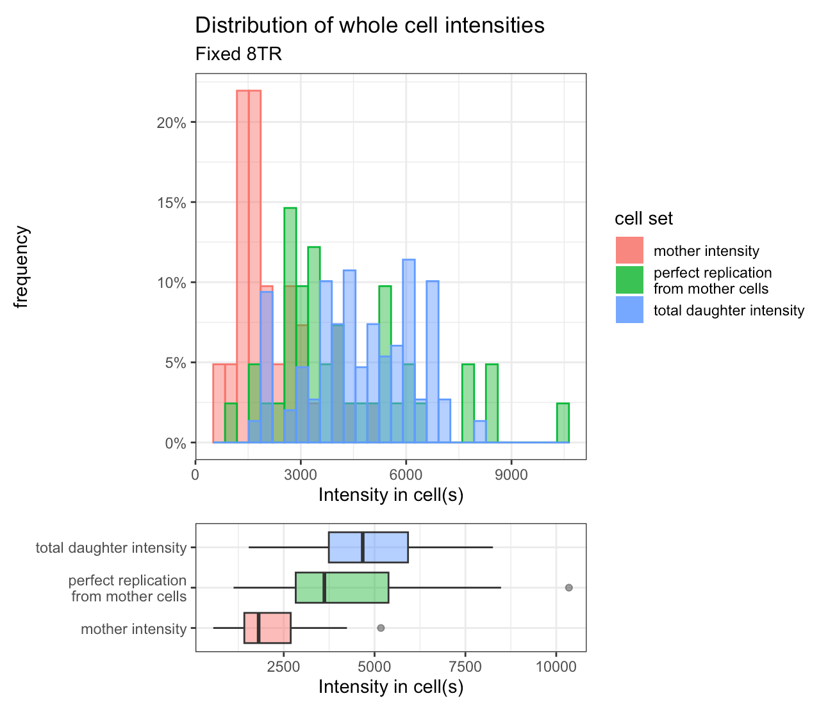
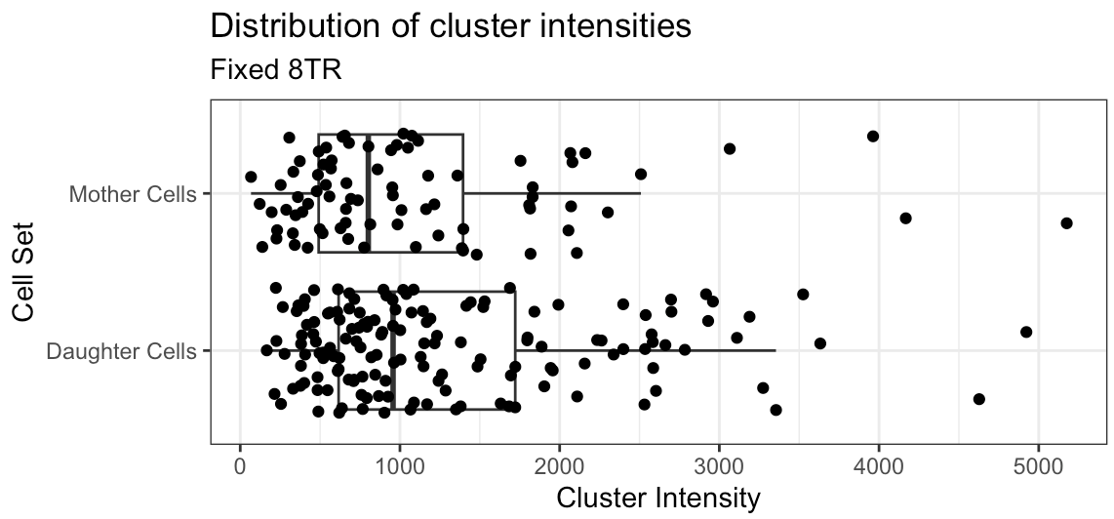
Fixed 8TR Data

Slide 4
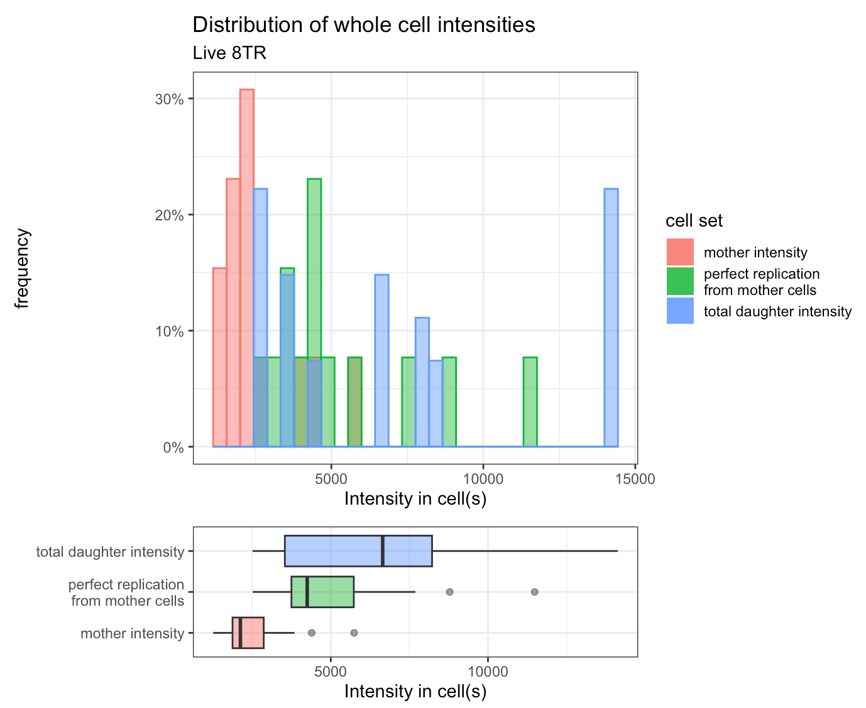
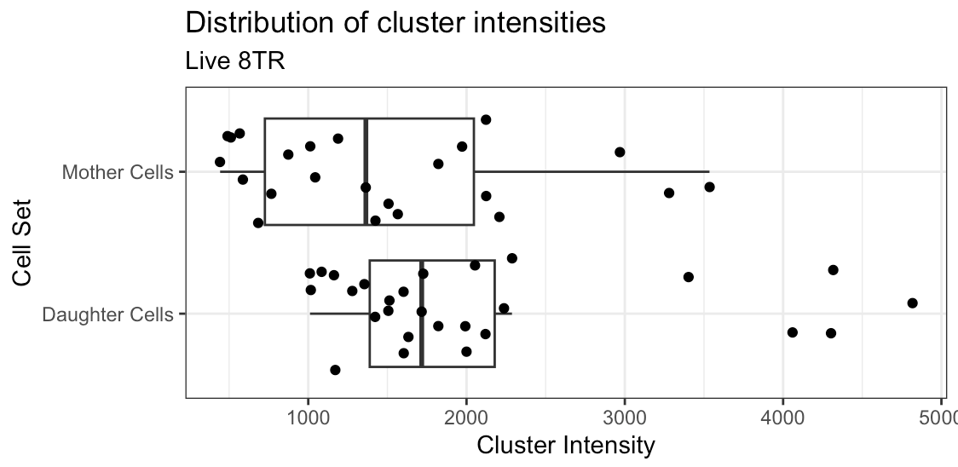
Live 8TR data

Slide 5
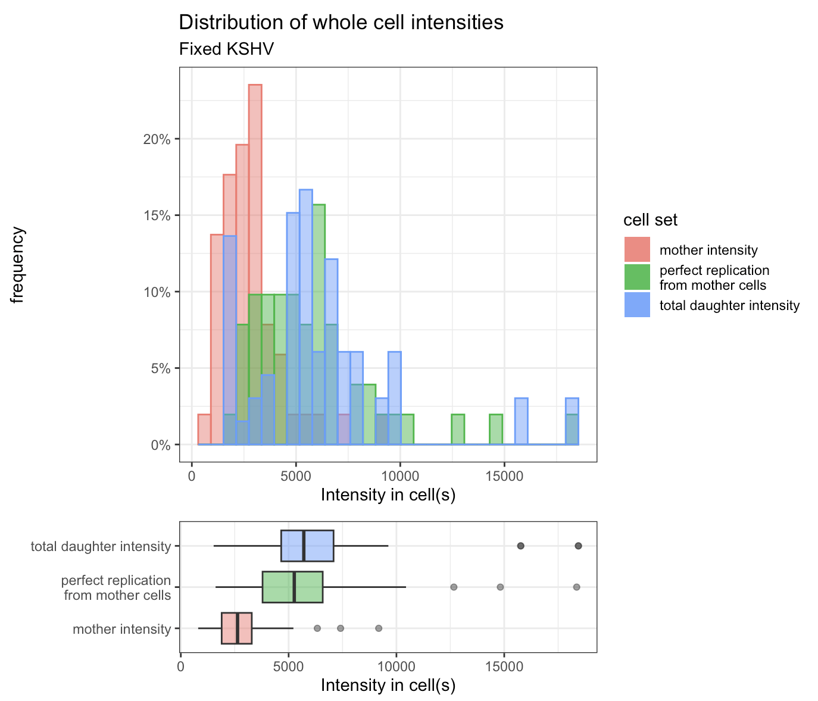
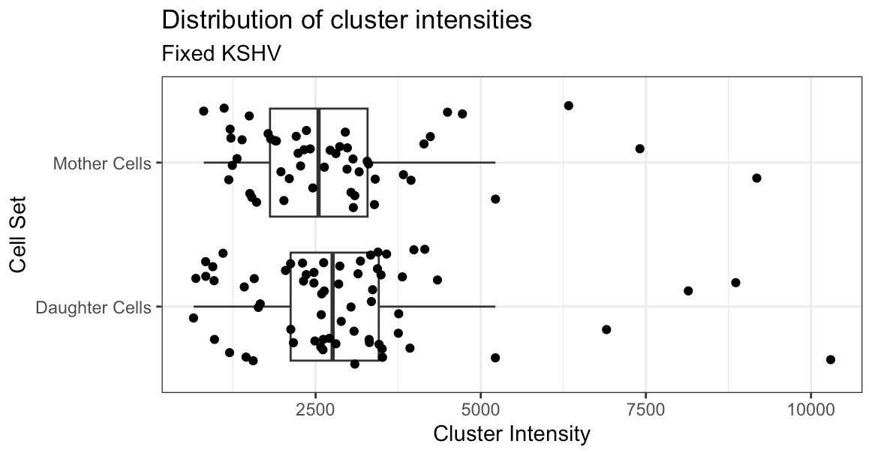
Fixed KSHV data

Slide 6
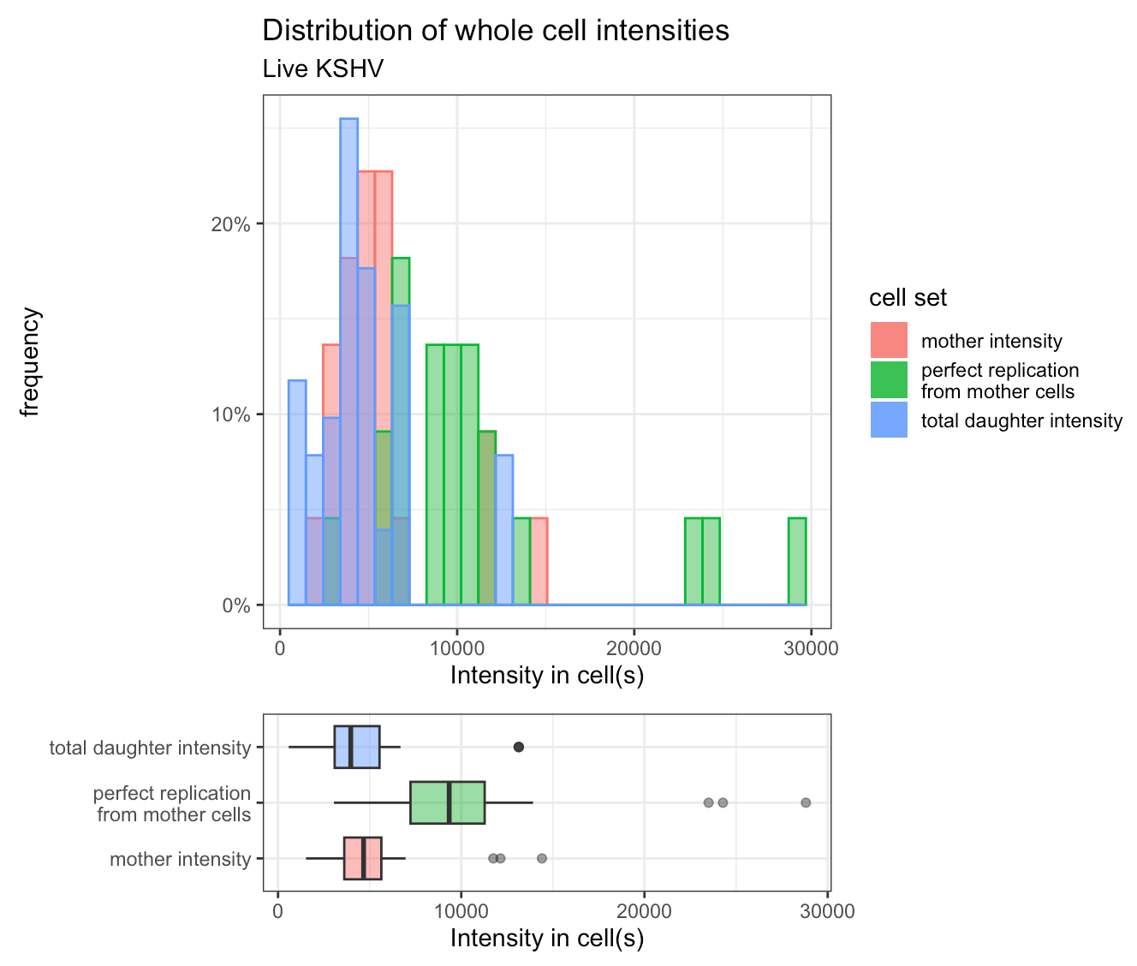
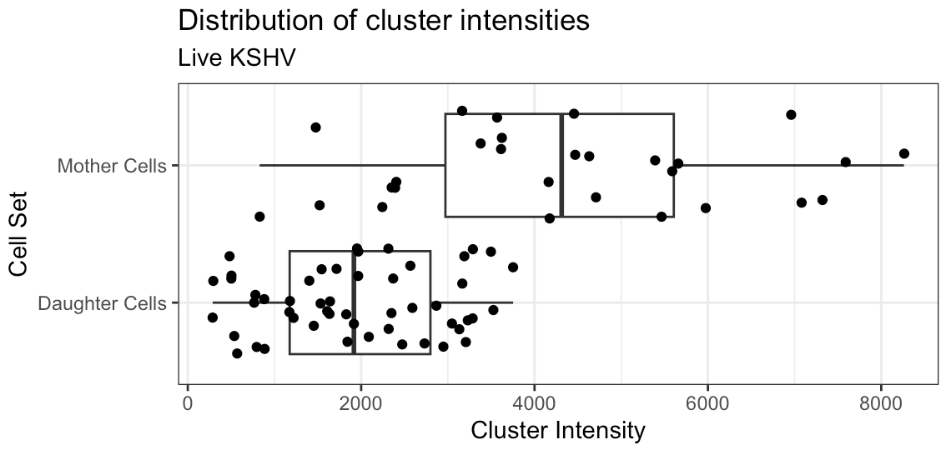
Live KSHV data

