Slide 1
Visualizing Intensity Data

Slide 2
Summary of original inference results
Experimental condition | Cell population | Number of clusters with intensity data | Parameters describing the fluorescence intensity of a single episome |  |  |  | MLE Parameters
Experimental condition | Cell population | number of clusters with intensity data | mean | standard deviation | variance |  | Replication efficiency (%) | Segregation efficiency (%)
fixed 8TR | Mother | 81 | 470.2 | 141.5 | 20022.25 |  | 76 (44-93) | 90 (72-100)
fixed 8TR | Daughter | 149 | 577.3 | 147.9 | 21874.41
live 8TR | Mother | 23 | 637.7 | 112.8 | 12723.84 |  | 6 (0-100) | 100 (0-100)
live 8TR | Daughter | 27 | 1551 | 367.3 | 134909.29
fixed KSHV | Mother | 52 | 1605.1 | 353.3 | 124820.89 |  | 84 (66-94) | 92 (78-99)
fixed KSHV | Daughter | 66 | 1226.4 | 213.6 | 45624.96
live KSHV | Mother | 28 | 2298.7 | 599.8 | 359760.04 |  | 88 (68-98) | 91 (71-98)
live KSHV | Daughter | 51 | 713.4 | 145.3 | 21112.09

Slide 3
Summary of updated inference results inferring the number of episomes in mother and daughter cells at the same time
 |  |  |  | Parameters describing the fluorescence intensity of a single episome* |  |  |  | MLE results |  | X0 Lambda
experimental condition | number of clusters with intensity data | number of daughter cell pairs | number of non-dividing cells | mean | standard deviation | variance |  | replication efficiency (%) | segregation efficiency (%)
fixed 8TR | 230 | 40 | 41 | 524.54 | 139.47 | 19452.68 |  | 84 (63, 94) | 88 (71, 97) | 4.08
live 8TR | 50 | 10 | 13 | 1043.72 | 304.28 | 92586.66 |  | 82 (26, 99) | 87 (34, 100) | 2.72
fixed KSHV | 118 | 33 | 51 | 1378.91 | 273.51 | 74805.66 |  | 82 (57, 95) | 93 (78, 100) | 2.06
live KSHV | 79 | 23 | 22 | 1165.15 | 341.48 | 116611 |  | 0 (0,99) | 0 (0,100) | 2.38
* Parameters determined as the median of the sampled values

Slide 4
Summary with updated pdf for mu and tau
experimental condition | number of clusters with intensity data | number of daughter cell pairs | number of non-dividing cells | Parameters describing the fluorescence intensity of a single episome* |  |  |  | MLE results |  | X0 Lambda
experimental condition | number of clusters with intensity data | number of daughter cell pairs | number of non-dividing cells | mean | standard deviation | variance |  | replication efficiency (%) | segregation efficiency (%) | X0 Lambda
fixed 8TR | 230 | 40 | 41 | 739.93 | 349.36 | 122055.3 |  | 75 [50-91] | 87 [64-100] | 3.06
live 8TR | 50 | 10 | 13 | 1165.95 | 465.84 | 217007.00 |  | 82 [25-100] | 87 [38 – 100] | 2.48
fixed KSHV | 118 | 33 | 51 | 1928.42 | 791.96 | 627201.80 |  | 66 [38-90] | 99 [76-100] | 1.51
live KSHV | 79 | 23 | 22 | 1200.54, 2742.54 | 555.69, 1052.839 | 308790.6, 1108469 |  | 73 [32-97] | 92 [64-100] | 2.04
* Parameters determined as the median of the sampled values

Slide 5
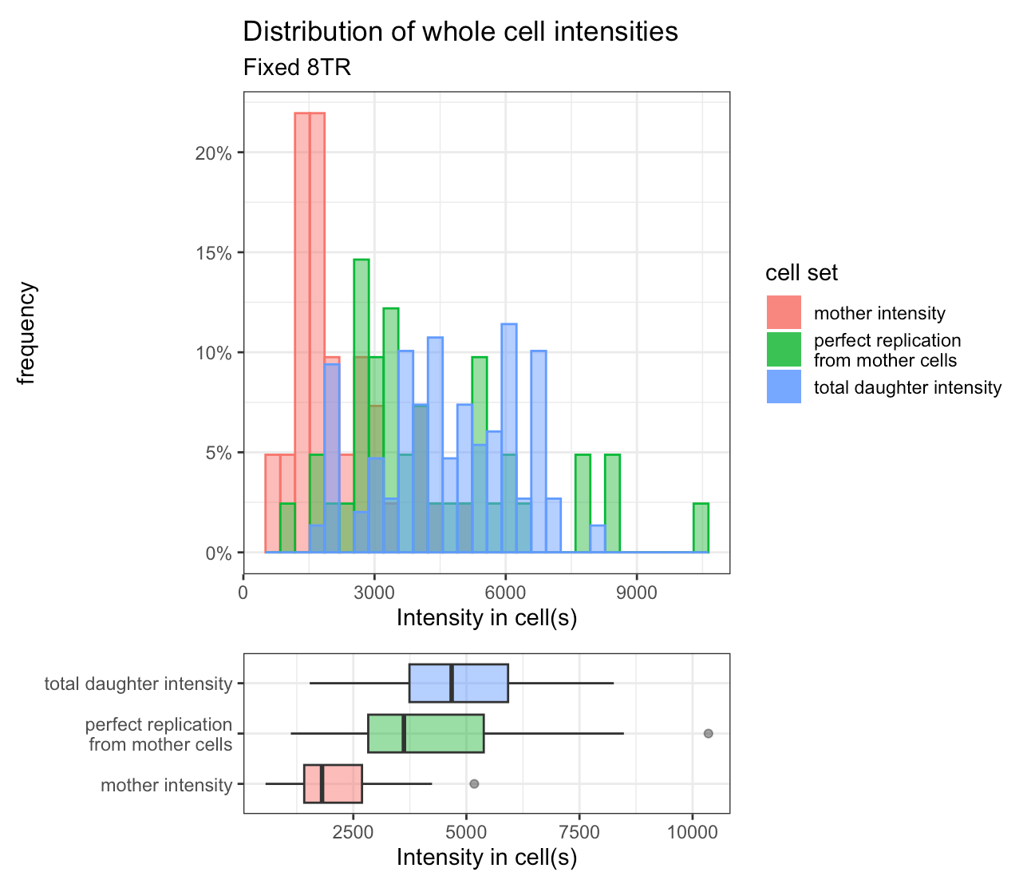
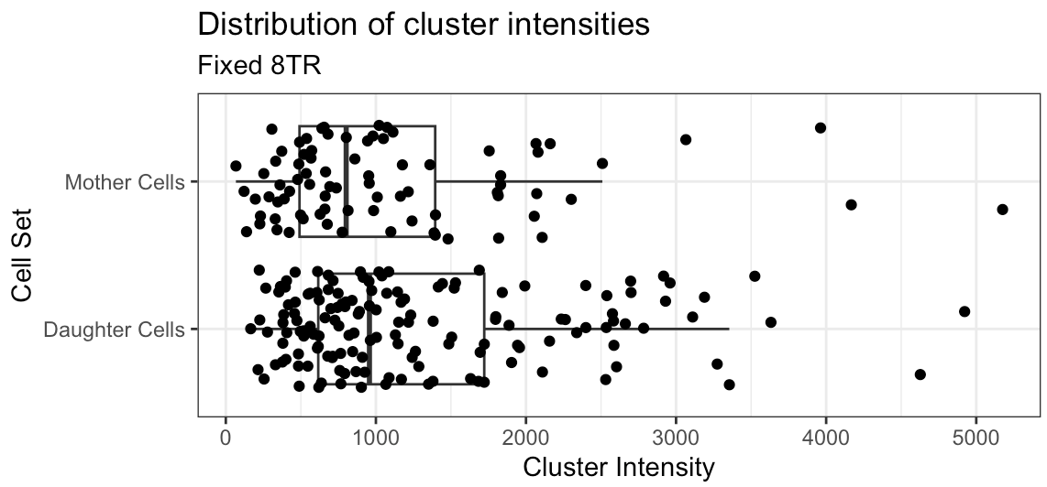
Fixed 8TR Data

Slide 6
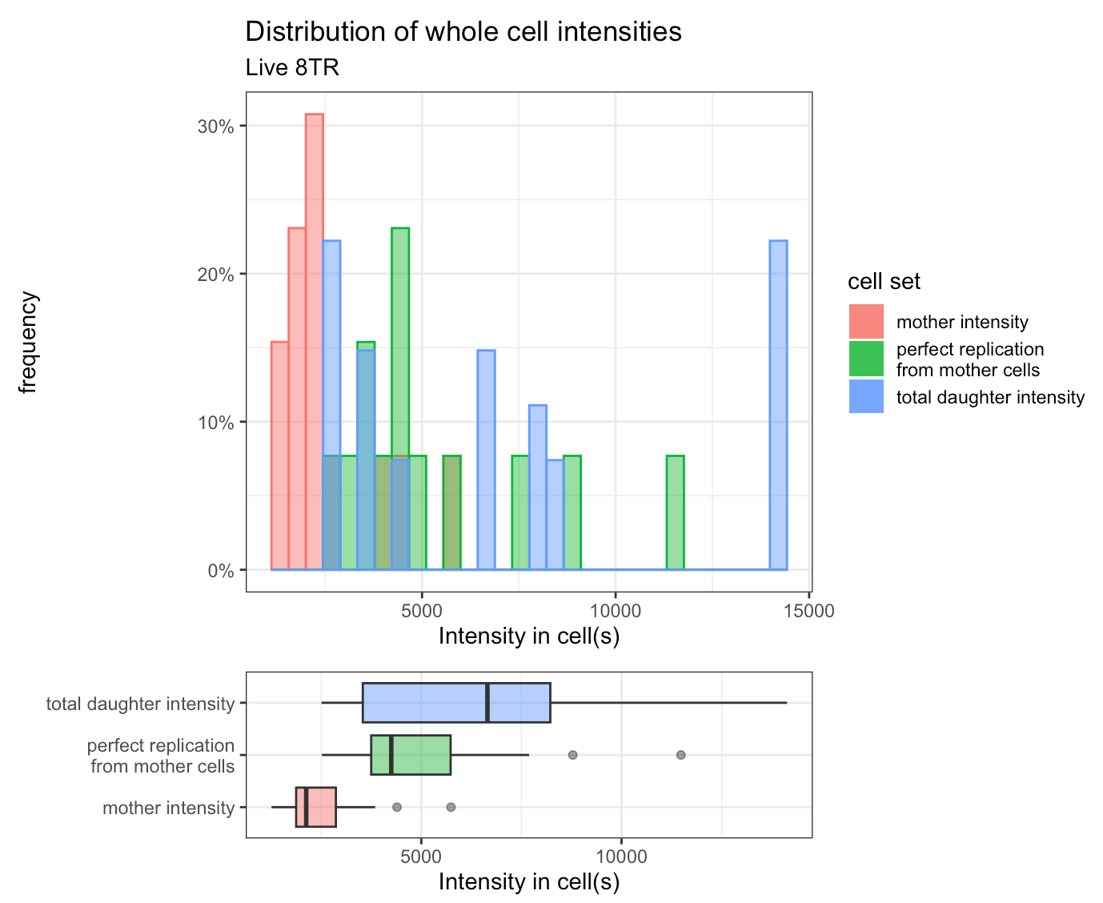
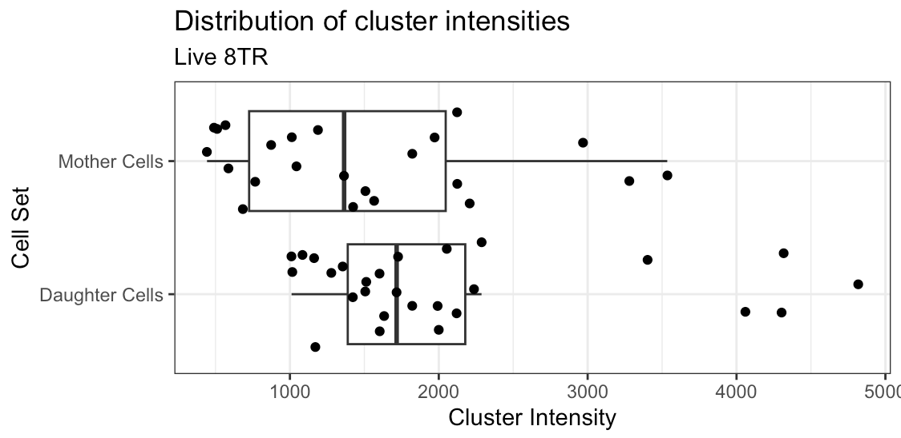
Live 8TR data

Slide 7
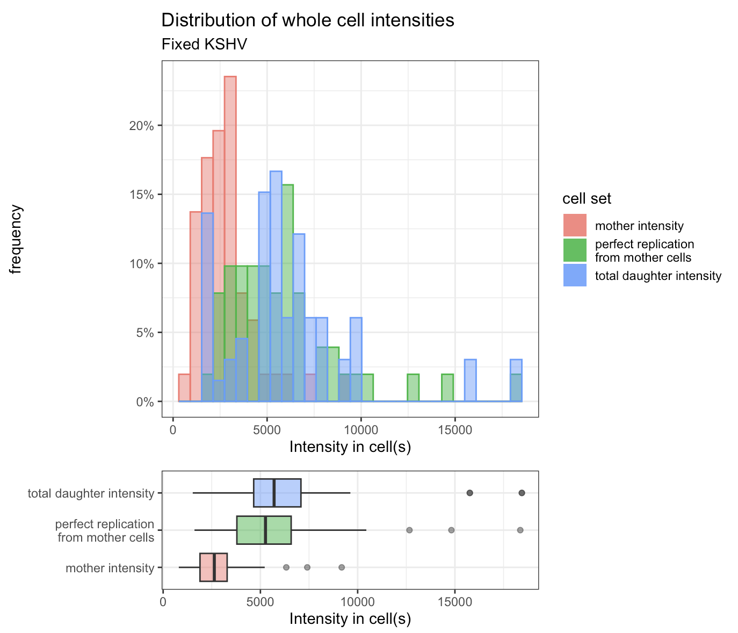
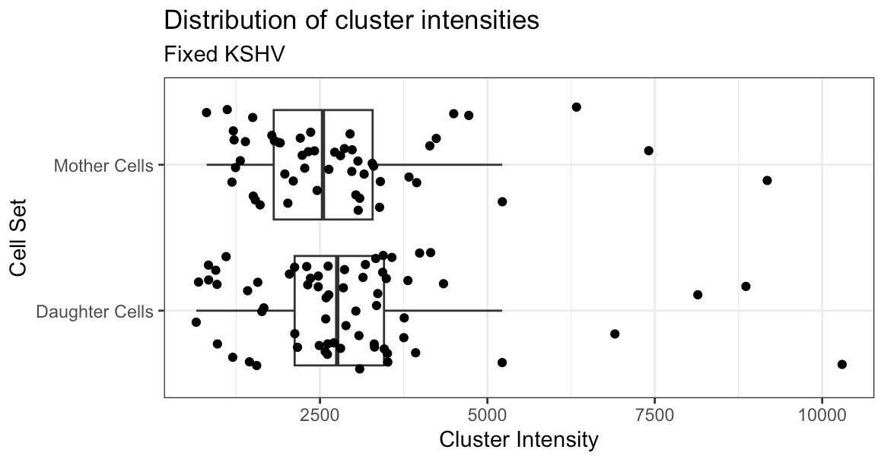
Fixed KSHV data

Slide 8
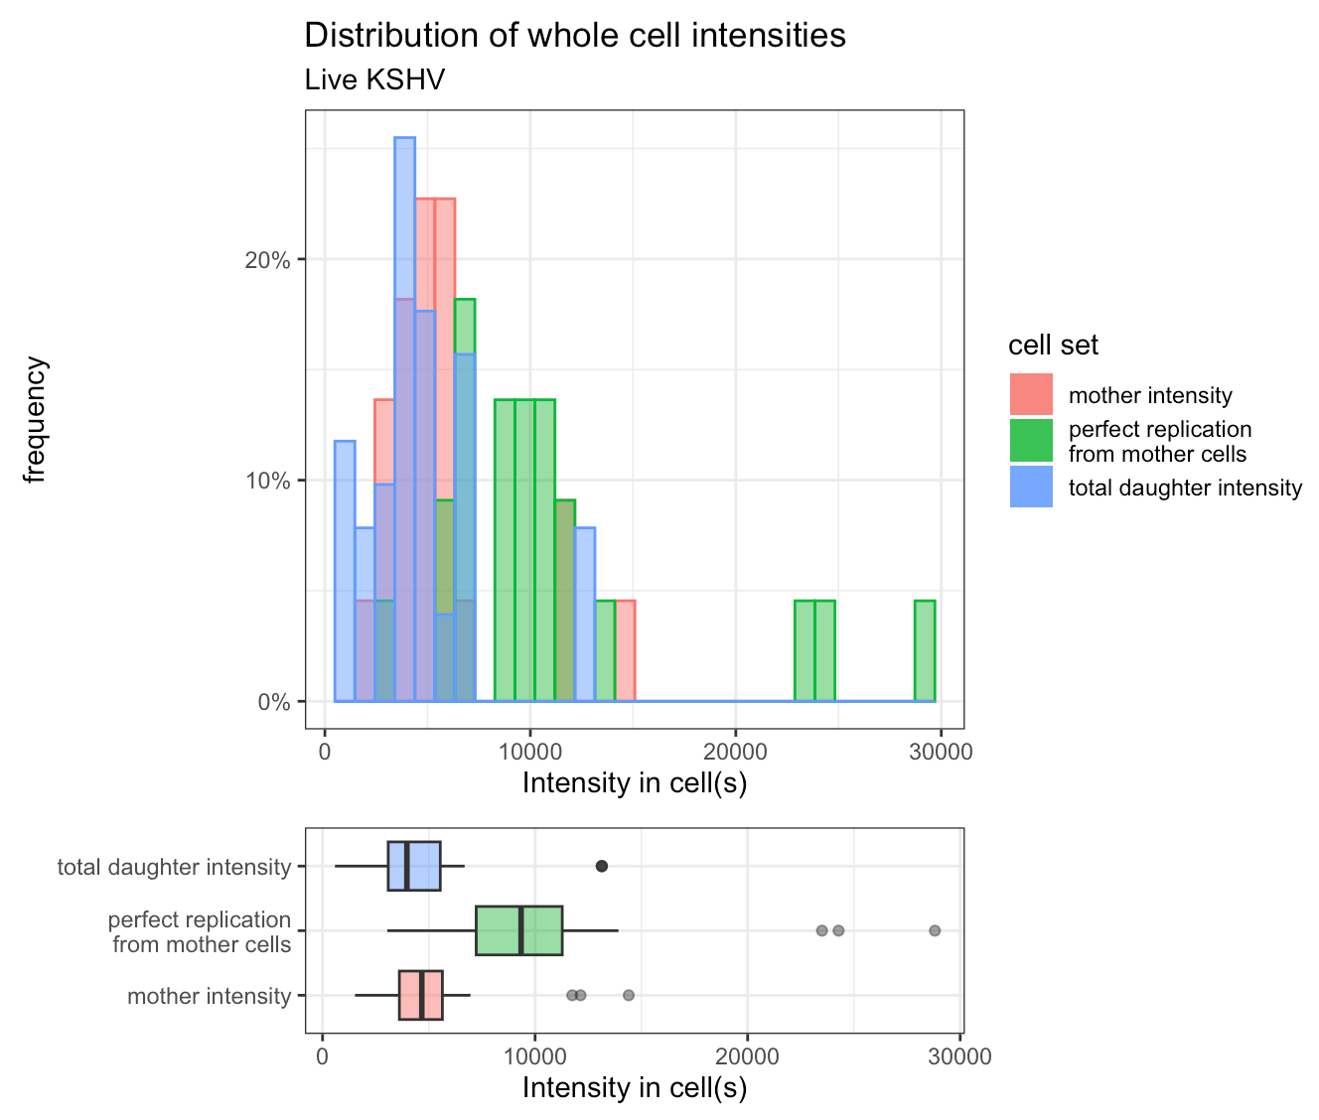
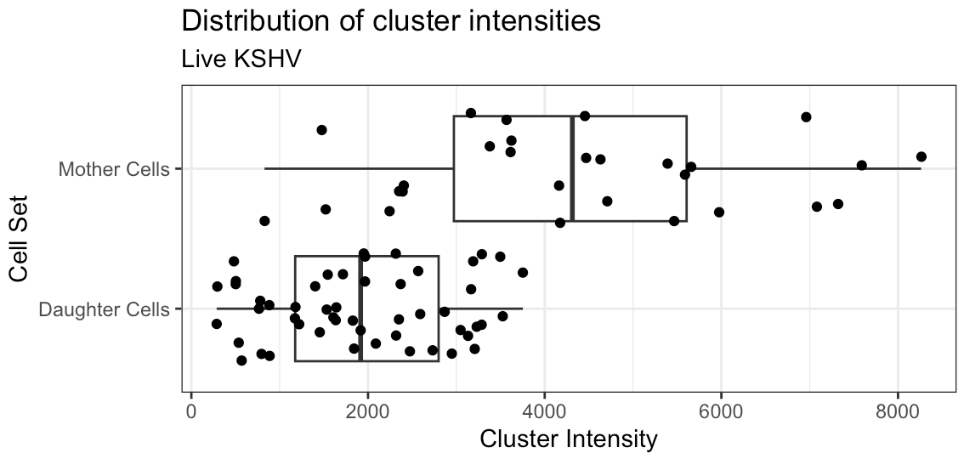
Live KSHV data

Slide 9
Understanding the problem with Live KSHV Inference
Concerns with the data:
The intensity of individual clusters in mother cells is higher than that of the daughter cells, suggesting either increased spatial overlap prior to division or GFP bleaching in post-division images.
Comparing the total fluorescence of non-dividing cells to the sum of daughter cell pairs suggests no replication (or even loss of episomes).
How does this affect the inference?

Slide 10
Brief overview of inference pipeline
Use MCMC to infer the number of episomes per observed cluster in both non-dividing and dividing cells
100,000 iterations
5000 burn-in iterations
Run two chains with different initial conditions to check convergence via Rhat and effective sample size
Add the samples of episomes per clusters within each cell at each iteration to construct a posterior distribution for the number of episomes per cell
Fit a poisson distribution to the number of episomes in non-dividing cells to get a probability distribution for X0
Run grid search for MLE of replication and segregation efficiency using likelihood function marginalized over X0
Find region of parameter values that make up 95% confidence region

Slide 11
Our pipeline infers a replication and segregation efficiency of 0% with confidence intervals from 0-100%

Slide 12
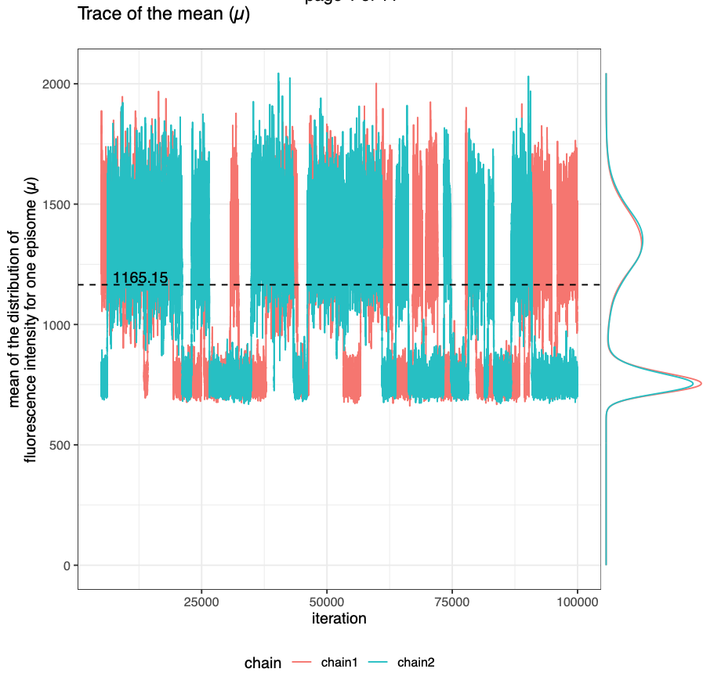
MCMC samples of the mean of fluorescence intensity show a bimodal distribution.
The median is 1165.15 (reported in table at start of slides but not very useful in this case). One mode is at 743 and the other is at 1339. The first mode is comparable to the mean of daughter cells in the old inference method (713).

Slide 13
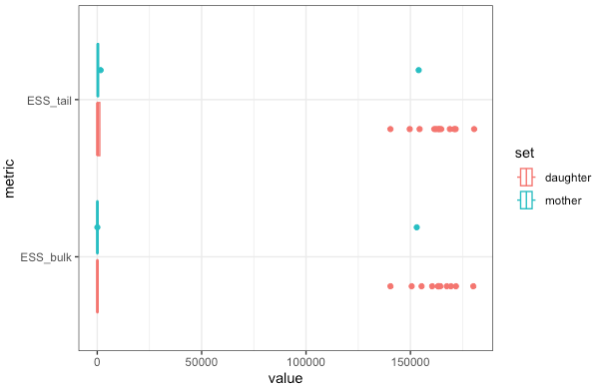
The effective sample size of most clusters is very small for most clusters
84% of clusters have a tail effective sample size less than 1,606 and a bulk sample size less than 100 despite running for 100,000 iterations and using 5000 burn-in iterations. This indicates that the chains have high auto-correlation.
The Rhat values are all between 1 and 1.025 (not shown), indicating the chains are mixed, and running them longer will not change the sampled posterior.

Slide 14
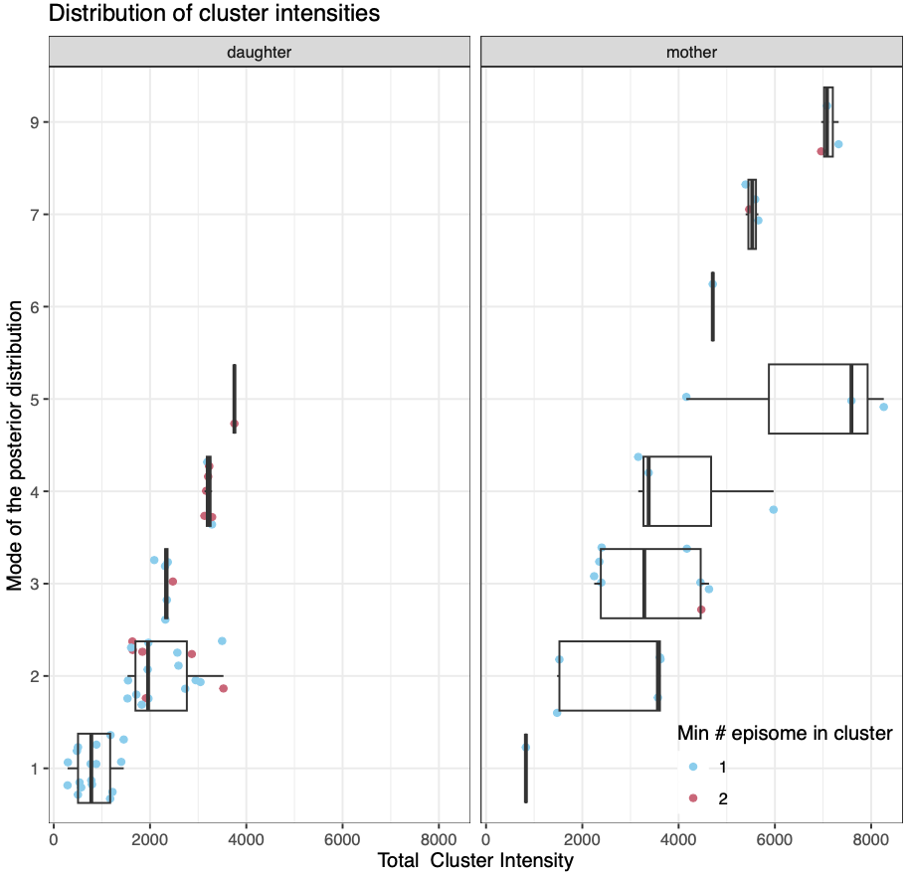
The inferred number of episomes per cluster does not increase with cluster intensity as is observed for the other datasets
For example, there are two clusters in the mother cells with intensity around 8000 whose posterior distribution has a mode of 5 episomes. However, there are clusters with a mode of 7 episomes that have lower intensity (around 5500)

Slide 15
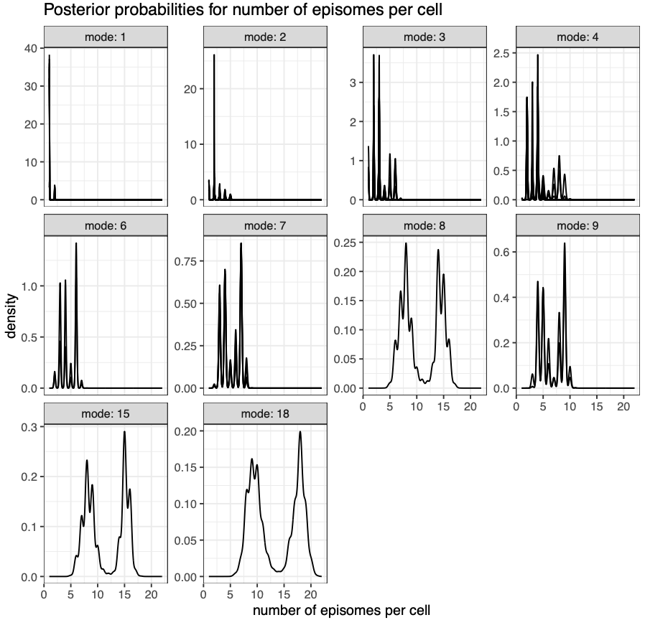
The posteriors for number of episomes per cell show much more uncertainty than the other experimental conditions, especially at larger values.
The distributions also reach much larger numbers of episomes per cell than the other datasets.

Slide 16
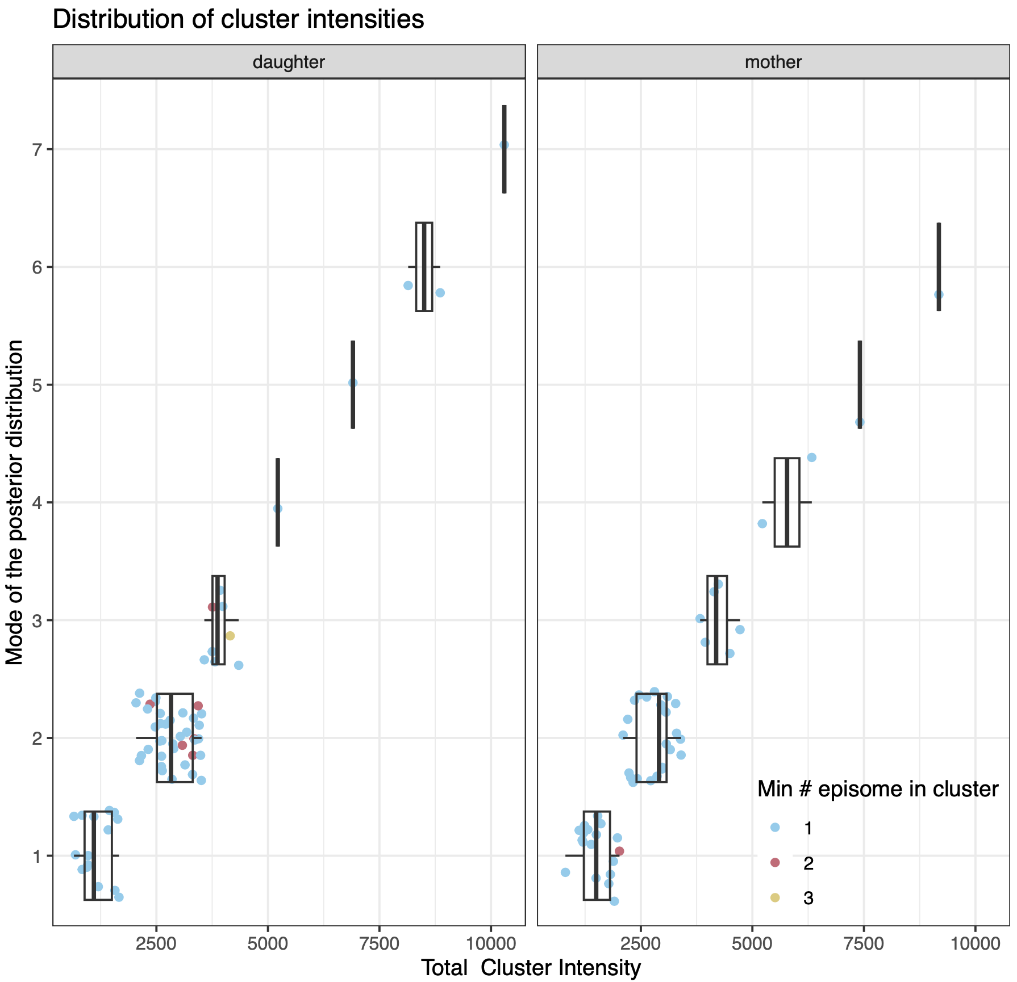
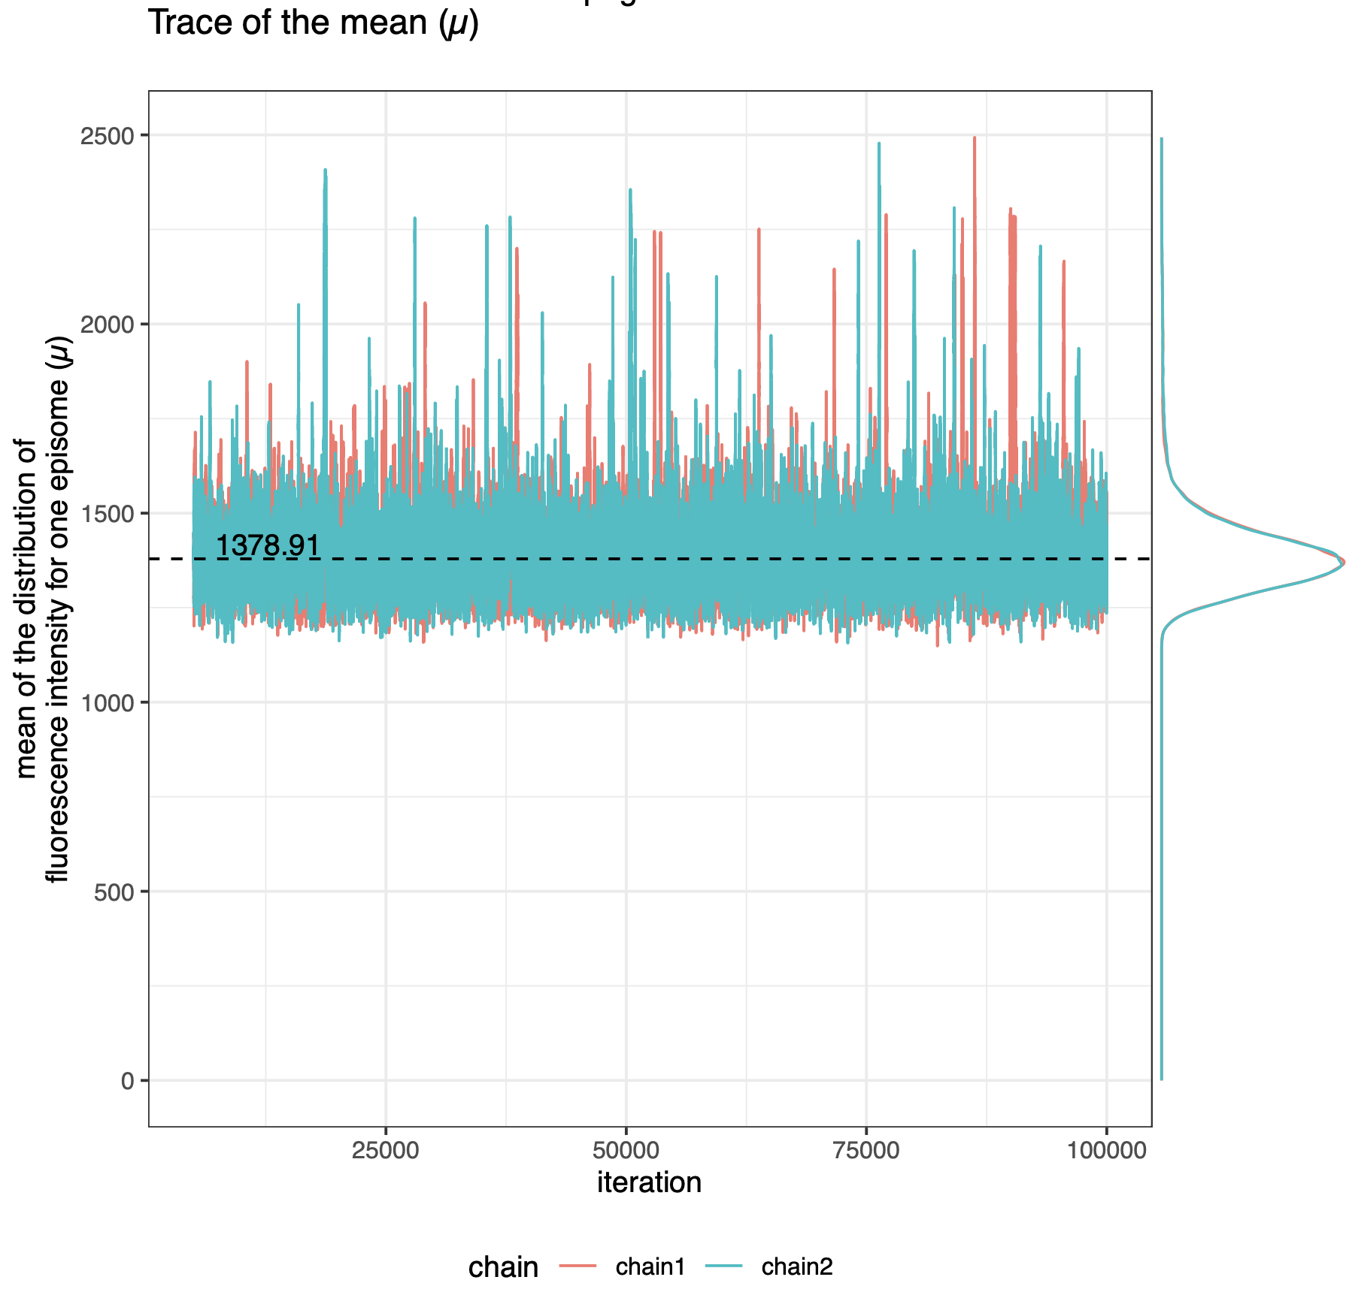
For reference, here are the results of fixed KSHV

Slide 17
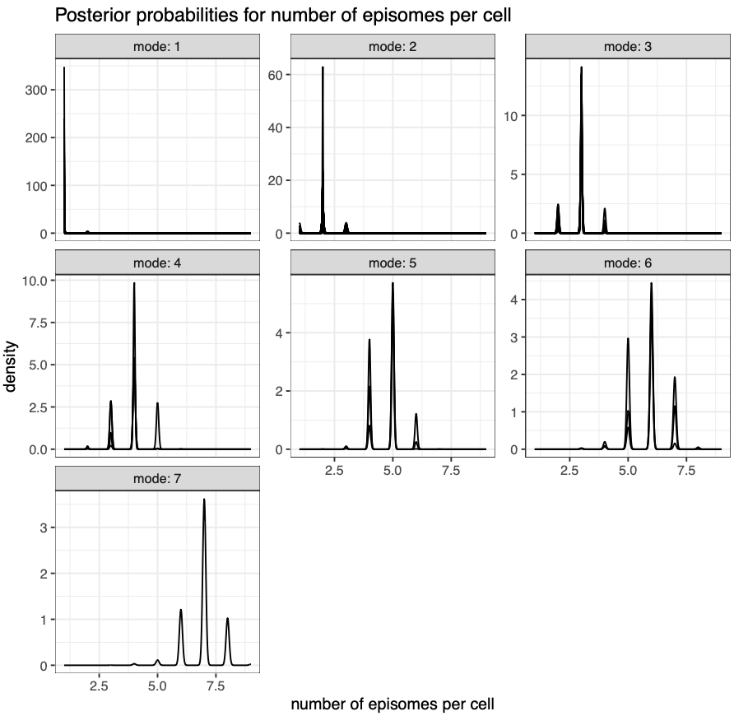
For reference, here are the results of fixed KSHV

Slide 18
What to do next?
I think the bimodal distribution for the mean of fluorescence intensity from MCMC suggests that the mother and daughter cell data do not have the same mean fluorescence for a single episome, likely due to GFP bleaching in daughter cells
We cannot use the current pipeline to generate accurate estimates.
Is it reasonable to use the pipeline as we were previously and assume a different mean fluorescence intensity in mother and daughter cells for this experimental condition only?
If not, I’m not sure we can solve the problem given the data as is

